Slide 1
Exercise3 - link
Multirotor Dynamics

Slide 2
Install python package
sudo apt-get install python3-pip
pip3 install numpy
pip3 install matplotlib

Slide 3
EE206 Internet
WIFI : NCRL_GPS / NCRL_GPS_5G
Password: ee405423

Slide 4
Usage
Download exercise3 file
unzip under the folder you want (This practice is not a ros package file)

Slide 5
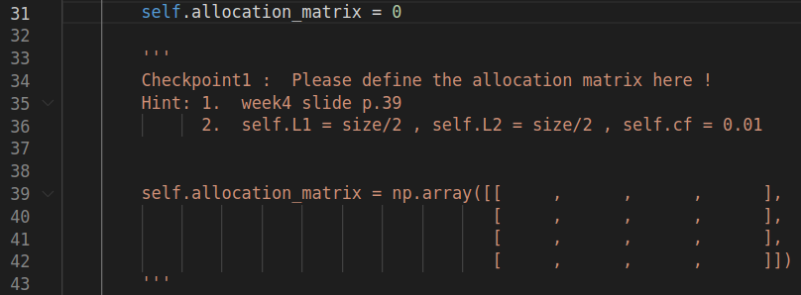
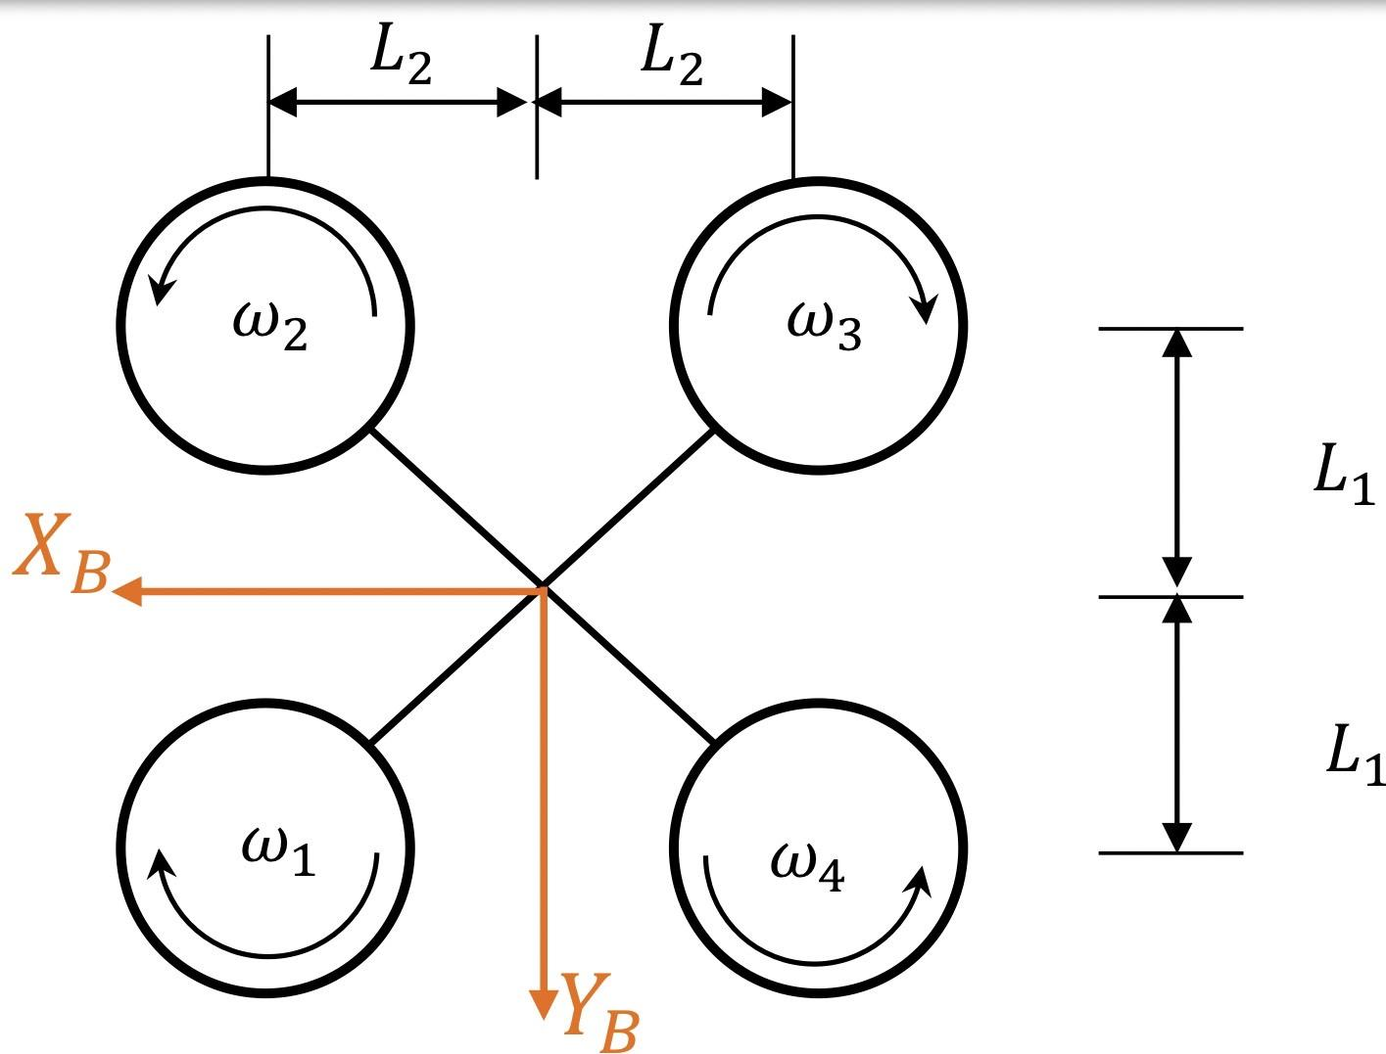
Checkpoint 1 - Allocation Matrix
Open Quadrotor.py
You need to complete the quadrotor class
Define self.allocation_matrix
Hint:
self.cf (Drag constant) ,
self.L1, self.L2 is defined above

Slide 6
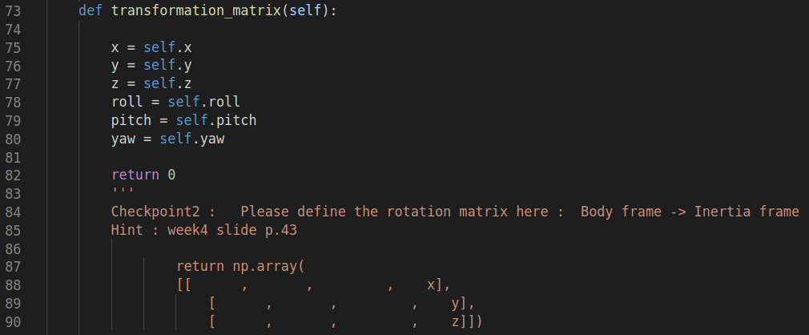
Checkpoint 2 - Rotation Matrix R (Body -> Inertia)
Open Quadrotor.py
Define transformation_matrix
在實際應用中， R 可以從 IMU上面取得，並且計算 RPY
在模擬中，R 可以幫助我們 update 下一個的 dynamics (ex: Thrust Force)

Slide 7
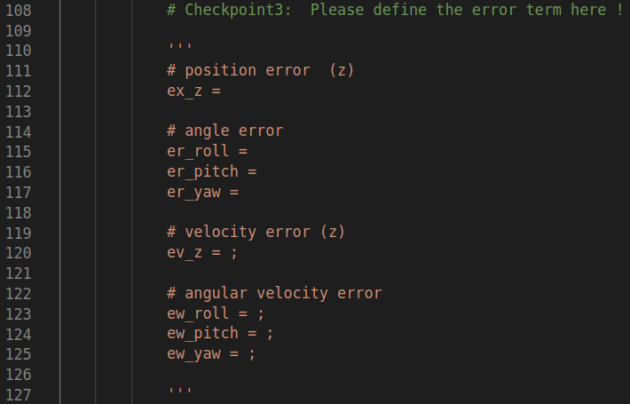
Checkpoint 3 - Error term
Open quadcopter_hover.py
Define the error term
ex_z : z 方向 位置誤差
ev_z : z 方向 速度誤差
er: 角度誤差
ew: 角速度誤差

Slide 8
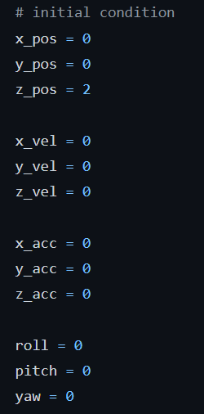
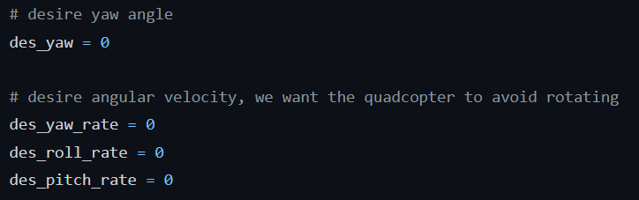
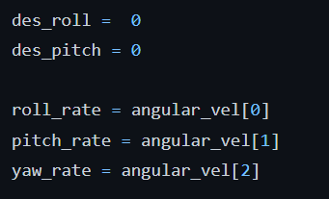
Checkpoint 3 - Error term
Some properties you will need

Slide 9
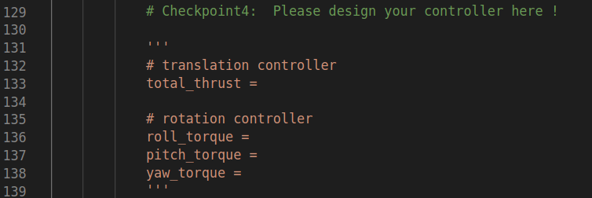
Checkpoint 4 - PD controller design
Open quadrotor_hover.py
Define your PD controller
Gain is already defined for you
Kp_z, Kd_z …..translation
Kp_roll, Kd_roll
Kp_pitch, Kd_pitch
Kp_yaw, Kd_yaw ……..rotation

Slide 10
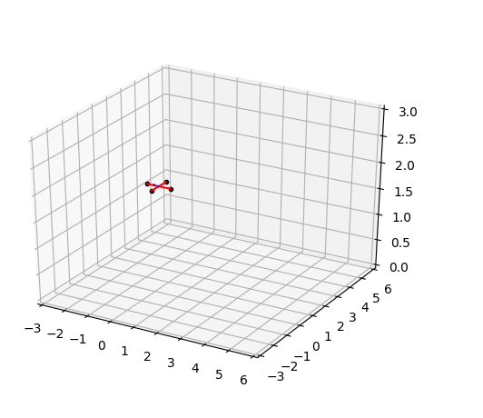
Demo - hover
python3 quadcopter_hover.py
desire roll 和 desired pitch 都是 0 可以修正姿態誤差，但是可以觀察出 quadcopter 會隨著時間有飄移，因為 quadcopter 無法修正 位置誤差 !

Slide 11
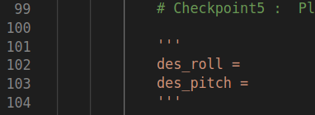
Checkpoint 5 - Define desire roll , pitch
Open quadcopter_trajectory
Define the desired roll and pitch to track trajectory
Hint :
It is related to the gravity and acceleration
roll angle can affect y_acc
pitch angle can affect x_acc

Slide 12
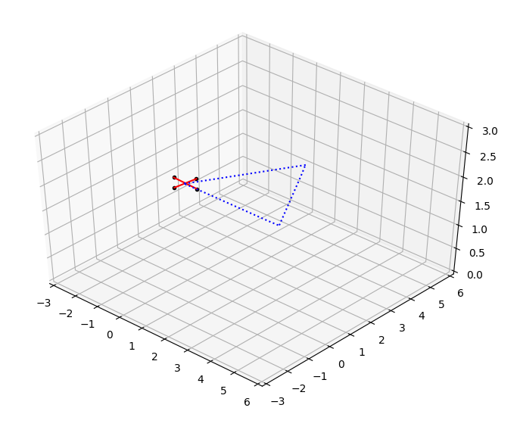
Demo - trajectory tracking
python3 quadcopter_trajectory.py
desired roll 和 desired pitch 定義成功時，quadcopter 可以補償位置誤差
可以觀察沒有加上 D control的話，quadcopter 的飛行狀況如何

