Slide 1
Encrypting and Decrypting messages using GnuPG
I am using a simple text file for this.
The contents of which is 'The answer is 42... it's always 42.'

Slide 2
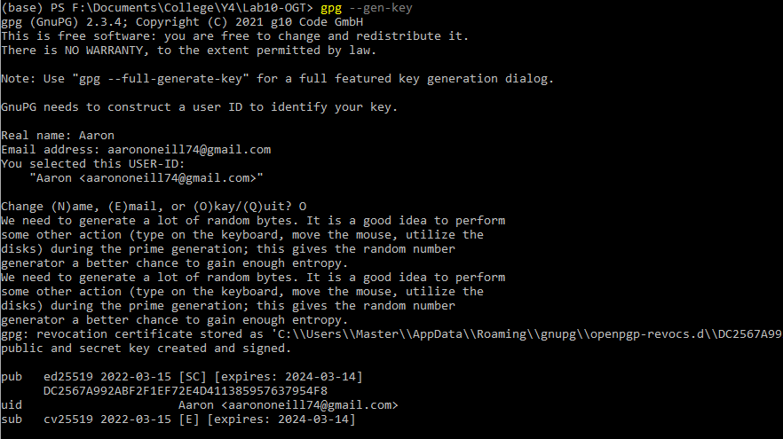
Firstly, we must generate keys that will be used throughout the process

Slide 3
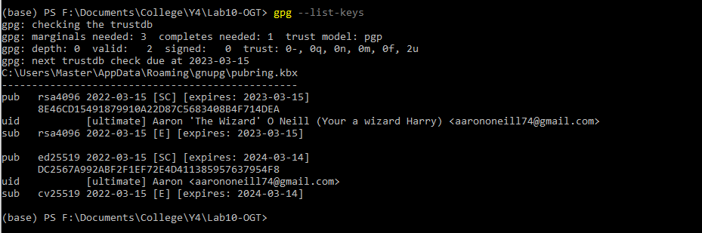
Here I am just showing that the keys are created

Slide 4
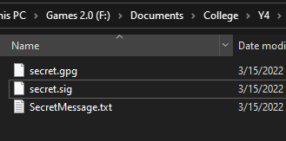
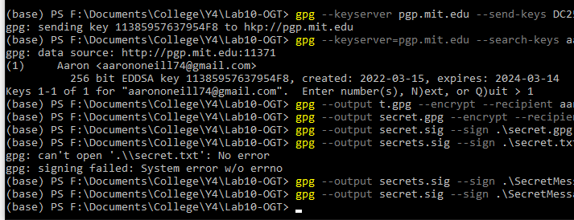
We then send off the key so others can get the public key.
We then encrypt the secret message and sign the message

Slide 5
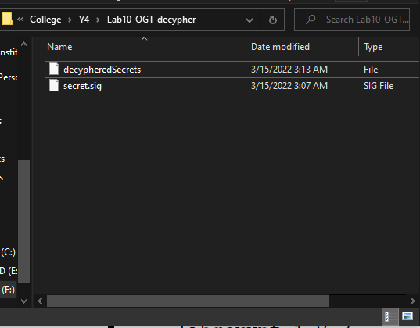
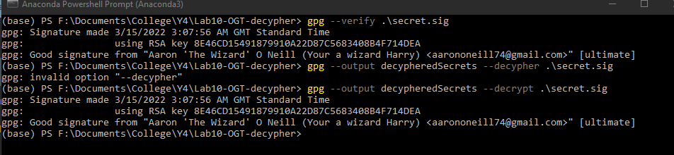
After that we send the file to another location. (in this instance its local)
We can then decrypt the secret and retrieve the message back. The decypheredSecrets contains the correct text.

Slide 6
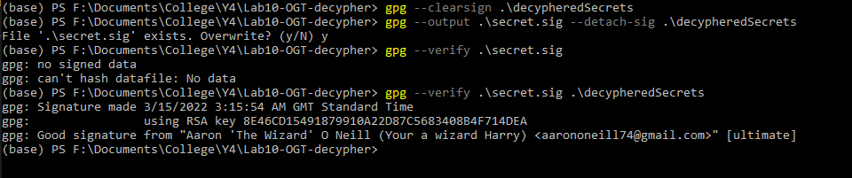
We can also verify that the correct signature was made.

