Slide 1
RS manual

Slide 2
Table of contents
How to use activation key?
How to share network license?

Slide 3
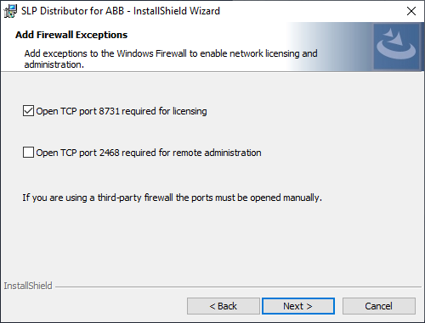
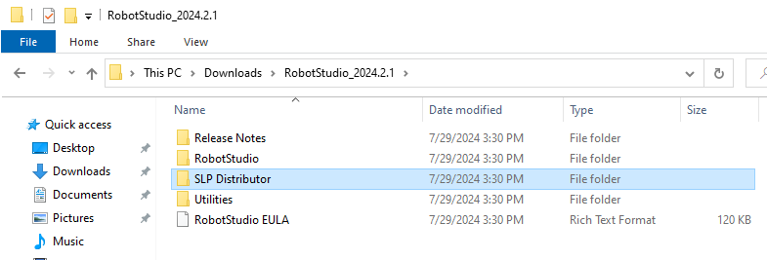
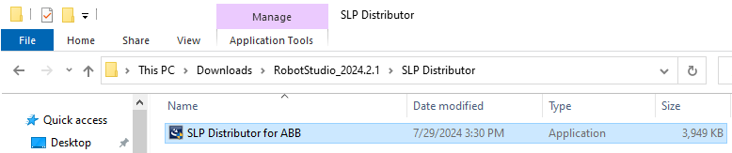
How to use activation key?
First install SLP distributor.
①
③
②
Ps:
TCP port 2468 is for server and administration.
Which computer need to install the license.

Slide 4
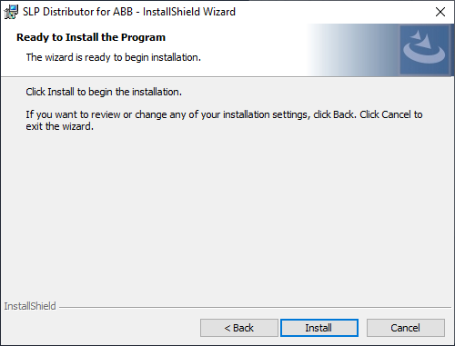
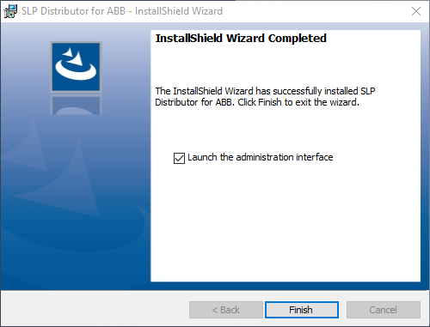
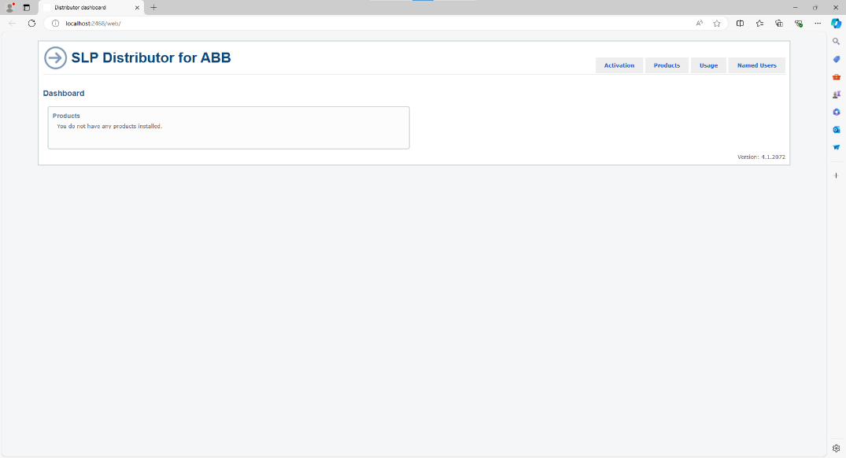
How to use activation key?
④
⑤
It will open SLP distributer, a website.

Slide 5
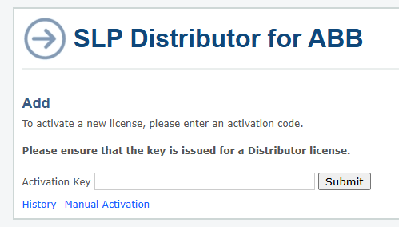
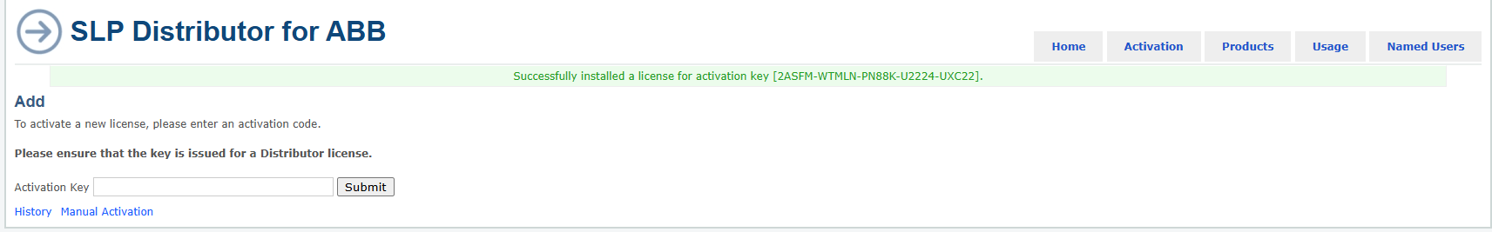
How to use activation key?(Auto)
This step is for administrator, not for student.
Enter your key and submit, it should be 25 words.(xxxxx-x….x-xxxxx)
PS:
After you submit the key, license would generate expire date.
Choose wisely the computer which you install license,
It is more complicate to remove the license to another computer.
If the key is correct, you would see this.

Slide 6
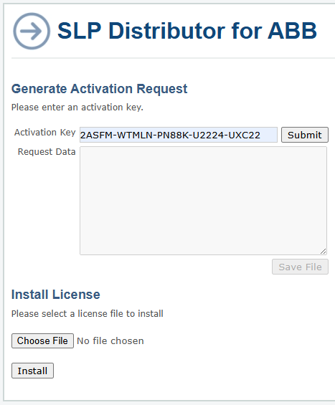
How to use activation key?(Manual)
Choose wisely the computer which you install license,
It is more complicate to remove the license to another computer.
The different of auto and manual are computer need to connect internet or not.
If auto install is succeed, then you don’t need to use manual activation.

Slide 7
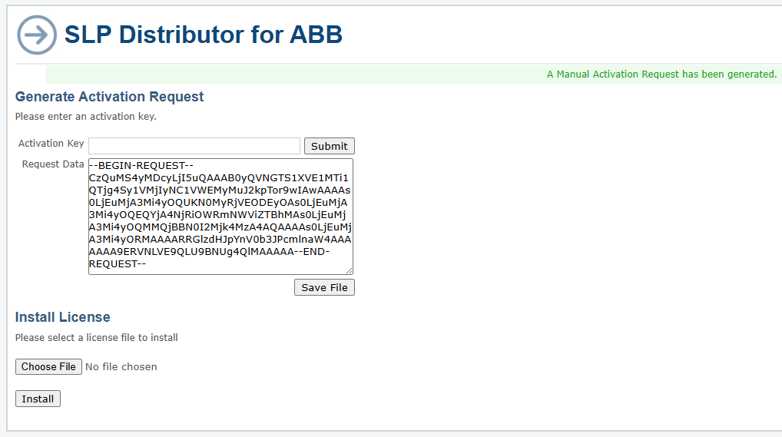
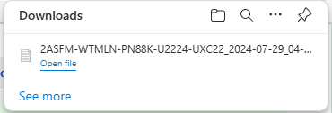
How to use activation key?(Manual)
If the key is correct, the request data would be generate.
The format like this.
Your activation key

Slide 8
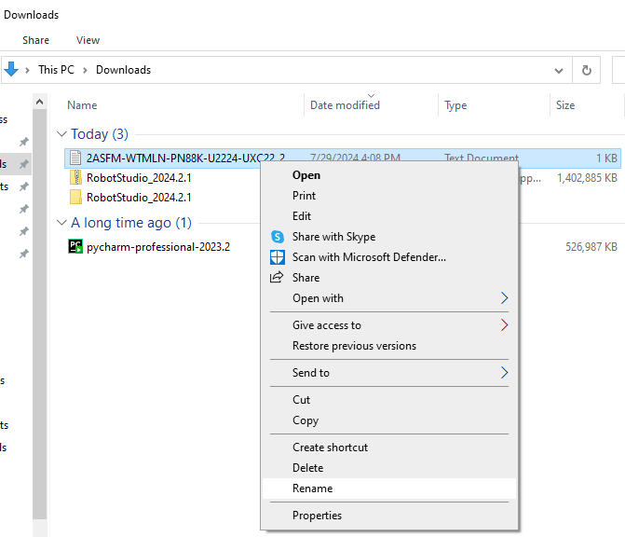
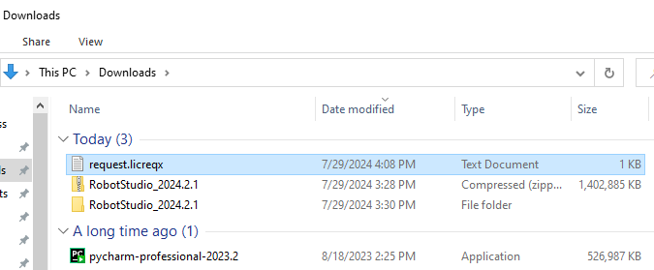
How to use activation key?(Manual)
Rename the file to request.licreqx

Slide 9
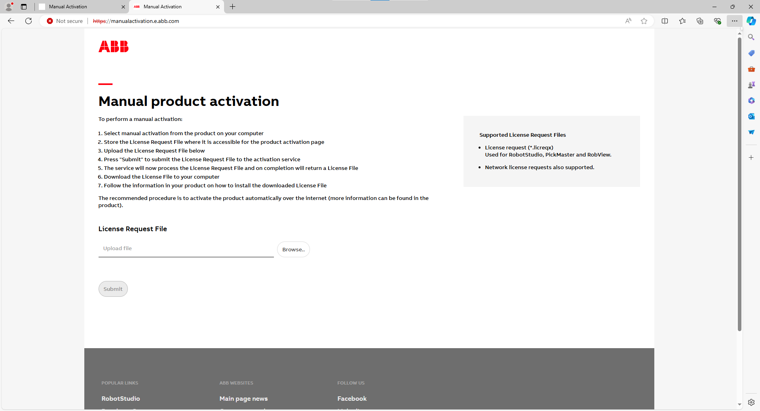
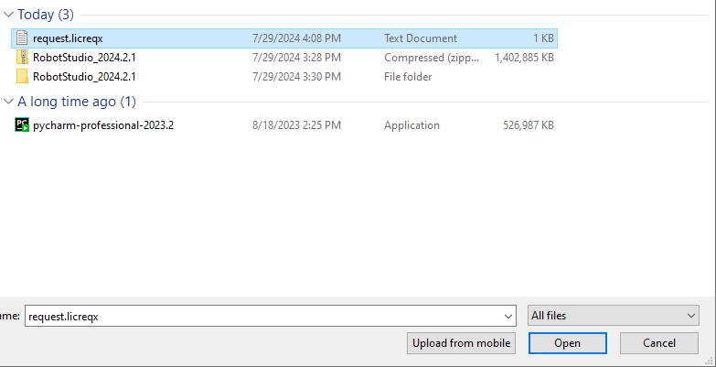
How to use activation key?(Manual)
Go to http://manualactivation.e.abb.com/
Upload request file.

Slide 10
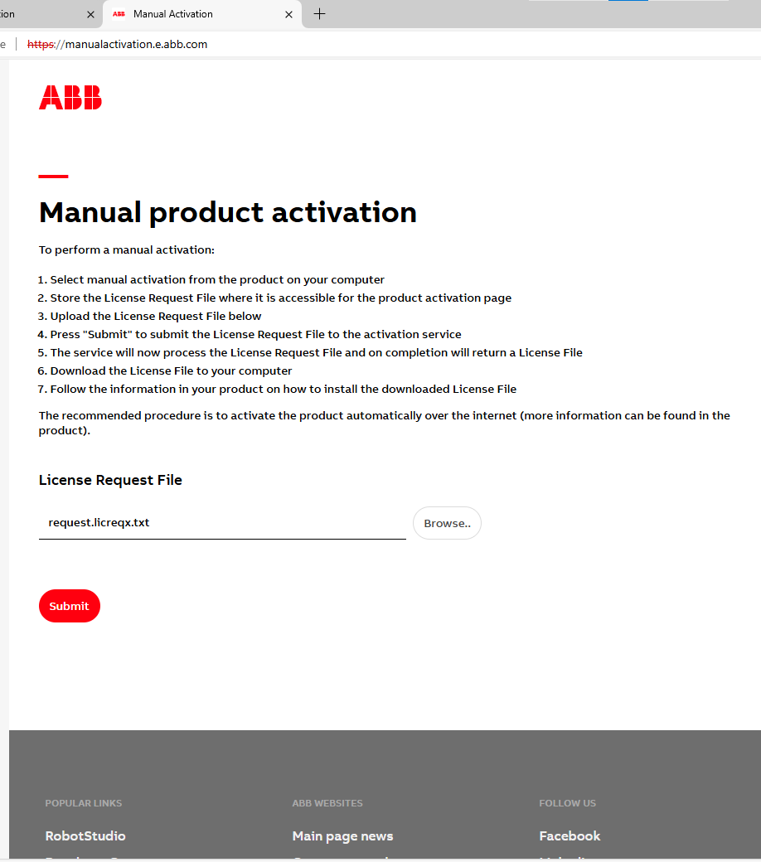
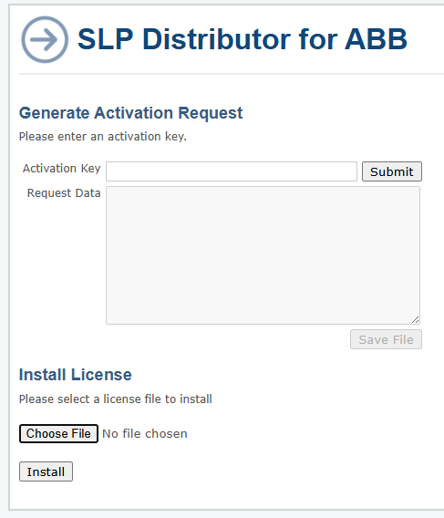
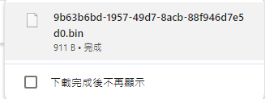
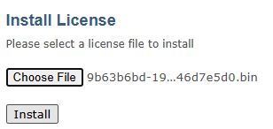
How to use activation key?(Manual)
You would get a .bin file.
Back to SLP distributor manual activation.
Upload .bin file

Slide 11
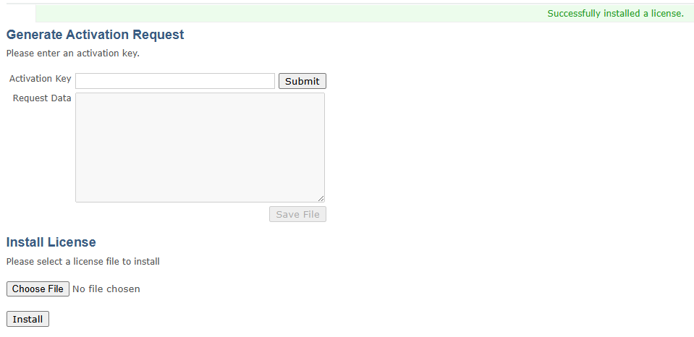
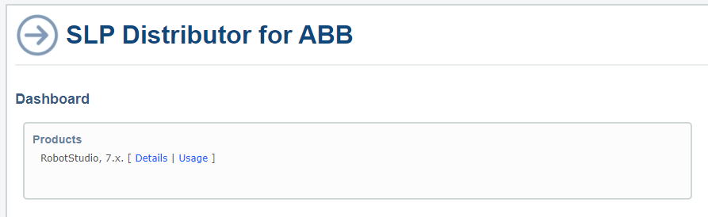
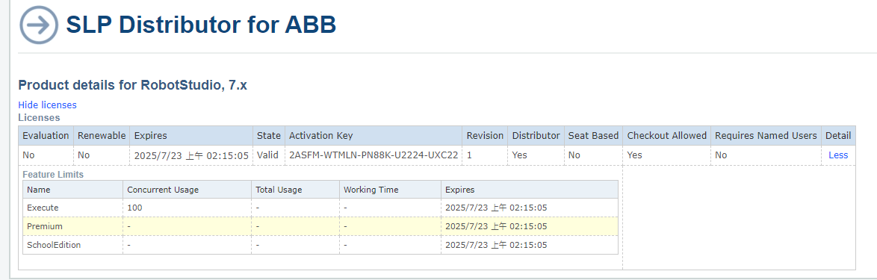
How to use activation key?(Manual)
If dashboard can see the product means license is in this computer.

Slide 12
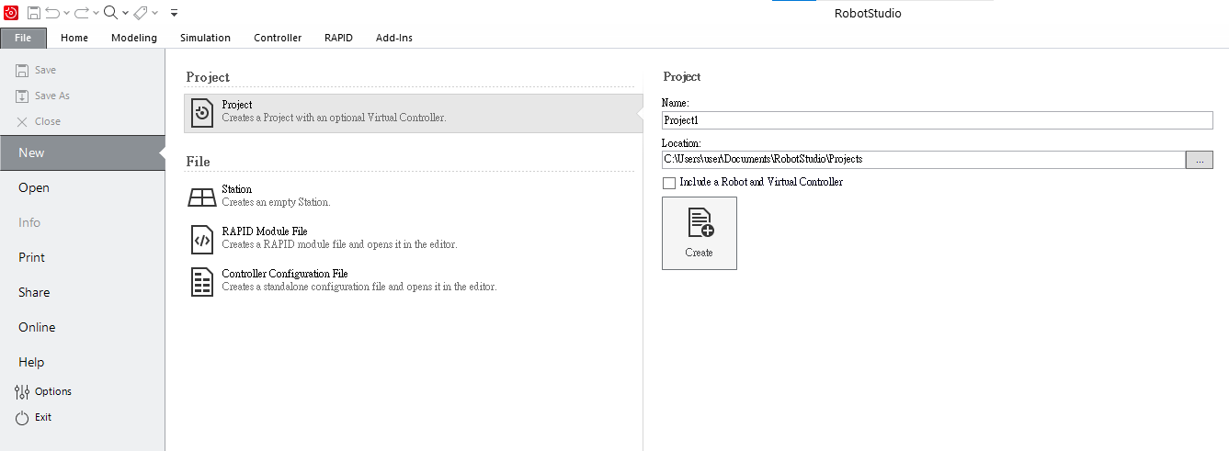
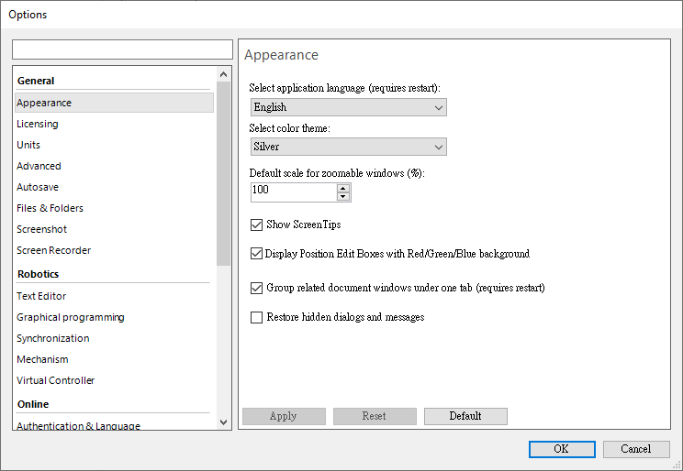
How to share network license?
②
①
Open robotstudio -> option

Slide 13
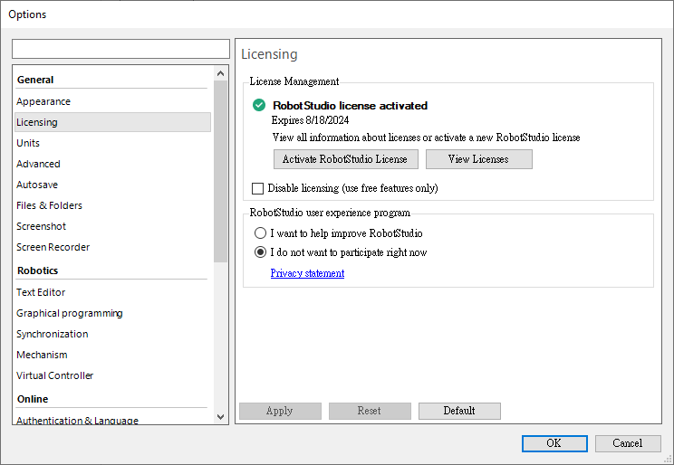
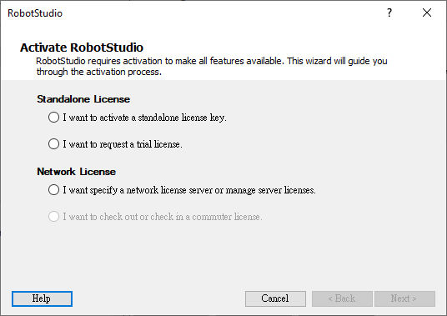
How to share network license?
③
④
⑤

Slide 14
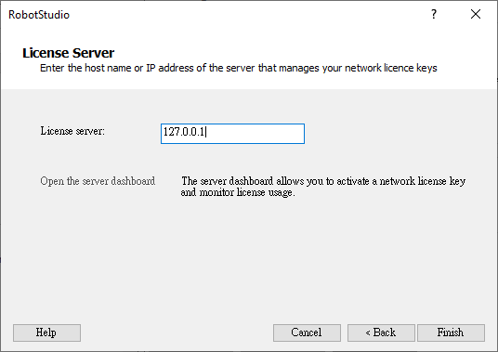

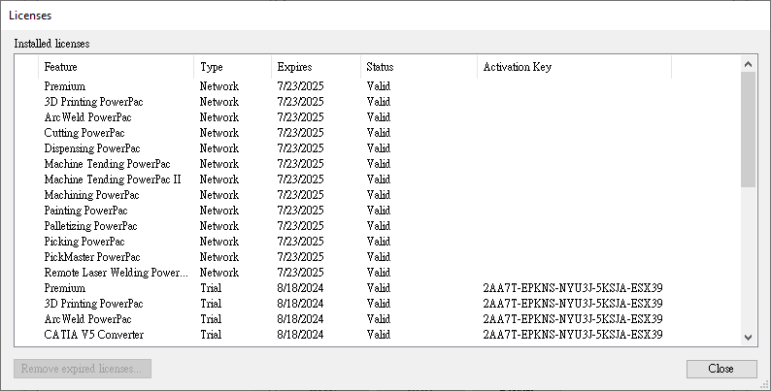
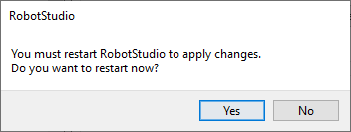
How to share network license?
You can see your license is updated.
⑥Enter 127.0.0.1 this is local IP connect to SLP
⑦
⑧

Slide 15
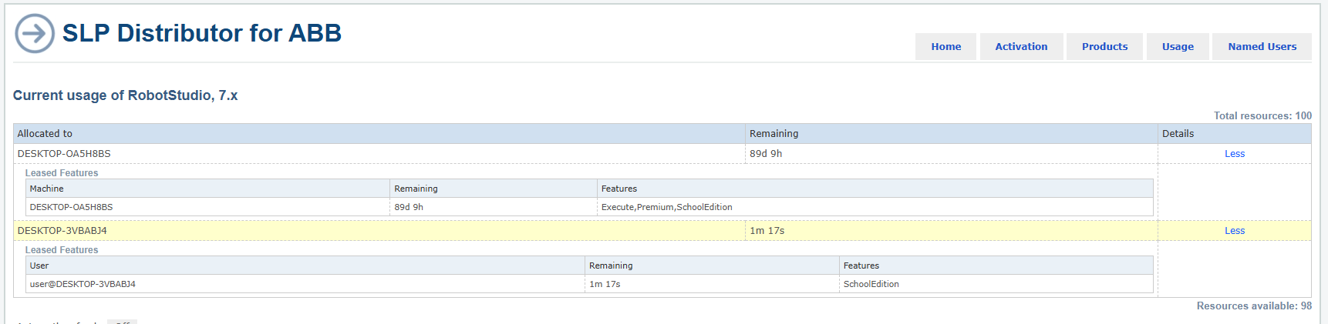
How to share network license?
This is commuter license which is checked out.
Server host

