Slide 1
RS manual

Slide 2
Table of contents
How to download RS(RobotStudio)?
How to share network license?
How to use commuter license mode?

Slide 3
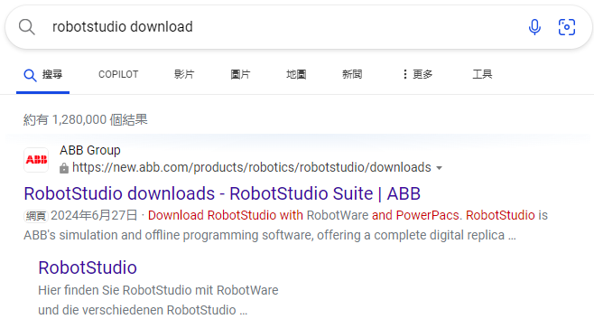
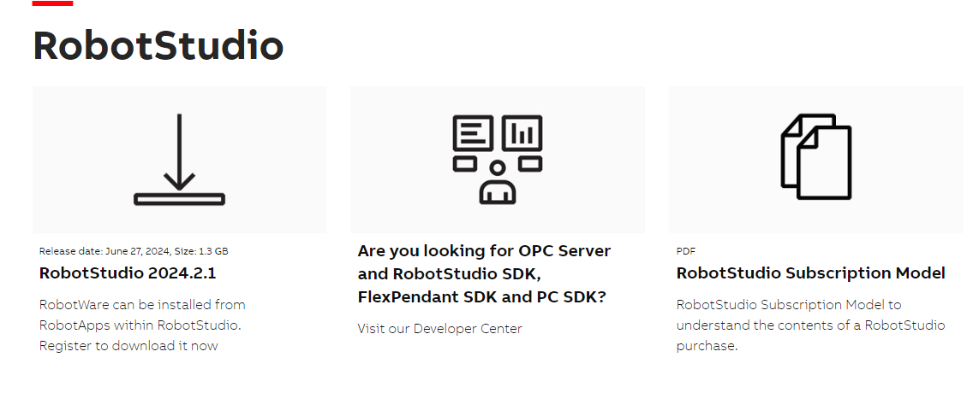
How to download RS(RobotStudio)?
①Search robotstudio download
③
②

Slide 4
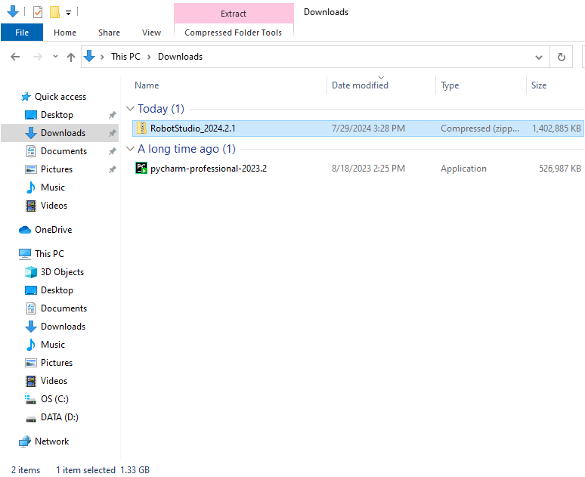
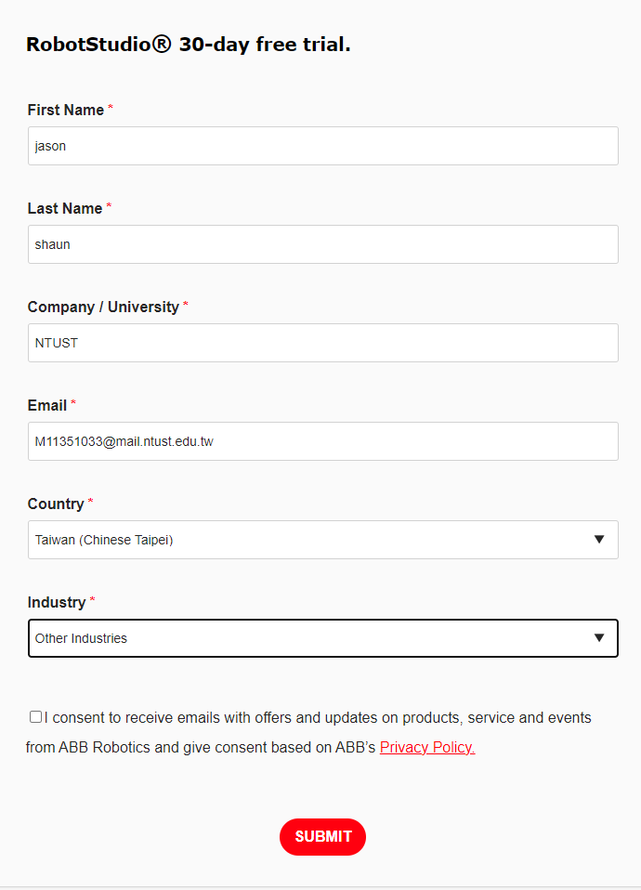
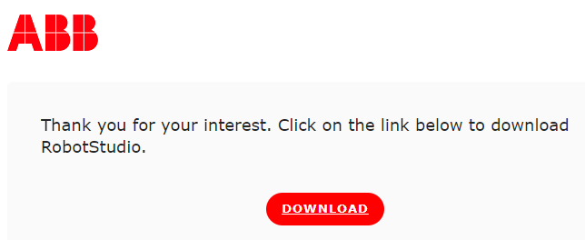
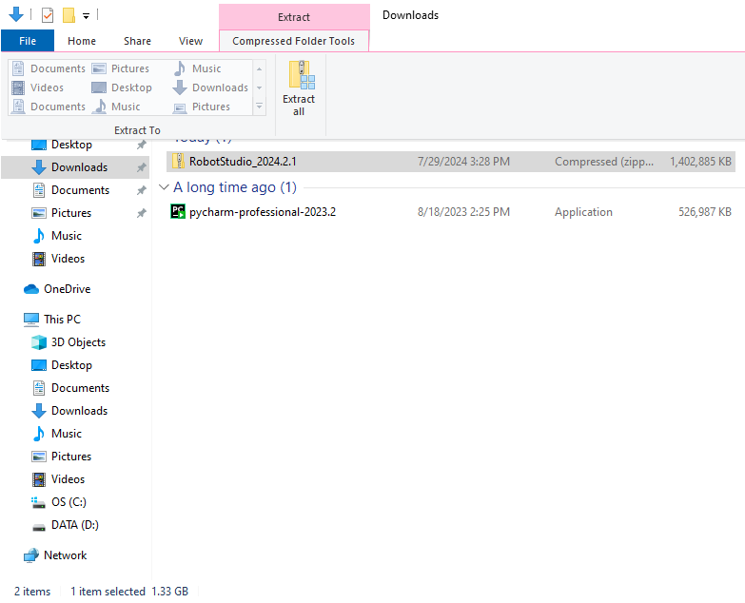
How to download RS(RobotStudio)?
④Fill in the form
⑦Unzip the folder.
⑥
⑤

Slide 5
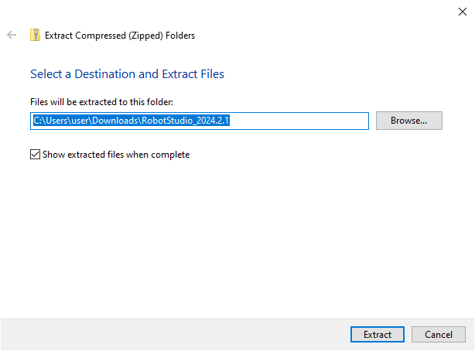
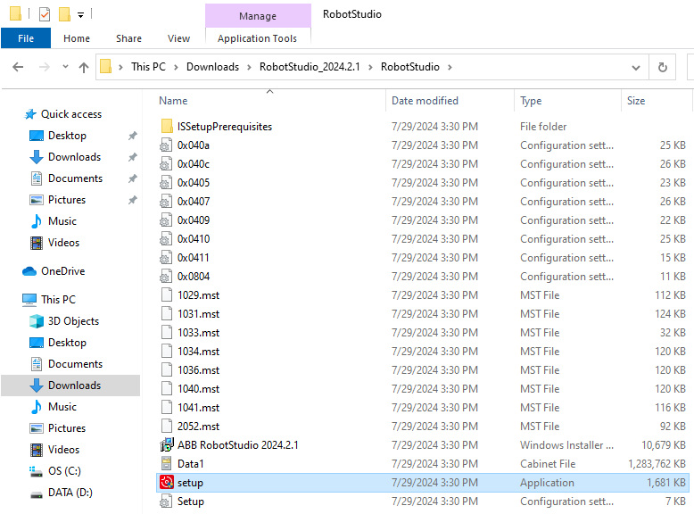
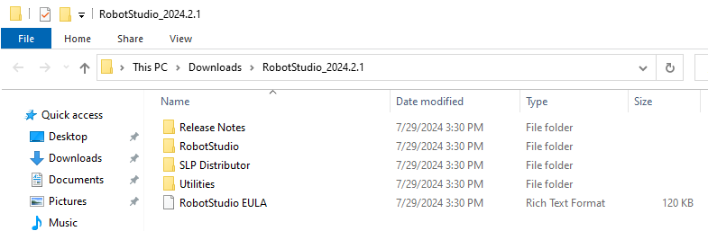
How to download RS(RobotStudio)?
⑧
⑨Enter the folder RobotStudio
⑩Click set up

Slide 6
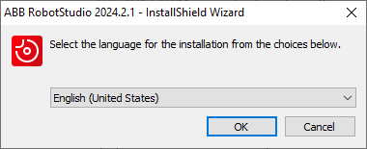
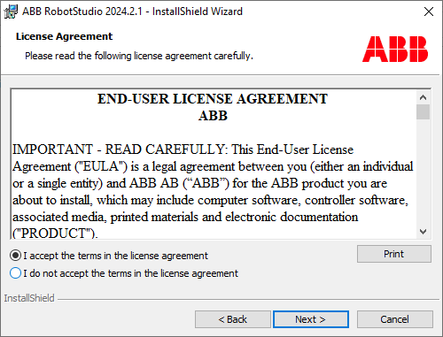
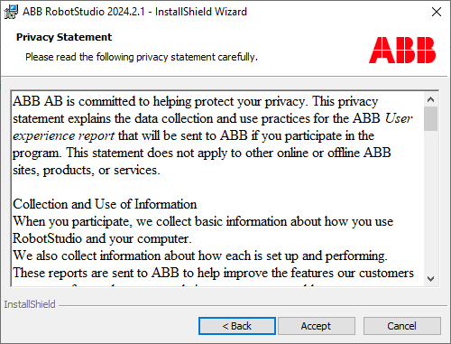
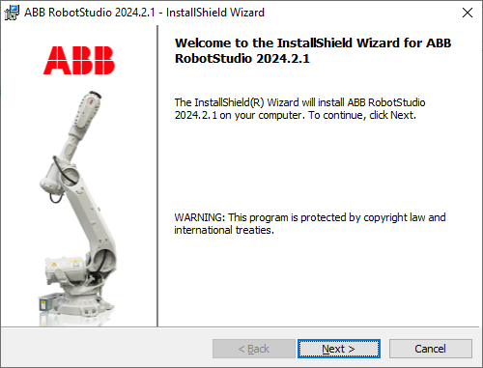
How to download RS(RobotStudio)?
⑪
⑬
⑭
⑫

Slide 7
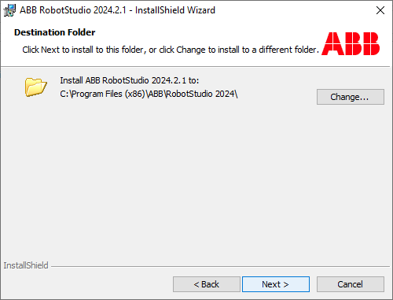
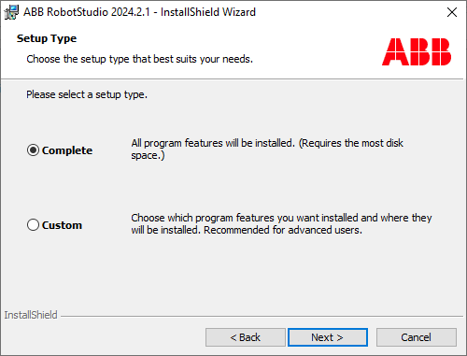
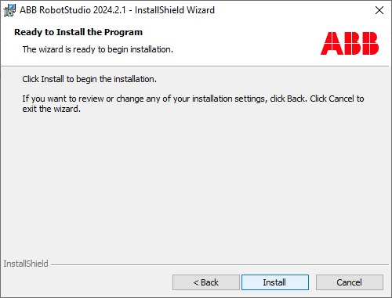
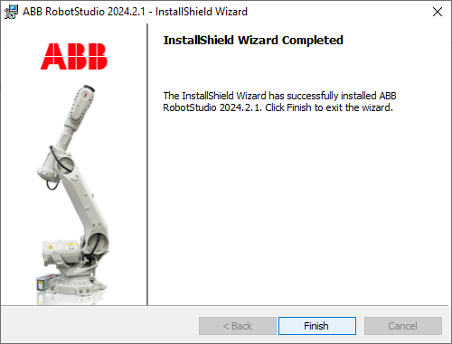
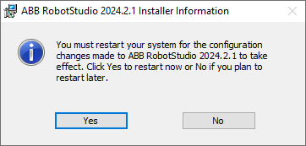
How to download RS(RobotStudio)?
⑮
⑯
⑰
⑱
Ps:
If the software is install in the school’s computer,
make sure computer have been created the recovery point
before restarting the computer.

Slide 8
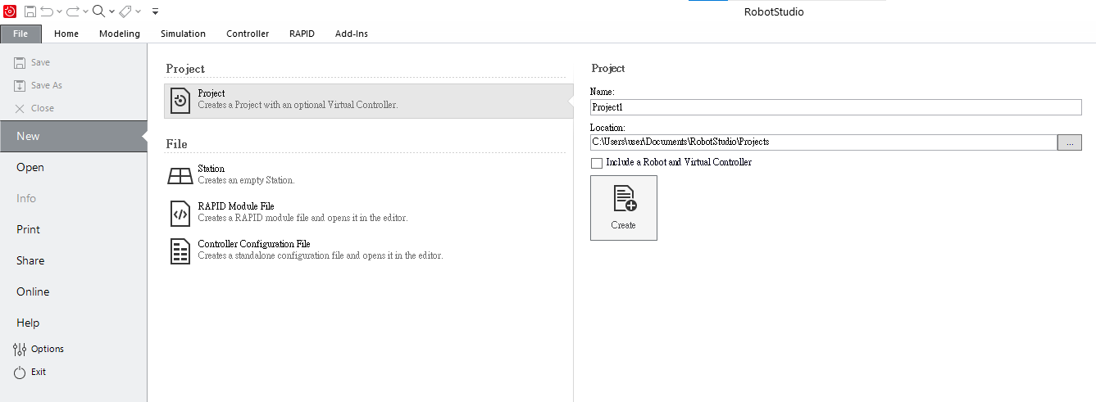
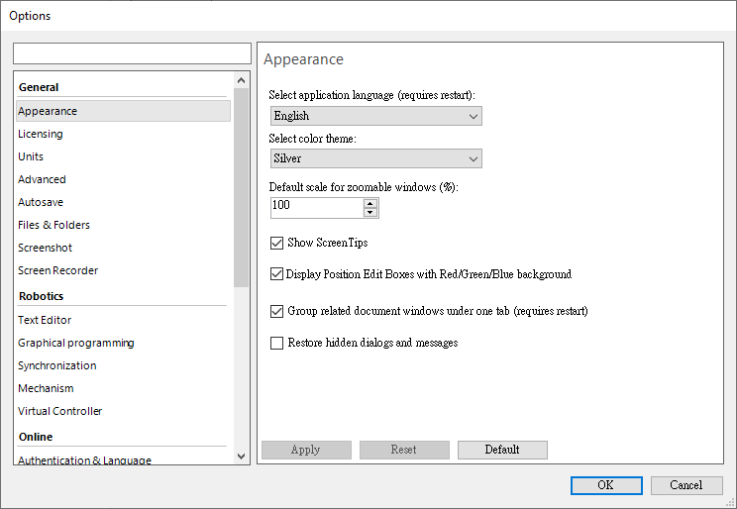
How to share network license?
②
①
Open robotstudio -> option

Slide 9
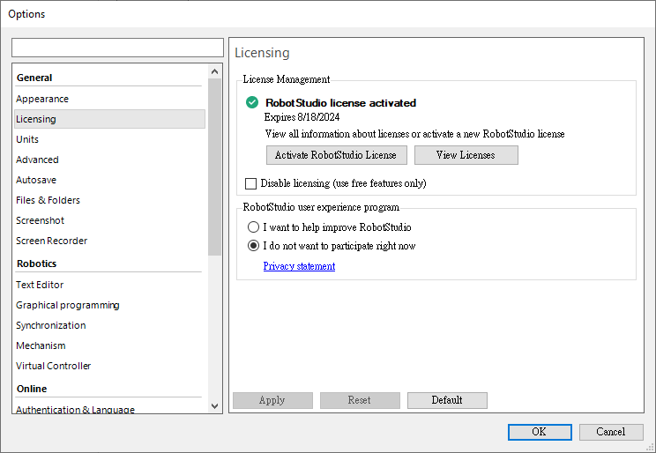
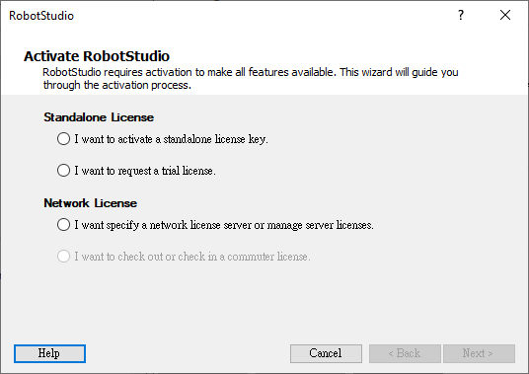
How to share network license?
③
④
⑤

Slide 10
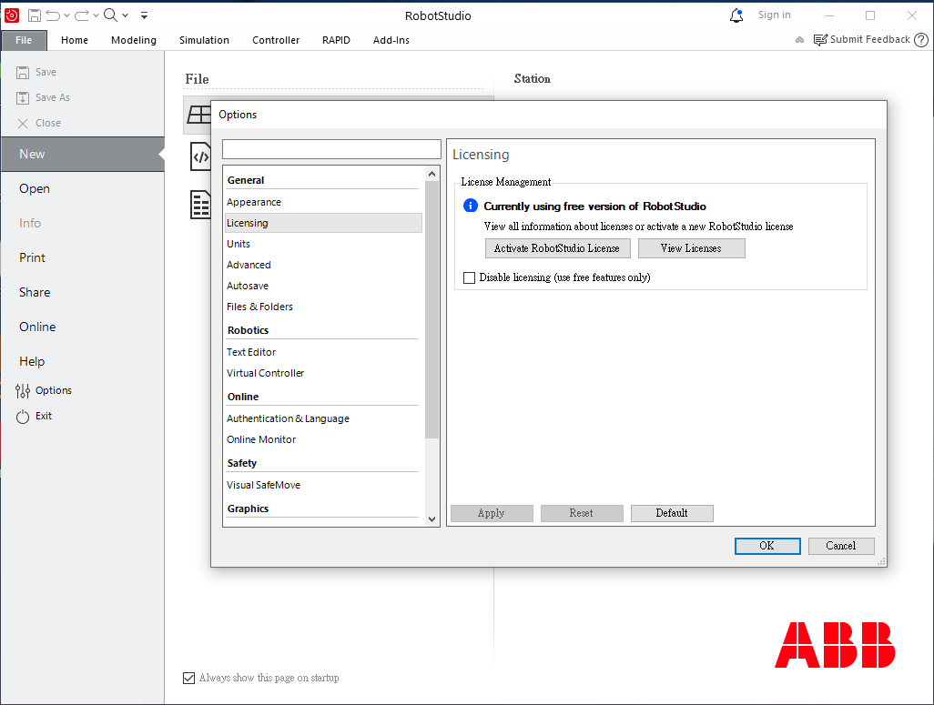
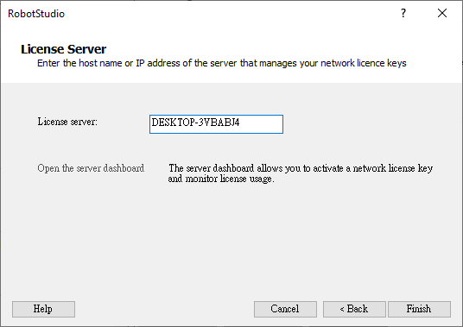
How to share network license?
⑥Enter the server’s computer name
⑦
Ps:
If student’s computer want to connect to server,
their devices have to connect same WIFI with server,
after using commuter mode so they can have license offline.

Slide 11
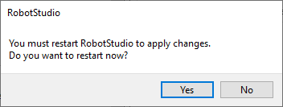
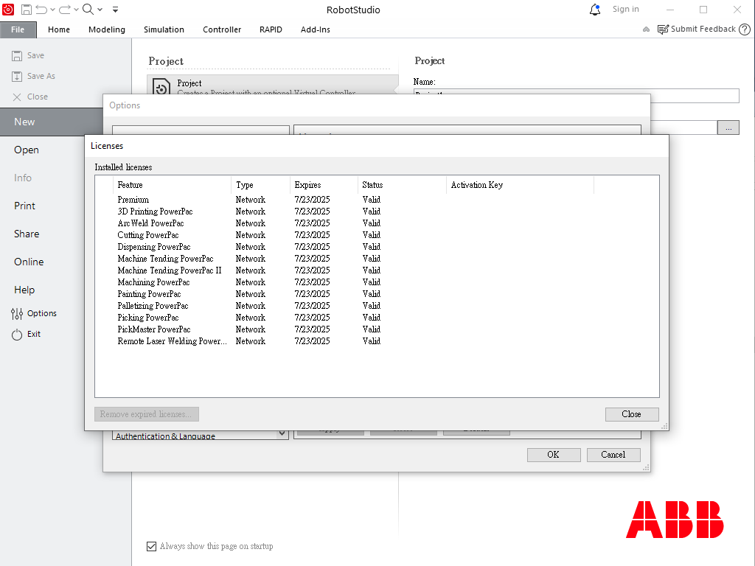
How to share network license?
⑧

Slide 12
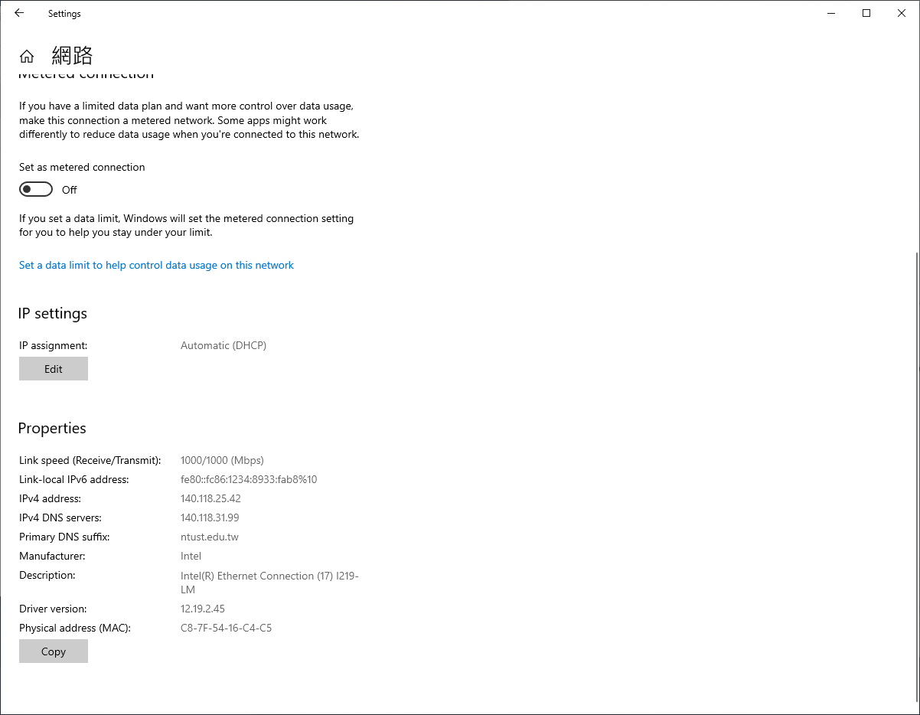
How to share network license?
If server is different, even enter the same host name can’t get the network license.
In the classroom, we use the WIFI named Classroom to connect network license.
The host server is located on the first row, from left to right third computer.

Slide 13
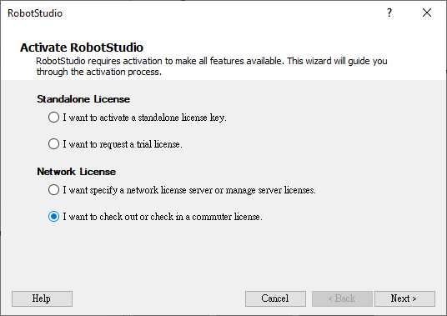
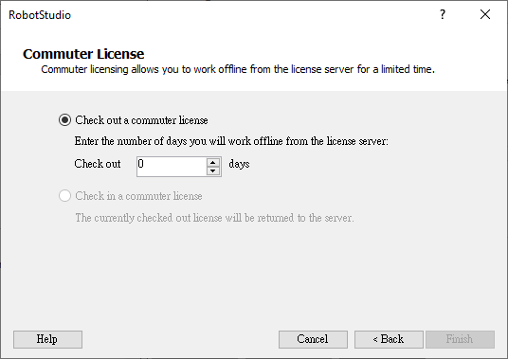
How to use commuter license mode?
③
④
①
Commuter license let user can check out network license for 90 days.
②
⑤

Slide 14
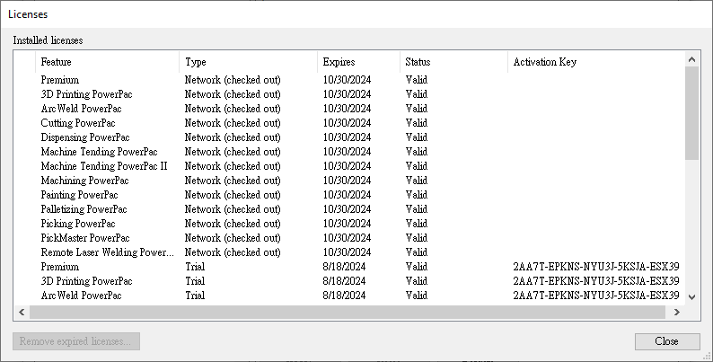
How to use commuter license mode?

