Slide 1
RS manual

Slide 2
Table of contents
How to download RS(RobotStudio)?
How to use activation key?
How to share network license?
How to use commuter license mode?
Student only need to see download, network and commuter license!

Slide 3
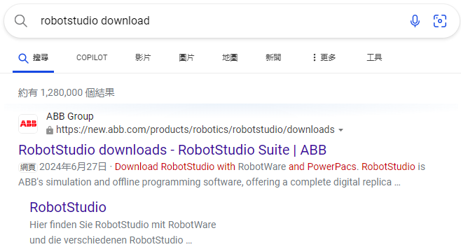
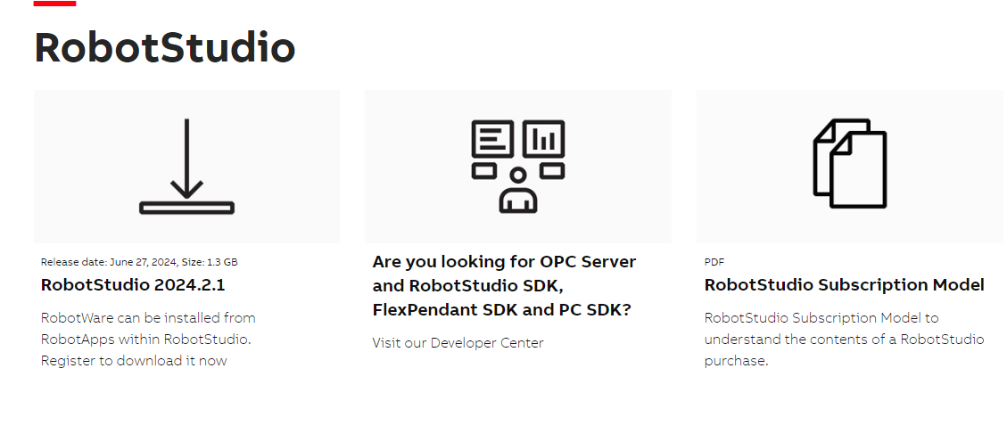
How to download RS(RobotStudio)?
①Search robotstudio download
③
②

Slide 4
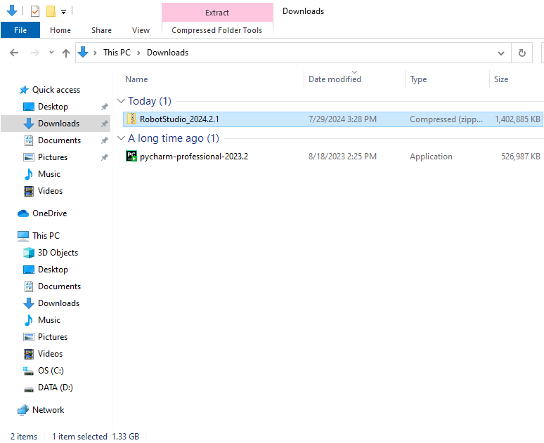
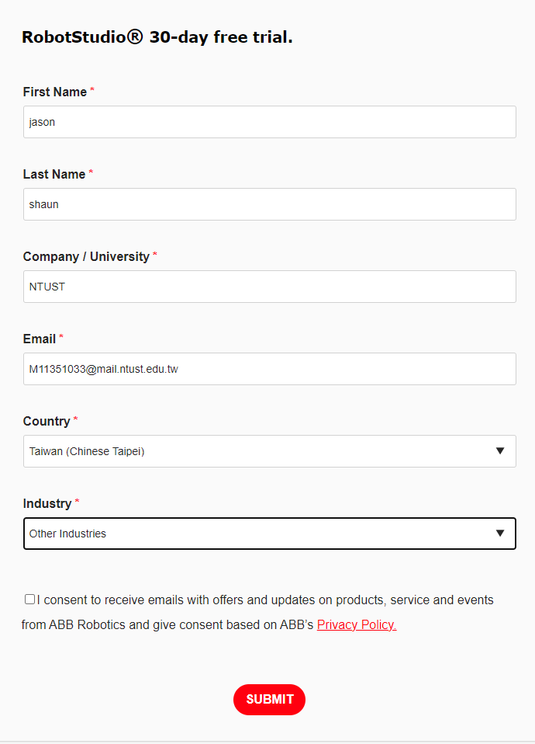
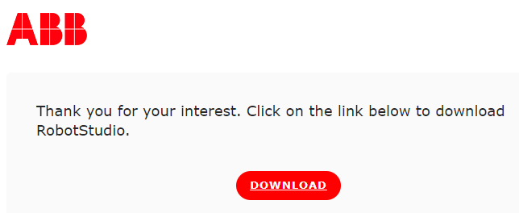
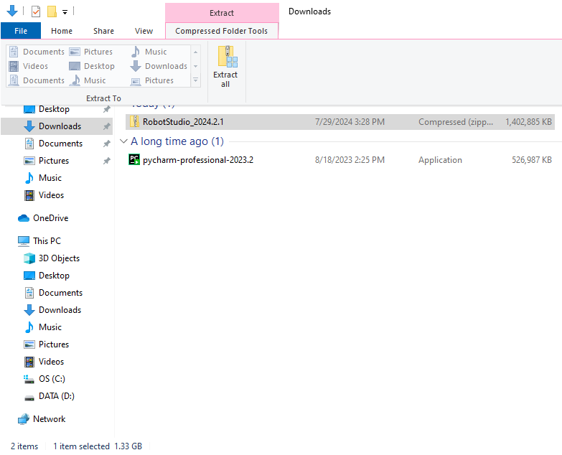
How to download RS(RobotStudio)?
④Fill in the form
⑦Unzip the folder.
⑥
⑤

Slide 5
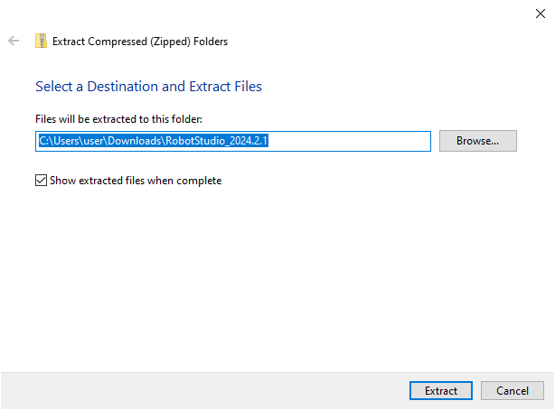
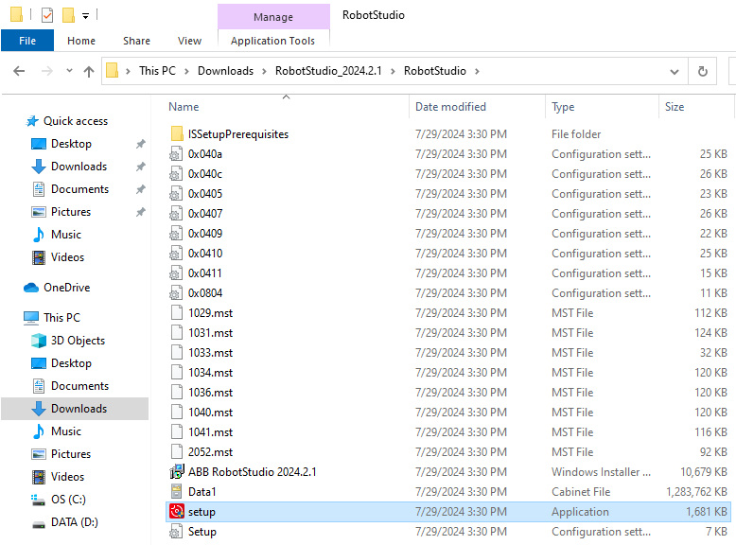
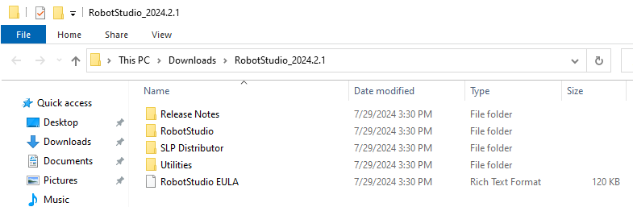
How to download RS(RobotStudio)?
⑧
⑨Enter the folder RobotStudio
⑩Click set up

Slide 6
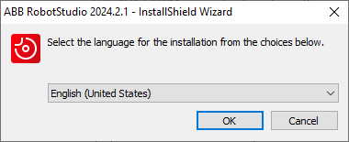
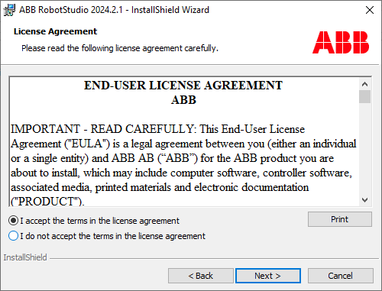
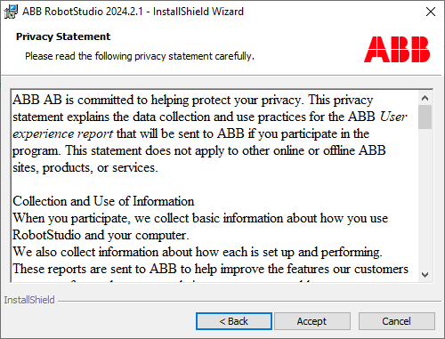
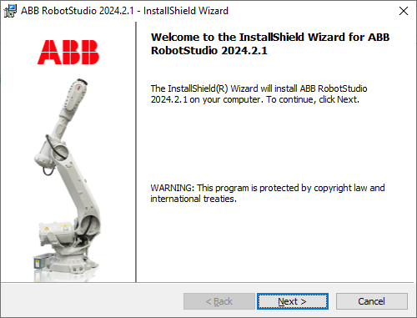
How to download RS(RobotStudio)?
⑪
⑬
⑭
⑫

Slide 7
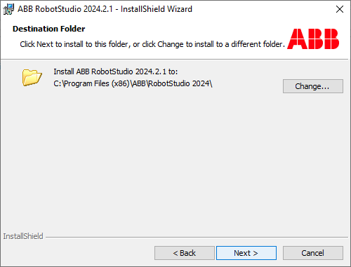
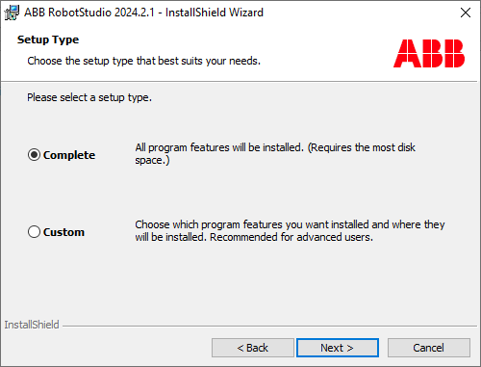
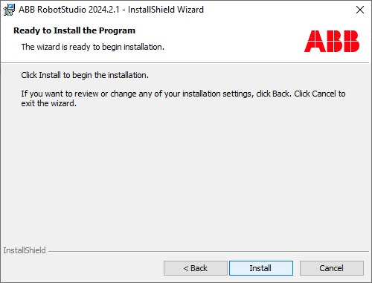
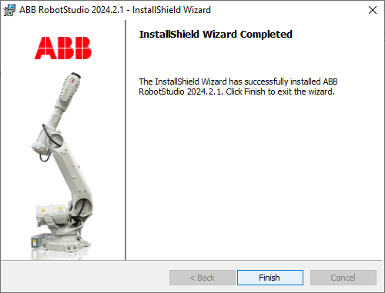
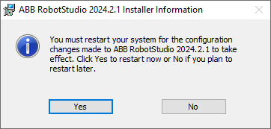
How to download RS(RobotStudio)?
⑮
⑯
⑰
⑱
Ps:
If the software is install in the school’s computer,
make sure computer have been created the recovery point
before restarting the computer.

Slide 8
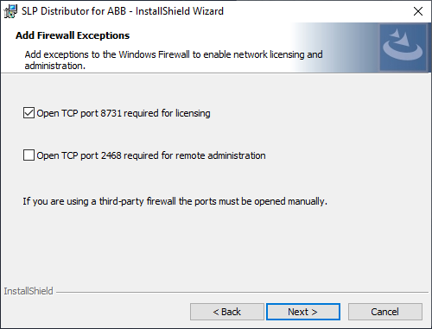
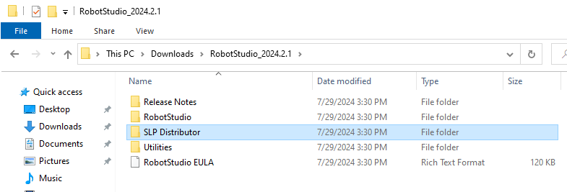
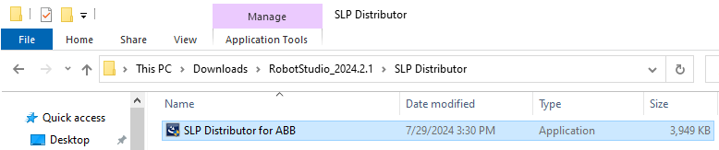
How to use activation key?
First install SLP distributor.
This step also need in both student and administrator.
①
③
②
Ps:
TCP port 2468 is for server and administration.
Which computer need to install the license.

Slide 9
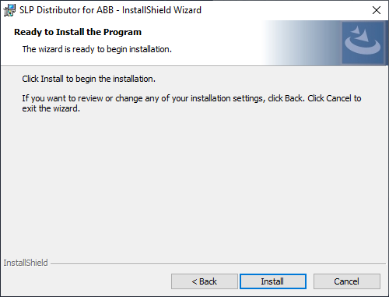
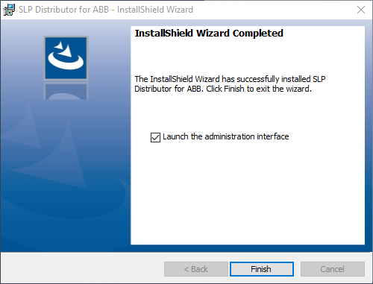
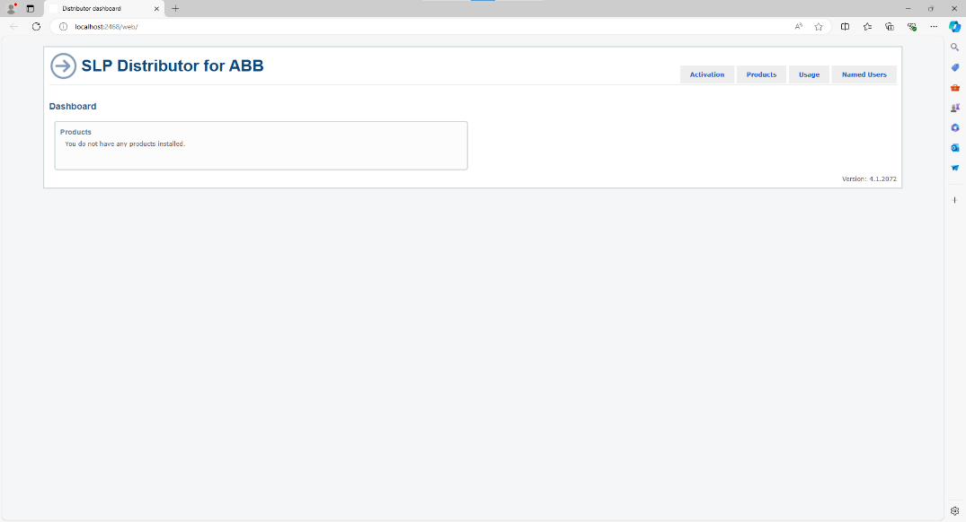
How to use activation key?
④
⑤
It will open SLP distributer, a website.

Slide 10
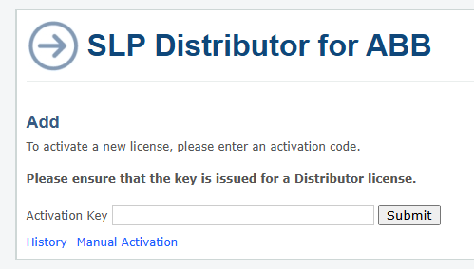
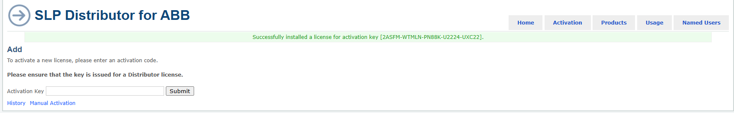
How to use activation key?(Auto)
This step is for administrator, not for student.
Enter your key and submit, it should be 25 words.(xxxxx-x….x-xxxxx)
PS:
After you submit the key, license would generate expire date.
Choose wisely the computer which you install license,
It is more complicate to remove the license to another computer.
If the key is correct, you would see this.

Slide 11
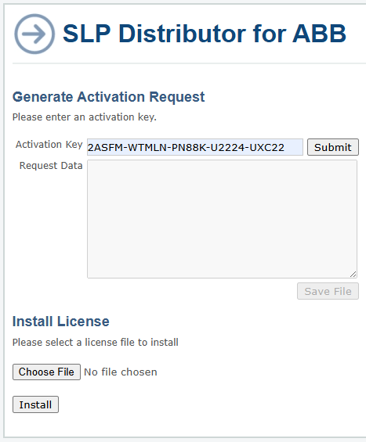
How to use activation key?(Manual)
Choose wisely the computer which you install license,
It is more complicate to remove the license to another computer.
The different of auto and manual are computer need to connect internet or not.
If auto install is succeed, then you don’t need to use manual activation.

Slide 12
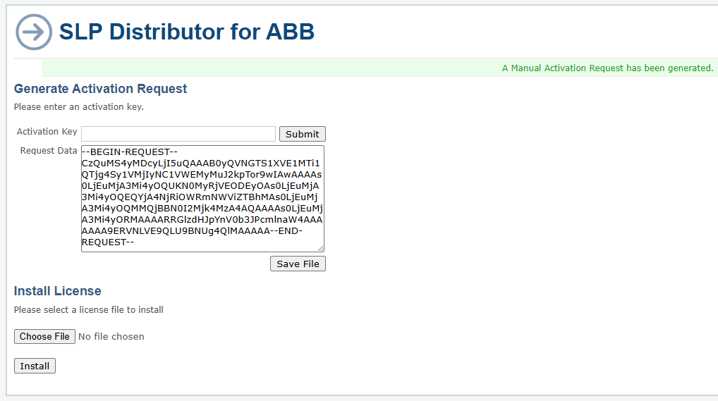
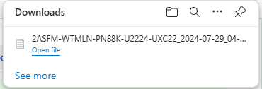
How to use activation key?(Manual)
If the key is correct, the request data would be generate.
The format like this.
Your activation key

Slide 13
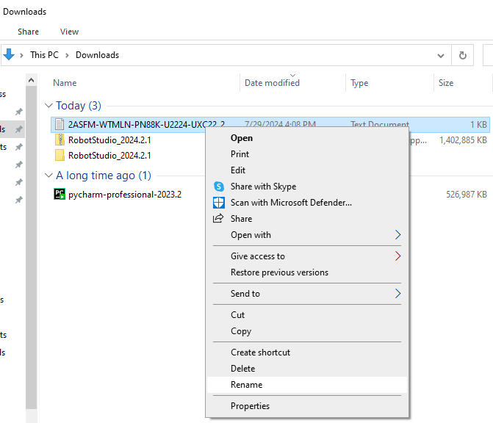
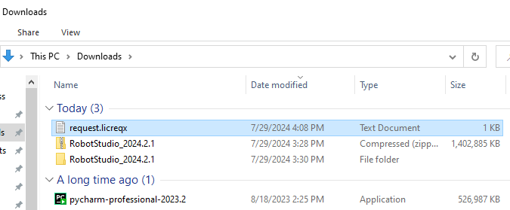
How to use activation key?(Manual)
Rename the file to request.licreqx

Slide 14
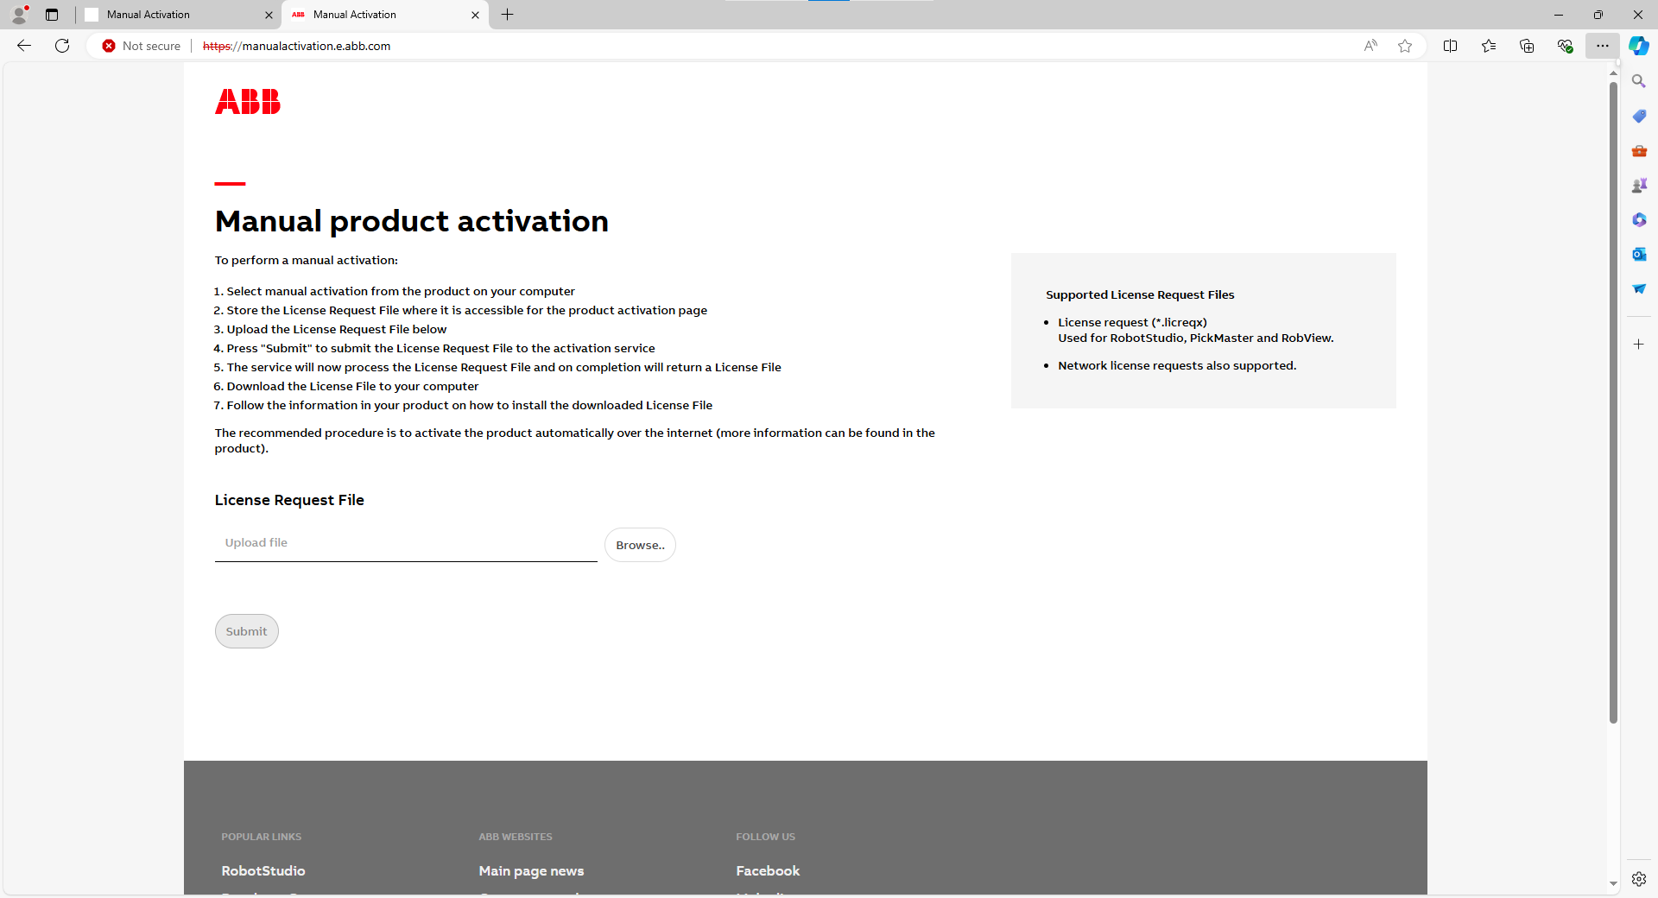
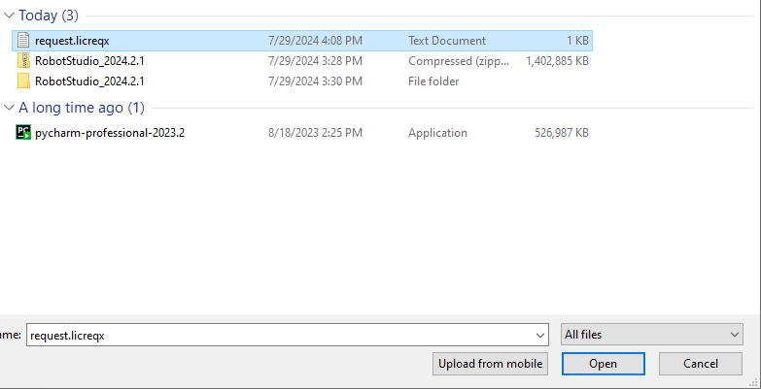
How to use activation key?(Manual)
Go to http://manualactivation.e.abb.com/
Upload request file.

Slide 15
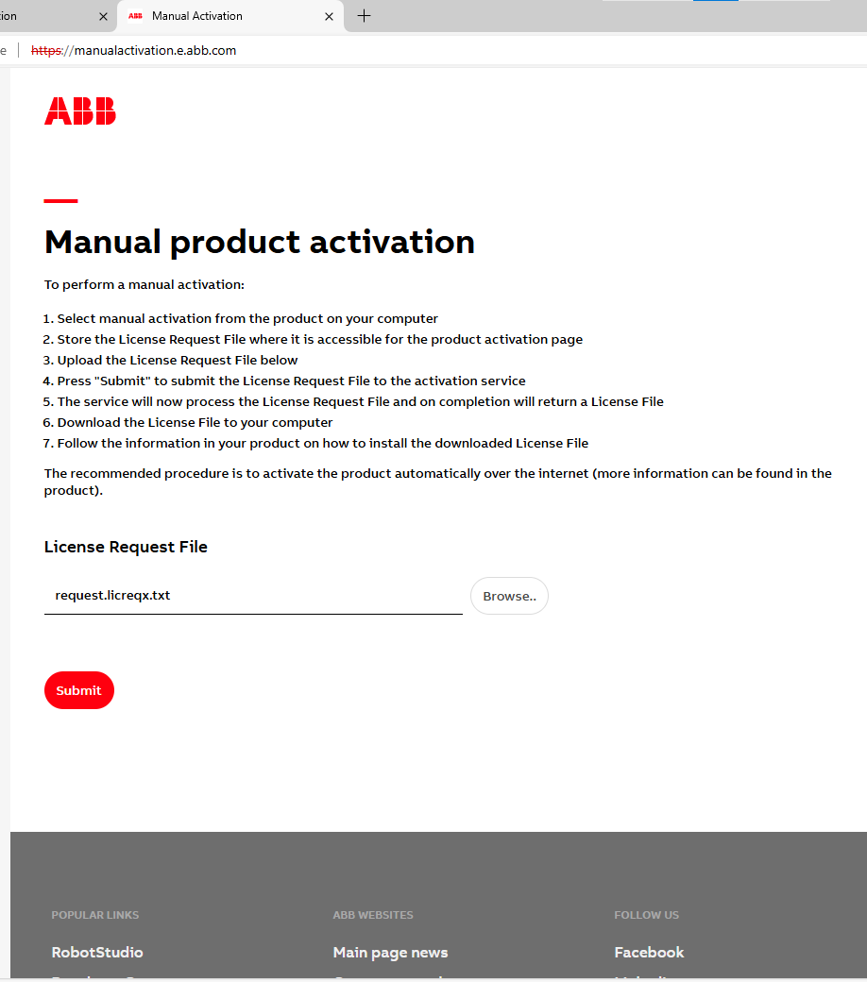
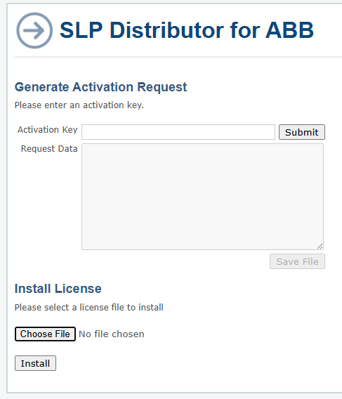
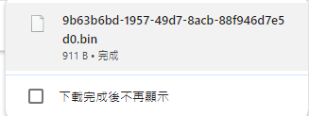
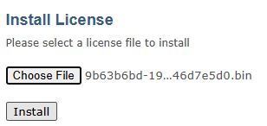
How to use activation key?(Manual)
You would get a .bin file.
Back to SLP distributor manual activation.
Upload .bin file

Slide 16
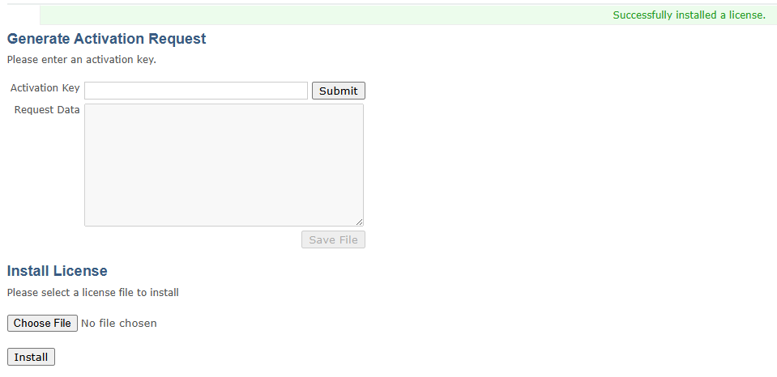
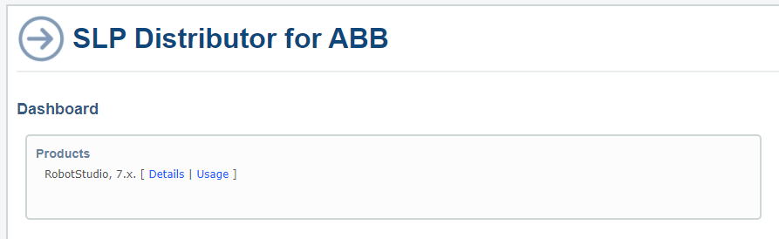
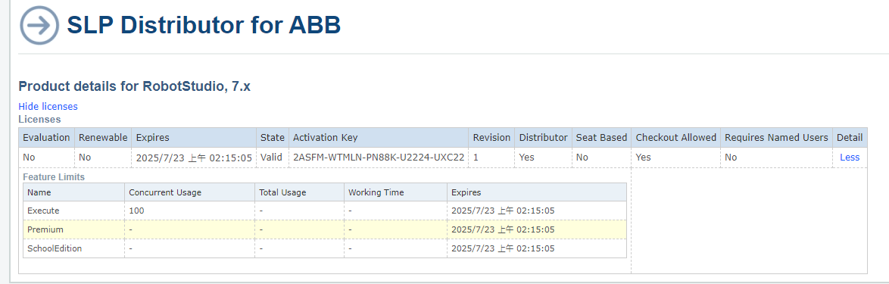
How to use activation key?(Manual)
If dashboard can see the product means license is in this computer.

Slide 17
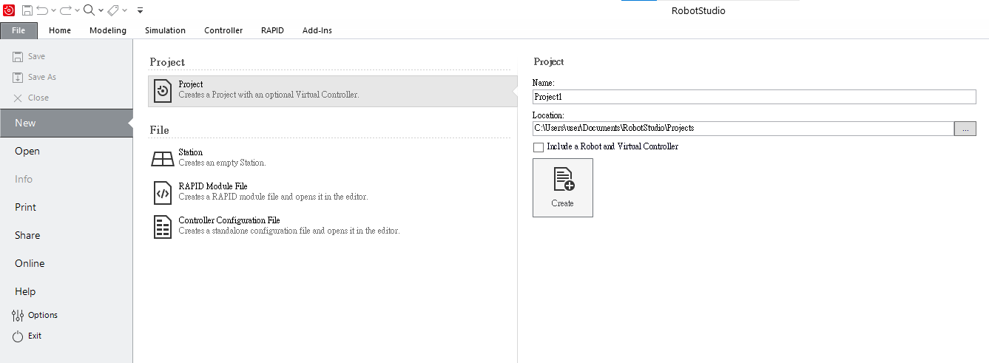
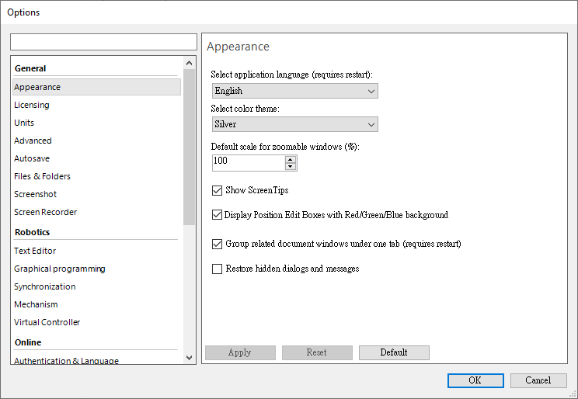
How to share network license?
②
①
Open robotstudio -> option

Slide 18
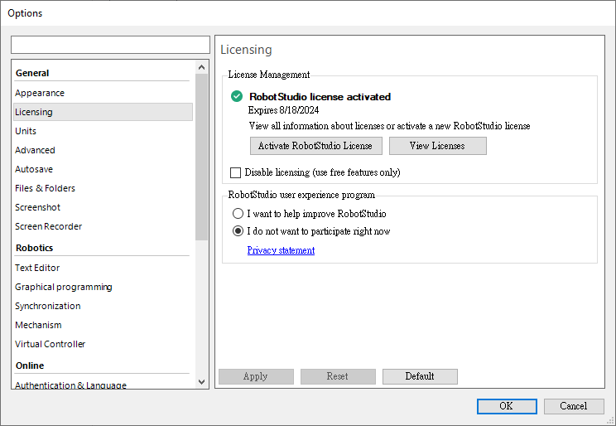
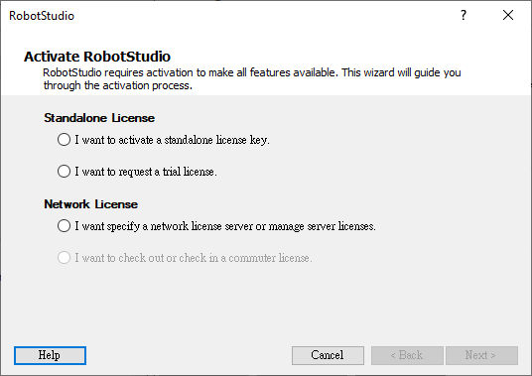
How to share network license?
③
④
⑤

Slide 19
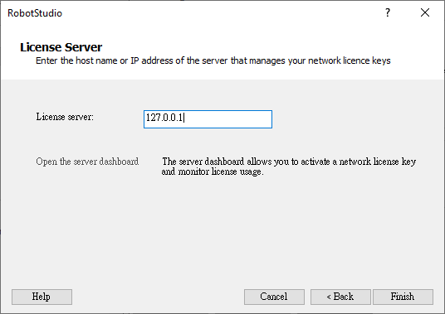

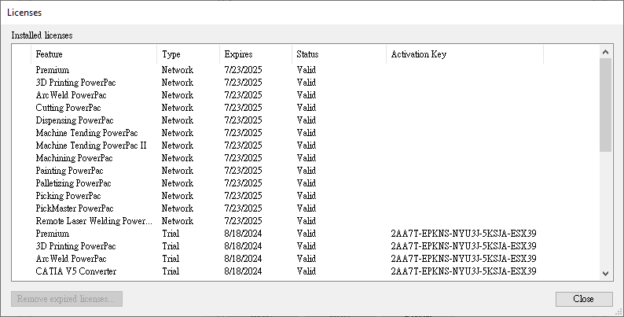
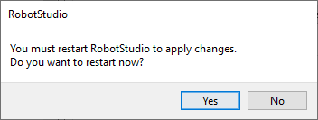
How to share network license?
(Administrator)
You can see your license is updated.
⑥Enter 127.0.0.1 this is local IP connect to SLP
⑦
⑧

Slide 20
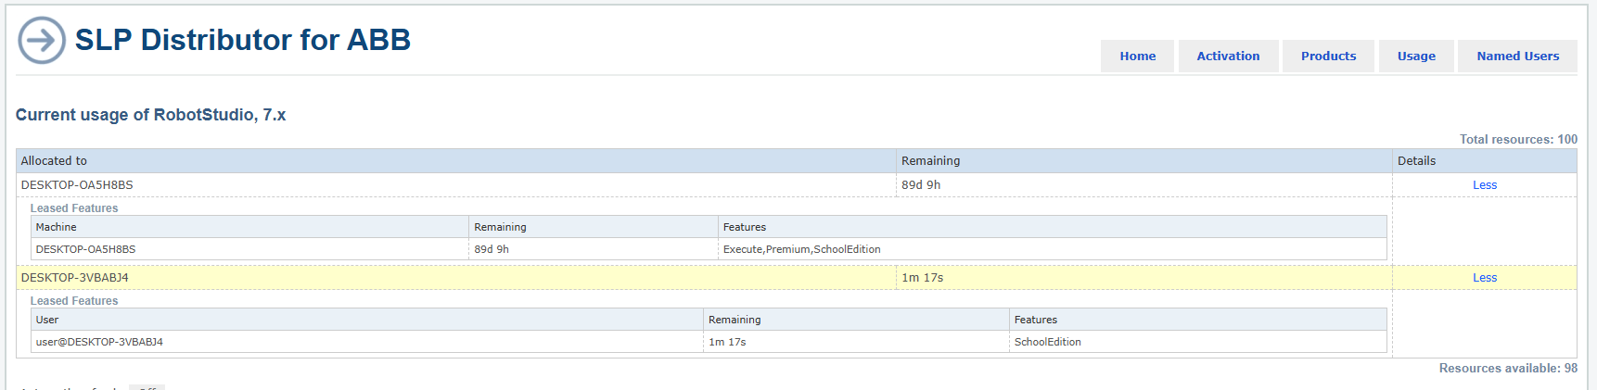
How to share network license?
(Administrator)
This is commuter license which is checked out.
Server host

Slide 21
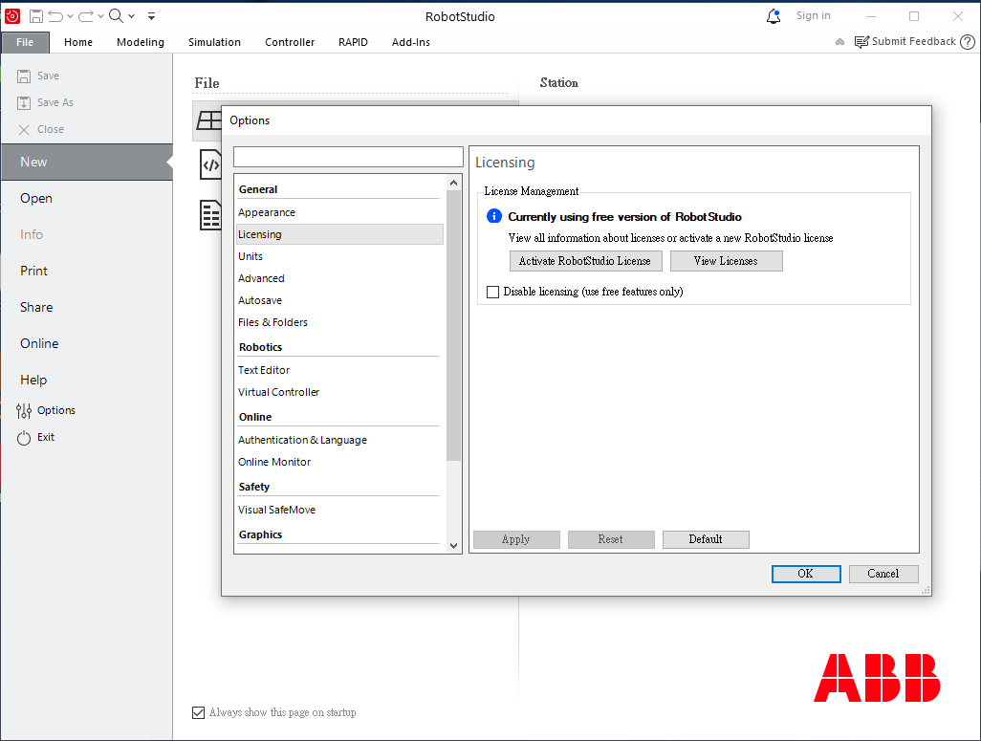
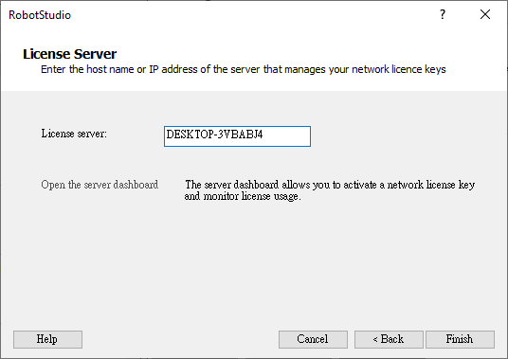
How to share network license?
(Student)
⑥Enter the server’s computer name
⑦
Ps:
If student’s computer want to connect to server,
their devices have to connect same WIFI with server,
after using commuter mode so they can have license offline.

Slide 22


How to share network license?
(Student)
⑧

Slide 23

How to share network license?
(Student)
If server is different, even enter the same host name can’t get the network license.
In the classroom, we use the WIFI named Classroom to connect network license.
The host server is located on the first row, from left to right third computer.

Slide 24


How to use commuter license mode?
③
④
①
Commuter license let user can check out network license for 90 days.
②
⑤

Slide 25

How to use commuter license mode?

