Slide 1

INTEGRATED COMMON SERVICES TO COMMON PEOPLE
TEAM MEMBERS:
AARON ANDE
THEJAS MONIKUTTAN
SHEBIN SAM
THIRMALREDDY MARY SHALINI
JENULIN MAKROS G

Slide 2
Problem Statement
Individuals often face difficulty in accessing various essential services.
Services such as government assistance, healthcare, housing, finance, and transportation
are scattered across different platforms.
The lack of a centralized platform leads to inefficiency and inconvenience for users.
Users need to visit multiple websites, fill out numerous forms, and follow various
processes to access different services

Slide 3
Unique Idea Brief (Solution)
Develop an integrated service website that serves as a one-stop platform for accessing
various essential services.
Simplifies the process for users to find and use the services they need.
Ensure a user-friendly interface that is easy to navigate and use.
Provide service providers with a dedicated portal to register and offer their services.
Implement a chatbot to assist users in navigating the website.
The chatbot can answer queries, provide information, and redirect users to the appropriate
pages by providing links.

Slide 4
Features Offered
User Registration and Login:
Simple and secure registration and login process.
Access to Various Services:
Government Services: Aadhar, Passport, Driving License, Vehicle Registration, etc.
Healthcare Services: Nearest hospitals, Nearest dispensaries, Nearest pharmacy
Housing and Rentals: Packers and Movers, House Renting, Nearest Community Details, Food and Water Suppliers.
Financial Services: Monthly Budget Calculator, Nearest ATM and Banks.
Transportation Services: Metro, Railway and Bus Services.
Chatbot Assistance:
A chatbot to help users with queries and provide quick links to relevant pages.

Slide 5
Process flow
User registers on the website by providing necessary details.
User logs in using their credentials.
User browses through different service categories.
User selects a service and accesses detailed information.
User completes any necessary forms or actions to utilize the service.
User interacts with the chatbot for assistance and quick navigation.

Slide 6
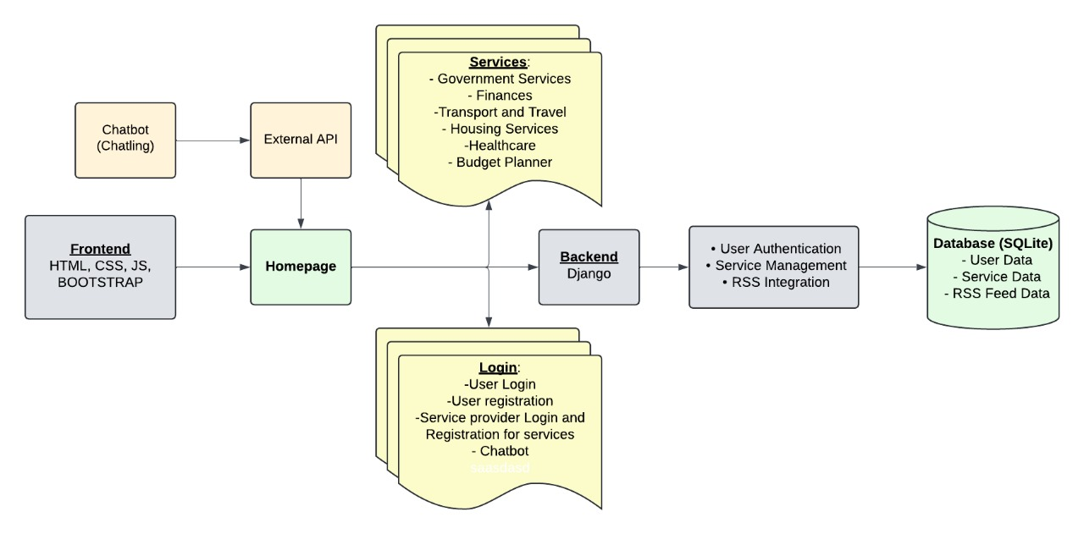
Architecture Diagram

Slide 7
Technologies used
Python, HTML, CSS, RSS
Frameworks: Django
Libraries: Bootstrap
Databases: SQLite
Version Control: Git
IDE: VS Code

Slide 8
Team members and contribution
Aaron Ande (Team lead) :
Front end Development
Resource collection
RSS
Thejas Monikuttan:
Front end Development
Resource collection
Report writing
Shebin Sam:
Backend Development
Resource collection
RSS
Thirmalreddy Mary Shalini:
Front end Development
Chatbot Integration
Resource collection.
Jenulin Makros G:
Front end Development
Chatbot Integration
Resource collection

Slide 9
Conclusion
The integrated service website addresses the need for a centralized platform for accessing essential services.
The chatbot feature enhances user experience by providing real-time assistance and quick navigation.
Our team is committed to delivering a solution that significantly improves the efficiency and convenience of accessing vital services.
We look forward to making a positive impact on the community by simplifying access to essential services for all.
*Project video link* : https://youtu.be/xtRLUWlZknA?si=fM7fxwNnp4x2fIMS

