Slide 1
GenAI Interactive Learning Games (Math Adventure)
TEAM NAME: KARUNYA_T18
TEAM MEMBERS:
AARON ANDE

Slide 2
Problem Statement
Many students struggle with conventional learning methods due to one-size-fits-all approaches that fail to adapt to individual learning speeds and abilities. Static question banks limit engagement, and students often lose motivation when faced with challenges that are either too easy or too difficult. The lack of personalized difficulty adjustments and interactive learning mechanics results in suboptimal learning outcomes.
This project aims to solve these issues by integrating Generative AI to create adaptive learning experiences. The system will dynamically generate math problems, modify difficulty levels based on performance, and provide real-time feedback to encourage active learning.

Slide 3
Unique Idea Brief (Solution)
1. Develop an AI-driven learning game that generates interactive math questions dynamically.
2. Implement an adaptive difficulty system that adjusts question complexity based on user
performance.
3. Introduce a scoring and rewards mechanism to enhance user engagement through stars,
coins, and power-ups.
4. Ensure an intuitive and user-friendly UI/UX with consistent design across game interfaces.
5. Incorporate AI analytics to track user progress, identify learning patterns, and suggest
improvements.
6. Provide real-time feedback to help students learn from mistakes and reinforce correct
concepts.

Slide 4
Features Offered
Adaptive Learning Theory
• Suggests that learning experiences should be personalized based on individual strengths
and weaknesses.
• Implementation in this project: The game will adjust difficulty levels dynamically based
on user performance.
Gamification in Education
• Applying game mechanics (rewards, challenges, achievements) to improve motivation
and engagement.
• Implementation in this project: Introducing stars, coins, power-ups, and progression
constraints to encourage learning.
Generative AI in Education
• AI models like GPT-2/GPT-3 can generate story-based, interactive math problems.
• Implementation in this project: AI will generate contextual, difficulty-based math problems dynamically.

Slide 5
Process flow
User opens the Home Page
Sees options to select:
Topic (Addition, Subtraction, etc.)
Difficulty Level (Beginner, Intermediate, Advanced)
User clicks on the topic
Navigates to the Game Page (GamePlay)
GenAI Module is triggered
Receives:
Selected topic
Difficulty level
Generates a creative, story-based math question with:
1 correct answer
3 incorrect (but plausible) options
Question is displayed to the user
Answer options shown as buttons or inputs
5. User selects an answer
If correct: Option turns Green
If incorrect: Selected option turns Red, correct one is highlighted
6. User can use Power-ups (optional)
50:50: Removes 2 wrong answers
Time Freeze: Pauses the timer
7. After answering all questions
User is taken to the Results Page
Score (stars, coins), Accuracy, Feedback (e.g., "Great job!", "Try again")
8. User can choose to:
Go back to Home Page or Proceed to next level

Slide 6
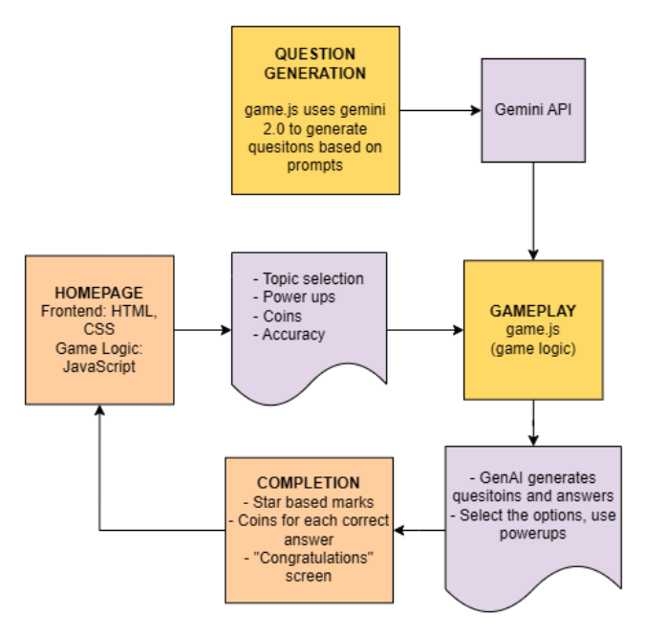
Architecture Diagram

Slide 7
Technologies used
Frontend Technologies
• HTML – Structure of the user interface
• CSS – Styling for layout, responsiveness, and visual elements
• JavaScript – Handles interactivity, user inputs, and game logic
Backend Technologies
• JavaScript (Node.js optional for local processing) – Used for game logic execution
• Gemini 2.0 API – Generates dynamic, story-based math problems based on user performance
• Local Storage (Optional) – Saves user progress and settings on the client device
Development Tools
• Code Editor – VS Code
• Browser – Chrome, Firefox, or Edge for testing and debugging
• Git (Optional) – Version control for tracking changes

Slide 8
Team members and contribution
Aaron Ande (Team lead) :
• Team lead
• Front end Development
• Resource collection
• Report writing
• Game logic development
• GenAI integration
• API integration

Slide 9
Conclusion
This project successfully demonstrates a Gamified Math Learning Platform enhanced by
Generative AI, where users can:
• Solve dynamically generated, story-based math questions which get difficult over the course of the topic.
• Use engaging game mechanics such as power-ups (50:50, Time Freeze) and a scoring
system (stars, coins).
• Receive real-time feedback and performance evaluation after each level.
The system provides an engaging learning experience that adapts to each user’s performance, ensuring a balance between fun and effective education.

