Slide 1


framework Aggregation and Archiving of Artifacts
“A Repository of Reliable Resources for Academia”
PROTOTYPE PRESENTATION
CS 411, SUMMER 2020
TEAM CRYSTAL

Slide 2
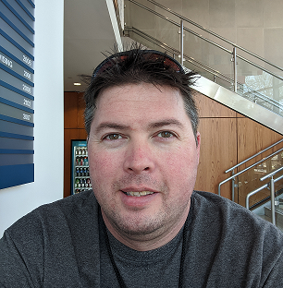

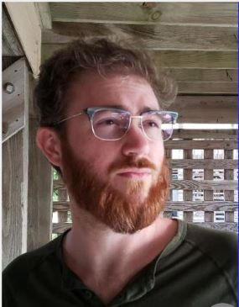
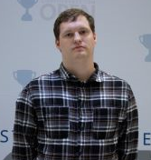
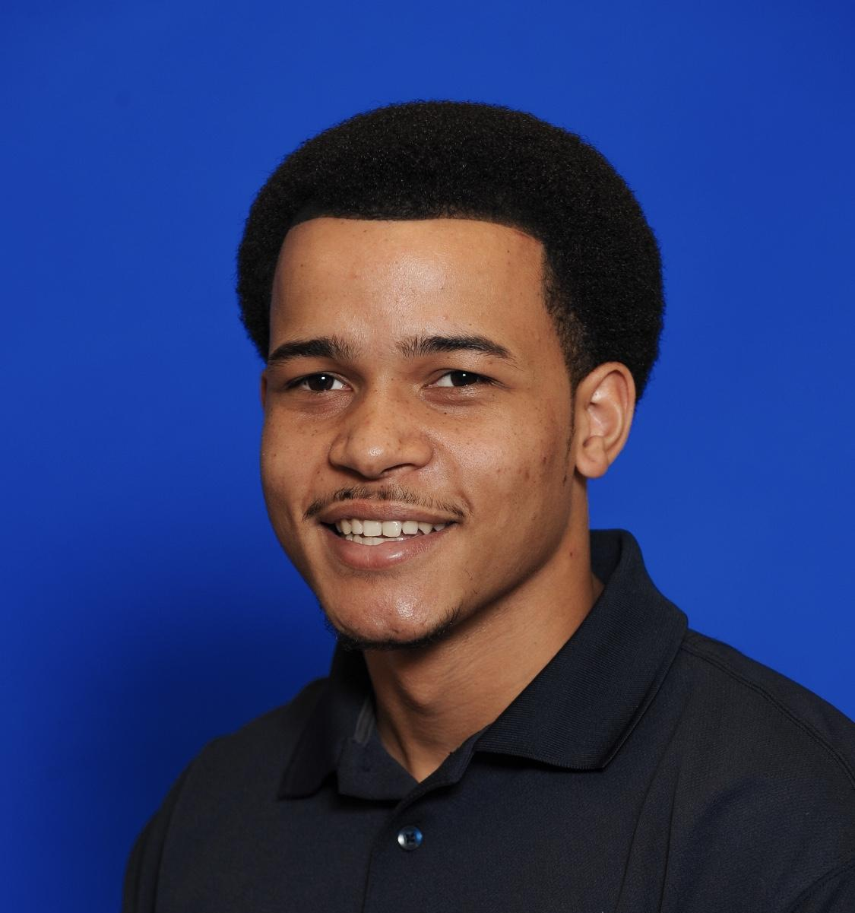

TEAM CRYSTAL
Team Crystal, comprised of computer science students at Old Dominion University, is developing the A³ framework.
Aaron Berman
Team Lead/Webmaster
Joshua Murphy
Documentation Manager/ Database Developer
Mike Campbell
Database Architect/Testing
Stephen Ayers
Algorithms Developer/Testing
Noah Jennings
Algorithms Developer-UI/UX Developer
Rosalie Oliva
UI/UX Developer
Notes:
Stephen Ayers
introduce the team - everyone says their own name--mention the section you’re covering(?)add under name what section each member is focusing on
rosalie couldn’t make it

Slide 3
TABLE OF CONTENTS
. . . . . . . . . . . . . . . . . . . . . . . . . . . . . . . . . . . 4
. . . . . . . . . . . . . . . . . . . . . . . . . . . . . . . . . . . . . . . . . . . 5
. . . . . . . . . . . . . . . . . . . . . . . . . . . . . . . 6
. . . . . . . . . . . . . . . . . . . . . . . . . . . . . . . . . . . . 8
. . . . . . . . . . . . . . . . . . . . . . . . . . . . . . . . . 9
. . . . . . . . . . . . . . . . . . . . . . . . . . . . . . 11
. . . . . . . . . . . . . . . . . . . . . . 12
. . . . . . . . . . . . . . . . . . . . . . . . . . 13
. . . . . . . . . . . . . . . . . . . . . . . . . . . . . . . . . . 14
. . . . . . . . . . . . . . . . . . . . . . . . . . . . . . . . . . . 16
. . . . . . . . . . . . . . . . . . . . . . . . . . . . . . . . . . . . . . . . 17
. . . . . . . . . . . . . . . . . . . . . . . . . . . . . . . . . . . . . . . . . 19
. . . . . . . . . . . . . . . . . . . . . . . . . . . . . . . . . . . . . . . . 23
Problem Statement
Definitions
Traditional Shortcomings
Solution Statement
Solution Characteristics
Customers and End Users
Real World Product vs Prototype
Major Functional Components
Development Tools
Database Schema
Agile Sprints
References
User Stories
Notes:
Stephen Ayers

Slide 4
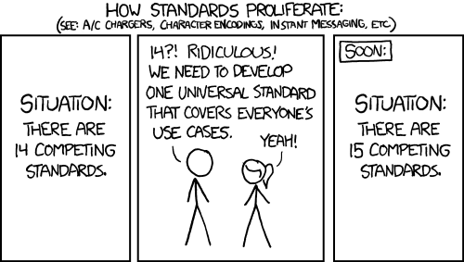
PROBLEM STATEMENT
Educators and students lack a framework to aggregate and archive fragmented and domain-specific artifacts for the purpose of academic knowledge management.
Image Credit:
(XKCD.com 2020)
Notes:
Stephen
-brunelle mentioned using example of current covid-19 issue, faculty moving to online some without experience on that medium
-faculty have content archives, but the knowledge artifacts aren’t centralized or easy to share with students and other faculty

Slide 5
DEFINITIONS:
Aggregate: Data that is composed of smaller pieces that form a larger whole.
Artifact: Refers to a file or document.
Knowledge Assets: The accumulated intellectual resources of an organization codified in electronic form.
Repository: Central location in which data is stored and managed.

Slide 6
TRADITIONAL SHORTCOMINGS:
Knowledge Repositories
Formal artifact aggregation in traditional academic environments does not exist [3]
The aggregation that does currently exist does not support tracking of changes through time [2]
Current aggregation is not strong enough to be considered centralized
Knowledge Accessibility
Knowledge is isolated by specialization [16]
Access is often restricted by course or major [16]
Artifact format preference by instructor can vary wildly and may not be functional to others [17]

Slide 7
TRADITIONAL SHORTCOMINGS:
Knowledge Asset Management
Instructor artifacts are often created in a variety of formats
Individual instructors must often be petitioned for information [17]
Loss of artifacts from reassignment of responsibilities [16]
ODU CS department syllabus collection once took two months [17]
Knowledge Environment Enhancement
Artifacts are specific to each course
ODU instructors use a variety of platforms (e.g., Bb, PLE, CoWeM) to host artifacts [17]
Special needs and distance learning lack proper support [3]
Shared artifacts can benefit organizations on a fundamental level [16]
Notes:
Harris
-bolded headers change to shortcomings/issue area
-suggestion to split 6/7 into 4 slides (4 topics, one slide each)

Slide 8
SOLUTION STATEMENT
A³ framework is a framework for aggregating and archiving artifacts for educators, researchers, and students. A³ framework seeks to overcome the challenges of individualization, location, and formatting in academic knowledge management by keeping information available, normalized, and centralized while being enhanced by a robust user interface.
Notes:
get hooks: normalize all the lines, do unit test
Robust means both a CLI and a GUI will be developed. Which allows for utilization by users who need/want a simple windowed interface and users who use a terminal and/or want to use A³ framework in automation through the use of scripting or integration with software tools, such as Git hooks.

Slide 9
SOLUTION CHARACTERISTICS:
Creating Formal Knowledge Repositories
Create a robust infrastructure for artifacts
Support version history of artifacts for organization of knowledge assets
Centralize information concisely and effectively
Improve Knowledge Accessibility
Create knowledge artifacts that are widely applicable
Create cross course accessibility
Normalize artifacts from varied platforms (e.g., Bb, PLE, CoWeM) into translatable formats*
*Not implemented in Prototype
Notes:
internal CONTENT of the file
Mike
A-cubed aims to create a robust, reliable infrastructure as a repository for knowledge artifacts…
...which will support recording changes to those artifacts for review and analysis.
The repository is created as a centralized collection of knowledge assets, facilitating easier sharing of instructional materials.

Slide 10
SOLUTION CHARACTERISTICS:
Knowledge Asset Management
Unify formatting among instructors through normalization
Remove necessity of individual knowledge asset request
Create systematic storage of vital course information
Automate collection of standard reference materials*
Knowledge Environment Enhancement
Translate artifacts to a universally applicable format
Core organizational improvements through a cooperative environment
Normalization to allow functionality across artifact formats
Special needs and distance learning accessibility*
*Not implemented in Prototype
Notes:
MIKE
Instructors don’t have to consider format choices when sharing materials--just use what works best for them, not only file types, but platforms, as well.
Recall the earlier example of the history of programming instructor complimenting their course materials with artifacts from a C++ course…
...a student accessing that information doesn’t have to go through the platform used by the C++ course, be it PLE, Blackboard, or another--they simply get direct access to the artifact.
The need for students to request individual knowledge assets from instructors is removed,
because the students gain direct access to the collection of artifacts.
This benefits students because of the quicker access to knowledge, but also consider the time saved for the instructor--no longer flooded with emails requesting course materials.

Slide 11

CUSTOMERS AND END USERS:
Old Dominion University Computer Science Department:
Real World Product:
Guest
Student
Faculty
Administrator
Tester
Prototype:
Guest
Faculty
Tester
Image Credit:
(Freepik.com 2020)
Notes:
MIKE
Instructors don’t have to consider format choices when sharing materials--just use what works best for them, not only file types, but platforms, as well.
Recall the earlier example of the history of programming instructor complimenting their course materials with artifacts from a C++ course…
...a student accessing that information doesn’t have to go through the platform used by the C++ course, be it PLE, Blackboard, or another--they simply get direct access to the artifact.
The need for students to request individual knowledge assets from instructors is removed,
because the students gain direct access to the collection of artifacts.
This benefits students because of the quicker access to knowledge, but also consider the time saved for the instructor--no longer flooded with emails requesting course materials.

Slide 12
RWP
vs.
Prototype
Feature/Capabilities Comparison Chart
Feature/Capability | Real World | A³ Prototype | A³ Prototype Actual
Database Storage | X | X | X
Graphical User Interface | X | Limited | Mock-up
Command Line Interface | X | X | Limited
User Authentication | X | Limited | Limited
Access Control | X | X | X
Artifact Upload | X | X | X
Repository Creation | X | X | X
Artifact Normalization | X | X | Limited
Artifact Comparison | X | X | X
Artifact Update | X | X | X
Artifact/Repo Deletion | X
Web Scraping | X | Limited | Limited
Artifact Change Record | X | X | X
Artifact Exporting | X | X | X
Artifact/Repo Tags | X | Limited | Limited
Artifact/Repo Searching | X | Limited | Limited
Artifact Contributor List | X
Artifact/Repo Sharing | X
Notes:
one more column: A3 Prototype actual

Slide 13
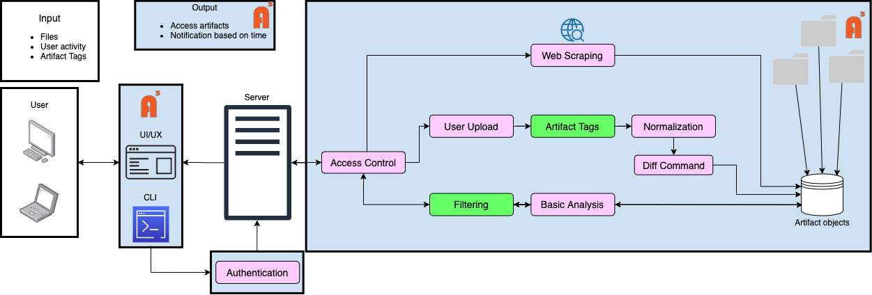
MAJOR FUNCTIONAL COMPONENTS
Limited
Algorithm
Asset
Notes:
Harris - Functional components
-need consistent capitalization

Slide 14
DEVELOPMENT TOOLS
Software Requirements:
Language: Python 3.8 or newer
Python framework: Flask,
mysql.connector, and pypandoc
GUI language: HTML, CSS, and JS
JS frameworks: React and Node (with
npm)
Documentation: pydoc and Sphinx
Configuration management: tox or Conda
Analysis: pycodestyle (formerly PEP 8) and Pylint
APIs: BeautifulSoup 4, requests, pandoc
Notes:
tox : testing
conda : more for development.
flake A

Slide 15
DEVELOPMENT TOOLS
Technology Requirements:
Code Repository with Version Control: GitLab
Issue Tracking and Development Scheduling: GitLab
Containerization: Docker and
Docker Compose
Database: MySQL
IDE: Visual Studio Code (VS Code)
Hardware Requirements: Single VM instance running an Ubuntu distribution on the ODU CS server
Notes:
tox : testing
conda : more for development.
flake A

Slide 16
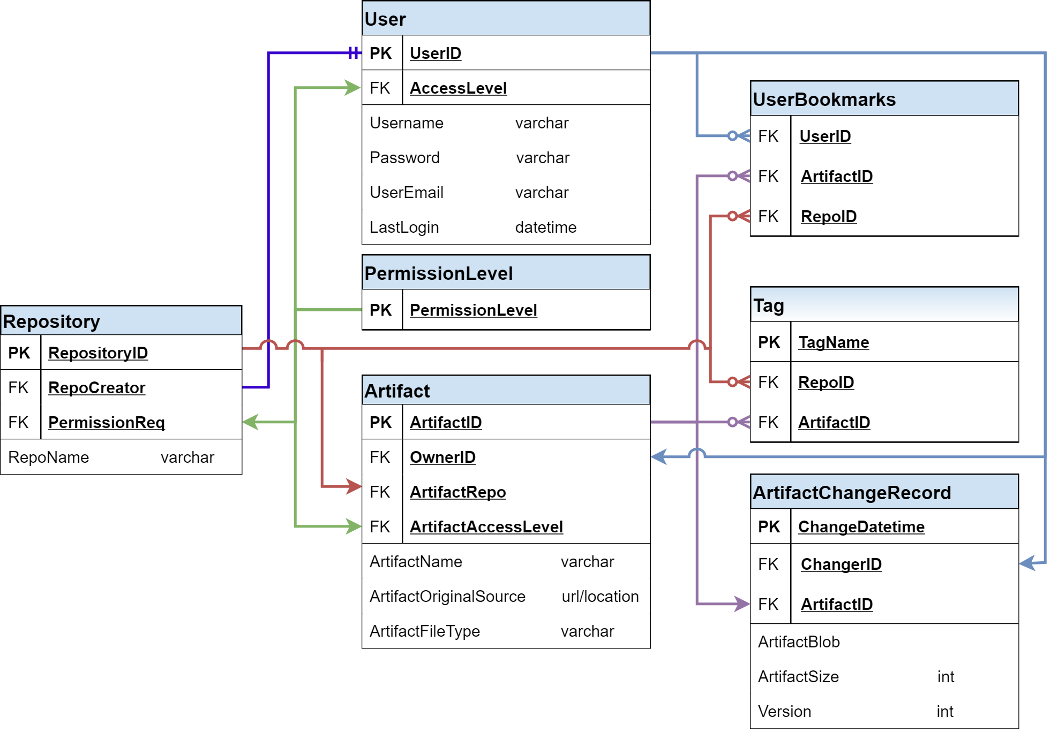
DATABASE:
Schema
Notes:
SHOULD WE ADD CREATION DATE/VERSION OF THE ARTIFACTS, ALONG WITH ITS CHANGE RECORD ??
noah
change record
change date
user id that changed it
artifact id that was changed
need to return to older versions ?
change log ?
gzip, blob
#add repo bookmarks -added
#artifact location -added

Slide 17
AGILE SPRINTS
Sprint 1
Sprint 2
Sprint 3
Sprint 4
Sprint 1 (July 5, 2020)
Database framework
CLI interface
Simple comparison function
Authentication/Role-based access
Testing
Sprint 2 (July 12, 2020)
Full database implementation
Normalization function(s)
Analysis function(s)
GUI framework
Testing
Sprint 3 (July 20, 2020)
Diff function (line-by-line)
Web scraping implementation
Final GUI implementation
Limited artifact tags and filtering
Testing
Sprint 4 - if time permits (July 27, 2020)
Full implementation of artifact tags and filtering
Notifications
Testing

Slide 18
framework A repository of reliable resources.
Our goal is simplicity.
Notes:
Stephen Ayers

Slide 19
REFERENCES
Blackboard Archive Extractor. (2016, December 15) cs.odu.edu. Retrieved March 10, 2020, from https://www.cs.odu.edu/~cpi/old/411/crystals17/.
Carroll, J., Choo, C. W., Dunlap, D., Isenhour, P., Kerr, S., MacLean, A., & Rosson, M. (2003). Knowledge Management Support for Teachers. Educational Technology Research and Development, 51(4), 42-64. www.jstor.org/stable/30221184
Davenport, T., Long, M. & Beers, M.. (1997). Building Successful Knowledge Management Projects [Working Paper]. Retrieved March 8, 2020, from https://www.researchgate.net/publication/200045855_Building_Successful_Knowledge_Management_Projects.
Document Management Software | eFileCabinet. (2020). eFileCabinet. Retrieved February 20, 2020, from https://www.efilecabinet.com.
Domes, S. (2017). Progressive Web Apps with React: Create lightning fast web apps with native power using React and Firebase. Packt Publishing Ltd.

Slide 20
REFERENCES cont.
File Sharing and Sync For Education, Schools and Universities - FileCloud. (2020). FileCloud. Retrieved February 20, 2020, from https://www.getfilecloud.com/file-sharing-and-sync-for-education/.
GitHub Features: The right tools for the job. (2020). GitHub. Retrieved March 10,il 2020, from https://github.com/features#team-management.
Kennedy, T. (2020, January 21). Home · Wiki · Thomas J. Kennedy / cs-roars-proposal. GitLab. Retrieved 26 April 2020, from https://git-community.cs.odu.edu/tkennedy/cs-roars-proposal/-/wikis/home.
Nvlpubs.nist.gov. (n.d.). Glossary of Key Information Security Terms. From https://nvlpubs.nist.gov/nistpubs/ir/2013/NIST.IR.7298r2.pdf.
MacFarlane, J. (2006). Pandoc - About pandoc. Pandoc.org. From https://pandoc.org/index.html.
Tsapps.nist.gov. (2020). Data Loss Prevention. From https://tsapps.nist.gov/publication/get_pdf.cfm?pub_id=904672.
Xie, I., & Matusiak, K. K. (2016, July 29). Digital preservation. Science Direct (255-279). Retrieved March 10, 2020, from https://www.sciencedirect.com/science/article/pii/B9780124171121000090

Slide 21
REFERENCES cont.
Zeil, S. (2019, December 26). Building the Website. cs.odu.edu. Retrieved 26 April 2020, from https://www.cs.odu.edu/~zeil/cowem/Public/buildingTheWebsite/index.html.
Zeil, S. (2020, January 21). zeil / CoWeM - Course Websites from Markdown. GitLab. From https://git-community.cs.odu.edu/zeil/Course_Website_Management.
Brunelle J., personal communication, March 2, 2020.
Kennedy T. J., personal communication, February 12, 2020.

Slide 22
APPENDIX

Slide 23
USER STORIES:
Guest
I must be able to :
choose to login with credentials
export a public artifact
view a list of public artifacts
access the database with both a CLI and limited GUI.
access the database outside of the network
I wish to be able to :
be notified of what type artifacts I can access (i.e. public/private)
filter and sort public artifacts that belong to the database
I must not be able to :
access private artifacts
edit or update artifacts
access user accounts
modify or update public artifacts
change a user’s access level
upload an artifact

Slide 24
USER STORIES:
Faculty
I must be able to :
do anything a guest can do
login with credentials
upload artifacts
edit and update artifacts I own
set access level requirement for artifacts I own
upload an artifact via web scraper
normalize files on upload
view a Diff report on command
view a list of all private artifacts
I wish to be able to :
access the source of any artifact
see usage reports about artifacts I own
tag artifacts with keywords describing their content
create notifications for myself regarding regular updates to artifacts
I must not be able to :
access, edit, or update artifacts I don’t own
delete user accounts
change a user’s access level

Slide 25
USER STORIES:
Tester
I must be able to :
access artifacts within my testing parameters
view reports about users and artifacts
have administrative capabilities within my testing parameters
analyze results
report test problems and anomalies
have all the capabilities of any other account type
manage the database including:
change attributes of any artifact, such as access level requirement
remove artifacts
create and change user accounts
I wish to be able to :
improve software quality
capture user requirements
I must not be able to :
test their own products
make all the decisions and changes to assure a better quality
edit database schema

