Slide 1
Julia’s type system and multiple dispatch
杜岳華
Julia Taiwan 發起人

Slide 2
Type
Everything in Julia is an object.
An object has its own type.

Slide 3
Type Declaration
Type is similar to class in object-oriented programming.
But it has more meanings……

Slide 4

Type Declaration
Name: Tom
Concrete type
type Dog
name::AbstractString
color::AbstractString
end
Color: brown
dog = Dog(“Tom”, “brown”)

Slide 5

Type Declaration
Abstract type
abstract Animal

Slide 6
Julia's type
abstract Animal
type Dog <: Animal
name::AbstractString
color::AbstractString
end
You cannot declare any fields in it.
More similar to struct in C instead of class in OOP.

Slide 7
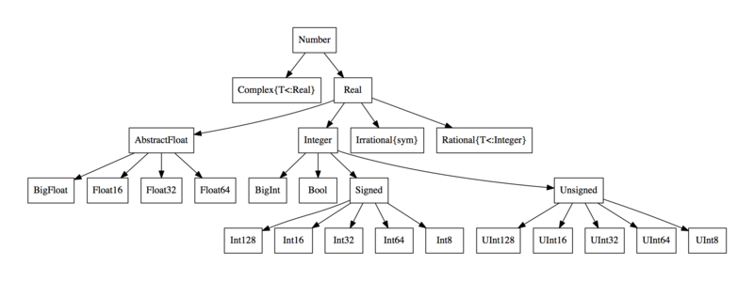
Type Hierarchy
Ref:https://en.wikibooks.org/wiki/Introducing_Julia/Types

Slide 8
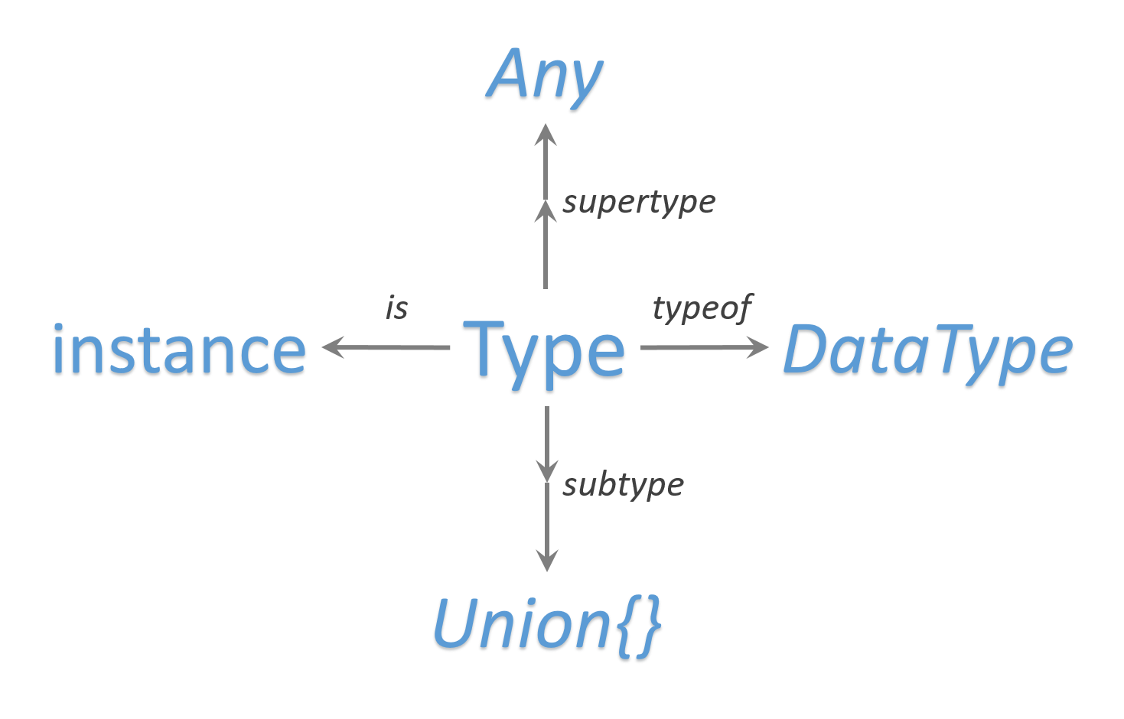
Type Hierarchy

Slide 9
Type System
動態的，但擁有一些靜態型別系統的優點
函式參數不加上型別，參數會被設成Any，加上型別可以增加效能跟系統的穩健性
參數化型別可以實現generic type
型別系統是以階層式（hierarchical）架構建立的，明確描述型別之間的關係

Slide 10
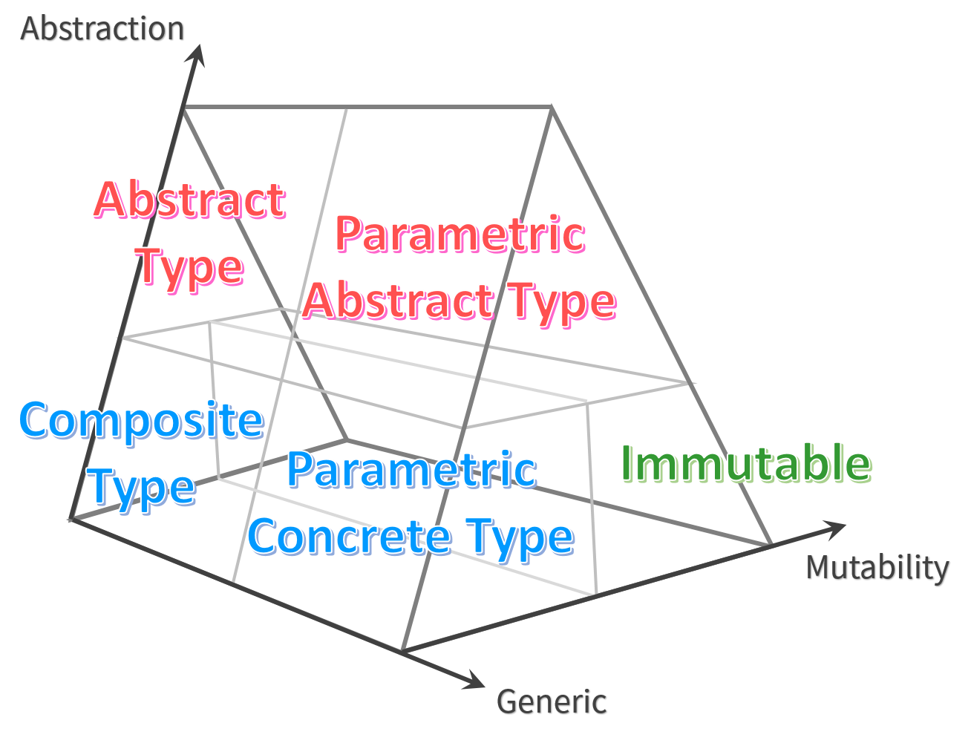
Type System
Union
Tuple

Slide 11
Algebraic type
Tuple
(1, 2, 3)
immutable
Union
Union{Integer, AbstractString}
I don't figure out the key scenario to use it……

Slide 12
The "nothing"
The singleton of type Void, the only object belongs to the type Void.
While function does not return, it returns nothing!

Slide 13
Union{Integer, Void}?
No! Nullable!
Sometimes, you are not sure a function gives a result, then you can use Nullable.

Slide 14
However…
Single inheritance
Abstract types cannot be instantiated.
Concrete types cannot be inherited.
So concrete type can only be the leaf in the hierarchy.

Slide 15

http://www.quickmeme.com/meme/36besu

Slide 16
It cannot be reused!
The major reason to use object-oriented programming is reusability.
However……
Behaviors are not inherited.
Fields are not inherited.
It cannot be reused!!

Slide 17
Hopefully, we have……
Parametric type
Multiple dispatch

Slide 18
Parametric type
The generic programming of Julia
It help draw out the type of fields.
Flexibility and constraints
type Coordinate{T <: Integer}
x::T
y::T
end

Slide 19
Before talking about multiple dispatch…
Let's review polymorphism!

Slide 20
Polymorphism
Dog and Cat have voice.
But their voices are different!
Subclass繼承superclass的method，method會依據不同的subclass有不同的行為
Animal
Dog
Cat

Slide 21
Polymorphism
polymorphism不只是單單放在物件導向的繼承上，只要符合同樣的function會依據不同型別而有不同行為就算
若是依據維基百科的定義：
Polymorphism is the provision of a single interface to entities of different types.
多型為不同型別的實體提供了單一介面
C++的函式多載（function overloading）跟運算子多載（operator overloading）

Slide 22
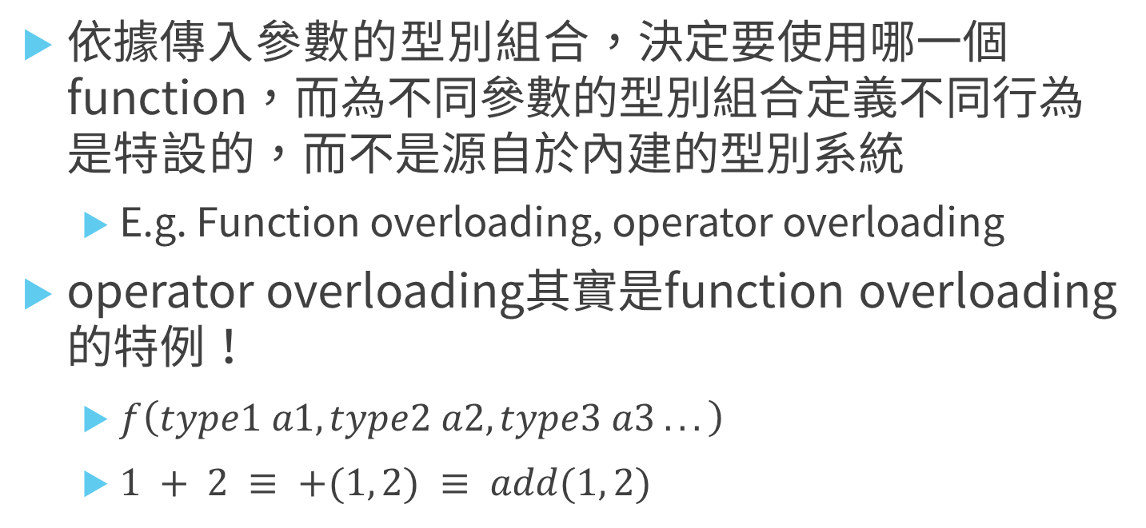
Ad hoc polymorphism
依據傳入參數的型別組合，決定要使用哪一個function，而為不同參數的型別組合定義不同行為是特設的，而不是源自於內建的型別系統
E.g. Function overloading, operator overloading
operator overloading其實是function overloading的特例！
$f\left(type1 a1, type2 a2, type3 a3 ...\right)$
$1 + 2 ≡ +(1, 2) ≡ add(1, 2)$

Slide 23
Parametric polymorphism
parametric polymorphism提供一種行為框架，直接定義一個function，然後依據傳入的型別做操作
E.g. C++的template (但是他定義的是data type而不是function)
泛型（generic programming），就是parametric polymorphism的一種表現方式
在其他語言中generic functions

Slide 24
Subtyping
The type of polymorphism in OOP.
Subclass 繼承了superclass的method介面，但是實作是依據subclass的method內容
我們通常把subclass當成superclass的子型別（subtype）

Slide 25
Multiple dispatch
It deals with “how to choose a function?”
for number
double
args
for string
double

Slide 26
Single dispatch
or dynamic dispatch
Python code
class Foo:
...
def double(x):
return 2*x
class Bar:
...
def double(x):
return str(x)*2
double
Foo
args
double
Bar

Slide 27
Back to multiple dispatch
double
Julia code
function double(obj::Foo, x)
return 2*x
end
function double(obj::Bar, x)
return string(x)*2
end
(obj::Foo, x::Any)
args
double
(obj::Bar, x::Any)

Slide 28
You can add/override them easily.
function double(obj::Foo, x)
return 2*x
end
function double(obj::Bar, x)
return string(x)*2
end
Open-close principle
function double(obj::Bar, x)
return “2”*x
end

Slide 29
Parametric method
Generic function
function compare{T <: Real}(x::T, y::T)
if x > y
return 1
elseif x == y
return 0
else
return -1
end
end

Slide 30
Parametric method
聰明的設計讓multiple dispatch替你"回答問題"
same_type{T}(x::T, y::T) = true
same_type(x, y) = false
same_type(1, 2) # true
same_type(1, 2.0) # false

Slide 31
避免模糊語意
g(x::Float64, y) = 2x + y
g(x, y::Float64) = x + 2y
g(x::Float64, y::Any) = 2x + y
g(x::Any, y::Float64) = x + 2y

Slide 32
從精確到廣泛是個好順序
g(x::Float64, y::Float64) = 2x + 2y
g(x::Float64, y) = 2x + y
g(x, y::Float64) = x + 2y
g(2.0, 3) # 7.0
g(2, 3.0+) # 8.0
g(2.0, 3.0) # 10.0

Slide 33
Constructors
要建構一個object，constructor是少不了的
There are 2 major kinds of constructor:
Inner constructor
Outer constructor

Slide 34
Outer constructor
顧名思義，這是一個定義在型別定義之外的constructor，他跟一般的method沒什麼不同
type Foo
bar
baz
End
Foo(x) = Foo(x,x)
Foo() = Foo(0)
Foo(2) # Foo(2, 2)
Foo() # Foo(0, 0)

Slide 35
Outer constructor
你可以很簡單的在型別宣告之外加上很多不同的constructor，如同其他語言的constructor overloading一般
擴充功能的時候很好用

Slide 36
Inner constructor
inner constructor，只能有一個
使用`new`是inner constructor的特權
type OrderedPair
x::Real
y::Real
OrderedPair(x, y) = x > y ? error("out of order") : new(x, y)
end

Slide 37
Outer and inner constructor
Inner
Outer
Outer
Outer

Slide 38
Parametric Constructors
Constructor can be parametric!
type Point{T<:Real}
x::T
y::T
Point(x, y) = new(x, y)
end
Point{T<:Real}(x::T, y::T) = Point{T}(x, y)
type Point{T<:Real}
x::T
y::T
end
=

Slide 39
Break!
Next, the OOP in Julia!

Slide 40
OOP in Julia
先來複習一下：
Encapsulation (封裝): 定義fields跟methods，甚至存取權限
Inheritance (繼承): 組織類別之間的關係，以便重用
Polymorphism (多型): 使可以同樣的methods根據不同的類別展現出不同的行為

Slide 41
Julia的哲學
Polymorphism
Multiple dispatch佔了重要的角色
解耦子型別繼承了不想要的方法
Inheritance
Julia的型別系統佔了重要的角色
只描述型別之間關係，而非實作
Encapsulation
若是中介的隱私狀態是不需要的，那封裝也是不需要的！

Slide 42
以往OOP方式
Subtyping + single dispatch
E.g. C++, Java, Python……

Slide 43
但是subtyping通常會有個問題……
當inheritance發生的時候，superclass的行為都會被subclass繼承，如此一來，確認superclass跟subclass的關係就需要無比精確，不然subclass就會繼承到不必要的行為
有些語言設法將method綁定在class上的作法打破，像是Swift、Scala或Rust，用trait

Slide 44
精巧設計
Parametric polymorphism + multiple dispatch
E.g. Julia, Common Lisp (?)
Subtyping
面對一個類別並定義他的行為
Julia
希望你在定義行為的時候考慮到整個type hierarchy，你需要對某群 (特定範圍)的type定義行為
善用泛型，讓你在定義行為的時候可以收放自如

Slide 45
OOP in Julia style
abstract Animal
immutable Dog <: Animal
color::AbstractString
species::AbstractString
end
immutable Cat <: Animal
color::AbstractString
species::AbstractString
end

Slide 46
OOP in Julia style
function color(a::Animal)
return a.color
end
function voice(d::Dog)
return "bark"
end
function voice(c::Cat)
return "meow"
end

Slide 47
OOP in Julia style
d1 = Dog("yellow", "Labrador")
voice(d1) # "bark“
c1 = Cat("brown", "?")
voice(c1) # "meow"

Slide 48
OOP in traditional style
type Foo
bar::Int64
baz::Function
function Foo(x::Int64)
this = new()
this.bar = x
function baz(input::AbstractString)
println(input)
end
function baz(input::Int64)
println(input * 10)
end
this.baz = baz
return this
end
end

Slide 49
OOP in traditional style
foo = Foo(10)
foo.bar # 10
foo.baz("Hello world!") # Hello world!
foo.baz(5) # 50

Slide 50
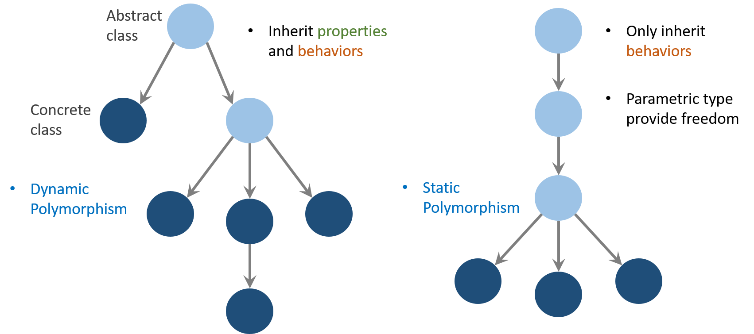
Julia’s object vs OOP

Slide 51
In software engineering aspect…
Separation of interface and implementation is an important issue…
It is born with it!

Slide 52
Abstract type as an interface
bar()
Foo
abstract Foo
function bar(obj::Foo, x)
……
end

Slide 53
Method signature as an interface
bar()
Foo
function bar(obj::Foo, x)
end

Slide 54

Julia tastes good!
http://images.clipartpanda.com/taste-clipart-dT8oABxEc.jpeg

Slide 55
What kind of language Julia belongs to?
We usually say that Java and Python are object-oriented languages.
So, how about Julia?
Julia majors in metaprogramming, and minors in object-oriented programming.

Slide 56
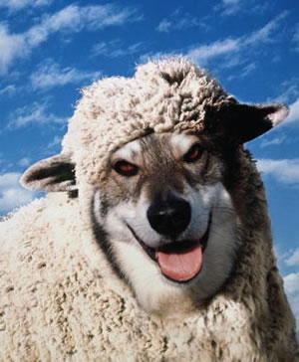
Object-oriented programming
metaprogramming
https://img.xiaomac.com/playes/2007/0305008E9.JPG

Slide 57
Elegant but complicated type system

Slide 58
Programming paradigms
Pseudo-object-oriented programming
Functional programming
Metaprogramming

Slide 59
Q&A

Slide 60
Thank you for attention

