Slide 1
Drought, Wildfire, and Groundwater Interpretation of the US and Colorado
Luke Mazza, Thomas Ho, Aiden Hamre, Aaron Jimenez

Slide 2
Topic Background and Overview
Two separate groups, groundwater and drought was one and wildfires the other
Through discussion we all believed our topics were related
Groundwater is a critical component of agriculture in the
Castle Rock and South Metro, CO which lack large bodies of water depend on groundwater
Both of those areas also suffer from drought/wildfires
Has caused billions of dollars in damages to the US, specifically the American West in recent decades

Slide 3
Hypothesis: The fluctuation and severity of each of these events are intrinsically linked and are following a trend of increasing severity and prevalence.
Droughts, Wildfires, and Groundwater have recently had increasing importance in Western US
Initial predictions:
Drought Prevalence and groundwater depletion have high correlation
Droughts create ideal wildfire conditions
Ample groundwater would mean less wildfires
Analyzing data from USA/CO will prove or disprove hypothesis
Compare trends between the US and CO to determine any common indicators for the events
Hypothesis and Reasoning

Slide 4
Datasets Descriptions
USGS National Groundwater Monitoring Network
Datasets extracted from a map system with differing sites from colorado.
Good for pinpointing/analyzing specific areas/cities
Poor at gaging large-scale trends.
Very difficult to work with in code..
United States Drought Monitor
Comprehensive/DSCI Drought statistics
CSV format
Weekly Measurements taken from 2000 - current
Easy to extract and analyze. .
Department of Agriculture
Monitoring Trends in Burn Severity (MTBS) project dataset (CSV).)
Measurements of every US fire. (beginning in the 1980s)
Dataset modification in Excel was required
Large dataset (>1 GB). Data filtering to fit timescale/region was necessary.
National Centers for Environmental Information
National Interagency Fire Center (NIFC) Wildfire Dataset.
Data was easy to extract/analyze. Available data from January 2000 - March 2023.

Slide 5
Description of Data Analyzation Techniques
Python third party libraries
Numpy - Computational/numerical methods applied to datasets. Datetime conversions.
Sci-kit learn - Mean-trend evaluation
Matplotlib - Plotting analyzed data
Pandas - Dataset reading, grouping, and splitting
Analyzation Techniques:
Data assorted from oldest-newest and plotted as a function of time to detect trends.
Data grouped by month or year to help visualize more apparent trends.

Slide 6
Limitations and Weaknesses to our Approach
Time comparison, one data set is by month(fire), while drought is done by week, and groundwater was inconsistent throughout.
Generalizes Entire US which is an inaccurate representation of the US and the rate or intensity of wildfires each state may experience.
Due to time constraints unable to accurately compare or identify regions with high accuracy.
Groundwater data covered less time than drought and wildfire

Slide 7
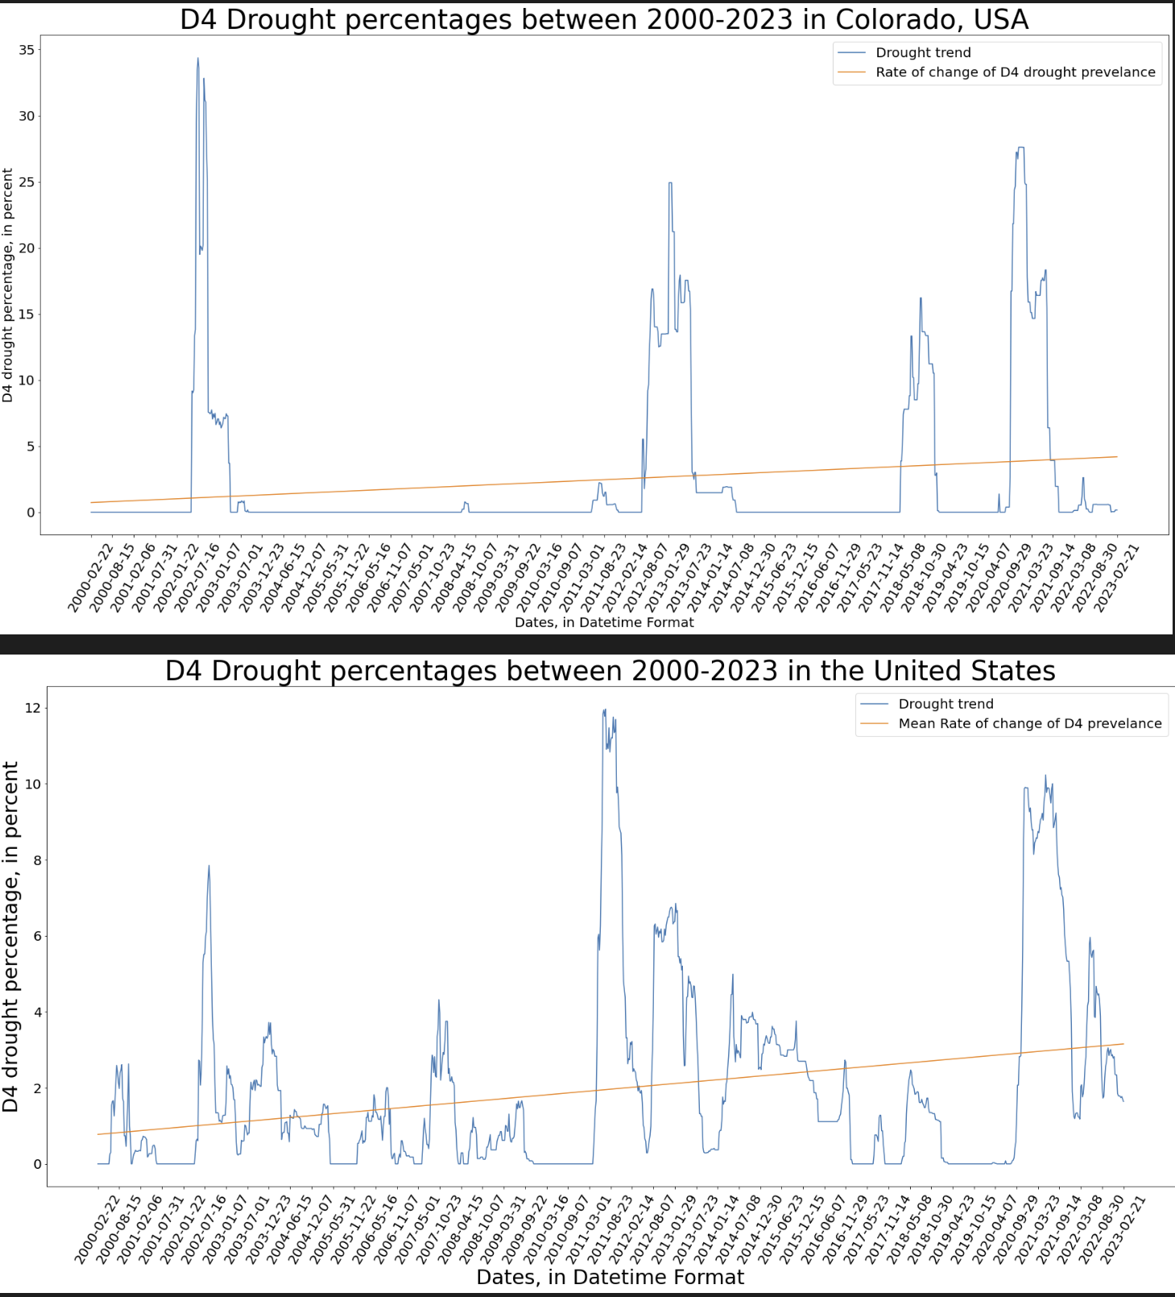
First point
Figure 1, D4 drought in Colorado/USA

Slide 8
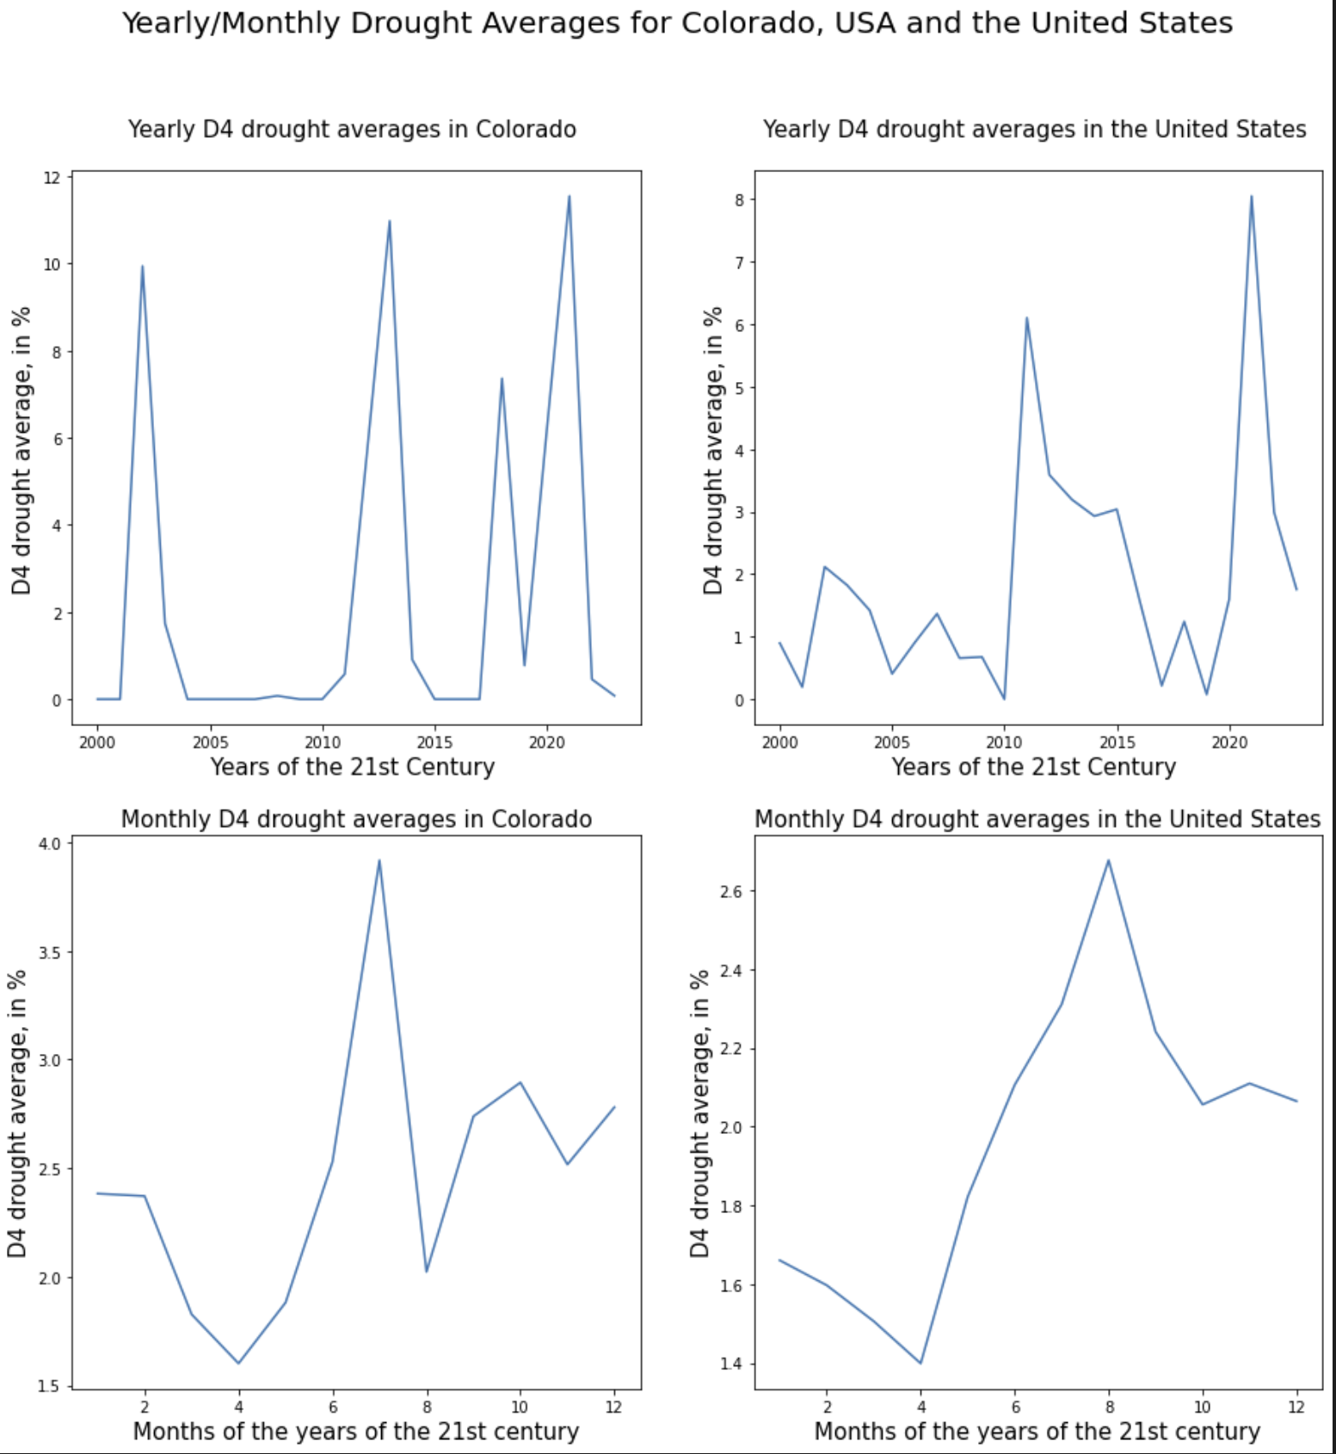
Figure 2, Yearly/Monthly D4 drought averages in USA/Colorado

Slide 9
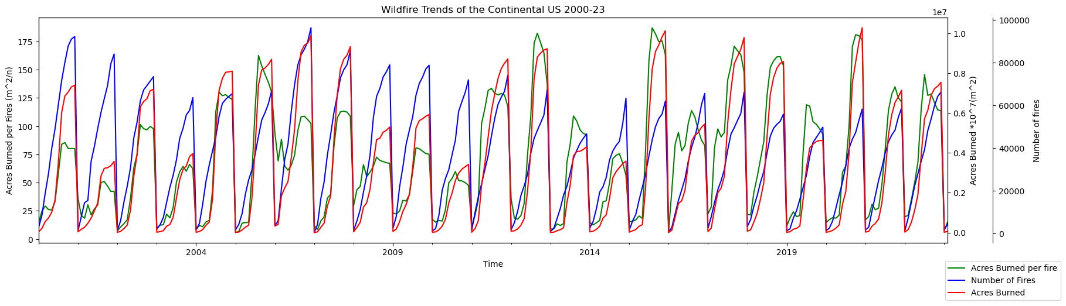
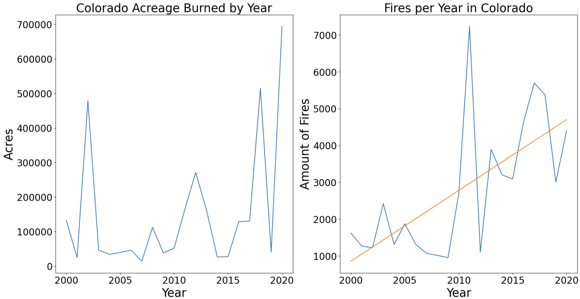
Figure 3, Number of fires, burned Acreage, and Acreage burned per fire in the US.
Figure 4,
Acreage Burned, and Fires per year in Colorado, USA

Slide 10
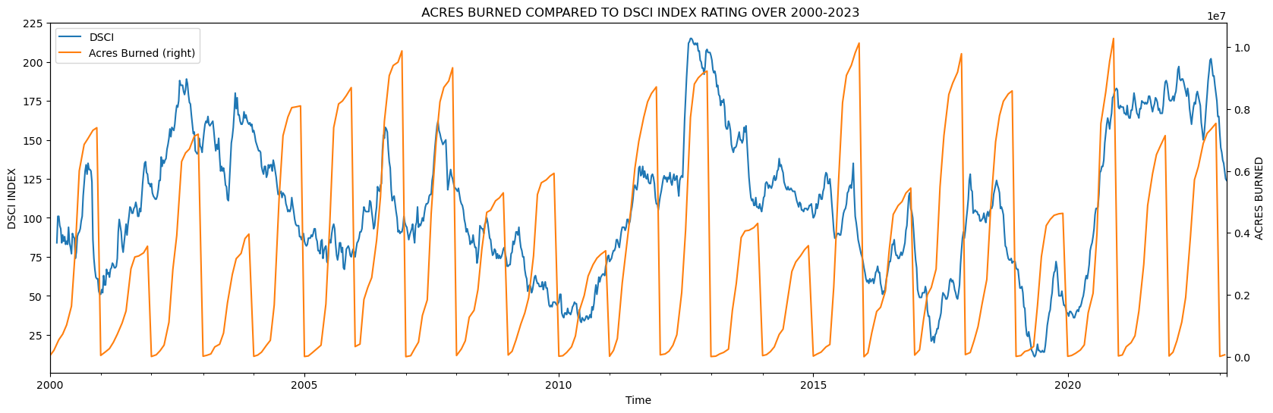
‘Peaks’ of Wildfire/Drought in the United States between 2000-2023
Major Peak Years(wildfire) | 2007 | 2008 | 2012 | 2016 | 2018 | 2021
Major peak years (drought) | 2002 | 2011 | 2012 | 2020 | 2021
Figure 5, DSCI drought index compared to Acres burned per year in the United States

Slide 11
‘Peaks’ of Wildfire/Drought in Colorado between 2000-2023
Major Peak Years(wildfire) | 2002 | 2012 | 2018 | 2020
Major peak years (drought) | 2002 | 2012-2013 | 2018 | 2020-2021
Colorado/USA D4 average drought prevalence statistical summary
USA
2000s: 1.05%
2010s: 2.20%
2020-2023: 4.07%
Colorado
2000s: 1.21%
2010s: 3.39%
2020-2023: 5.75%

Slide 12
Analysis of Drought-fire relation/severity in the United States Versus Colorado
United States
Fire Prevalence Nationwide is affected by more than drought severity
Variation in climate, fire preparedness, and seasonality can skew fire-drought relations across the U.S.
Number of fires are decreasing, yet acreage burned per fire is increasing.
No clear trend in total burned acreage
D4 drought is on the rise and DSCI drought peaks are lengthening
Colorado
Peaks of Drought and wildfire match almost exactly
Smaller scale of land/region lead to more concise matches in trends
Acreage burned + fire numbers are increasing in Colorado
D4 drought increases while peaks are becoming more common and severe.
Colorado has worse drought severity compared to the whole USA.

Slide 13
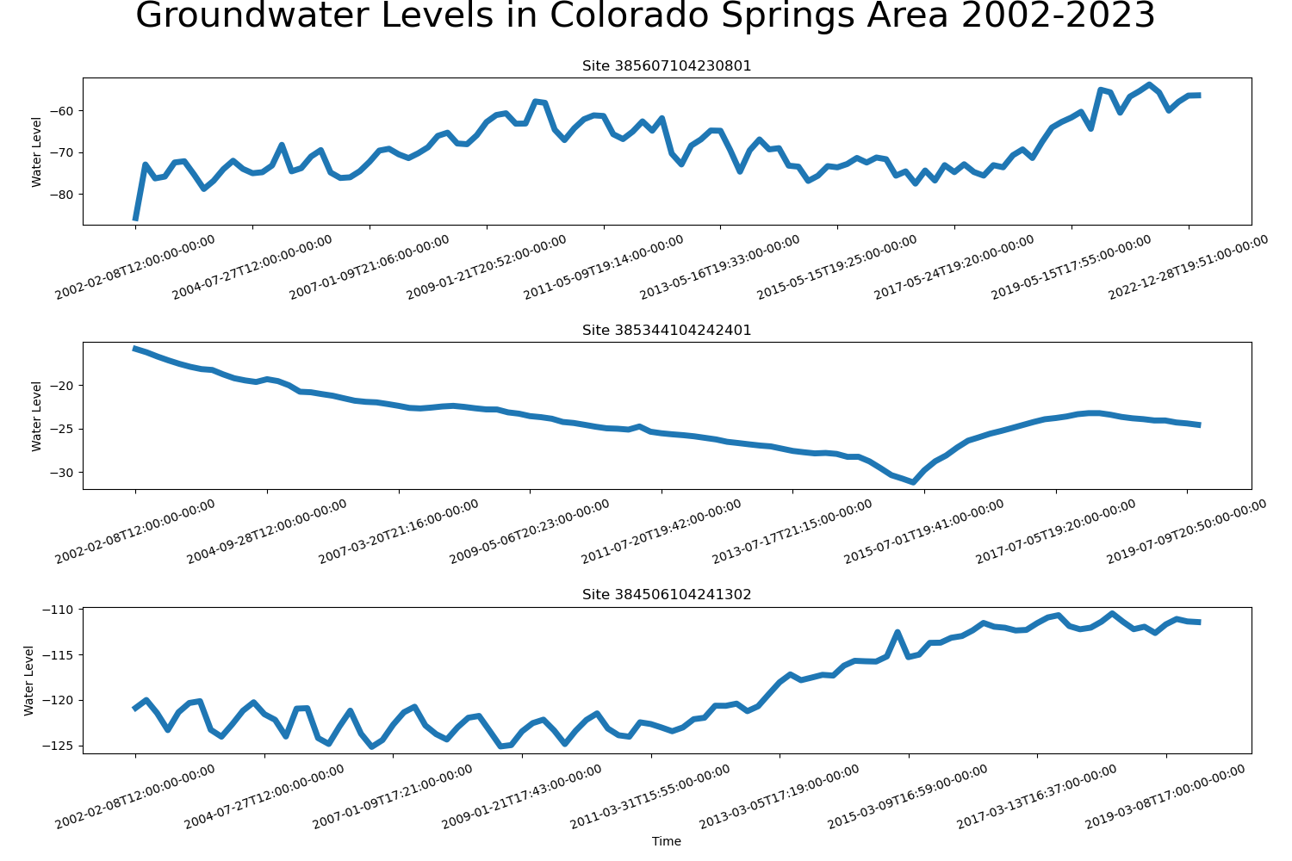
Groundwater in Colorado Springs, Co
Data from well locations near Colorado Springs
Shows no consistent trend for increase or decrease in the past 20 years
Figure 6: USGS groundwater levels in Colorado Springs at different sites.

Slide 14
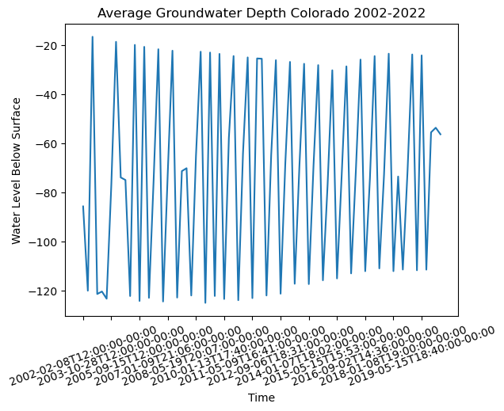
Colorado Groundwater
Visualization/interpretation
Compiled average data from locations all around the state of Colorado
Data show great variation within single years
The data show a small but consistent decreasing trend from 2002 to 2015.
There is very little correlation between groundwater level, drought, and wildfire data
Could fluctuate more based on human impact.
Figure 7: USGS Mean Groundwater Levels of Colorado

Slide 15
Future Research/inquiries
Human impact on groundwater levels.
Does groundwater data at a national scale have a clearer relationship to drought and wildfire?
Prevalence of the same region having repeat wildfires, drought, and low or high groundwater levels
Can humans reduce the severity of these disasters
Other regions of the US and world.
Effect of climate change on these disasters
How do other water source data such as snowpack depth and reservoir levels change in relation to drought and wildfire data?
What natural hazards does groundwater impact
What causes overlapping groundwater sources and what implications do they pose?

Slide 16
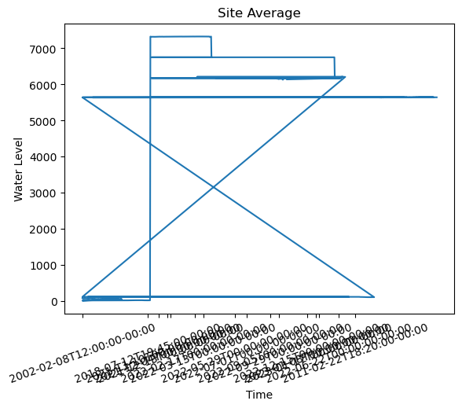
Questions?

Slide 17
Sources:
1- “Current Map: U.S. Drought Monitor.” Current Map | U.S. Drought Monitor, https://droughtmonitor.unl.edu/CurrentMap.aspx.
2- “Groundwater.” Groundwater | Castle Rock, CO - Official Website, https://crgov.com/1792/Groundwater#:~:text=Castle%20Rock%2C%20and%20most%20South,Denver%2C%20Arapahoe%20and%20Laramie%20aquifers.
3- NCEI.Monitoring.Info@noaa.gov. “U.S. Wildfires.” U.S. Wildfires | National Centers for Environmental Information (NCEI), https://www.ncei.noaa.gov/access/monitoring/wildfires/ytd/0.
4-California Department of Forestry and Fire Protection (CAL FIRE). “GIS Data.” Cal Fire Department of Forestry and Fire Protection, https://frap.fire.ca.gov/mapping/gis-data/.
5- “Monitoring Trends in Burn Severity Burned Area Boundaries (Feature Layer).” Catalog, Publisher U.S. Forest Service, 3 Apr. 2023, https://catalog.data.gov/dataset/monitoring-trends-in-burn-severity-burned-area-boundaries-feature-layer-27201.
6- “National Water Information System.” USGS Groundwater Historical Instantaneous Data for the Nation: Build Time Series, https://waterdata.usgs.gov/nwis/uv/?referred_module=gw.

