Slide 1



Visualization Walls Using Commodity Clusters:
Rocks Viz Roll
Student: Aaron Robinson
Advisor: Dr. Bruce Segee
August 7, 2009

Slide 2
Introduction
In 2004, 58% of the Top500 fastest supercomputers in the world were commodity clusters (From RocksClusters.org)... Why?
Cost less than custom architecture
Allow more organizations to enter HPC
Growth in HPC increases data set size and quantity = Rise in visualization demand
Solution: Fusion of commodity clusters and high-resolution data visualization

Slide 3
Related Works
LionEyes Display wall
  12 projectors
  12 dual Xeons w/ NVIDIA Quadro 900 XGL (render)
  2 Xeons w/ NVIDIA Quadro 900 XGL (application)
  Resolution: 4096x2304
Hyperwall-2 (NAS Advanced Supercomputing)
  128 LCD screens
  128 GPUS
  1,024 cores
  74 teraflops

Slide 4
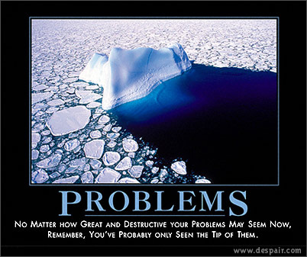
Two Problems
Commodity clusters require computer scientists to rethink:
System Management
Programming Methodology

Slide 5
Rocks Clusters
SQL Database & Master Repository
Back-end nodes connect via PXE or CD
Red Hat Kickstart
Package downloading via torrent
New nodes exchange packages without front-end
Cluster DB used for propagating configuration changes

Slide 6
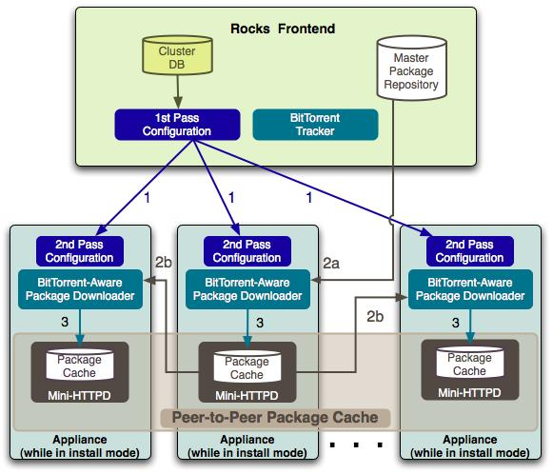

Slide 7
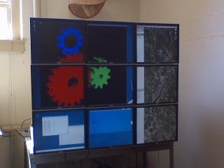
DMX & Xinerama
DMX (Xdmx) = multiple displays from multiple machines
Xinerama = multiple displays unified as single screen

Slide 8
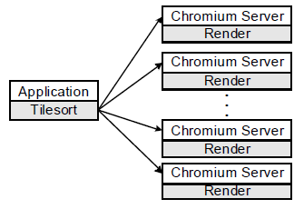
Chromium
Manipulates OpenGL for graphics cluster
Stream Processing Unit (SPU)
Mothership
Tilesort SPU
Render SPU

Slide 9
SAGE
Stream graphics from rendering cluster
Collaborative environment
Components:
Free Space Manager
SAGE Application Interface Library (SAIL)
SAGE Receiver
User Interface (UI)

Slide 10
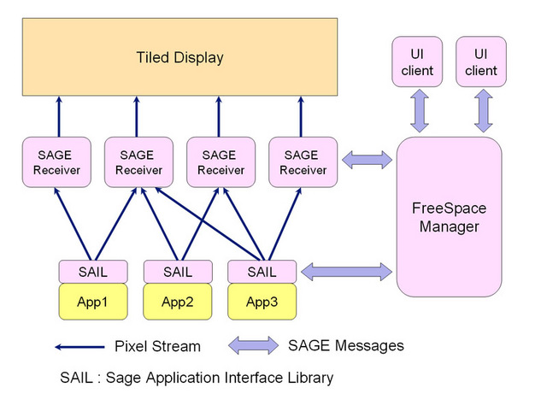

Slide 11
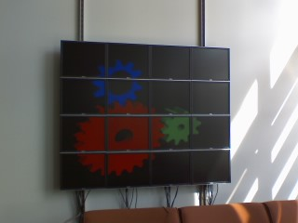
Results
Rocks 4.2.1 – issues
Rocks 5.0
Dual Pentium 3s w/ 3x Geforce4 MX 4000s 128MB (3 nodes)
Core 2 Quads w/ nVidia 8600GT Dual-DVI cards 256MB (2 nodes)

Slide 12
Acknowledgment
We would like to thank the National Science Foundation (Grant 0754951) and the Department of Defense for funding the Supercomputing REU program at the University of Maine.

Slide 13
References
G. Bruno, M. J. Katz, F. D. Sacerdoti, and P. M. Papadopoulos, “Rolls: Modifying a Standard System Installer to Support User-Customizable Cluster front-end Appliances,” presented at IEEE International Conference on Cluster Computing, San Diego, USA, 2004. Available: http://www.rocksclusters.org/rocks-doc/papers/ieee-cluster-2004/paper.pdf. [Accessed: Jul. 20, 2009].
“The Rocks Avalanche Installer,” Jun. 19, 2008. [Online]. Available: http://www.rocksclusters.org/rocks-doc/papers/two-pager/paper.pdf. [Accessed: Jul. 29, 2009].
“Distributed Multihead X Project,” Jun. 13, 2004. [Online]. Available: http://dmx.sourceforge.net/. [Accessed: Jul. 30, 2009]
“Using Chromium with DMX,” Sep. 1, 2006. [Online]. Available: http://chromium.sourceforge.net/doc/dmx.html. [Accessed: Jul. 31, 2009]
“Scalable Adaptive Graphics Environment,” [Online]. Available: http://www.evl.uic.edu/cavern/sage/index.php. [Accessed: Jul. 31, 2009]
“SAGE :: DESCRIPTION,” [Online]. Available: http://www.evl.uic.edu/cavern/sage/description.php. [Accessed: Jul. 31, 2009]

Slide 14

Questions?

