Slide 1
Re-engineering key components of our data processing pipeline
Aaron Robinson

Slide 2


Background
Ion Mobility Spectrum (IMS)
  Software in development
  Large data volumes
Unified Ion Mobility Format (UIMF)
  Data management solution
  SQLite database
  Structured SQL schema
Deisotoping
  Decon2LS used for deconvolution
  Challenges due to fast frame/scan rate
Notes:
Fast scan rate leads to small ion counts because you’re measuring data too fast. AS a result, deisotoping of low abundance features becomes increasingly difficult. So we generally resort to summing across a scan and frame range.

Slide 3
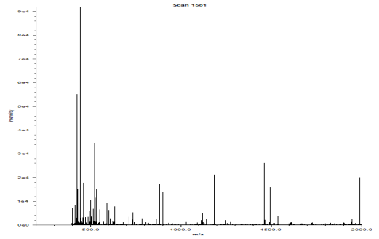
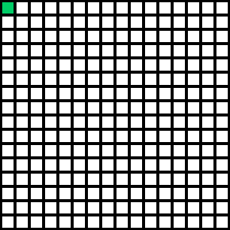
Decon2LS Deisotoping
Bin
Intensity
0
269328
269328
269328
0
298781
…
0
6
6
6
0
20
…
Raw Data:
Scans (IMS)
0
1
2
3
4
5
6
7
8
9
10
11
12
13
14
15
…
1
2
3
4
Area Summed
5
6
7
8
Bins are converted into m/z values
Summing enhances deisotoping
  Provides greater intensities
Sliding window: 3 Frames by 9 Scans
Width = Current Scan + 4
Height = Current Frame + 1
Frames (LC)
9
10
11
12
13
14
15
16
…
UIMF

Slide 4

Decon2LS Deisotoping
Current Scan
Process:
Sum window & deisotope data
Scans (IMS)
0
1
2
3
4
5
6
7
8
9
10
11
12
13
14
15
…
1
Current Frame
2
3
4
5
6
7
8
Frames (LC)
9
10
11
12
13
14
15
16
…
UIMF

Slide 5
Decon2LS Deisotoping
Current Scan
Process:
Sum window & deisotope data
Increment scan & repeat step 1
Scans (IMS)
0
1
2
3
4
5
6
7
8
9
10
11
12
13
14
15
…
1
Current Frame
2
3
4
5
6
7
8
Frames (LC)
9
10
11
12
13
14
15
16
…
UIMF

Slide 6
Decon2LS Deisotoping
Current Scan
Process:
Sum window & deisotope data
Increment scan & repeat step 1
Iterate steps 1-2 over scan range
Scans (IMS)
0
1
2
3
4
5
6
7
8
9
10
11
12
13
14
15
…
1
Current Frame
2
3
4
5
6
7
8
Frames (LC)
9
10
11
12
13
14
15
16
…
UIMF

Slide 7
Decon2LS Deisotoping
Current Scan
Process:
Sum window & deisotope data
Increment scan & repeat step 1
Iterate steps 1-2 over scan range
Scans (IMS)
0
1
2
3
4
5
6
7
8
9
10
11
12
13
14
15
…
1
Current Frame
2
3
4
5
6
7
8
Frames (LC)
9
10
11
12
13
14
15
16
…
UIMF

Slide 8
Decon2LS Deisotoping
Current Scan
Process:
Sum window & deisotope data
Increment scan & repeat step 1
Iterate steps 1-2 over scan range
Scans (IMS)
0
1
2
3
4
5
6
7
8
9
10
11
12
13
14
15
…
1
Current Frame
2
3
4
5
6
7
8
Frames (LC)
9
10
11
12
13
14
15
16
…
UIMF

Slide 9
Decon2LS Deisotoping
Current Scan
Process:
Sum window & deisotope data
Increment scan & repeat step 1
Iterate steps 1-2 over scan range
Scans (IMS)
0
1
2
3
4
5
6
7
8
9
10
11
12
13
14
15
…
1
Current Frame
2
3
4
5
6
7
8
Frames (LC)
9
10
11
12
13
14
15
16
…
UIMF

Slide 10
Decon2LS Deisotoping
Current Scan
Process:
Sum window & deisotope data
Increment scan & repeat step 1
Iterate steps 1-2 over scan range
Scans (IMS)
0
1
2
3
4
5
6
7
8
9
10
11
12
13
14
15
…
1
Current Frame
2
3
4
5
6
7
8
Frames (LC)
9
10
11
12
13
14
15
16
…
UIMF

Slide 11
Decon2LS Deisotoping
Current Scan
Process:
Sum window & deisotope data
Increment scan & repeat step 1
Iterate steps 1-2 over scan range
Increment frame and return to 1st scan
Scans (IMS)
0
1
2
3
4
5
6
7
8
9
10
11
12
13
14
15
…
1
2
Current Frame
3
4
5
6
7
8
Frames (LC)
9
10
11
12
13
14
15
16
…
UIMF

Slide 12
Decon2LS Deisotoping
Current Scan
Process:
Sum window & deisotope data
Increment scan & repeat step 1
Iterate steps 1-2 over scan range
Increment frame and return to 1st scan
Repeat steps 1-4 until the whole UIMF file is traversed
Scans (IMS)
0
1
2
3
4
5
6
7
8
9
10
11
12
13
14
15
…
1
2
3
4
5
6
7
8
Frames (LC)
9
10
11
12
13
14
15
16
Current Frame
…
UIMF

Slide 13
Shortcomings
This data was re-read 27 times!!!
Re-reading of spectra data
  Up to 6x required reads
Reconverting bins to m/z values
  Multiple calls to Math.Pow()
  No dynamic programming
Scans (IMS)
0
1
2
3
4
5
6
7
8
9
10
11
12
13
14
15
1
2
3
4
5
6
Raw Data:
7
8
T = Bin * BinWidth / 1000
Frames (LC)
Bin
Intensity
9
0
269328
269328
269328
0
298781
…
0
6
6
6
0
20
…
10
11
12
13
14
15
16
UIMF
Notes:
Should I point out all data which was read this much?

Slide 14

UIMF Library Improvements
Spectra caching
  Data is only read once
  All scans are cached per frame range
  2x List<List<int[]>>
    Bins & Intensities
Bins to m/z values caching
  T values and powers calculated once
  Dynamic programming implemented
Notes:
Estimate spectra cache: ~64.6mb = 8 * 4700 * 600 * 3 (2*sizeof(int)*avg_bins_per_spectra*num_scans*height_of_window)
Worst case spectra cache: ~ 1gb = 8 * 73000 * 600 * 3 (2*sizeof(int)*max_bins_per_db*num_scans*height_of_window)
Both calculated from QC_Shew_noppp_600_100_fr720_th7d_Cougar_rep2
m/z values cache: ~18.3mb

Slide 15

Spectra Caching
Current Scan
First call creates cache
  Frames queried one at a time
  Spectra arrays append to list
  Frames are added to a 2nd list
As sliding window moves
  Trailing frames are removed
  New frames are added
Scans (IMS)
0
1
2
3
4
5
6
7
8
9
10
11
12
13
14
15
…
1
Current Frame
Cache
2
3
4
5
6
7
8
Frames (LC)
9
10
11
12
13
14
15
16
…
UIMF

Slide 16
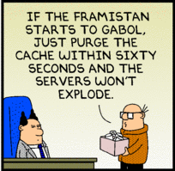
Bins to m/z Values Caching
Two-dimensional Array
  Rows = Number of bins
  Columns = t, t³, t⁵, t⁷, t⁹, t¹¹
Dynamic Programming
  Calculate t and t²
  t³ =t * t²
  t⁵ =t³ * t²
  And so on…

Slide 17
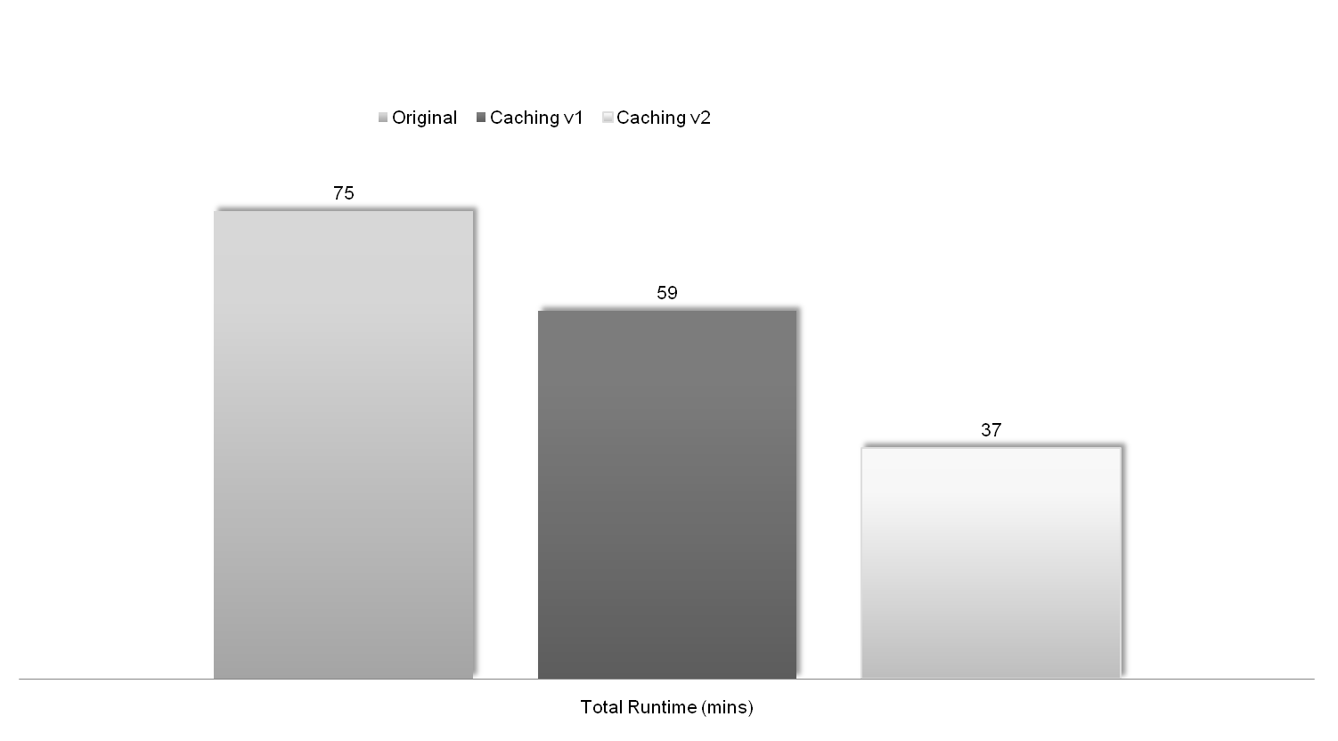
Decon2LS Results
HSer_2pt0_420_100_c2_150um_fr560_Cheetah_0001
Bins: 138000
Disk Space: 804 MB
Frames: 560
Scans: 420
Caching v1: Spectra Caching Schema
Caching v2: Spectra Caching Schema & Powers of T Caching Schema
Notes:
You will have to say why you’re not using THRASH in your comparisons. I guess you know the answer since with THRASH taking more than 90% of the processing time its hard to show what we’ve improved on. The use of RAPID gives that indication. The gains will definitely translate over to THRASH but the run times won’t reduce so drastically. Also the charts are not proportional. 75 minutes is way too bigger than 289 minutes. Correct this figure. Also the graphs should get the most focus, so reduce the font size of the text and make the graphs as big as possible.

Slide 18
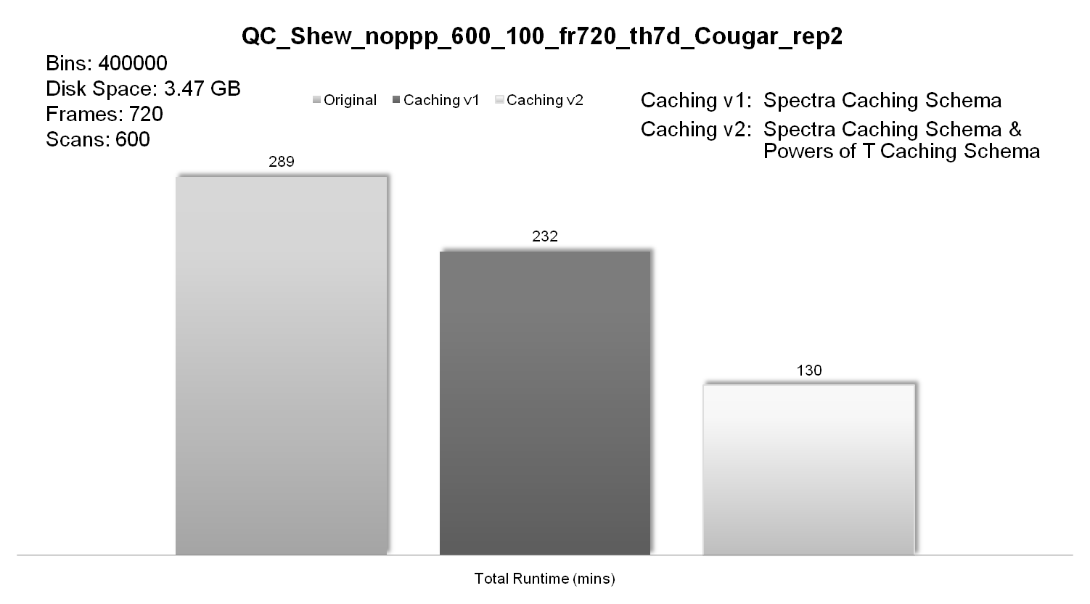
Decon2LS Results

Slide 19
Tradeoffs
Specific data access pattern
  Random access
    Invalid output
Addition memory requirement
  Spectra cache: ~64.6 MB
  T values cache: ~18.3 MB

Slide 20

Acknowledgements
Informatics:
Anuj Shah
Kevin Crowell
Gordon Slysz
Brian LaMarche
Gordon Anderson
SULI Program:
Karen Wieda
Frances Skomurski
Funding:

