Slide 1

Beauty in the Complexity of Sailing
A quick skim through of the vast complexity of a sport that relies on the mysterious powers of the natural world.
By: Aaron Robinson

Slide 2
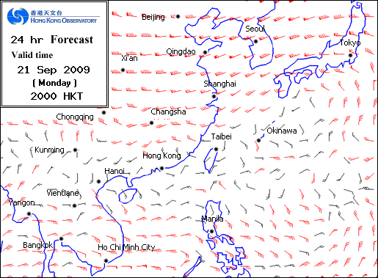
Wind Power
Water bodies and flat land provide low friction for high-speed winds
Wooded areas and rocky formation slow winds and channel their directions

Slide 3
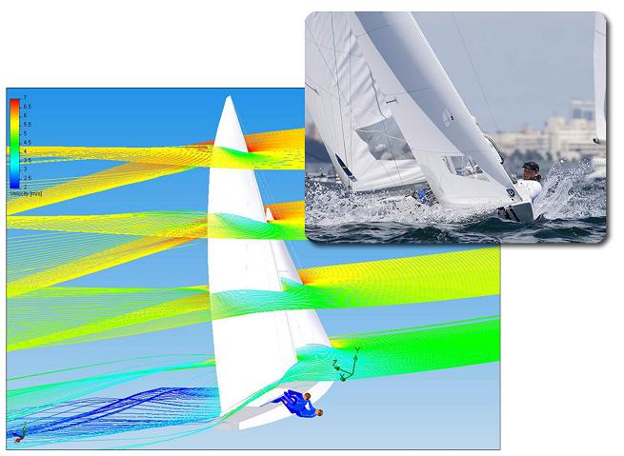
Fluid Dynamics
Winds modeled as fluid
Sails act as airfoils
Multiple sails are arranged to harness power
Jib, Spinnaker, Gennaker, Genoa, etc.
Pushed vs Pulled

Slide 4
Sails

Slide 5
Fluid Dynamics Cont.
Water modeled as fluid
Hulls, Keels, and other structures used to create low friction flow while supporting sails
Objective is to always Balance Forces between the sails and the structure

Slide 6
Hulls

Slide 7
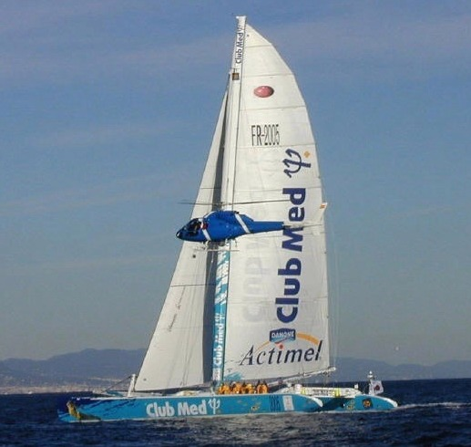
The Race
Round-the-world sailing event with no-rules/no-limits
Ally technology and the environment
Unite maritime cultures while promoting creativity

Slide 8
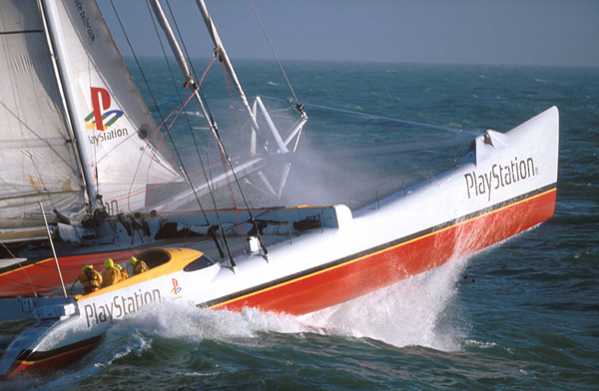
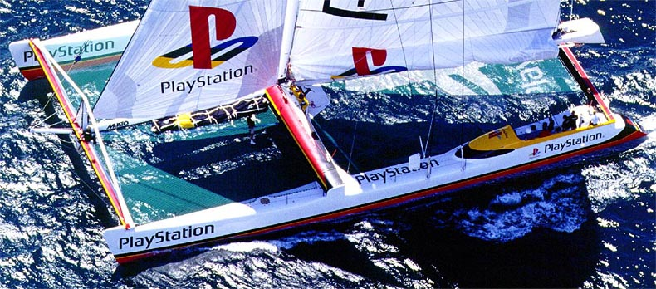
Team PlayStation
Withdrew from “The Race” on Day 16
Round the world record of 58 d. 9 h. 32 m. and 45 s.
Launched with 105 ft length but lengthened to 125 ft to avoid pitch pole.

Slide 9
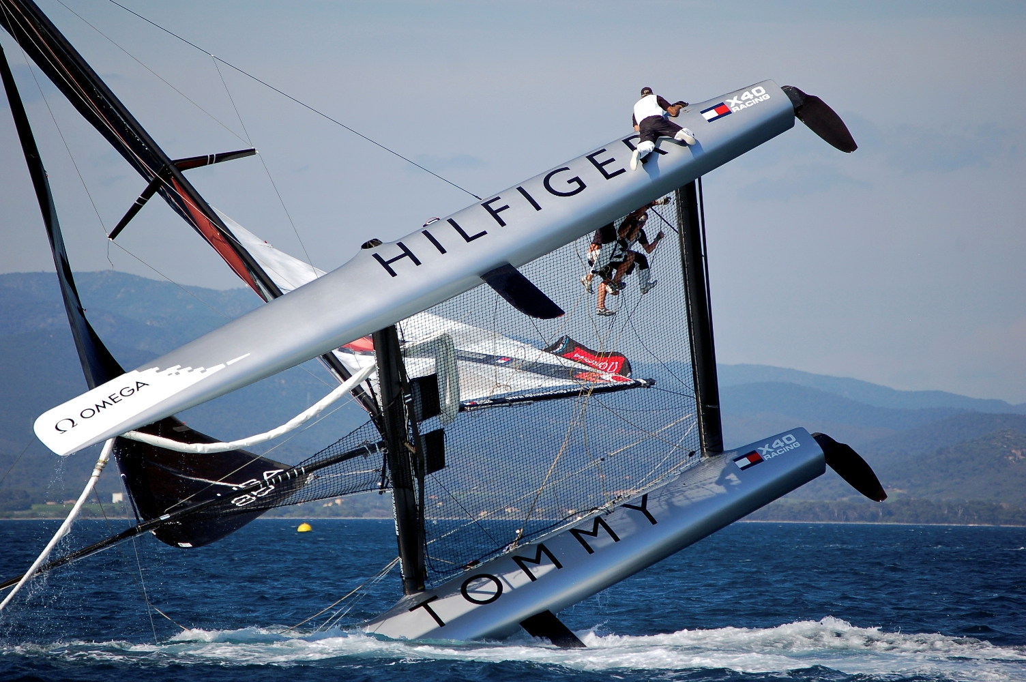
A Pitch Pole

Slide 10
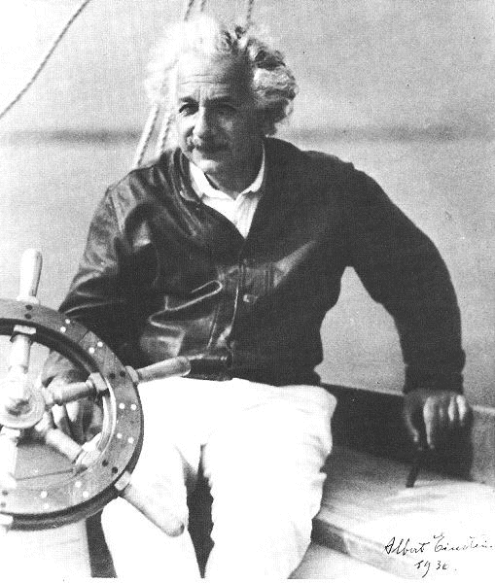
Einstein and Sailing
A sense of wonder for the beauty and complexity in the natural world.

