Slide 1
Cross-Modal Knowledge Distillation for Ultra-Lightweight Edge AI: A Resource-Aware Approach
A Presentation by Aaron Mano Cherian

Slide 2
INTRODUCTION
Edge Computing Paradigm
Multi-Modal Deep Learning
Deployment Challenges
Knowledge Distillation
Research Gaps
Real-time AI at data source with limited resources
(Reduced dependencies on Central Systems)
Processing diverse inputs (visual, audio, sensor)
Resource constraints
& Complexity
Teacher-student approach for model compression
Lack of resource-aware cross-modal knowledge transfer

Slide 3
Research Gaps
Resource constraints in current CMKD approaches
Integration between CMKD and resource-aware computing
Absence of standardized resource utilization metrics
Scalability Issues in Multi-Device Edge AI Networks
Suboptimal Knowledge Transfer in Noisy or Incomplete Data Scenarios
1
2
3
4
5

Slide 4





Motivation
Growing demand for edge computing
Resource constraints
Efficient multi-modal processing
Privacy and latency concerns
Real-Time Monitoring Capabilities

Slide 5
Emotion Recognition
EEG to GSR knowledge transfer
Action Recognition
Effective for limited data scenarios
Literature Review Highlights
Cross-Modal Learning & Knowledge Distillation
Image Processing Supervision transfer approaches
Efficient lightweight models
Contrastive Learning,
Memory-Efficient Feature, Fusion
Efficient Transformers

Slide 6
Feature alignment between modalities
Action CMKD
Multi-teacher approaches Adaptive computation
Edge AI Deployment Challenges:
Computational constraints
Multi-modal processing issues
Energy efficiency concerns
Literature Review Highlights
Edge AI Deployment Challenges:
Computational constraints
Multi-modal processing issues Energy efficiency concerns
Resource-Aware Deep Learning
Neural architecture search
Adaptive computation :

Slide 7
Literature Review: Tabular
Authors/Year | Contribution | Methodology | Key Finding | Relevance to RA-CMKD
Gupta et al. (2016) | Cross-modal supervision transfer | Feature-level distillation | Enables knowledge transfer with limited target data | Foundation for modality-agnostic transfer
Zhao et al. (2020) | Multi-teacher CMKD | Bayesian formulation with prior knowledge | Effective for datasets without superior knowledge | Enables multi-source knowledge fusion
Li et al. (2022) | Edge-optimized transformers | Hardware-aware architecture search | 85% memory reduction with 97% accuracy retention | Directly addresses edge deployment needs
Baltrusaitis et al. (2019) | Multi-modal learning challenges | Taxonomy of 5 core challenges | Identified critical fusion/co-learning bottlenecks | Guides modality interaction design
Han et al. (2020) | Deep compression techniques | Pruning + quantization + Huffman coding | 35-49× model size reduction | Core inspiration for compression module
Yang et al. (2021) | Energy consumption modeling | NeuralPower energy prediction framework | Memory access dominates energy use (70-85%) | Informs energy-aware allocation strategy
Tan et al. (2019) | Resource-aware NAS | Multi-objective optimization | 1.5× better accuracy-latency tradeoff | Basis for adaptive architecture search
Wang et al. (2019) | Automated quantization | RL-based bit-width selection | 4-8× compression with ≤2% accuracy loss | Guides modality-specific quantization
Cai et al. (2020) | Once-for-all networks | Progressive shrinking strategy | 5× latency reduction across devices | Enables hardware-adaptive deployment

Slide 8
Problem Formulation
Cross-Modal Knowledge Transfer for Resource-Constrained Edge AI
Subject-Independent Learning for Multi-Modal AI Systems
Multi-Modal Fusion for Enhanced Representation Learning
Dimensionality Reduction and Feature Compression for Edge Devices
Adaptive Resource-Aware CMKD for Edge AI
Develop efficient KT techniques to distill high-level representations from resource-rich modalities to resource-constrained ones without performance degradation.
Design a robust CMKD framework that generalizes across subjects and real-world conditions, minimizing dependency on personalized data
Implement lightweight feature compression strategies to reduce computational overhead.
Develop a dynamic knowledge distillation framework that adjusts to resource constraints
Integrate diverse sensor modalities through efficient fusion techniques
Feature extraction method
Feature extraction method

Slide 9


SDG
“The most sustainable way is to not make things. The second most sustainable way is to make something very useful, to solve a problem that hasn’t been solved.”
– Thomas Sigsgaard
SDG 9: Industry, Innovation, and Infrastructure
Enabling AI capabilities on existing hardware infrastructure
SDG 12: Responsible Consumption and Production
Extending device lifecycles through software optimization
SDG 7: Affordable and Clean Energy
Minimizing energy consumption for AI operations
Reducing need for hardware upgrades
Reducing e-waste through efficient resource utilization
Enabling AI applications in energy-constrained environments

Slide 10
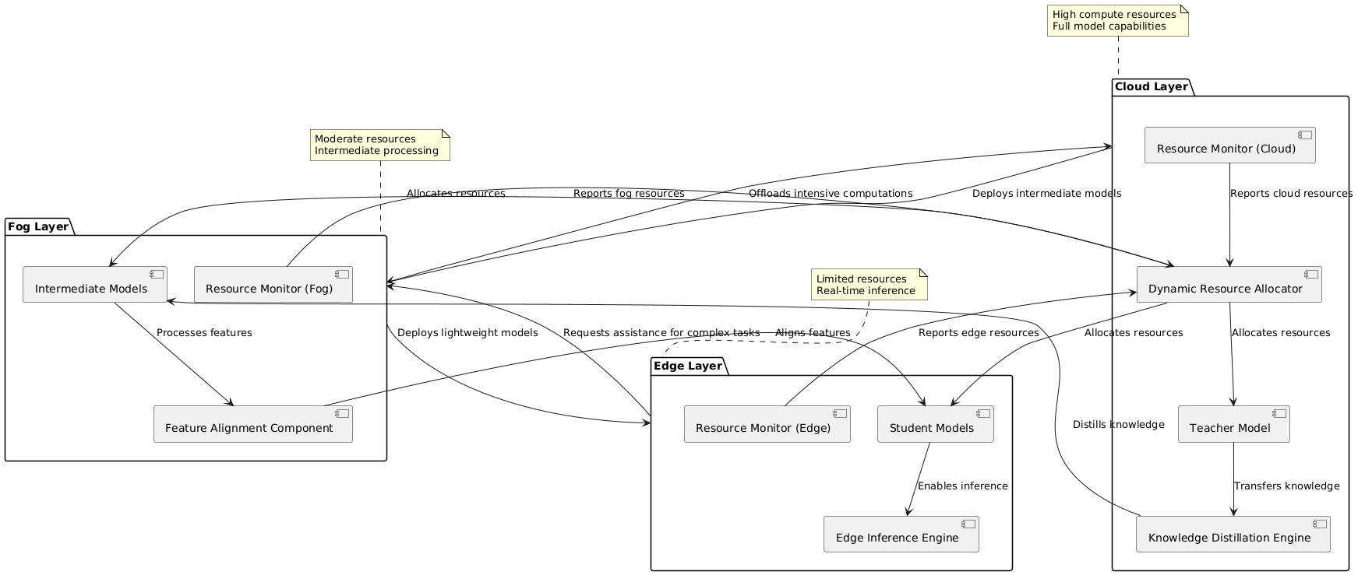
Proposed Architecture Design

Slide 11
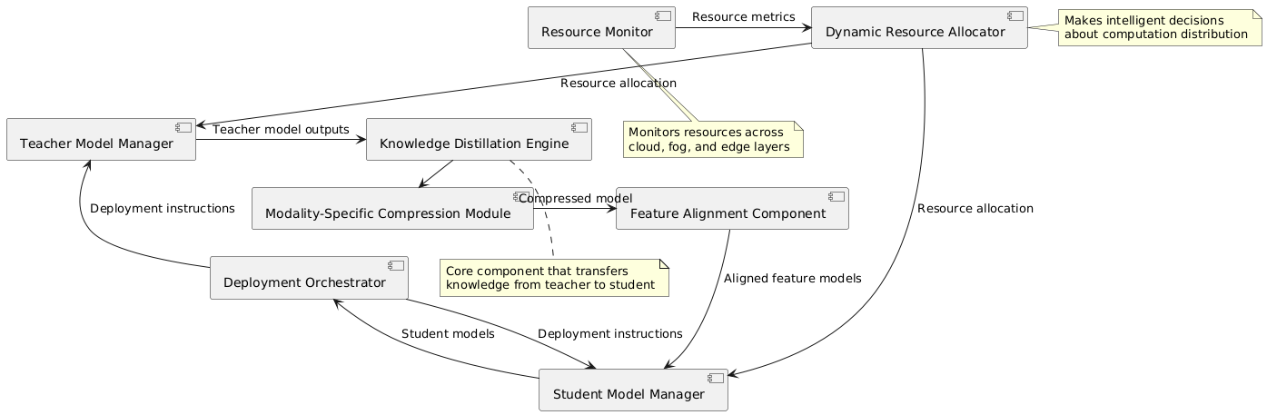
Component Interaction

Slide 12
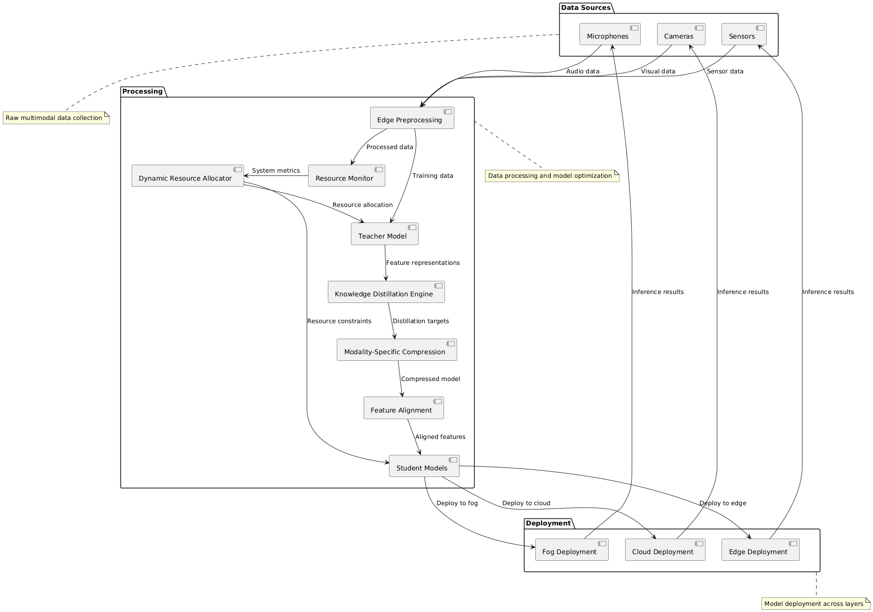
System Data Flow Diagram

Slide 13
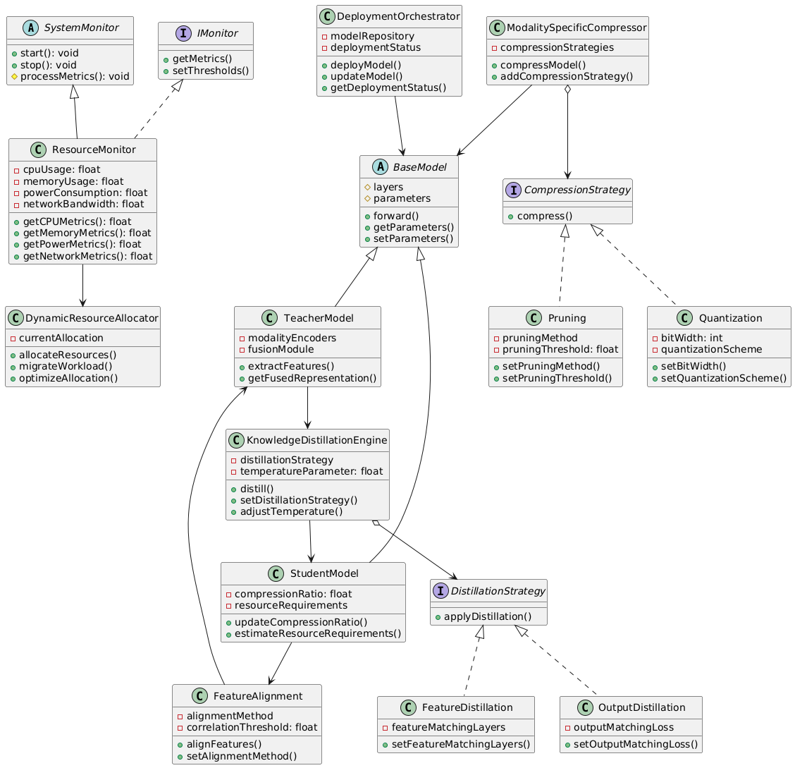
System Class Diagram

Slide 14
Theoretical Description
Create lightweight feature alignment strategy
Feature matching, contrastive learning, latent space optimization
Develop an Adaptive CMKD Loss Function
Develop modality-specific compression techniques
1
balances cross-entropy, knowledge distillation, and feature alignment.
Quantization, pruning, knowledge distillation through TensorRT, OpenVINO, Pytorch FX
Design dynamic resource allocation mechanism
Enable Real-Time Edge Deployment
Adaptive scheduling, real-time optimization using Kuberbnetes & PyTorch Profiler
Optimize inference speed and memory usage
Validate framework through real-world testing
Optimize cross-modal knowledge transfer efficiency

Slide 15
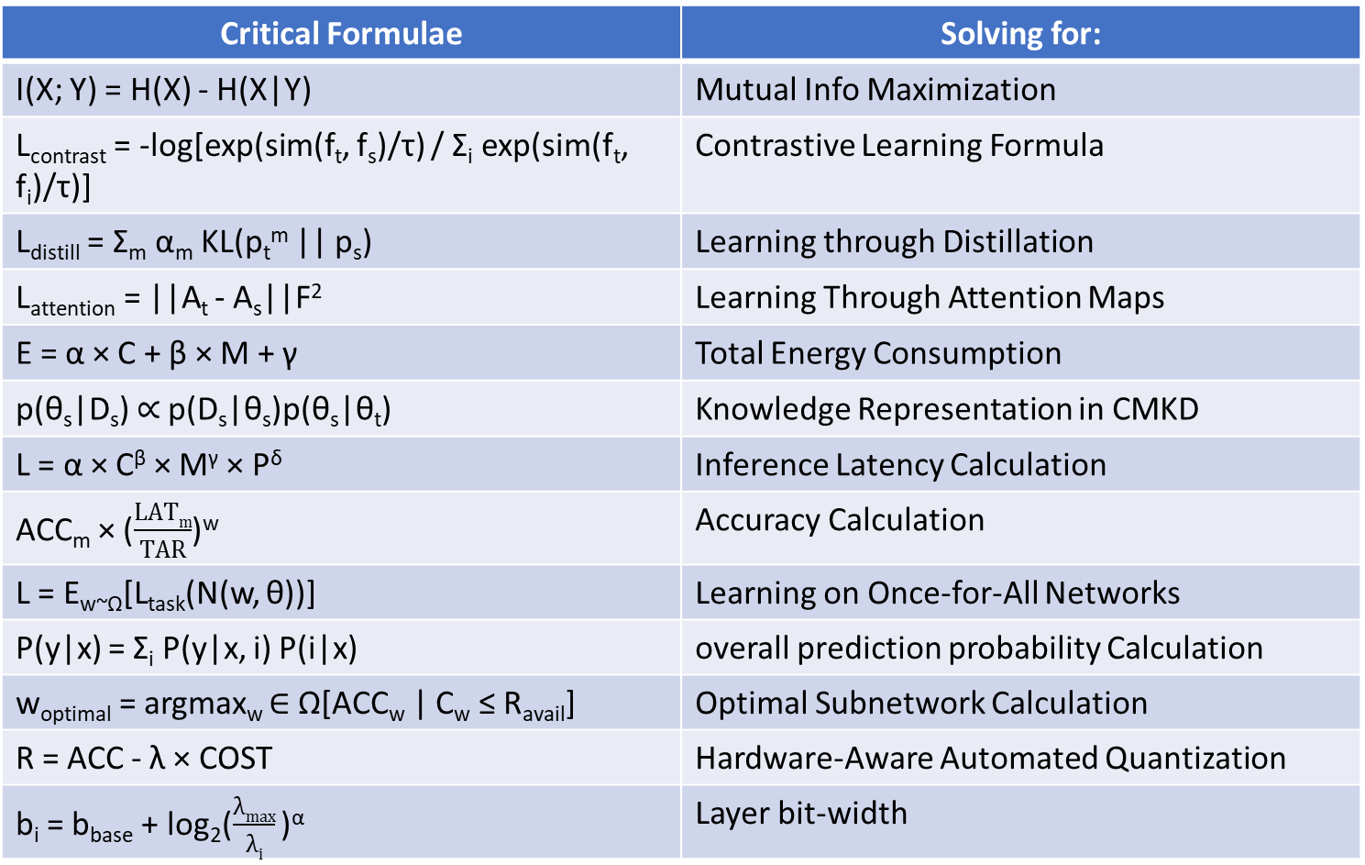
Analytical Description
Critical Formulae | Solving for:
I(X; Y) = H(X) - H(X|Y) | Mutual Info Maximization
L_{contrast} = -log[exp(sim(f_{t}, f_{s})/τ) / Σ_{i} exp(sim(f_{t}, f_{i})/τ)] | Contrastive Learning Formula
L_{distill} = Σ_{m} α_{m} KL(p_{t}^{m} || p_{s}) | Learning through Distillation
L_{attention} = ||A_{t} - A_{s}||F² | Learning Through Attention Maps
E = α × C + β × M + γ | Total Energy Consumption
p(θ_{s}|D_{s}) ∝ p(D_{s}|θ_{s})p(θ_{s}|θ_{t}) | Knowledge Representation in CMKD
L = α × C^{β} × M^{γ} × P^{δ} | Inference Latency Calculation
ACC_{m} × ($\frac{LATm}{TAR}$)^{w} | Accuracy Calculation
L = E_{w~Ω}[L_{task}(N(w, θ))] | Learning on Once-for-All Networks
P(y|x) = Σ_{i} P(y|x, i) P(i|x) | overall prediction probability Calculation
w_{optimal} = argmax_{w} ∈ Ω[ACC_{w} | C_{w} ≤ R_{avail}] | Optimal Subnetwork Calculation
R = ACC - λ × COST | Hardware-Aware Automated Quantization
b_{i} = b_{base} + log₂($\frac{λmax}{λi}$ )^{α} | Layer bit-width

Slide 16
Software tools and Simulation Parameters
Development Environment:
PyTorch (primary deep learning framework)
Hardware Platforms:
Cloud: ROG Zephyrus G14
Datasets:
AV-MNIST (audio-visual)
Multi-modal IoT sensor data
Edge: ROG Zephyrus G14
Fog: ROG Zephyrus G14
TensorRT & OpenVINO (model optimization)
Docker & Kubernetes (deployment)

Slide 17
Results Analysis

Slide 18
Resource Adaptation Performance

Slide 19
Ablation Studies

Slide 20
Conclusion
Performance-Resource Tradeoff
Adaptive Capability
Modality-Specific Optimization
Component Synergy
At medium resource settings, we maintain 95% of the teacher model's accuracy while using only 7.1% of its memory footprint and 13.4% of its computational complexity.
The framework demonstrates robust performance under varying resource conditions, with graceful degradation as resources become constrained, maintaining at least 87.5% of optimal accuracy even under critical resource limitations.
Our compression techniques show differential effectiveness across modalities, with visual data benefiting most from spatial redundancy reduction techniques, while audio data responds better to temporal compression methods.
The ablation study reveals significant performance improvements from the combination of our three key techniques, suggesting strong synergistic effects between dynamic resource allocation, modality-specific compression, and lightweight feature alignment.
Feature extraction method
Feature extraction method

Slide 21
Societal and Environmental Impact
Technological Democratization
Environmental Benefits
Application Domains
Bringing advanced AI capabilities to resource-constrained environments
Enabling innovative applications in developing regions
Reduced energy consumption for AI workloads
Extended hardware lifecycles, reducing e-waste
Lower carbon footprint for AI applications
Healthcare: Lightweight monitoring systems
Smart cities: Efficient IoT analytics
Industrial IoT: Resource-efficient predictive maintenance

Slide 22
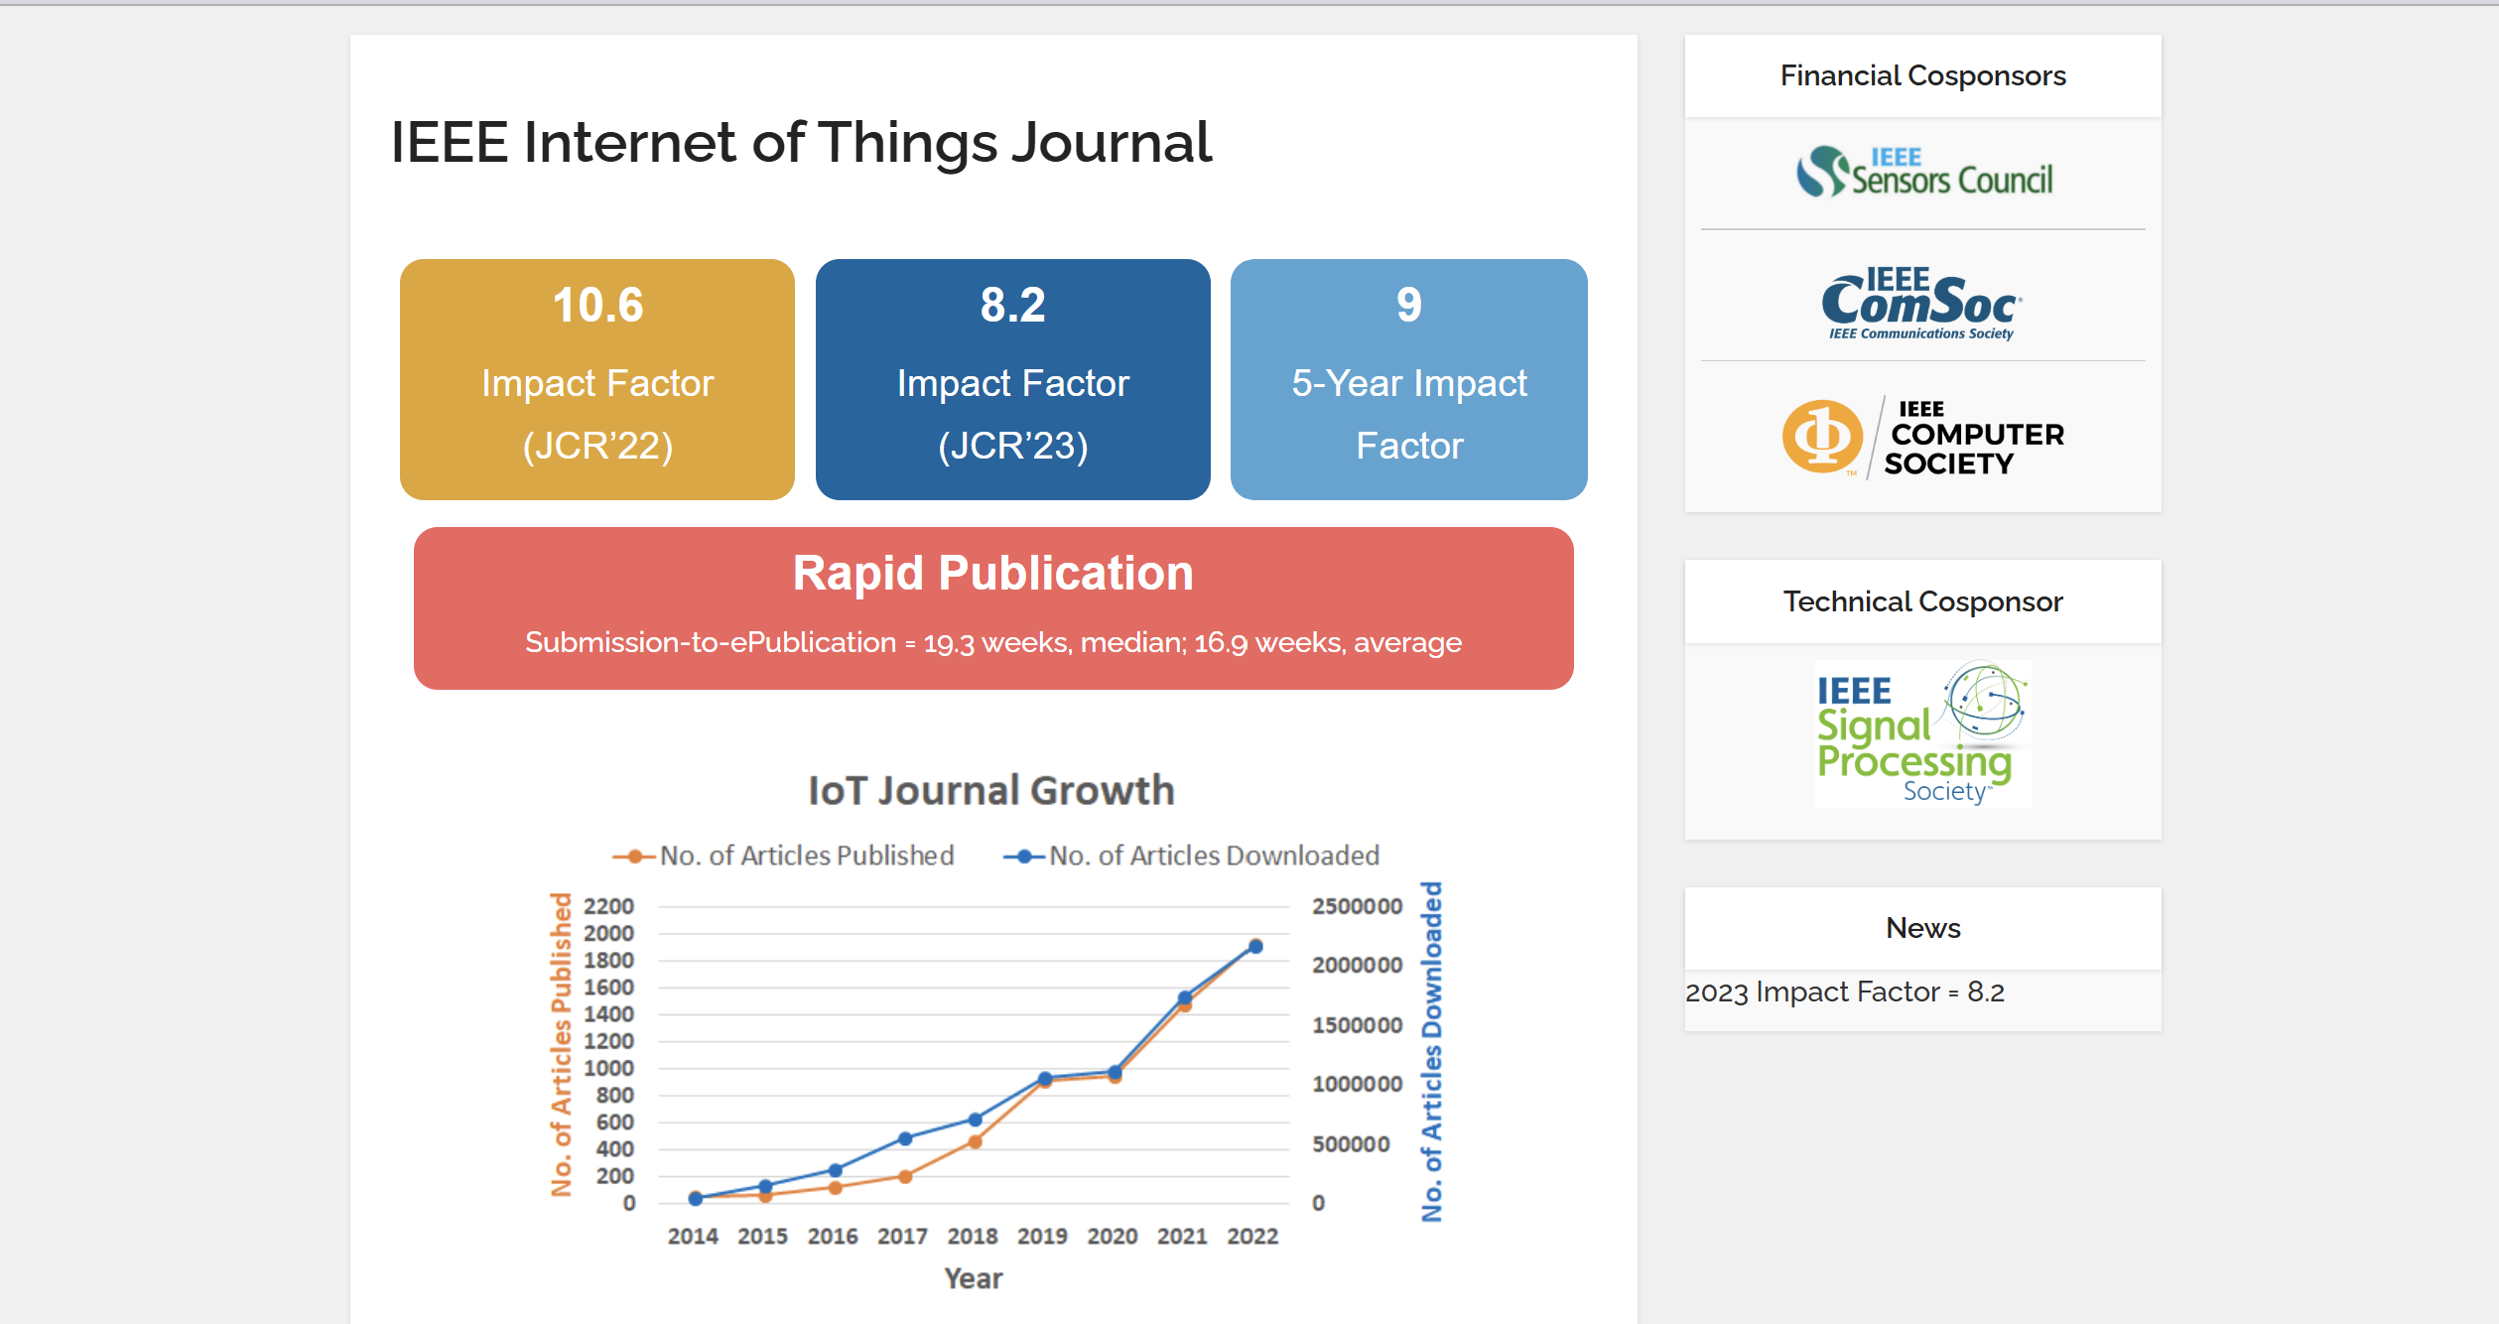
OUTCOME
Target Journal:

Slide 23
References
Zhao, B., Duan, L., Tang, D., Tao, D., & Xu, C. (2020). Knowledge as priors: Cross-modal knowledge generalization for datasets without superior knowledge. Proceedings of the IEEE/CVF Conference on Computer Vision and Pattern Recognition (CVPR), 4835-4844. https://openaccess.thecvf.com/content_CVPR_2020/papers/Zhao_Knowledge_As_Priors_Cross-Modal_Knowledge_Generalization_for_Datasets_Without_Superior_CVPR_2020_paper.pdf
Gupta, S., Hoffman, J., & Malik, J. (2016). Cross modal distillation for supervision transfer. Proceedings of the IEEE Conference on Computer Vision and Pattern Recognition (CVPR), 2732-2740. https://openaccess.thecvf.com/content_cvpr_2016/html/Gupta_Cross_Modal_Distillation_CVPR_2016_paper.html
Liu, Y., Chen, X., Wang, Z., & Zheng, Y. (2023). EmotionKD: A cross-modal knowledge distillation framework for emotion recognition based on physiological signals. ACM International Conference on Multimedia. https://dl.acm.org/doi/abs/10.1145/3581783.3612277
Christian Zimmermann and Thomas Brox. (2017). Learning to estimate 3D hand pose from single RGB images. ICCV, 4903–4911.
Jiawei Zhang, Jianbo Jiao, Mingliang Chen, Liangqiong Qu, Xiaobin Xu, and Qingxiong Yang. (2017). A hand pose tracking benchmark from stereo matching. ICIP, 982–986
Silberman, N., Hoiem, D., Kohli, P., & Fergus, R. (2012). Indoor segmentation and support inference from RGBD images. ECCV.
Deng, J., Dong, W., Socher, R., Li, L.-J., Li, K., & Fei-Fei, L. (2009). ImageNet: A large-scale hierarchical image database. CVPR.
Jhuang, H., Gall, J., Zuffi, S., Schmid, C., & Black, M. J. (2013). Towards understanding action recognition. ICCV.
Zhao, B., Duan, L., Tang, D., Tao, D., & Xu, C. (2020). Knowledge as priors: Cross-modal knowledge generalization for datasets without superior knowledge. Proceedings of the IEEE/CVF Conference on Computer Vision and Pattern Recognition (CVPR), 4835-4844. https://openaccess.thecvf.com/content_CVPR_2020/papers/Zhao_Knowledge_As_Priors_Cross-Modal_Knowledge_Generalization_for_Datasets_Without_Superior_CVPR_2020_paper.pdf
Gupta, S., Hoffman, J., & Malik, J. (2016). Cross modal distillation for supervision transfer. Proceedings of the IEEE Conference on Computer Vision and Pattern Recognition (CVPR), 2732-2740. https://openaccess.thecvf.com/content_cvpr_2016/html/Gupta_Cross_Modal_Distillation_CVPR_2016_paper.html
Liu, Y., Chen, X., Wang, Z., & Zheng, Y. (2023). EmotionKD: A cross-modal knowledge distillation framework for emotion recognition based on physiological signals. ACM International Conference on Multimedia. https://dl.acm.org/doi/abs/10.1145/3581783.3612277

