Slide 1
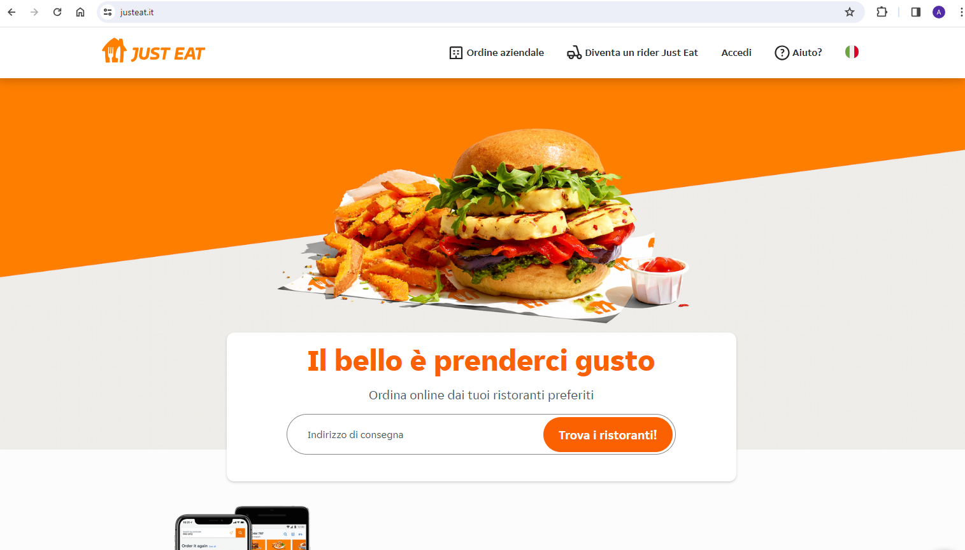
https://www.justeat.it/

