Slide 1
Urban Sound Classification
Chih-Wei Chang & Benjamin Doran
Notes:
1

Slide 2
Overview
Dataset
What is the data
Feature extraction
Models
Types
Variability of data
Overfitting
Accuracy
Notes:
2

Slide 3
Models
Libraries Used:
Sci-Kit Learn
Tensorflow
Librosa(for handling .wav file)
We tested:
Naive Bayes
Random forest
SVM
Deep Neural Networks
Recurrent Neural Networks
Convolutional Neural Networks
Notes:
3

Slide 4
The UrbanSound Dataset
Created by Justin Salamon & Christopher Jacoby & Juan Pablo Bello
Contains 8732 labeled sound excerpts (shorter than 4s) of real field-recording urban sounds from 10 classes : (1).air conditioner, (2).car horn, (3).children playing, (4). Dog bark, (5). Drilling, (6). Engine idling, (7). Jackhammer, (8) gun shot, (9) siren, and (10.) street music.
The largest free urban sound dataset.

Slide 5
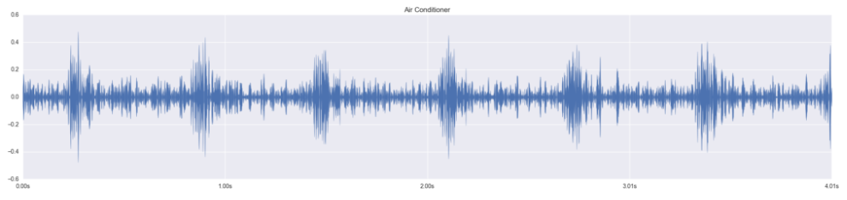
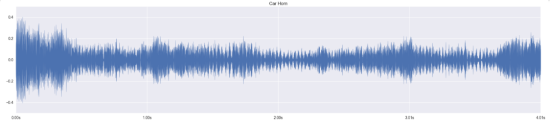
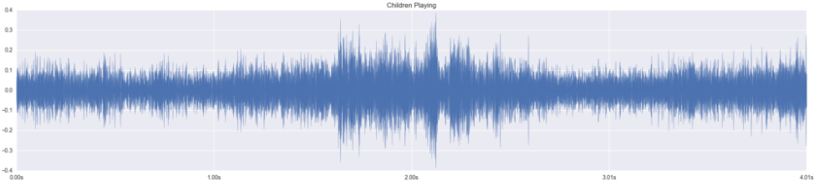
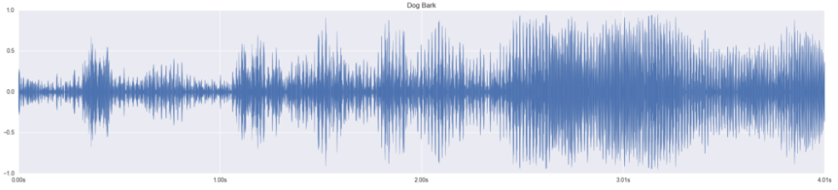
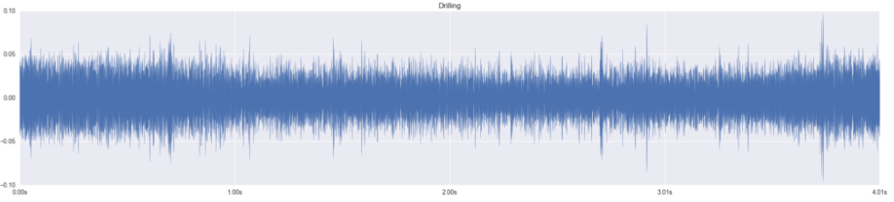
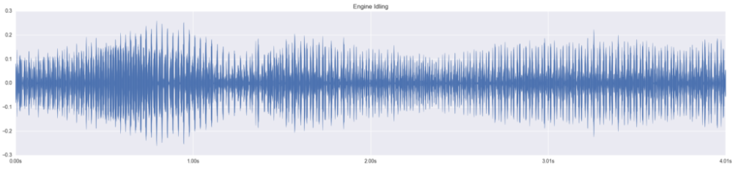
Feature Extraction for Sound Data
Most classification problems have data that can be easily expressed as vector forms. But when it comes to sound data, feature extraction is not straightforward.
Air conditioner
Car horn
Children playing
Dog barks
Drilling
Engine idling

Slide 6
Feature Extraction
Mel Frequencies Cepstral Coefficient (MFCC) are features that is widely in automatic speech and speech recognition.
Steps to extract features include:
1. Frame the signal into shorter frames. (20-40 ms)
2. For each frame, calculate the periodogram estimate of power spectrum
3. Apply the mel filterbank, sum the energy in each filter
4. Take logarithm of the filterbank energy.

Slide 7
Challenge in Feature Extraction
Get equal size of features from sound files of different length, different resolutions, and different number of channel.
Our 3 approaches:
Approach 1: Extract “characteristics” of each sound clips, so the number of characteristics is independent from original data shape.
Approach 2: Zero Padding to make shorter samples longer.
Approach 3: Having different density of filterbanks in each sample.
Shorter samples have denser filterbanks so all the sample can have the same number of filterbanks.

Slide 8
Models Types:
We tested:
Naive Bayes
Random forest
SVM
Deep Neural Networks
Recurrent Neural Networks
Convolutional Neural Networks
Libraries Used:
Sci-Kit Learn
Tensorflow
Librosa (for handling .wav file)
Python_speech_features (for handling .wav file)
Notes:
4

Slide 9
Variability of Data
Data Set | Total Dimensions | Size per Sample
Raw data(not modeled) | 2D | 1D: Variable length
Flattened Zero-padded MFCC | 2D | 1D: 27600 features
193features | 2D | 1D: 193 features
Const_shape MFCC | 3D | 2D:20 rows 41 features
Const_shape LogMFCC | 3D | 2D:20 rows 41 features
Sklearn Is only able to take 2D data, meaning we needed to flatten data such as the MFCC data that gave us additional rows per sample.
Sklearn and TensorFlow are both unable to handle variable sized data meaning we often needed to use zero padding.
Notes:
8

Slide 10
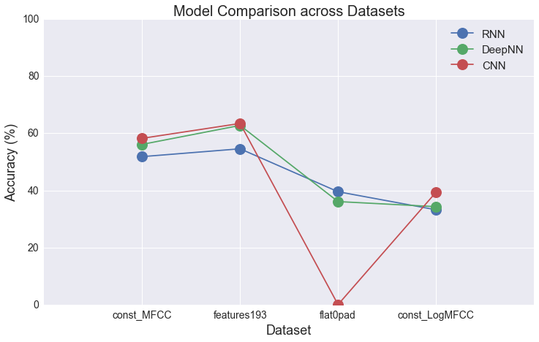
Accuracy
const_MFCC: Random Forest 52%, SVM 55%, NB 20%
feature193: Random Forest 61%, SVM 60%, NB 24%
Notes:
9

Slide 11
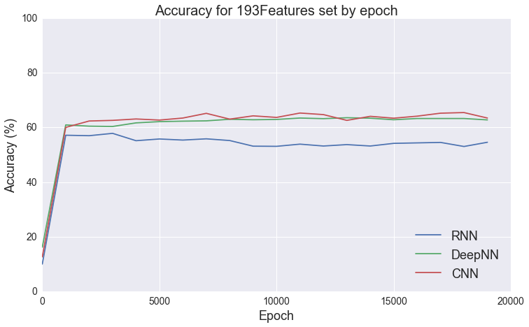
Accuracy
Notes:
10

Slide 12
Overfitting
With all models overfitting was a serious issue.
Neural Nets needed regularization on all layers
DeepNN's did best with 80% dropout on each layer.
No Neural Nets with more than 3 hidden layers.
DeepNN and RNN had most trouble, followed by CNN.
However, DeepNN was also the easiest to compensate for the overfitting.
Next Step would be increasing dataset size …
Notes:
11

Slide 13
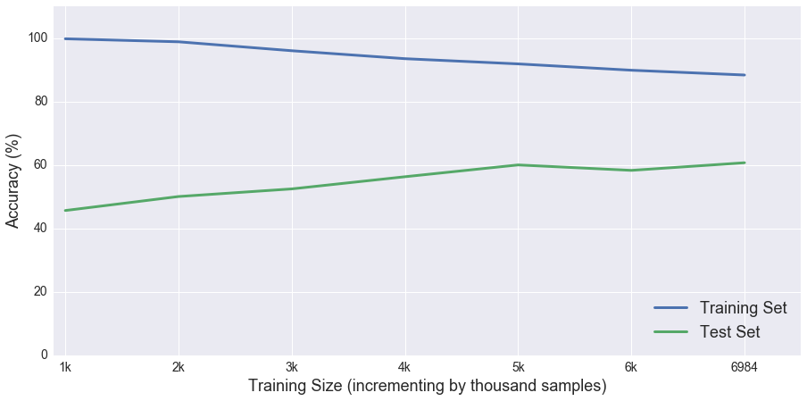
Training Curve Plot

