Slide 1

News, August 2014

Slide 2
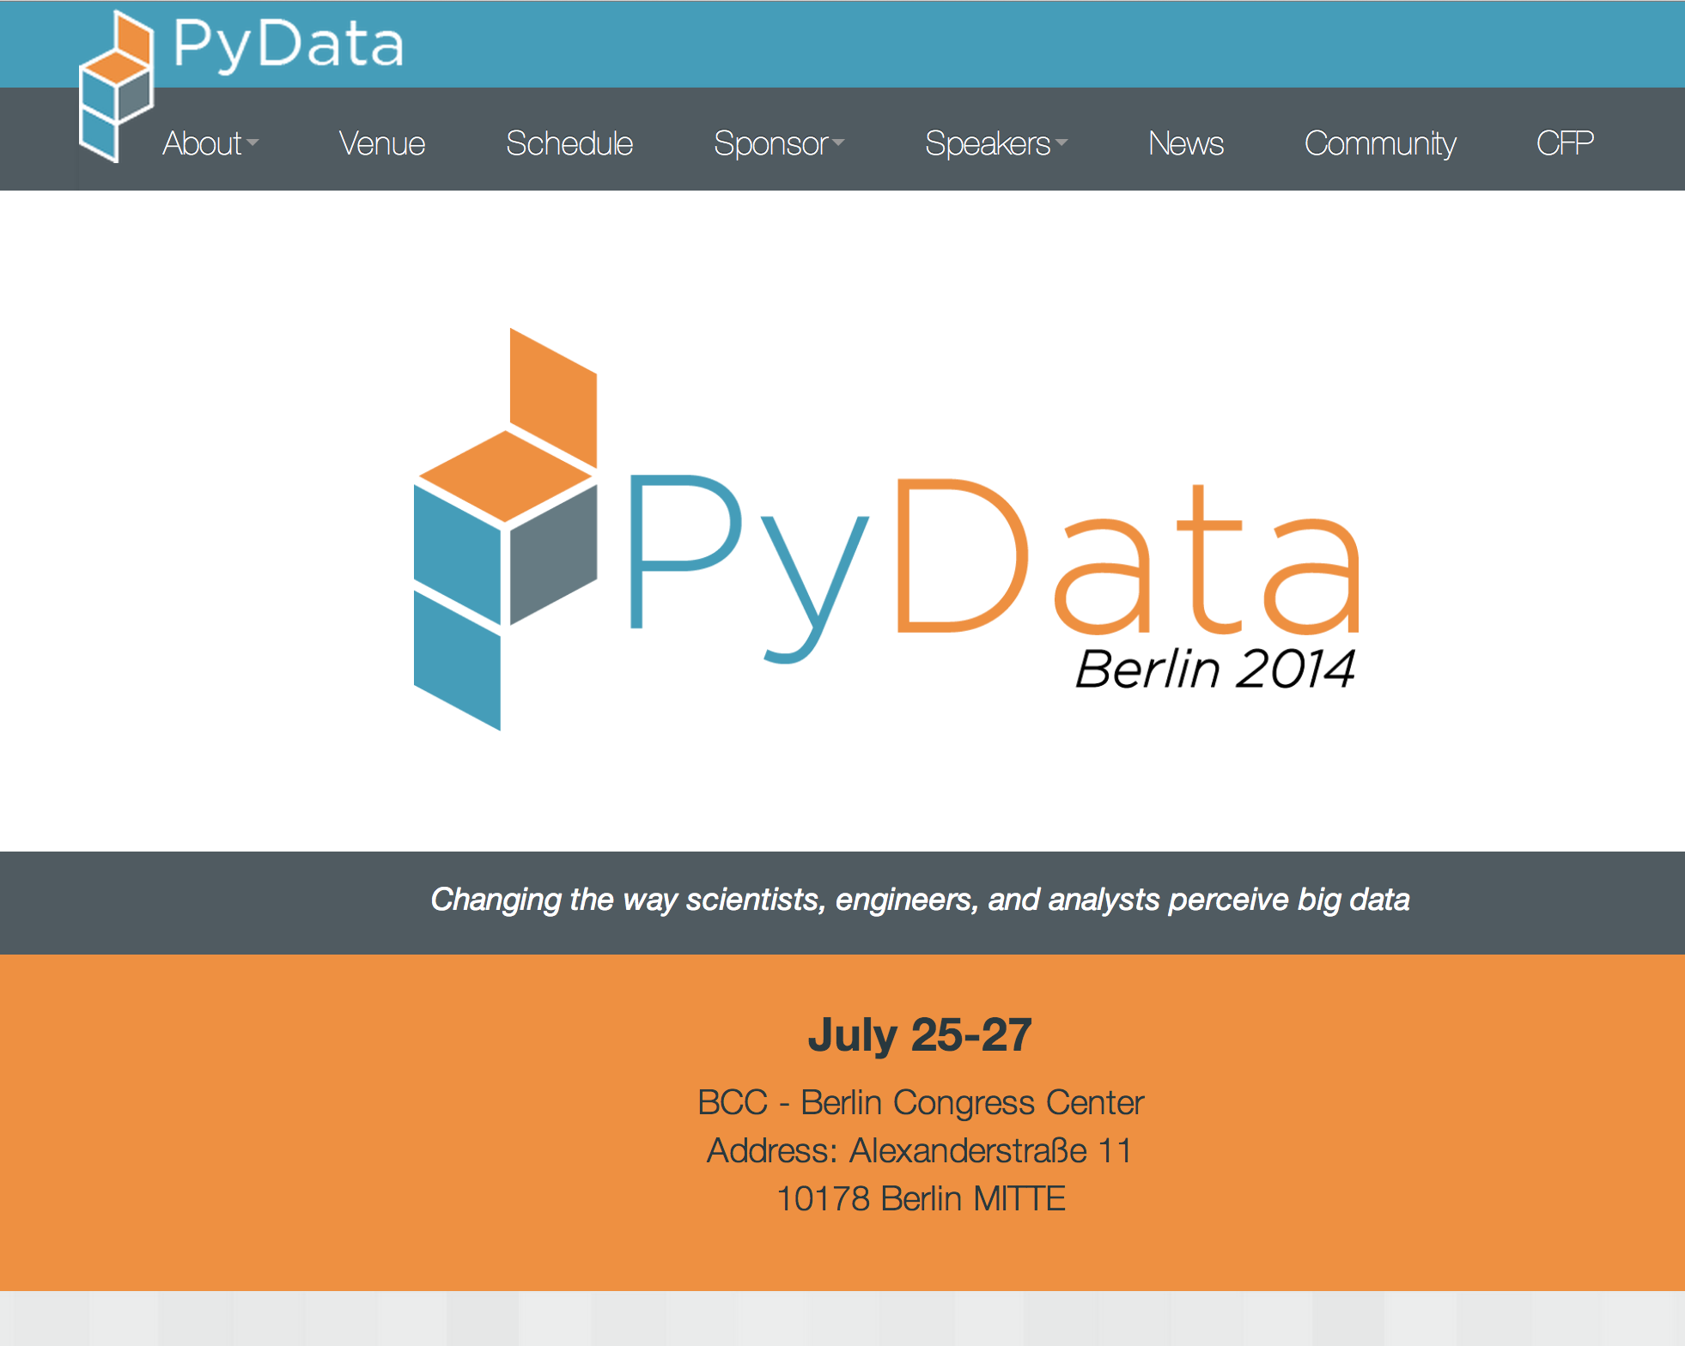
PyData Berlin – highlights!

Slide 3

Project Jupyter announced
Agnostic iPython, to be the interactive analysis tool.
Lead by Fernando Perez
Jupyter.org

Slide 4

Pivigo and KPMG launch data science bootcamp
Course offered to convert PhDs to data scientists
Industry placements
To address the talent shortage

Slide 5
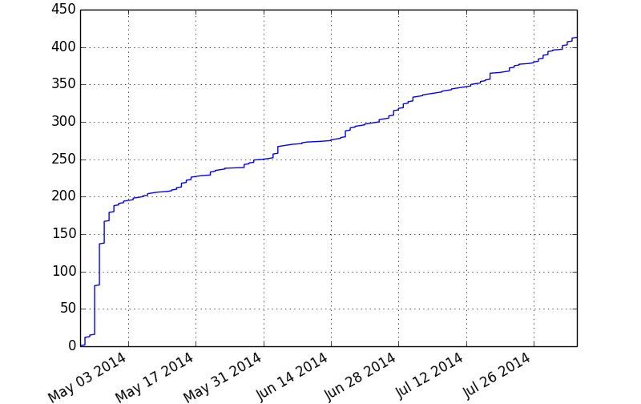
PyData London 400+ members

Slide 6
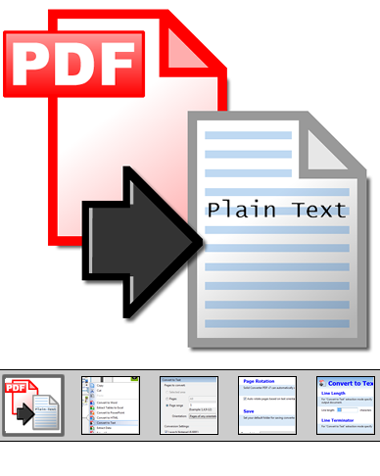
POTM: Textract
Python package to dump text content out of documents.
CLI or script interface
No OCR as yet but you’ve heard of piping right?

