Slide 1

News, September 2014

Slide 2

PyCon UK
The biggest Python event of the year!
Held at the Technocentre at Coventry University
Great jacket potatoes!

Slide 3
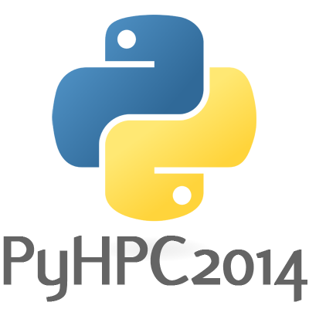
PyHPC – Call for papers
Workshop attached to SuperComputing (SC) 14 in New Orleans in November.
Full Paper Submission by September 5th.

Slide 4

Word2vec, deep learning released
Unsupervised, deep learning algorithms from Google
Now integrated into Python – uses Numpy etc.

Slide 5
PyDatians are good citizens

Slide 6

POTM: Requests
The HTTP request library
Updated to use urllib3
2.4.0 released on 29th August

