Slide 1

News, February 2015

Slide 2
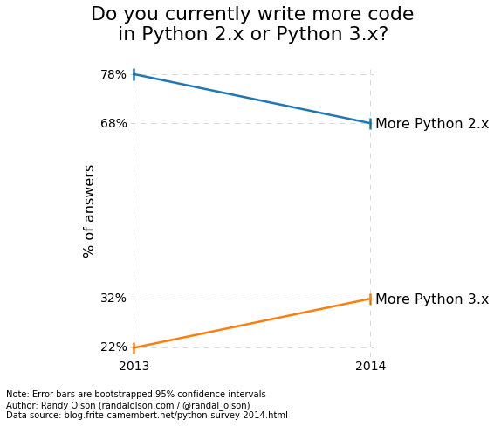
Python Data Usage Survey 2014
http://www.randalolson.com/2015/01/30/python-usage-survey-2014/

Slide 3
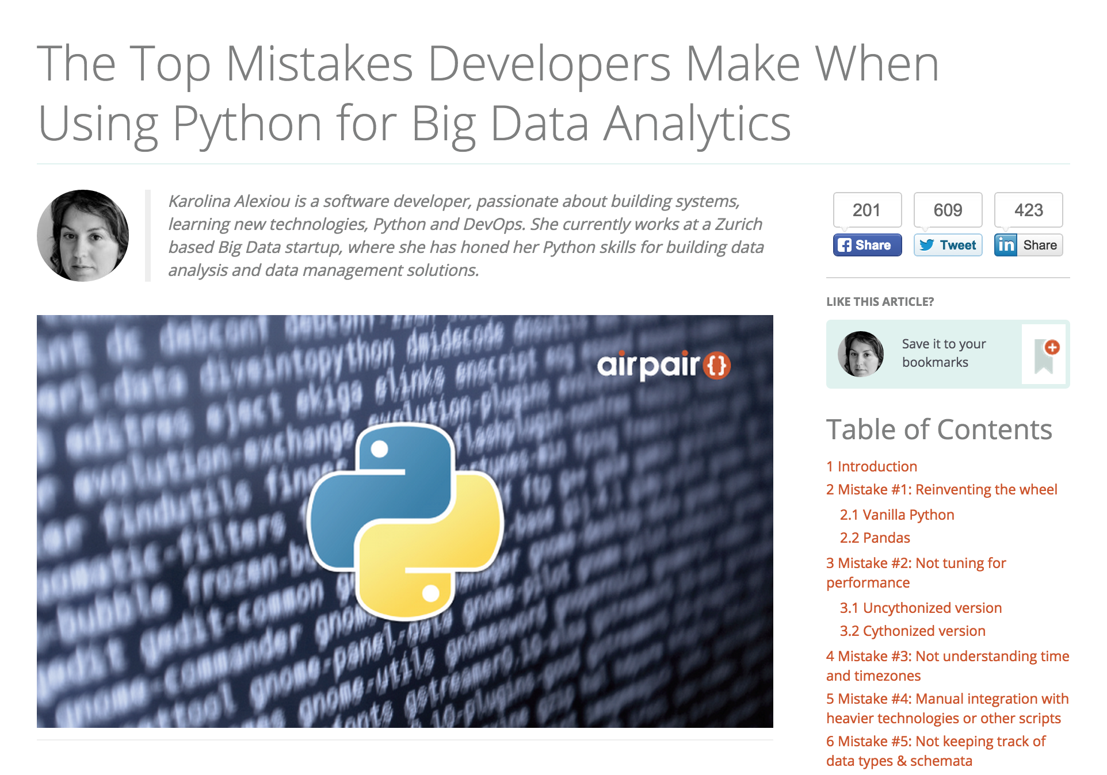
Top Mistakes When Using Python for Big Data
https://www.airpair.com/python/posts/top-mistakes-python-big-data-analytics

Slide 4
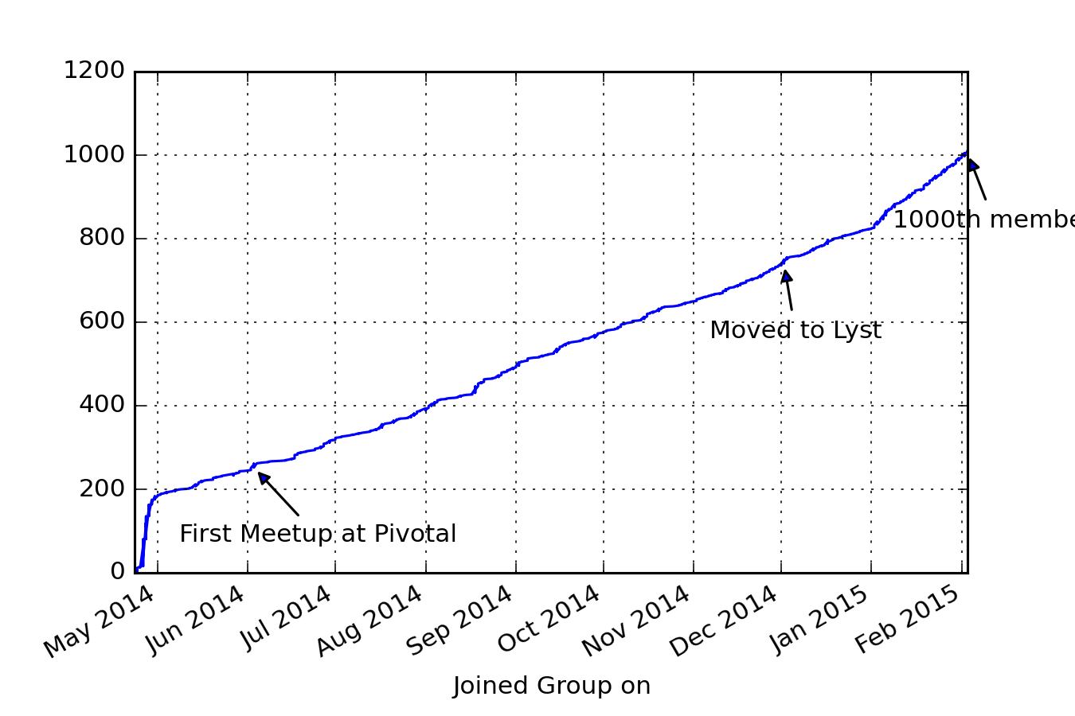
1000. members.

Slide 5

POTM: matplotlib
The graphing library in Python
MATLAB-style for simple use, OO for advanced use
Stable API, others have built on it.
import seaborn as sns

Slide 6
PyData London 2015!!!!
Updates

