Slide 1

News, March 2015

Slide 2
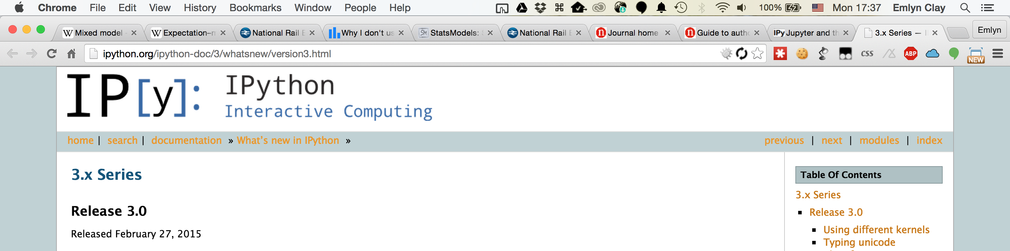
Last release of iPython!
Last release before moving to Jupyter.
Different kernels, new custom widget syste,
conda create -n ipython3 ipython pyzmq tornado jinja2 jsonschema

Slide 3
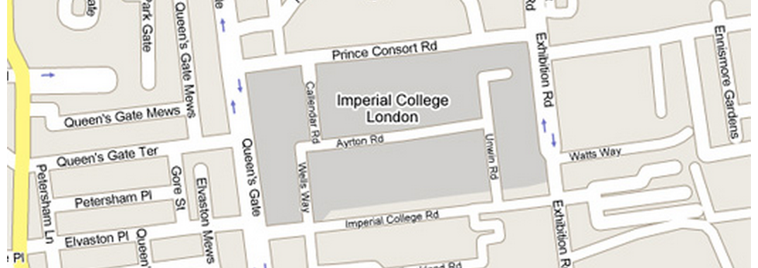
Google-Machine Learning Tutorial Series.
Speaker: Daniel Polani
Title: Information Theory in Intelligent Decision Making
Date: March 4, 2015
Time: 14:00 - 16:00
Location: Huxley, 145

Slide 4
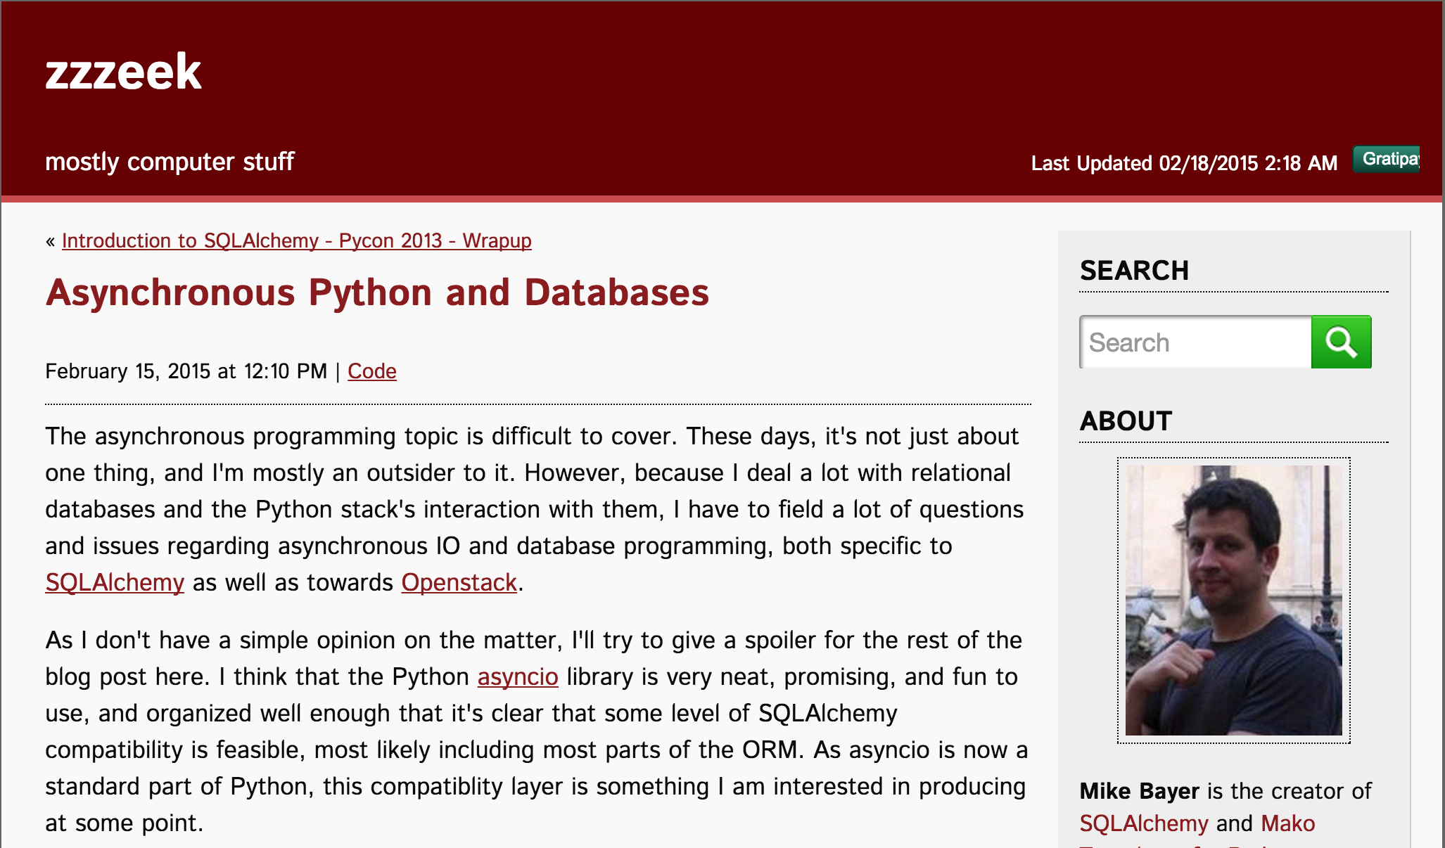
Async Python and databases
http://techspot.zzzeek.org/2015/02/15/asynchronous-python-and-databases/

Slide 5
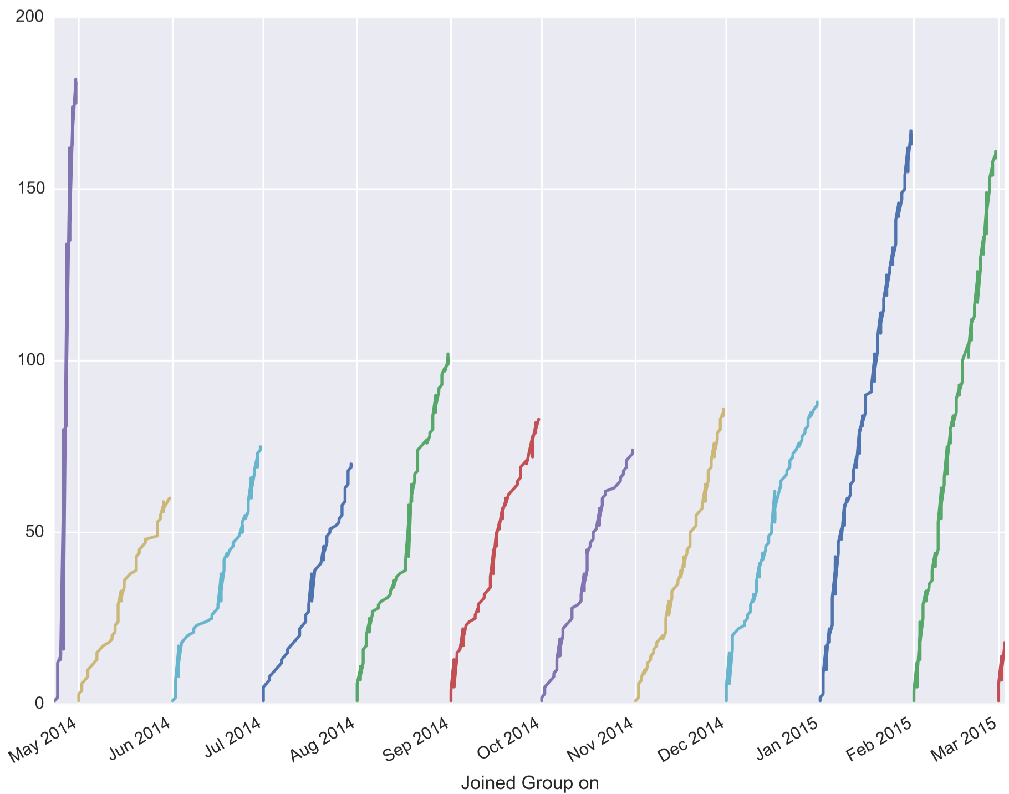
When do members join in the month?

Slide 6

POTM: SQLalchemy
The king of SQL abstraction.
Database agnostic.
Autoschema for quick use.
Declarative interface for perfomance.

Slide 7
PyData London 2015!!!!
Updates

