Slide 1


MadeCR: Correlation-based Malware Detection for Cognitive Radio
Yanzhi Dou, Kexiong (Curtis) Zeng, Yaling Yang, Danfeng (Daphne) Yao
Department of Electrical and Computer Engineering
Virginia Tech, USA

Slide 2
Overview
Background
Challenges & contributions
Attack model & security goal
MadeCR design
Artificial malware generation
Prototype & evaluation
Conclusion & future work

Slide 3
Background
CR: An intelligent radio technology to boost spectrum utilization
Challenging security and information assurance issues
  A traditional radio can only affect its own network
  CR can be exploited to launch large scale attacks
  More destructive than traditional radio system
Security problems need to be addressed proactively

Slide 4
Background
Existing proposals for CR security
  Prevents downloading of malicious software
  Leverages ordinary personal computer protection measures
  Focuses on the networking aspect of CR security
MadeCR: Enhance the security of CR device itself
  Anomaly detection techniques

Slide 5
Challenges & contributions
Unique challenges
  Complexity in countering data flow poison
  How to evaluate in the absence of real malwares?
Contributions
  Involve feasible data flow analysis by employing clustering techniques
  Generate artificial CR malwares through mutation testing techniques
  Identify the critical vulnerable components to refine the detection system

Slide 6
Overview
Background
Challenges & contributions
Attack model & security goal
MadeCR design
Artificial malware generation
Prototype & evaluation
Conclusion & future work

Slide 7
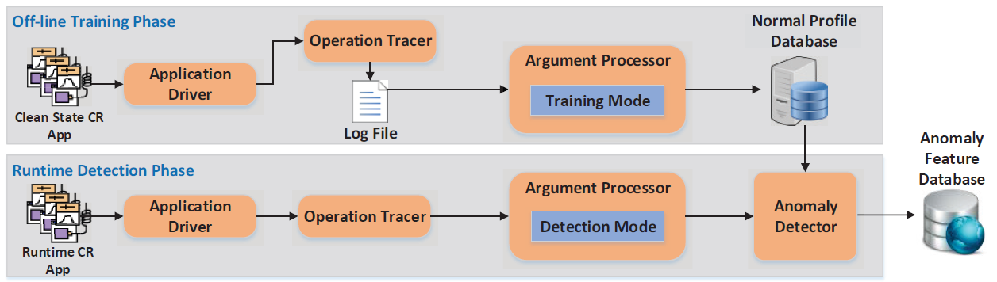
MadeCR design

Slide 8
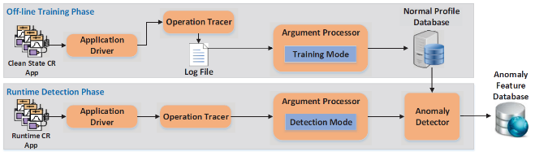
Argument Processor
High level
  Continuous space -> discrete space

Slide 9
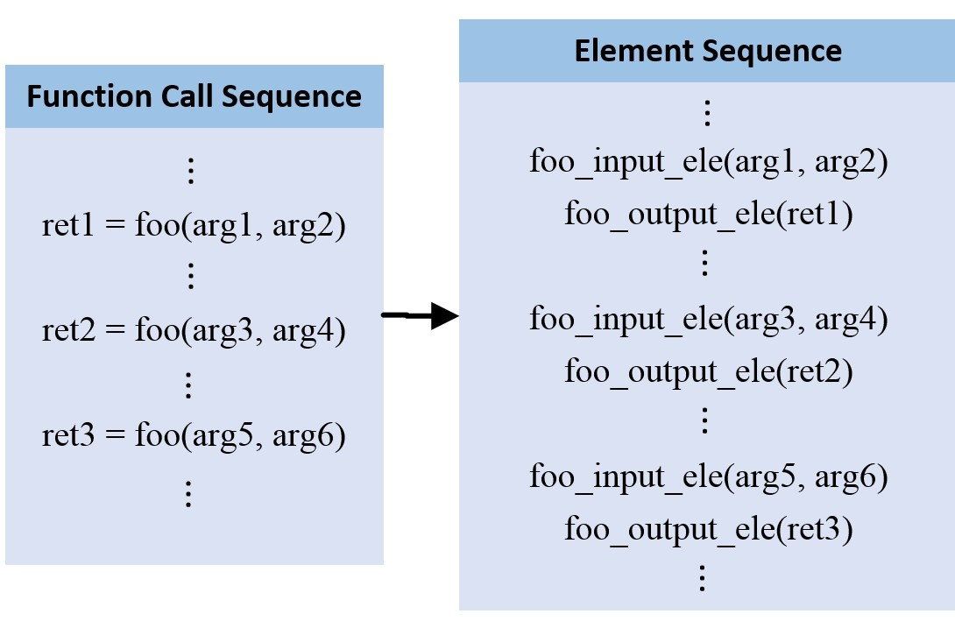
Argument Processor
Step 1

Slide 10
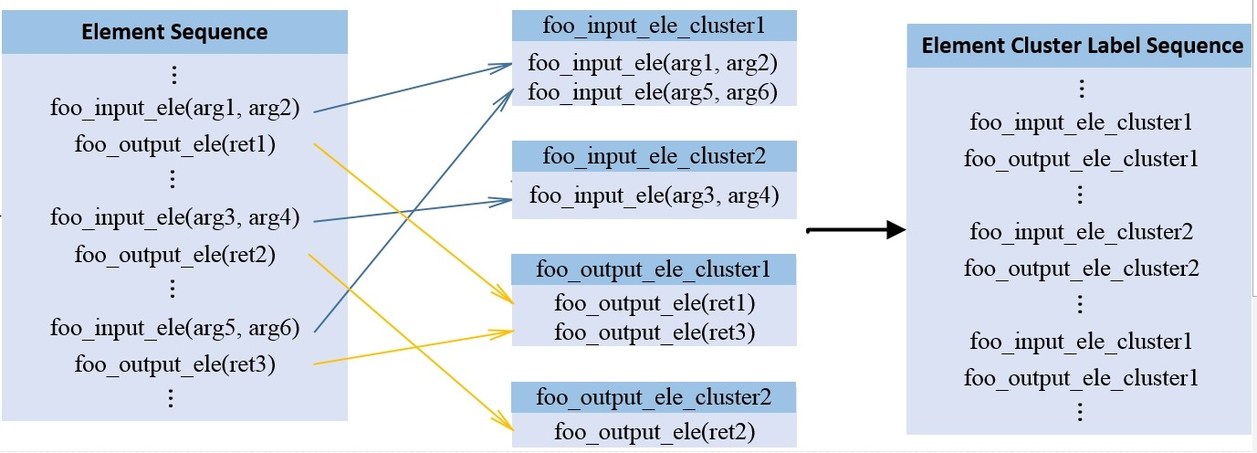
Argument Processor
Step 2

Slide 11
Anomaly Detector
Recognize abnormal sequences
  Construct a database of normal behavior
  Calculate the deviation as the criterion
Methods
  N-gram model
  Hidden Markov Model (HMM)

Slide 12
System refinement
Observation
  Many intercepted functions provide little contextual information
    e.g. Printing operation message on screen
    Tokens of thread scheduling in Python
  Operation fidelity of CR is determined by the integrity of its RF parameters
Select security-critical function call
  Improve the detection accuracy and detection speed

Slide 13
Overview
Background
Challenges & contributions
Attack model & security goal
MadeCR design
Artificial malware generation
Prototype & evaluation
Conclusion & future work

Slide 14
Artificial malware generation
Motivation: Proactive defence -> no real malware
  Traditional IDS evaluation method not applicable
Observation
  Malware is a special kind of mutant

Slide 15
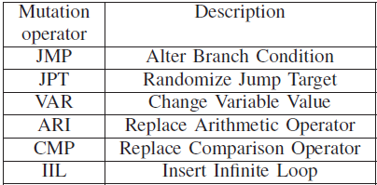
Artificial malware generation
Method: Generate artificial malware by Mutation testing
  Six mutation operators
  Byte code level
  A wide range of malware-alike behaviors

Slide 16
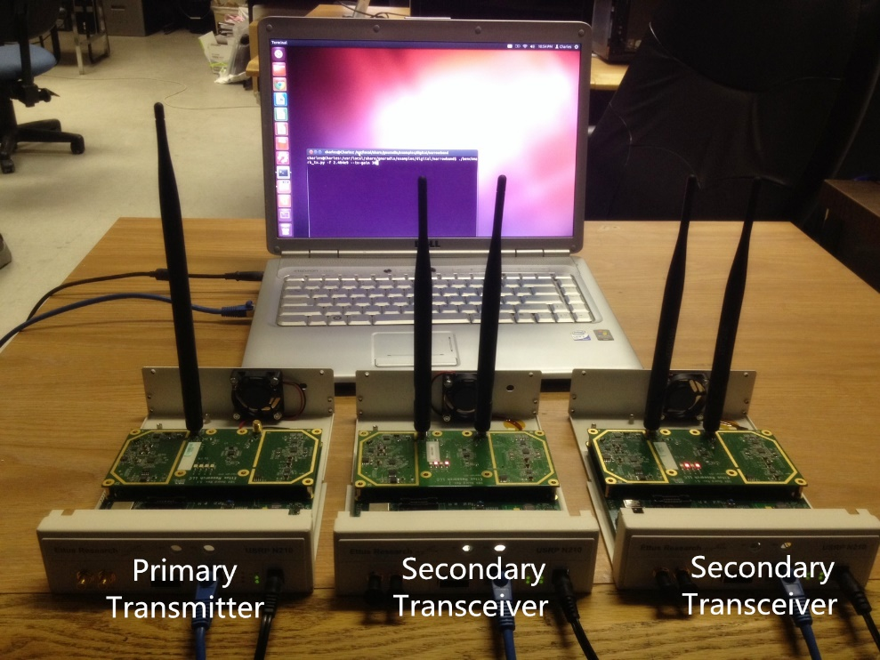
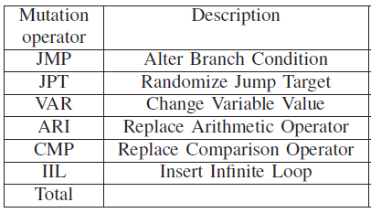
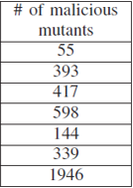
Prototype & evaluation
A host computer with Intel Core i7-2600 CPU @ 3.40GHz * 8 and 8GB memory
CR testbed

Slide 17
Prototype & evaluation
2 versions * 2 implementations
  N-gram, N-gram refined, HMM, HMM refined
Focus on two metrics
  Detection accuracy
  Computational overhead

Slide 18
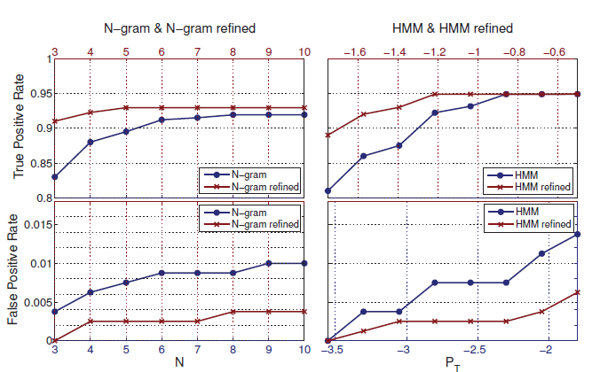
Prototype & evaluation
Accuracy

Slide 19
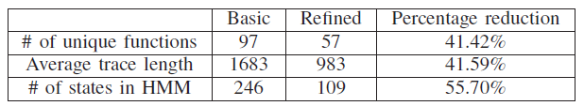
Prototype & evaluation
Computational overhead

Slide 20
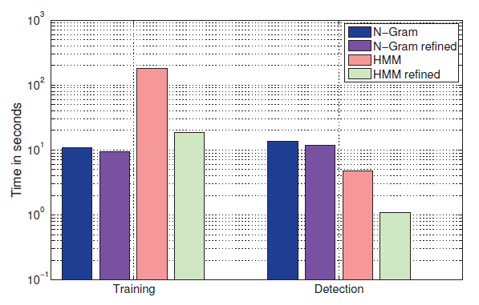
Prototype & evaluation
Computational overhead
182.28
18.38
4.81
1.10

Slide 21
Conclusion & future work
MadeCR: First approach to detect malwares for CRNs
  Monitor both control flow and data flow
  Detect suppression attacks
  Generate artificial mutants for evaluation
  Propose refinement approach
Future work: Monitor CR at multiple-layer
  Radio hardware, operating system, user application, and network

Slide 22

Overview
Background
Challenges & contributions
Attack model & security goal
MadeCR design
Artificial malware generation
Prototype & evaluation
Conclusion & future work

