Slide 1

Hy-Vee Retail Data Analysis
Aaron Feldman, Kate McCoy, Jacque Thompson

Slide 2
Agenda
Questions
Solutions
Deliverables
Recommendations

Slide 3
Questions
Do Different Brands’ Prices Affect Other Brands?
Hypothesis 1: Sales Price Affects Quantity Sold
Hypothesis 2: Top Brands Are Sensitive To Each Other
Hypothesis 3: Less Popular Brands Less Sensitive To Price Change
Can We Predict Inventory Turnover Of The Top 5 Brands?
Hypothesis 4: Using Top 5 Brands’ Sales Prices, We Can Predict Quantity Sold Of Top 5 Brands

Slide 4
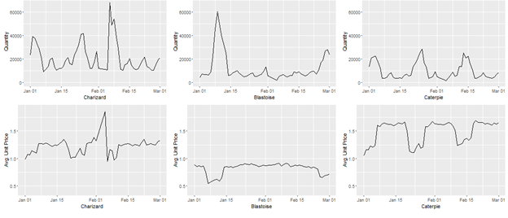
Hypothesis 1: Sales Price Affects Quantity Sold

Slide 5
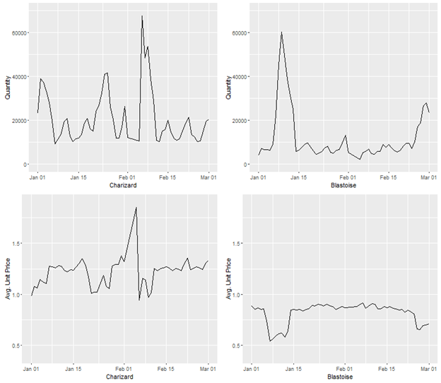
Hypothesis 2: Top Brands Affect Each Other
-Solution: On average, prices of top brands not sensitive to each other.
-Weak correlation between CharizardPrice and BlastoiseQuantity; Vice Versa

Slide 6
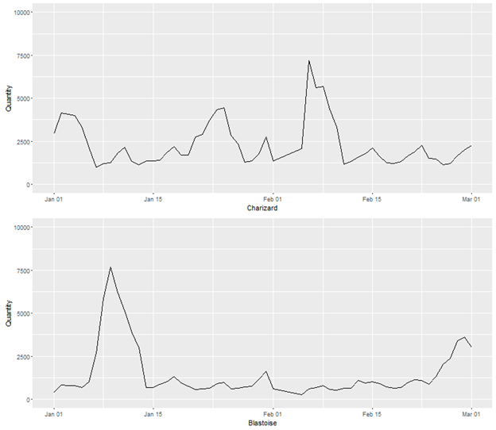
Hypothesis 2: Top Brands Affect Each Other
-Solution: Prices of top brands sensitive to each other based on flavor.
-Blastoise decreased price Jan 5th.
.28 Correlation between CharizardQuantity
And BlastoisePrice
Charizard
Blastoise

Slide 7
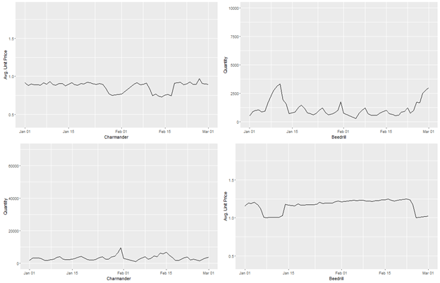
Hypothesis 3: Less Popular Brands Less Price Sensitive
-Beedrill Quite Insensitive To Price
-Charmander Less Sensitive
-Solution: Yes, Less Popular Brands are Less Price Sensitive
-Hypothesis: More Loyalty, Niche market.

Slide 8
Questions
Do Different Brands’ Prices Affect Other Brands?
Hypothesis 1: Sales Price Affects Quantity Sold
Hypothesis 2: Top Brands Are Sensitive To Each Other
Hypothesis 3: Less Popular Brands Less Sensitive To Price Change
Can We Predict Inventory Turnover Of The Top 5 Brands?
Hypothesis 4: Using Top 5 Brands’ Sales Prices, We Can Predict Quantity Sold Of Top 5 Brands

Slide 9
Hypothesis 4: Predict Quantities Based on Prices
Top 5 Brands Of Product
Predicting Quantities Based On Sales Price
Input: Sales Prices 1-5
Output: Quantity Sold 1-5
Brand | TotQuant | TotSal
Charizard | 1,831,160 | 1,484,433
Blastoise | 868,810 | 642,533
Caterpie | 564,643 | 664,659
Charmander | 237,982 | 196,284
Beedrill | 209,122 | 381,925

Slide 10
Hypothesis 4: Predict Quantities Based on Prices
Multiple Linear Regression
Use Variables That Help Tell The Story
Weight Those Variables Based On Relationships

Slide 11
Hypothesis 4: Predict Quantities Based on Prices
Validating Predictions
Significant Predictors Made Up Majority Of Explanation Of The Quantity
Statistical testing supported our hypothesis
Small Differences between Predicted and Actual Quantities
But not for Beedrill
Significant Predictors verified by P-values
Solution: We Can Predict Quantities Sold Based on Top 5 Brands’ Prices
However, We Do Not Feel Comfortable Predicting The Quantity Sold Of Beedrill
Notes:
45, 85, 70, 54 R2 values
Charizard, Blastoise, Caterpie, Charmander, Beedrill

Slide 12
Deliverables
Code To Organize Data
Python, R, SAS
Regression To Predict Quantity Sold Of Top 4 Brands
Excel Interface
Corporate View Prototype
Individual Store Prototype
Documentation Of How To Redo Our Process

Slide 13
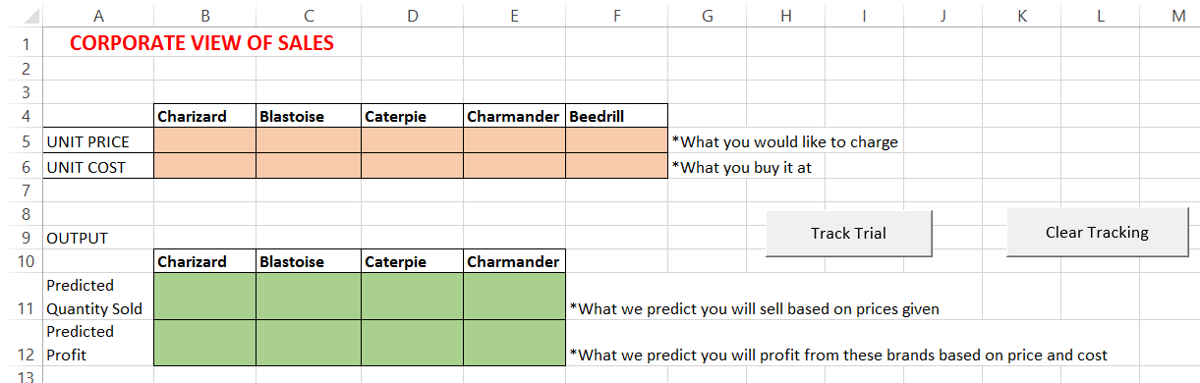
Deliverables - Excel Interface
Interactive Way To Predict Quantities and Profit
Corporate View Of Sales
What Happens If Hy-Vee Runs A Storewide Ad?

Slide 14
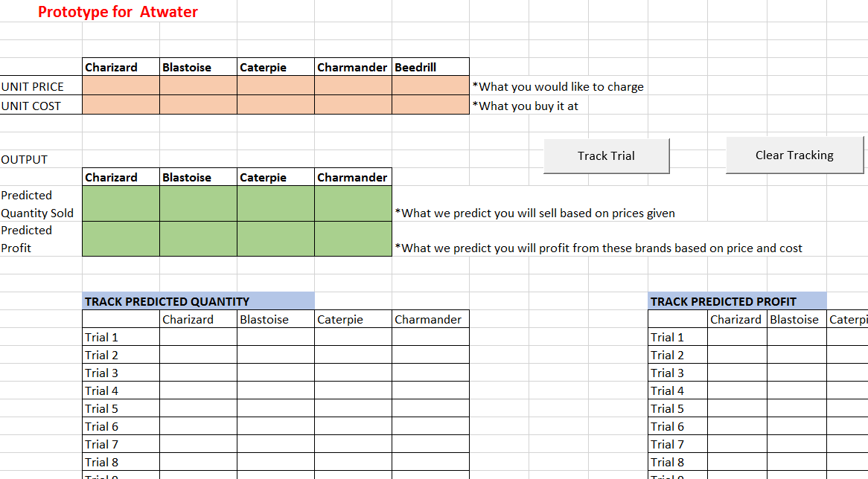
Deliverables - Excel Interface
Individual Store View
New Regression Weights
Only Works For That Store
Goal: Predict Quantities Sold For That Specific Store

Slide 15
Recommendations
Implement The Excel Workbook
Adjust Regression For Individual Stores
Aggregate By Store (Clean Data in R, output in SAS)
Calculate Store Specific Regression Weights in R
Input Into Store Specific Workbook
A/B Testing

Slide 16
Overview
Questions
Solutions
Deliverables
Recommendations

Slide 17

Questions?
aaron.m.feldman@drake.edu kate.mccoy@drake.edu jacqueline.thompson@drake.edu

