Slide 1
Physics FS
Assets ZIP Management with PhysFS
Aarón Guerrero Cruz

Slide 2
What is PhysFS?

Slide 3
01
02
03
04
Compressed Files
Optimization
Portable
Easy to install on any project
Secure
No file access is permitted outside the specified dirs
Flexible
Archives can be used transparently as directory structures

Slide 4
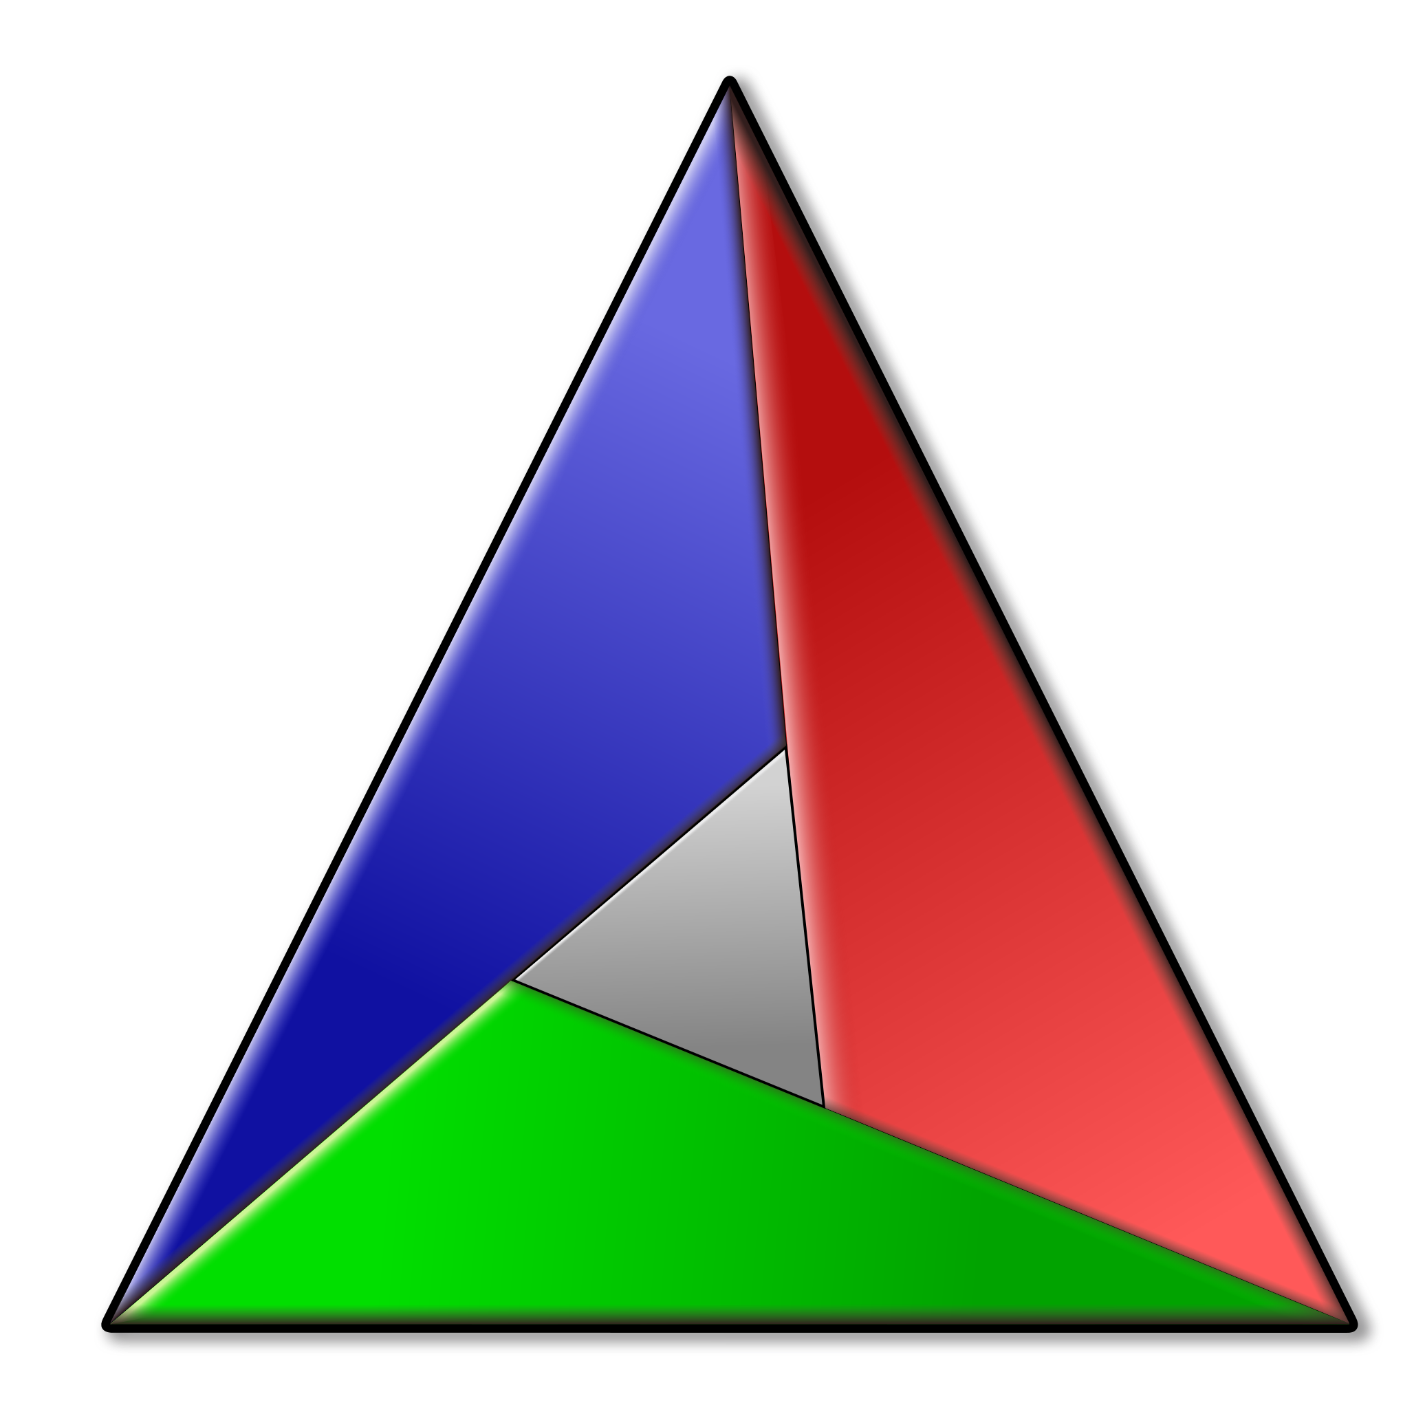
CMake
CMake is an extensible, open-source system that manages the build process in an operating system and in a compiler-independent manner.

Slide 5

CMake
It’s done
CMake is an extensible, open-source system that manages the build process in an operating system and in a compiler-independent manner.

Slide 6
Implementation

Slide 7
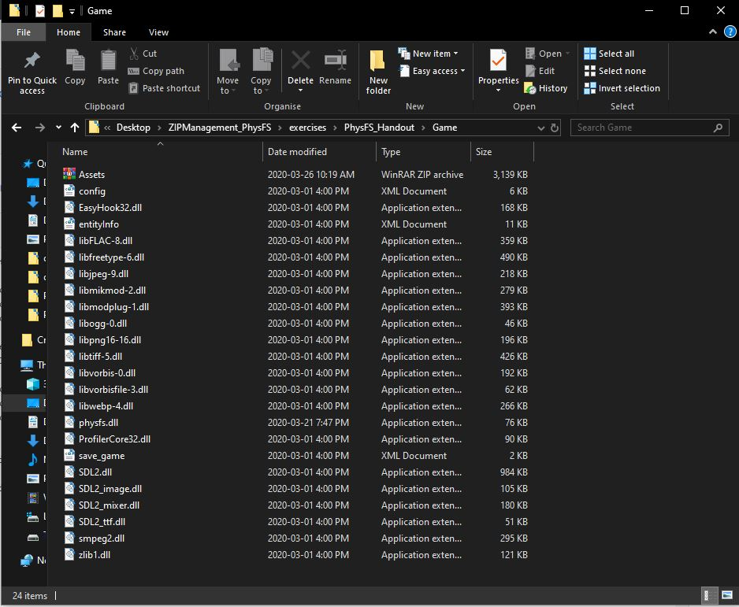
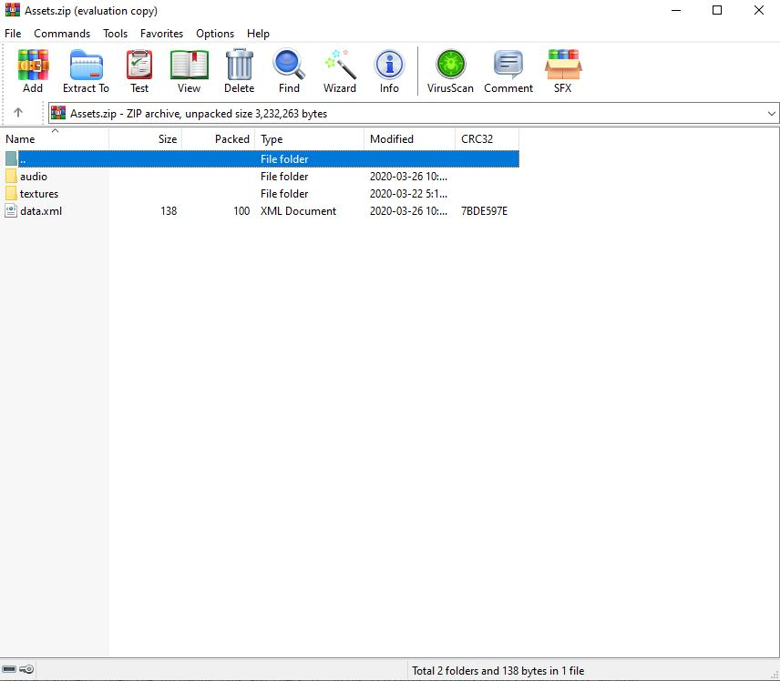

Slide 8
Open the Handout

Slide 9

TODO 0:
It only consists of opening a link with DOCUMENTATION that will help you the rest of TODO’s

Slide 10

TODO 1:
You must initialize and de-initialize the PhysFS API.
The first step of any new API.

Slide 11
TODO 2:
Mount the desired ZIP with PhysFS.
Like the one found in the constructor, but not at default (“.”)

Slide 12
TODO 3:
You want to return the number of bytes it has read from the file that we passed to this function.
Look for readBytes on the page you opened at the beginning.
The buffer is likely to cause confusion in this step, you have a good clue in the code.

Slide 13
TODO 4:
Uncomment all of this and resolve how to load the document from the memory with the link below.
Don’t panic, it seems like a lot but you just have to focus on the “result” and check if the function you just programmed it’s working.

Slide 14

TODO 5:
Check what is SDL_RWops
You only need to return ret equal to some function.

Slide 15

TODO 6:
You don’t need to do anything there.
Just watch how the files will load from now on.

Slide 16
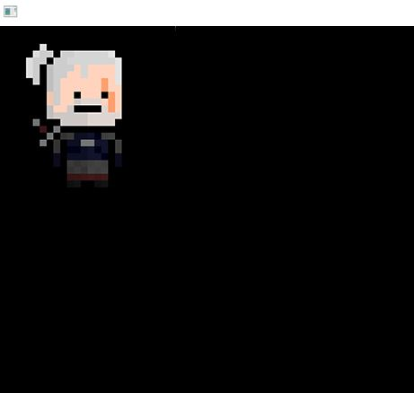

Solution
Geralt of Rivia
Random music
SFX pressing “1”

Slide 17
That’s all!
Thank you!

