Slide 1
ECE 622 Project – Sobel Filter Operation
Aaron Funes
5/10/26

Slide 2
Overview
Introduction
Design and References
Testbench Simulation
Results

Slide 3
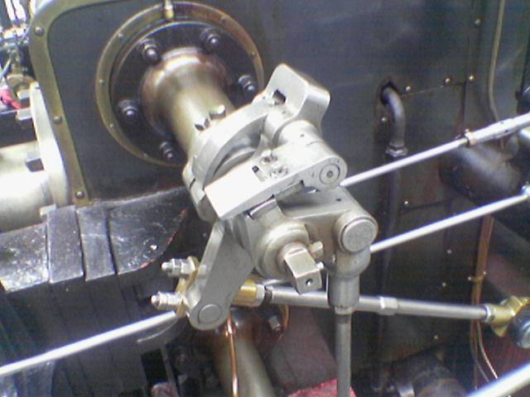

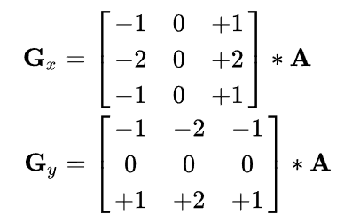
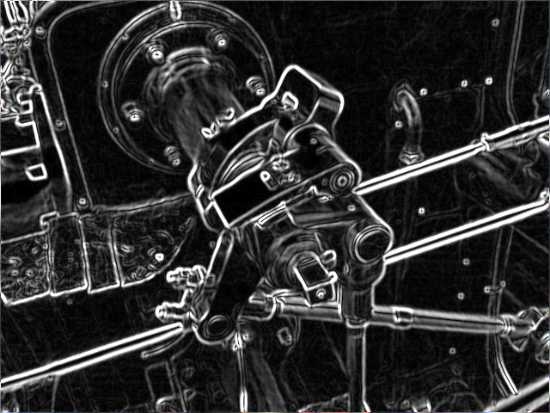
Introduction
Sobel Filter is used in Image Processing to perform edge detection.
The Filter operation is defined as such
To Perform the filter operation a 3x3 pixel matrix is taken from the image, and then convolved with the following filters, G_{x} and G_{y} .
These filters take the x-direction derivative, y-direction derivative, and averaging of the 9 pixels within the matrix.

Slide 4
Design and References
Sobel
Design is broken down into multiple modules.
  Sobel X
    Performs the X-direction filter application
  Sobel Y
    Performs the Y-direction filter application
  Square Root
    Square root operatorr
  Sobel
    Top level module with above lower level modules instantiated within.
Sobel X
Sobel Y
Square Root

Slide 5
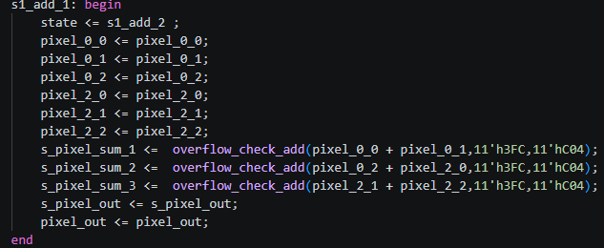
Design and References
S1_idle
S1_done
Sobel X & Y
  Similar structure and design is used for the design code
  The main difference that must be taken in to account is the specific array indexes used.
  State Machine design is used and multiple registers are used to break down arithmetic logic.
  Saturation limits are also applied to keep ranges in check
S1_add3
S1_mult
S1_add2
S1_add1

Slide 6
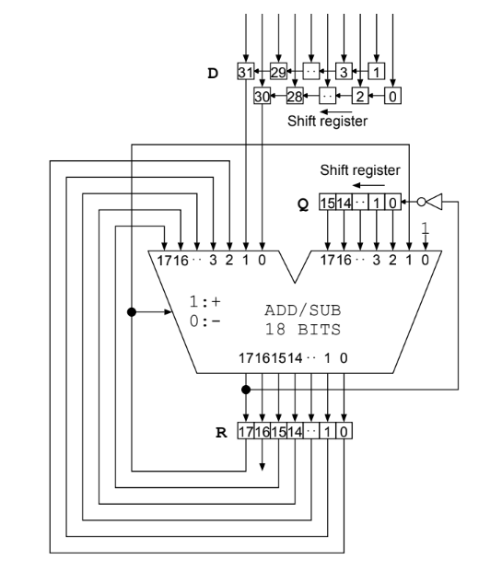
Design and References
S1_idle
S1_done
Square Root
  Square root design is based on reference code and documents.
    Code Reference: link
    Document Reference: link
  Original design is only start controlled and has no state machine design
  Design was updated to perform logic in a state machine format instead
S1_busy

Slide 7
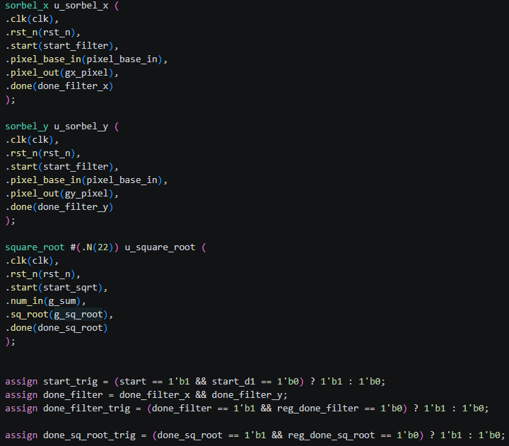
Design and References
S1_idle
S1_done
Sobel
  Top Module design that sequences the steps required to perform the Sobel filter
  Start signals are controlled for the square root module as well as the Sobel X & Y modules.
  The done signal from the lower level modules are used to transition through states.
S1_sqr_root
S1_filter
S1_add
S1_mult

Slide 8
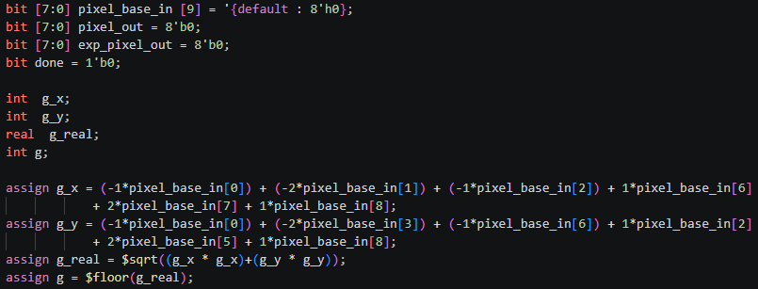
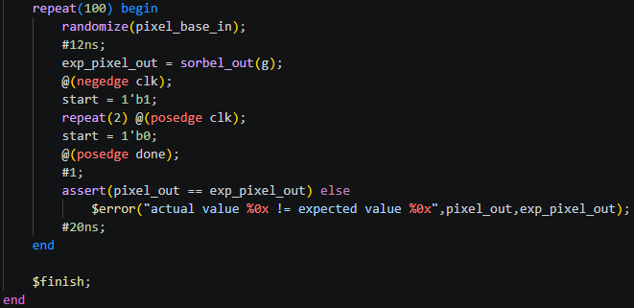
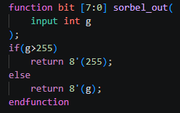
Testbench Simulation
Testbench stimulus generated from using a 8-bit 9x1 array, meant to represent matrix sample from an image.
Testbench verification is done by calculating the expected result using integer variables, placing the square root value in to a real variable, and then flooring it to 8-bit integer value needed.
The stimulus is randomized 100 times and asserted after each run.

Slide 9
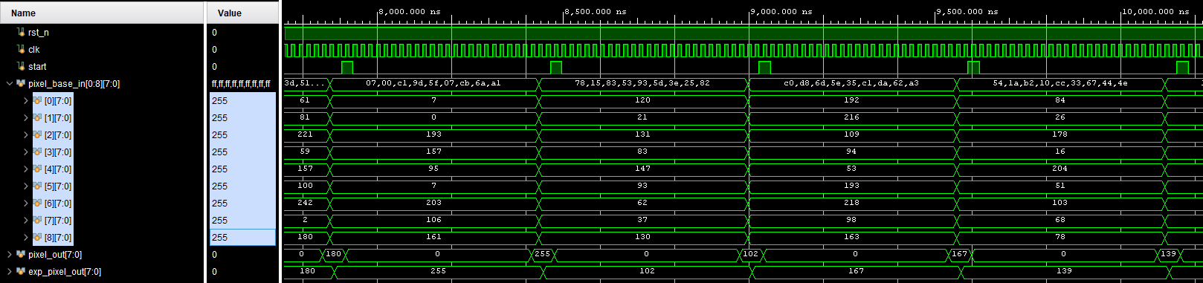
Results

