Slide 1


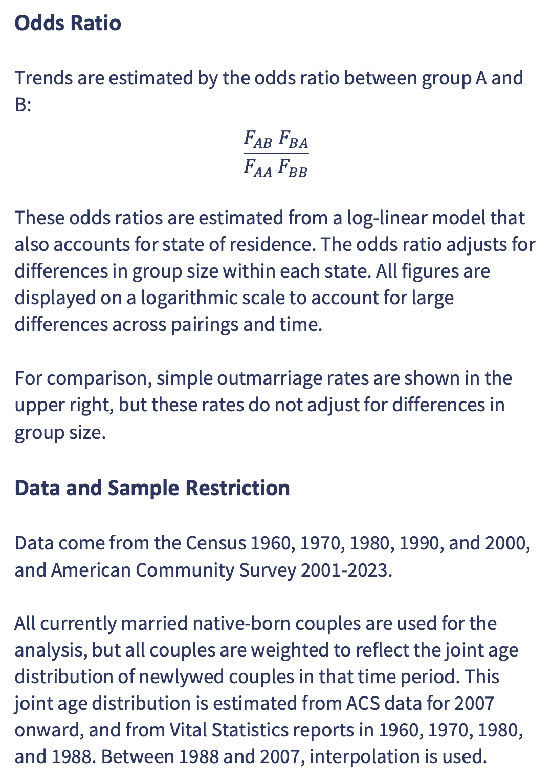
Trends and Heterogeneity in Interracial Marriage in the United States, 1960-2023
The likelihood of interracial marriage has increased exponentially for some pairings, but has leveled off for other pairings, creating some convergence over time.
Outmarriage Rates
Aaron Gullickson
Department of Sociology, University of Oregon
aarong@uoregon.edu
One in six couples are now racially exogamous. Large differences by the race of partner are strongly affected by group size differences.
Highlights
One in six marriages are now between partners of a different race, compared to less than 0.3% in 1960.
Interracial marriage has increased consistently throughout the time period for many groups but has leveled off for unions involving East/Southeast Asian and American Indian/Alaska Native partners.
Interracial marriage has grown the fastest for marriages involving a Black partner, but from the lowest initial rates, leading to overall convergence in the likelihood of interracial marriage across different pairings.
The intermarriage patterns of Hispanic partners varies substantially by their chosen racial identification.
The change to multiracial reporting in 2000 did not substantially affect overall trends.
Take a picture to download the full paper
Abstract
Trends for Multiracial Partners
Panethnic Group Heterogeneity
While scholars recognize that interracial marriage in the United States has grown exponentially since the 1960s, our understanding of this trend for specific racial pairings is piecemeal and thin, owing to issues with data comparability and lack of information on marriage timing between 1980 and 2007. In this article, I use log-linear models of Census and American Community Survey data to analyze trends in interracial marriage from 1960 to 2023 across major single-race groups, as well as some important subgroups. Weights are applied to match the joint age distribution of currently married partners to the age distribution of newlyweds in the same time period. While the overall trend is one of exponential increase, important heterogeneity is visible when examining particular racial pairings or subgroups. Most notably, the likelihood of interracial marriage for East/Southeast Asian and American Indian/Alaska Native spouses plateaued by the end of the 20th century and has not continued to grow. On the other hand, the likelihood of interracial marriage for Black spouses, although far lower than any other group at the start of the period, has increased more rapidly than any other group. Overall, these results indicate an ongoing transformation of group boundaries.
Methods
Histogram shows the distribution of husband’s age in 2008, before and after age weighting, with actual distribution of newlywed husbands shown by dotted line.
Odds Ratio
Trends are estimated by the odds ratio between group A and B:
$$\frac{F_{AB}{ F}_{BA}}{F_{AA}{ F}_{BB}}$$
These odds ratios are estimated from a log-linear model that also accounts for state of residence. The odds ratio adjusts for differences in group size within each state. All figures are displayed on a logarithmic scale to account for large differences across pairings and time.
For comparison, simple outmarriage rates are shown in the upper right, but these rates do not adjust for differences in group size.
Data and Sample Restriction
Data come from the Census 1960, 1970, 1980, 1990, and 2000, and American Community Survey 2001-2023.
All currently married native-born couples are used for the analysis, but all couples are weighted to reflect the joint age distribution of newlywed couples in that time period. This joint age distribution is estimated from ACS data for 2007 onward, and from Vital Statistics reports in 1960, 1970, 1980, and 1988. Between 1988 and 2007, interpolation is used.
The racial identification of Hispanic spouses strongly predicts the race of different-race partners.
White-Black and White-API spouses are about equally likely to marry a partner of one of their component races, but that is not true of White-AIAN spouses who are much more likely to marry White partners.
A comparison of age-weighted results to those for newlyweds indicates a close fit, although age-weighted results are somewhat higher.
Robustness Checks
Asian subgroups have very different trends of interracial marriage over time.

