Slide 1

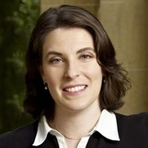
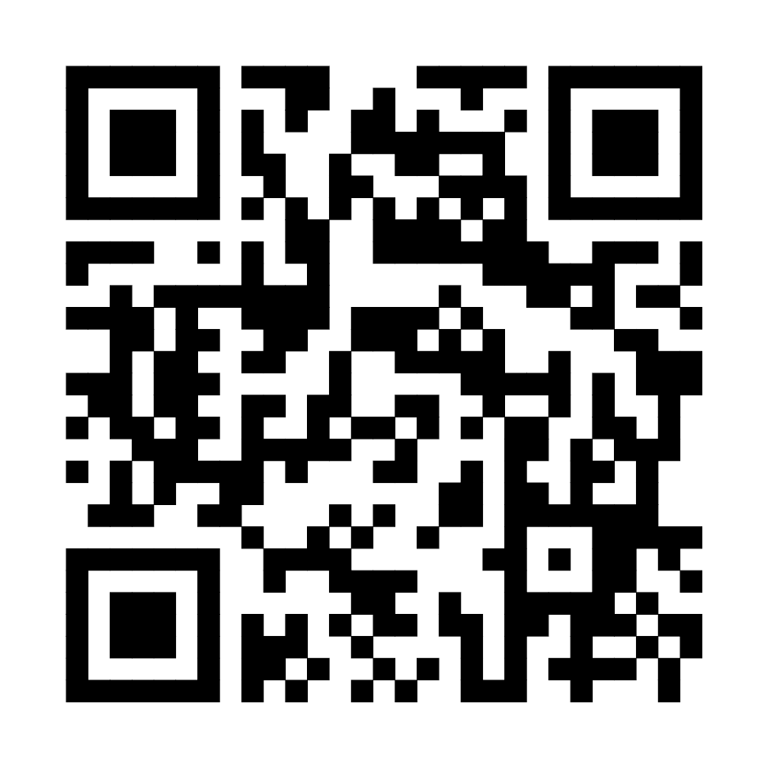
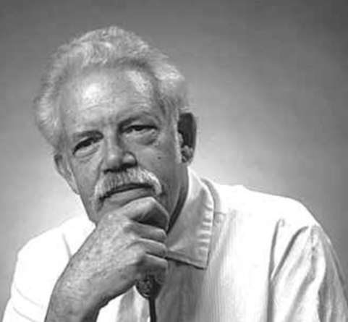
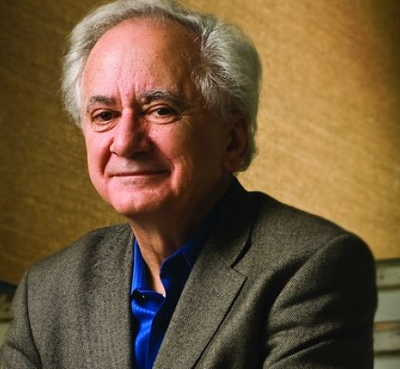
The Dynamics of Population Mixing: A Simulation Approach
The share of the population that identifies as mixed is highly dependent on intergroup partnering trends, starting group size, and racial classification regime
Scenario Parameters
Intergroup partnering trends include a “progress” and a “plateau” case from an initial very low rate
Aaron Gullickson
Department of Sociology, University of Oregon
aarong@uoregon.edu
Aliya Saperstein
Department of Sociology, Stanford University
asaper@stanford.edu
Classification regimes vary by the height of peak AB classification at 50/50 ancestry and the degree of decline across generations as one ancestry becomes dominant
Highlights
Under most realistic scenarios, the growth of a self-identified mixed population is modest.
Modest growth occurs because mixed ancestry lineages tend to “fold back” into single-race classification.
In cases of unequal group size, higher rates of intergroup partnering can lead to growth in the majority population at the expense of both the mixed and minority populations.
Implications
Many factors would have to align to produce a “post racial” utopia of population mixing.
Contemporary growth of the U.S. multiracial population is a unique consequence of the “biracial baby boom” and is unlikely to continue apace.
Intermarriage and multiracial identification will not necessarily help to usher in a “majority-minority” society as might be expected.
The Role of Classification Regimes
The Role of Starting Group Size
The share of the population with mixed ancestry varies primarily by partnering trends and starting group size, rather than classification regime
Even if barriers to intergroup partnering are eliminated, when starting group size is uneven, mixed and minority populations shares often decline over the long run
Methods
We use SOCSIM to micro-simulate population mixing over 200 years with an initial two group (A & B) population.
Each simulation varies by initial relative group size, maximum intergroup partnering level, and norms for AB classification.
Intergroup partnering is allowed at increasing rates over time.
Children of mixed unions are assigned an A, B, or AB identity based on their share of group A ancestry.
A
B
Intergroup Union (A-B)
G1
A
B
AB
Classification Decision (AB)
G2
Intergroup Union (A-AB)
A
AB
G3
AB
Classification Decision (A)
A
B
After 200 years, the proportion of mixed ancestry individuals who identify as mixed ranges from less than 10% to about 75%, but in most simulated scenarios is less than half of its theoretical maximum
In Memoriam
Take a picture to download the full paper
Eugene Hammel
(1930-2025)
Anthropologist,
Creator of SOCSIM
Richard Alba
(1942-2025)
Sociologist,
Majority-Minority projection skeptic

