Slide 1


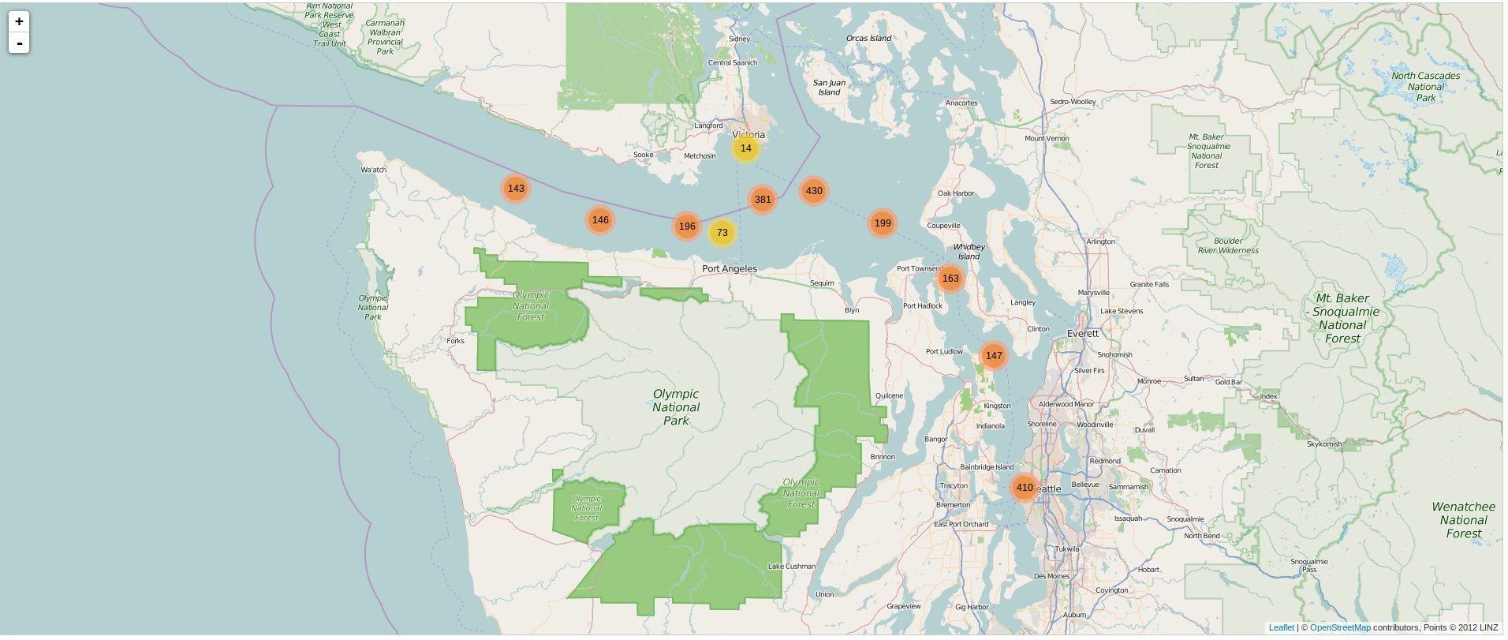
LAISIC
Intern:
Naval Research Enterprise Internship Program (NREIP)
University of Wisconsin-Madison
Organization:
SSC Pacific
Lab Coordinator:
kathleen.gately@navy.mil
Project Dates: JUN 01 – AUG 06 2015
Project Objective and Research Approach:
Develop a web based mapping application to display Automated Identification System (AIS) data
Develop an API to access the AIS data from database
Investigate methods to minimize data foot print on the map
Results / Accomplishments / Next Steps:
Built a mapping application based on Leaflet
Created an application to ingest AIS data into MySQL database
Created a Python application to provide a web based API to display AIS data based on a user query
Next:
Test and incorporate into existing LAISICAnalyzer code.
DISTRIBUTION STATEMENT A. Approved for public release; distribution is unlimited.

