Slide 1
E-kart
By Kamal Nayan(13cs01031)
Goddu vivek(13cs01030)

Slide 2
Project Description
In the following project we designed a E-Commerce website.
The main motivation behind this project is the growing trend of E-Commerce start ups.
We at E-Kart sell different kinds of electronics ranging from Laptops to Gaming Consoles.
Most of the basic functionalities are incorporated into the project.

Slide 3
features
A user can register and create an account in our website.
A user has to sign–in for using a personalized version of the website.
A user can add items to a cart.
A user can buy a cart of items.
Each user is provided with a wallet which has a particular balance.
A user can review and rate a product.
A user can search for a product.

Slide 4
ADDITIONAL FEATURES
Products are divided into categories.
Search Suggestions are provided.
Transactions are implemented using a wallet.
Transaction history is maintained for DBA.
Products are displayed on basis of popularity.
When a particular product is displayed, similar products are also displayed.

Slide 5
databases
Tables:
Users
Product
Cart
Categories
Reviews
Transaction
Transaction Details
Wallet

Slide 6
Domain constrains
VARCHAR : FIRST_NAME, LAST_NAME, EMAIL_ID, CITY, STATE, ZIP, PASSWORD, PHONE, ADDRESS, REVIEW, PRODUCT_NAME, DESCRIPTION, CATEGORY_NAME
INT : RATING, PRICE, STOCK, VIEW_COUNT, TOTAL_PRICE, QUANTITY, CATEGORY_ID, PRODUCT_ID, REVIEW_ID, TRANSACTION_ID
BLOB : PRODUCT_IMAGE_SMALL, PRODUCT_IMAGE_LARGE

Slide 7
CONSTRAINTS

Slide 8
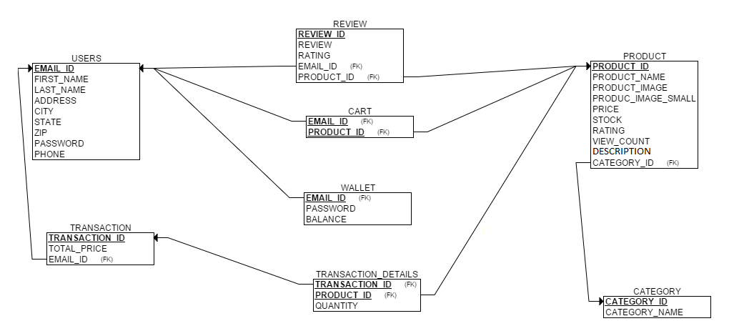
E-R DIAGRAM

Slide 9
RELATIONAL SCHEMA

Slide 10
Triggers
Rating This trigger helps in changing the rating of the product on the basis of reviews. However when there are no reviews some random rating is given by the DBA.

Slide 11
Normalization
Functional Dependencies
Email_id —› Users
Product_id —› Product
Category_id —› Categories
(User_id,P_id) —›Cart
Review_id —› Reviews
Transaction_id —› Transaction
Transaction_id —› Transaction_Details
User_id —› Wallet
All the tables are in BCNF.

Slide 12
Experimental setup
Back End Technologies used are
PHP
MySQL
Front End Technologies used are
HTML
CSS,
JavaScript
Ajax,
Bootstrap
JQuery

