Slide 1

Sreekar K(13CS01012)
Arun Tilak.S(13CS01043)

Slide 2
About Bidbot
Bidbot is an online auction portal.
It is a place where users can auction various types of items from electronics to vehicles etc.
Users will compete for an item through bidding and the highest bidder will get the item.
Users will participate in the bidding using their money from e-wallet.

Slide 3
How it works?
Each user will be given an amount of 1 lakh rupees upon registration.
This money will be utilized to buy the items that are up for auction.
When they are out of money or low on balance, they are not allowed to bid on products to maintain the justice in the auctions.
To gain money users have to sell any of their products in order to get money. This feature was added to promote trade among users.

Slide 4
Requirements
A user or customer has to signup, create his own account with his details and log into his account with a password.
Users can only participate in the bidding by logging into their accounts else they are redirected to register page.
He/she searches for products by typing in the search bar or they can choose a particular category of products available and browse through.

Slide 5
Pages
Home Page
Register
Post Ad
Product Detail
My Account

Slide 6
Functions
User Accounts :
A user can login with his credentials and can participate in bidding.
User can also Log Out!
Different Categories:
All the products have been categorized for a user friendly performance.
And different categories have different increment amount on bid.

Slide 7
Additional Functions
Restricted access to buy :
Unless the user is registered and logged in, the person can’t participate in the auction.
And only Users with Sufficient Balance are allowed to raise a bid.
Dynamic Updating:
The timer, bid amount and seller will be updated without any refreshing and thus without any delay.This gives users a better experience while competitively bidding for a product.

Slide 8
Additional Functions
Time Extension on each bid:
Every time an user bids in a particular auction the timer for the auction is extended by 10s so that other users get fair warning and have enough time to think about bidding.
Search Suggestions:
Search Suggestions are provided for search bar.

Slide 9
Additional Functions
Bid History
A history of bids on all products is provided for access only to DB Admin.
This can be used to provide better recommendations for user.

Slide 10
Tables
Users
Products
Account
Auction
Categories
Bids

Slide 11
Triggers
Producttoauction:
This trigger is activated when a new product is posted.The product is simultaneously added to auction list.
BidCheck: This trigger checks whether the user who is bidding on the product has enough balance to place the bid.
Checkuser:
This trigger checks before inserting values into users table while registration. It checks if any other user exists with the same Email ID.

Slide 12
Procedure
BidNow
This procedure helps in incrementing the price of the specific product as per the category’s increment rate.
Login:
Checks if the given email id and password exists in the users table.
Register:
Inserts the account details into account table and user details into user table.

Slide 13
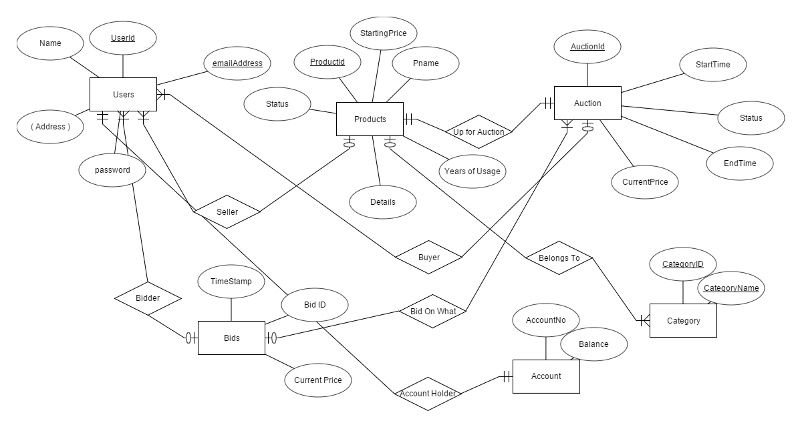
E-R Diagram

Slide 14
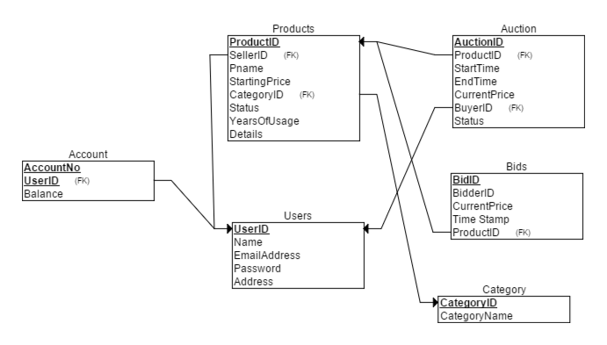
Relational Schema

Slide 15
Normalization
Functional Dependencies
UserID—› Users
ProductID—› Products
CategoryID—› Categories
(UserID,AccountNo) —›Account
(BidID)->Bids
AuctionID->Auction
All Tables are in BCNF Normal Form

Slide 16
Experimental Setup
Back End Technologies used are
PHP
MySQL
Front End Technologies used are
HTML
CSS,
JavaScript
Ajax,
Bootstrap
JQuery

Slide 17
Future Works:
We have stored bids made by all users in a separate table, this can be used to showcase the recent bidders for a specific product.
Recommendations can be provided to users on the basis of their previous experiences.
Transactions are implemented using a dummy wallet. This can be developed into PayPal or through online gateway

Slide 18
Future Works:
Wish list feature can be added where users can select their desired products and we will notify when the product is up for auction.
We can implement bid coins where user can use them for bidding any product instead of money. And bid coins can be allowed to be traded between accounts.And even bid coins can be put up for auction

