Slide 1
Charging Aotearoa — Where to Build Next
Commercial whitespace analysis for NZ EV charging operators
Case study deliverable
Notes:
Kia ora. I'm presenting my case study response — an analytical deliverable framed as if I were briefing the commercial strategy lead at a NZ charging network operator. The deliverable comprises a Snowflake warehouse, a dbt project, a six-page Power BI dashboard, and this short pitch. I'll walk through the approach, the modelling decisions, the headline findings, and where I'd take the analysis next.

Slide 2
What I heard — and who I built it for
• Brief is deliberately vague: "Is supply keeping up with demand?" First decision was framing.
• Audience choice: commercial / strategy lead at a charging network operator (ChargeNet, BP Pulse). Every visual answers "should I build here, and how big?"
• Alternative framings (policymaker, consumer) would have shaped this differently. Operator framing forces the sharpest commercial decisions.
• Deliverables: ELT pipeline (Snowflake + dbt) + analytics dashboard (Power BI) + this pitch.
Notes:
The case study's primary question is 'is supply enough?' — a question that sounds simple but actually breaks down differently for three audiences: a policymaker cares about national equity of access; a consumer wants route planning; a network operator wants to know where to spend their next CapEx dollar. I picked the operator framing because it forces the sharpest decisions — every chart on my dashboard has to answer 'should we build here, and how much capacity?' That's a much higher bar than a generic 'is supply enough' headline.

Slide 3
Approach — six principles guiding the build
• Source-of-truth in the warehouse, not in BI. Every metric recomputable from public data.
• Medallion architecture (Bronze → Silver → Gold) — clear separation of concerns.
• dbt for transforms. SQL-first, version-controlled, lineage-aware, test-enforced.
• Idempotent everywhere. DDL, loaders, dbt models, seeds — every re-run is safe.
• Defensive data quality. 157 dbt tests gating the build.
• One credential everywhere — key-pair RSA auth across dbt, SnowSQL, Python, Power BI.
Notes:
Let me explain my philosophy. First, the source of truth lives in the warehouse, not in Power BI — every metric the dashboard shows can be reproduced by running a SQL query against Snowflake. Power BI is rendering, not computing. Second, medallion structure: Bronze is 1:1 with source, Silver does the cleaning and joining, Gold is the business-ready star schema. Third, dbt over hand-written SQL — version control, lineage, tests, docs. Fourth, every step is idempotent: I can blow away the warehouse and rebuild from scratch in 60 seconds. Fifth, 157 tests at the dbt layer plus manual review of every data quality issue I found. And sixth — particularly proud of this one — every component of the stack uses the same RSA key-pair authentication. No passwords, no env vars, no key rotation drift. One private key file, four clients.

Slide 4
Architecture — data flow end-to-end
┌───────────────┐ PUT ┌──────────┐
│ MVR CSV │ ────────▶ │ │
│ EVRoam JSON │ │ RAW │
│ Stats NZ XLSX │ ─Python─▶ │ schema │
│ LINZ GPKG │ ─Python─▶ │ │
└───────────────┘ └────┬─────┘
│ dbt
▼
┌──────────┐
│ BRONZE │ 4 views
│ SILVER │ 6 views
│ GOLD │ 14 tables
└────┬─────┘
│ Import
▼
┌──────────┐
│ Power BI │ 6 pages
│ PBIP │
└──────────┘
• All compute happens in Snowflake. dbt + Python orchestrate, they don't process.
• Power BI imports Gold aggregates (small — largest is 469 rows).
Notes:
Here's the full picture. Four source files — the case-study CSV and JSON, plus the two additional blends (Stats NZ population and LINZ TA boundaries). They land in Snowflake's RAW schema via SnowSQL for simple file-based sources, and Python for the XLSX and GeoPackage that need preprocessing. Once in RAW, dbt takes over: four Bronze views (1:1 with source), six Silver views (parsing, joins, spatial enrichment), then 14 Gold tables that form the star schema. Power BI imports the Gold aggregates — they're small, the largest is 469 rows. All compute is in Snowflake; dbt and the Python loaders are clients, not engines.

Slide 5
Why dbt + Snowflake + Power BI specifically
• dbt over Python transforms: lineage, tests, docs, SQL-first. Auto-generated docs site is itself a deliverable.
• Snowflake over alternatives: native GEOGRAPHY type for spatial joins, cheap XS warehouse for trial-scale data, mature Power BI connector.
• Power BI over Tableau: matches NZ business audience tooling, PBIP folder format is source-controllable, conditional formatting via DAX.
• Python only where SQL can't: XLSX parsing (openpyxl), GeoPackage reading (geopandas), TA-name reconciliation seed generation. 3 loaders, ~80 lines each.
Notes:
Each tool earns its place. dbt over Python because the analytical work is fundamentally SQL — joins, aggregations, window functions — and dbt makes that testable and lineage-aware via the auto-generated docs site included in the deliverable. Snowflake because it has native GEOGRAPHY type for the spatial point-in-polygon work, separation of compute and storage so an XS warehouse handles 200K rows cheaply, and a mature Power BI connector. Power BI because in the NZ business market, Tableau is rarely the customer's existing tool. And Python only where SQL genuinely can't reach — parsing Excel, reading binary geometry, generating the reconciliation seed.

Slide 6
Four data sources — two provided, two chosen
• Motor Vehicle Register (case study): 196,728 vehicles. Snapshot — fleet reconstructed via FIRST_NZ_REGISTRATION_YEAR.
• EV Roam Charging Stations (case study): 407 sites with lat/lon, operator, connector list, kW.
• Stats NZ Subnational Population (chosen blend): 67 TAs × 3 years. Enables per-capita normalisation.
• LINZ TA 2023 boundaries (chosen blend): polygon geometries for spatial point-in-polygon joins.
• All four CC BY 4.0 — public, redistributable, attributed.
Notes:
The case study provides MVR and EV Roam. The interesting design choice was what to add. I chose Stats NZ subnational population because per-capita normalisation is what makes 'is supply keeping up?' actually answerable — without population, you can't fairly compare a 1.8M-population Auckland to a 6K-population Mackenzie. And LINZ TA boundaries because the spatial join from station coordinates to TA needs polygons. Both blends are public CC BY 4.0. The big modelling caveat is that MVR is a snapshot — vehicles deregistered before extract are missing — so I focus time-series analysis on 2018 forward where survivorship bias is minimal.

Slide 7
Five key modelling decisions — and what I learned
• 1. EV cohort classification — BEV vs PHEV vs HEV vs FCEV vs ICE
• 2. Benchmark choice — EU AFIR + NZ Strategy (stacked, not either/or)
• 3. Geographic grain — Territorial Authority (67 buckets), not Region or SA2
• 4. Name reconciliation — three sources spell the same TA three different ways
• 5. Source data quality issues — discovered and corrected in version-controlled seeds
Notes:
Five decisions shaped the deliverable. The first three are about modelling intent — what to count, what to compare against, at what grain. The last two are about real-world data quality realities that the case study brief deliberately under-specified.

Slide 8
What counts as an "EV" — and what does "enough" mean
• 5 cohorts locked early: BEV / PHEV / HEV / FCEV / ICE. Only BEV and PHEV count toward charger demand.
• EU AFIR (Benchmark A): 1.3 kW public charger capacity per BEV, 0.8 kW per PHEV.
• NZ National EV Charging Strategy (Benchmark B): 10,000 public chargers by 2030; DC fast every 75 km on SH (legacy), hubs every 150–200 km (current).
• Why stack both: AFIR gives sharp operator-actionable kW shortfall; NZ Strategy gives local political reference.
Notes:
Let's start with what counts as an EV. MVR has 15+ distinct MOTIVE_POWER values. Not all are plug-in. A 'PETROL HYBRID' is a Toyota Camry Hybrid — regenerative braking only, doesn't use public chargers. So I locked five cohorts in a dbt macro. On benchmarks: the question 'is supply enough' is meaningless without a yardstick. I picked EU AFIR because it converts cleanly to operator-actionable kW shortfall by TA. Then I stacked the NZ National EV Charging Strategy on top for local political context: 10,000 chargers by 2030, 75 km legacy / 150 km current spacing. AFIR is the headline; NZ Strategy is the context.

Slide 9
Why Territorial Authority — and the dirty-data lesson
• Grain choice — TA (67 NZ TAs). Region (16) is too coarse — Auckland Region is 1.7M people in one bucket. SA2 (~2,400) too fine — most have <50 EVs.
• TA matches operator decision grain (city / district scale).
• Name reconciliation problem: MVR has 'WHANGAREI DISTRICT' (uppercase, no macron). Stats NZ has 'Whangārei district' (macron, lowercase d). LINZ has 'Whangarei District' (no macron, capital D).
• Solution: seed_ta_name_map.csv — 67-row reconciliation, version-controlled, hand-reviewed, with canonical names + region + island annotations.
• Lesson: never trust string joins across NZ government datasets. The macron issue alone would silently drop ~10 TAs from any naïve join.
Notes:
Geographic grain was the first hard call. NZ Regional Council (16) is too coarse — Auckland Region alone is 1.7M people, you can't make commercial whitespace decisions at that level. SA2 — the 2,400 statistical-area-2 polygons — is too fine; most rural SA2s have under 50 EVs. TA — 67 city and district councils — is the sweet spot. It's also the grain at which a charging operator actually makes site-selection decisions. But that created a problem: the same TA appears three different ways across our three data sources. If you naively join on TA name, you silently drop around 10 TAs because of the macron mismatch alone. So I built a 67-row reconciliation seed — version-controlled CSV, hand-reviewed — that maps each source's name to a single canonical form. Build it once, every downstream model uses it. This was the analysis-quality save of the whole build.

Slide 10
What I found when I actually looked at the data
• 'bp charge Wairakei' station: longitude stored as 76 (in India). Should be 176. Caught by dbt test; corrected via seed_evroam_overrides.csv.
• 'STADIUM SOUTHLAND': stored at Auckland CBD coordinates instead of Invercargill. Discovered via 'zero-km cross-island pair' anomaly in distance analysis.
• MVR oddities: two rows have TLA = '8-GEAR AUTO' and 'OTHER' (a transmission type leaked into TA field). 2 / 196,728 — flagged, filtered, documented.
• Stats NZ aggregate row leaked: my first loader missed 'New Zealand(3)'. Caught by population range test (>2.5M sanity bound). Loader patched.
• All fixes are in version control. Re-running the build reproduces the same clean output.
Notes:
A handful of real data quality issues surfaced during the build. The bp charge Wairakei station has its longitude stored as 76 instead of 176 — the operator entered the wrong number, putting the station on the map in India. I found it via a dbt test flagging lat/lon outside the NZ bounding box. The fix is in an override seed file — version controlled, with a reason column for audit. Similar story for Stadium Southland — its coordinates point to Auckland CBD, discovered when the distance-to-nearest-station analysis flagged a '0 km cross-island' pair. The MVR has two records with garbage TLA values — probably a data-entry error decades ago. Stats NZ's footnote suffixes initially leaked an aggregate national row into my TA-level table. None of these are catastrophic, but cumulatively they're the difference between a dashboard that lies confidently and one that tells you when it doesn't know.

Slide 11
Fleet composition — what's actually on the road
• 9,623 EVs total (BEV + PHEV) — 72.6% BEV / 27.4% PHEV.
• Average fleet age: 3.2 years. Newer than expected for a market often described as used-import-dominated.
• 79.8% are NEW imports, only 20.1% used. Tesla Model 3, BYD Atto 3, MG ZS lead the new-import wave.
• Nissan Leaf still dominant single model at 1,484 vehicles (15% of all EVs) — mostly used JDM imports, mostly CHAdeMO.
• Operator implication: install base is two cohorts — older Leafs (CHAdeMO) and newer Teslas / BYD / MG (CCS Type 2). Dual-format stations are not optional.
Notes:
Now — the findings. I'll walk through the dashboard pages in order, starting with the lay of the land. The first page of the dashboard — EV Fleet Landscape — answers 'who's charging?' Three things worth flagging. First, NZ's EV fleet is younger than the typical narrative suggests — average vintage is 3.2 years. Second, 80% are new imports — Tesla Model 3 and Y, BYD Atto 3, MG ZS — not used Japanese imports. The 'JDM used import' stereotype is half wrong now. Third, the Nissan Leaf is still the single biggest model at 1,484 vehicles, 15% of the entire EV population, almost all imported used and uses CHAdeMO. So an operator has two distinct customer bases: older Leafs that need CHAdeMO, newer Teslas and BYDs that need CCS Type 2. This is why every NZ DC fast site has both formats. It's not redundancy — it's market reality.

Slide 12
Charging network — connector formats decoded
• 1,077 operative connectors across 407 stations. 67% DC / 33% AC.
• kW bands: 50–149 kW (DC fast) is largest at 482 connectors. 150+ kW ultra-fast only 61 (6% of total).
• Format mix: Type 2 CCS 33%, Type 2 Socketed 32%, CHAdeMO 30%, others <5%.
• Format glossary: CCS Type 2 (Tesla/BYD/MG modern); Type 2 Socketed (AC destination charging); CHAdeMO (Nissan Leaf, declining); Type 1 CCS (older, niche in NZ).
• Build-out wave: clear 2018 spike (EECA funding), slowdown 2019–2020, recovery from 2022.
Notes:
The second page of the dashboard — Network Deep Dive — breaks down the charging network technology. NZ has 1,077 operative connectors today, two-thirds DC, one-third AC. The connector format mix is the interesting story. Type 2 CCS is the modern fast-DC standard — combines AC and DC pins in one connector. Type 2 Socketed is AC-only destination charging — slow, used at hotels and shopping malls, you bring your own cable. CHAdeMO is the older DC standard from Japan, used by the Nissan Leafs we just talked about — being phased out globally but still 30% of NZ's connector count. The fact that CCS, CHAdeMO, and AC Socketed are each around 30-33% reflects NZ's dual-cohort market — operators build dual-format DC fast sites with both CHAdeMO and CCS so they can serve any vehicle. The 2018 station-build spike is the EECA co-investment fund kicking in. We're now in a second growth wave.

Slide 13
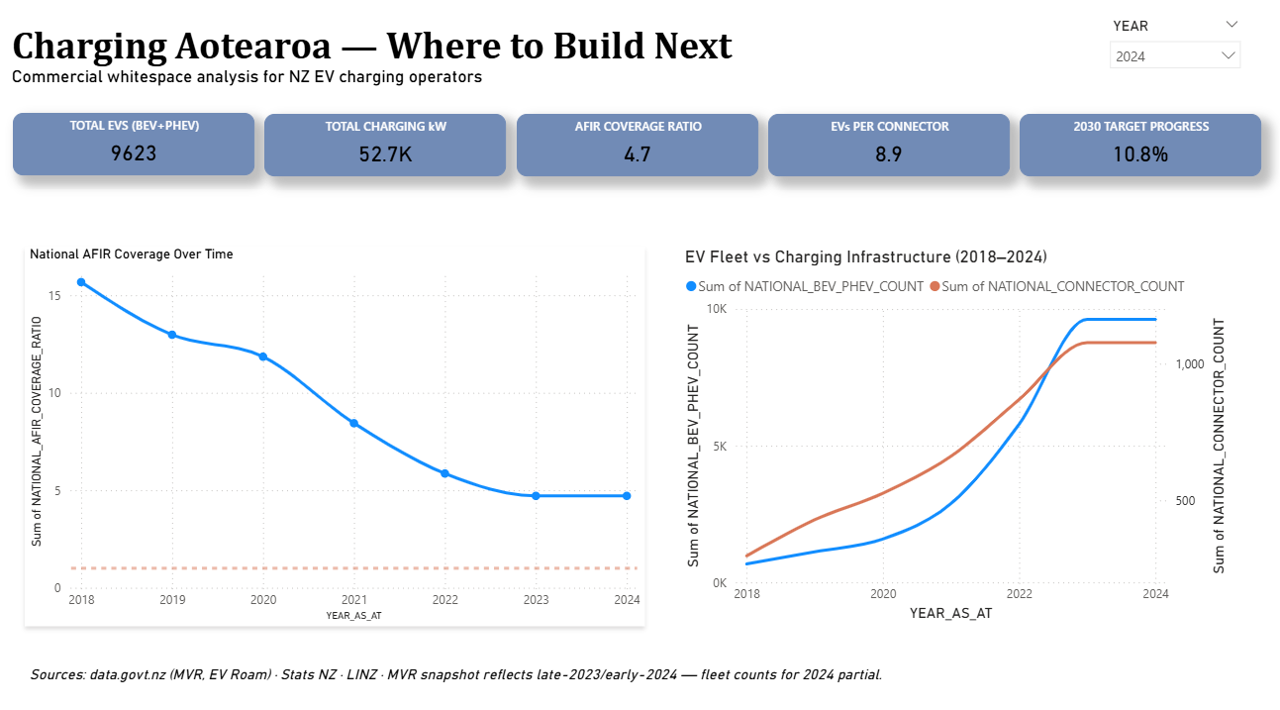
National AFIR coverage — the trajectory tells the story
• 2018: 15.7× over-supplied (early honeymoon)
• 2024: 4.7× over-supplied (still buffer, shrinking fast)
• 2030 target progress: only 10.8% of NZ's 10,000-charger goal
• EVs grew 14× while connectors grew 3.6× over six years — demand outpacing supply 4:1
• At current rates, NZ crosses AFIR=1.0 around 2030 — same year as the NZ Strategy target
Notes:
Now that you've seen the fleet and the network, here's what the trends say. This is the executive summary page — the third page of the dashboard. Don't read this as 'supply isn't enough' — nationally NZ is comfortably over the AFIR threshold today, at 4.7 times required kW. The story is the trajectory. In 2018 the country was 15.7x over-supplied — early EV adoption with abundant infrastructure. By 2024 that margin has shrunk to 4.7x and is still falling. Why? EVs grew 14x over six years while public charging capacity grew only 3.6x. Mathematically, if you extrapolate the current trajectory, NZ crosses the AFIR threshold of 1.0 somewhere around 2030 — almost exactly the year the NZ National EV Charging Strategy targets 10,000 chargers. The country has roughly five years of national margin. The interesting question is no longer 'is supply enough' — it's 'where does the margin run out first?' That's an operator question.

Slide 14
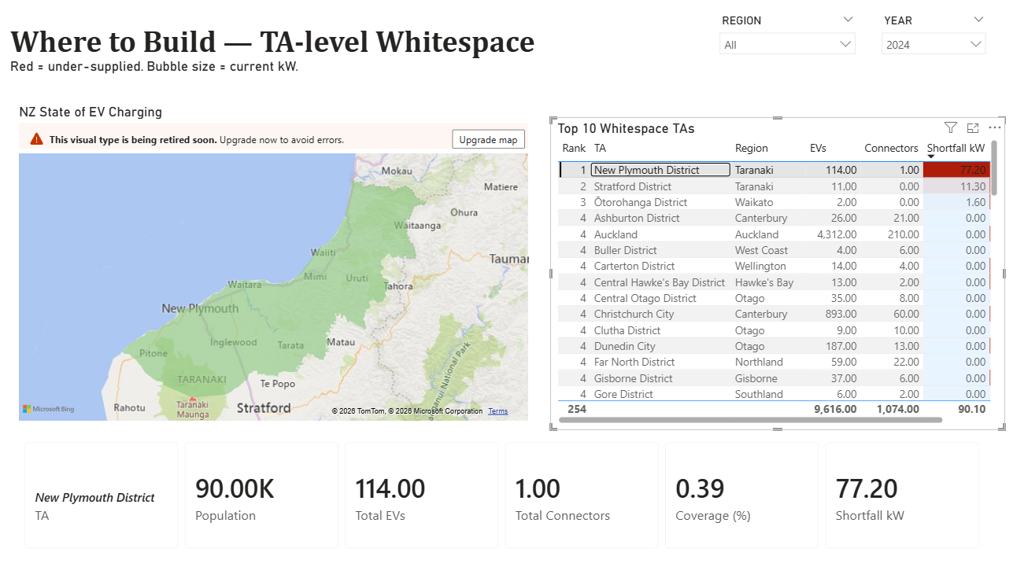
Where to build — the whitespace map
• Only 3 TAs technically under AFIR threshold today: New Plymouth (90K pop, 114 EVs, 1 connector!), Stratford, Ōtorohanga.
• 64 other TAs all meet AFIR — tourism corridors like Mackenzie (95×) and Westland (103×) are over-supplied (chargers serving out-of-region traffic).
• Top whitespace ranking drives the operator pitch (right-rail of the whitespace map page).
• "Where to build first" answer: New Plymouth. Right now. Lowest-competition, highest-demonstrated-demand site in the country.
Notes:
This is the punchline. The whitespace map — the fourth page of the dashboard — is the operator answer. Across 67 NZ Territorial Authorities, only three are technically under the AFIR threshold today. New Plymouth District jumps out: a city of 90,000 people with 114 registered EVs and one public connector. One. Coverage ratio of 0.39 — they need 197 kW of public charging and have 60. The next two — Stratford and Ōtorohanga — are small towns with under 15 EVs each; building there would be speculative. New Plymouth isn't speculative; demand is already on the road. The other 64 TAs all meet AFIR, with interesting structure — tourism corridors like Mackenzie (Mt Cook) and Westland (West Coast) are at 95x to 103x because chargers there serve out-of-region traffic. Auckland's at 2.33x — densest market but still over the line. If I were ChargeNet's #2 competitor: build New Plymouth first. After that, top-10 by AFIR shortfall on the right.

Slide 15
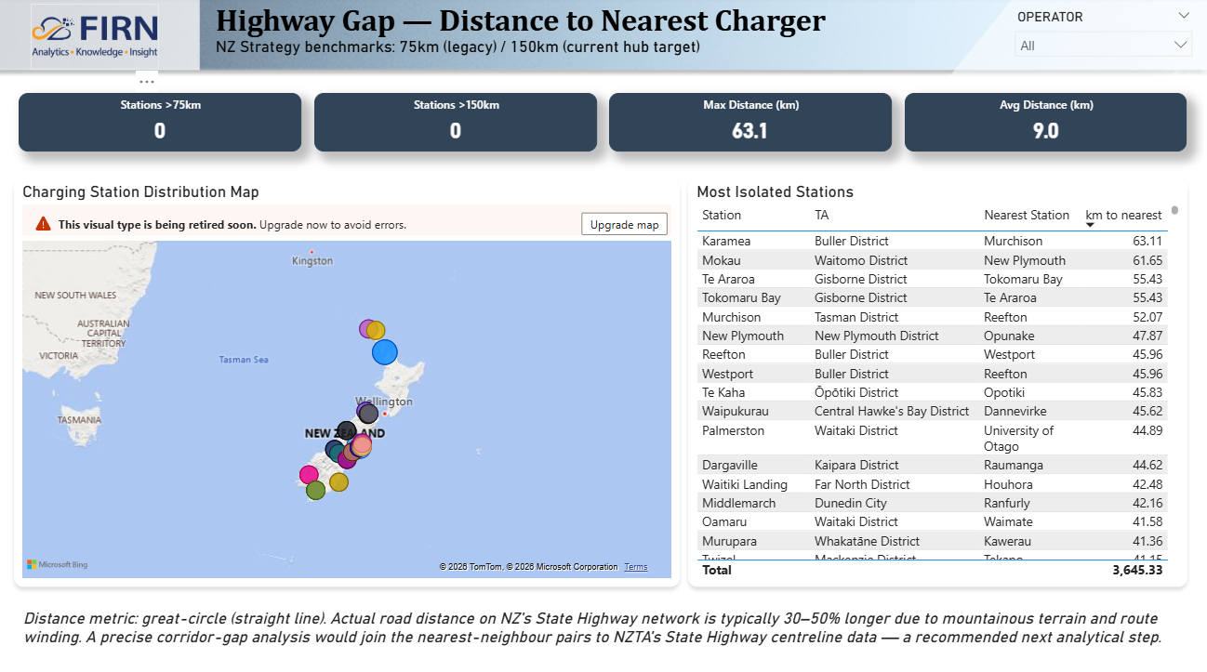
Highway Gap — distance to nearest charger
• 0 stations breach the 75km legacy threshold or 150km current hub target (great-circle).
• Average inter-station distance: 9 km; max 63 km (Karamea ↔ Murchison).
• Most isolated rural corridors: West Coast, East Cape, central Taranaki.
• Caveat: great-circle distance only — actual road distance on NZ's SH network is typically 30–50% longer.
• Operator implication: a 'second wave' investment thesis. Whitespace TAs (Slide 14) come first; State Highway corridor fill-in is next.
Notes:
Page 5 of the dashboard is the Highway Gap analysis. NZ Strategy sets two distance benchmarks: 75km legacy spacing on State Highways, 150km hub spacing as the current target. By great-circle distance, NZ meets both — zero stations breach either threshold. Max is 63km (Karamea-Murchison), average is 9km. But great-circle is optimistic — actual road distance on NZ's mountainous SH network is typically 30 to 50 percent longer. So this page tells you NZ meets the targets by air, not necessarily by road. The most isolated rural pairs are predictable: West Coast, East Cape, central Taranaki. For an operator this is a second-wave investment thesis — the whitespace TAs are the first plays; State Highway corridor fill-in is next, and needs NZTA's actual road-network centreline data to quantify properly. Including this page in the deliverable matters because the honest disclosure of the caveat IS the value — a less rigorous analysis would just claim 'NZ meets NZ Strategy targets' and stop.

Slide 16
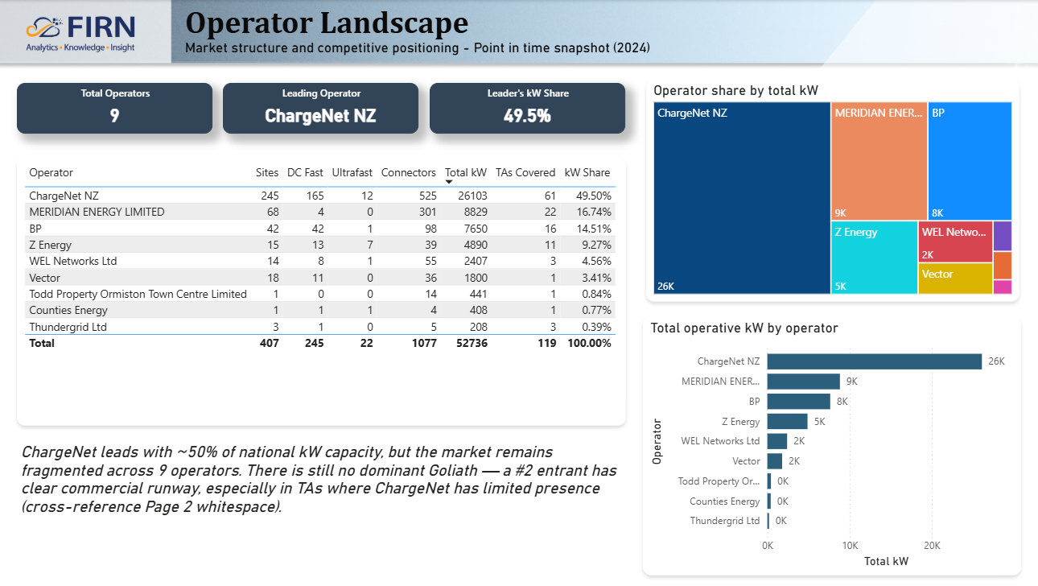
Operator Landscape — fragmented market, no Goliath
• 9 operators in NZ's public charging market.
• ChargeNet leads at 49.5% of national kW (245 sites / 525 connectors / 26 MW / 61 of 67 TAs covered).
• Meridian 16.7%, BP 14.5%, Z Energy 9.3% — top 4 = 90% of national capacity.
• Long tail: WEL Networks (4.6%), Vector (3.4%), plus 3 sub-1% operators.
• Strategic read: NOT a duopoly. A #2 entrant has clear runway, especially in TAs where ChargeNet has limited presence.
Notes:
Page 6 is the Operator Landscape — market structure for somebody considering entry. Nine operators total. ChargeNet leads at 49.5% of national kW but isn't a dominant Goliath. Meridian at 16.7% (generator-backed). BP at 14.5% (petrol forecourt advantage). Z Energy at 9.3% (same forecourt advantage). Together top-4 = 90% of capacity. Then a fragmented long tail — WEL Networks 4.6% (Waikato regional lines company), Vector 3.4% (Auckland), plus three sub-1% operators. The strategic read: this isn't a petrol-retail duopoly. A new entrant who builds 50 well-sited stations could take #5 or #6 nationally; 100-150 puts them in striking range of #2. Connect back to the whitespace map — ChargeNet's lowest-presence TAs correlate with the highest-AFIR-shortfall TAs. That's the entry-strategy signal.

Slide 17
Recommendations + next analytical steps
For an operator, today
What I'd add next sprint
• Build in New Plymouth. Highest AFIR shortfall, lowest competition, demand demonstrated.
• Default new sites to CCS Type 2 + 50–150 kW band, with CHAdeMO for the Leaf install base.
• Cross-reference the whitespace map page for sub-target TAs: Stratford, Ōtorohanga, Hastings, Western Bay of Plenty.
• NZTA SH centreline — turns great-circle distance into actual road-network gap analysis.
• Grid capacity data — charger sizing must match local lines. Currently invisible.
• EECA Public EV Charger Dashboard usage — flips analysis from 'where's the gap' to 'where's the profitable gap'.
• EV imports time series — Customs / NZTA registration funnel. Predicts next 12 months of fleet growth.
Notes:
So what would I tell a strategy lead with this analysis? Build New Plymouth first. Default new builds to CCS Type 2 plus CHAdeMO at 50–150 kW. And look at the rest of the top-10 whitespace TAs on the whitespace map page for second-wave sites. Given another sprint, three additions would strengthen the analysis materially. First, NZTA's State Highway centreline data — that turns my great-circle distance analysis into proper road-network gap analysis, which matters because NZ's roads wind a lot. Second, grid capacity data — I can tell you where demand is, but not whether the local lines can support a 150 kW station. Third, EECA's Public EV Charger Dashboard has actual utilisation data — which existing sites are profitable. With that you flip from 'where's the gap' to 'where's the gap AND the profitable demand.'

Slide 18
Thank you — happy to dig into anything
• Built: Snowflake warehouse + dbt project (30 models, 157 tests) + Power BI dashboard (6 pages, 28 measures) + dbt docs site.
• Headline: NZ has ~5 years of national AFIR margin; New Plymouth is the standout site opportunity today.
• Public artifacts: dbt docs HTML (browseable), Snowflake operational runbook, the PBIP folder.
• Repo: all of this is version-controlled — 12+ commits, idempotent rebuild from scratch.
Notes:
That's the substantive material. To recap deliverables: Snowflake warehouse, 30-model dbt project with 157 passing tests, six-page Power BI dashboard, and a browseable dbt documentation site as a static HTML file. The whole thing is in version control with idempotent rebuild from scratch. Happy to dig into any layer: the data quality fixes, the DAX measures, the architecture choices, the modelling logic, the Snowflake DDL, anything. Thank you.

Slide 19
Appendix
Connector format glossary · AFIR formula · dbt project shape
Notes:
(Appendix slides — leave-behind material for Q&A.)

Slide 20
Appendix A — Connector format glossary
• Type 2 CCS — modern fast-DC. Tesla, BYD, MG, VW, Polestar, Audi, Hyundai/Kia (new). ~33% of NZ connectors.
• CHAdeMO — older DC standard. Nissan Leaf (all gens), older Mitsubishi. ~30% of NZ; declining globally.
• Type 2 Socketed — AC-only destination charging (7–22 kW). Hotels, malls, workplaces. ~32% of NZ.
• Type 2 Tethered — AC with hard-wired cable. Niche, usually private/destination.
• Type 1 CCS — older DC variant. Older Outlander PHEV, BMW i3. <2% of NZ.
Notes:
The connector format glossary serves the Q&A. CCS Type 2 is the global modern standard that Tesla, BYD, and MG all use in NZ. CHAdeMO is the legacy DC standard from Japan, used almost exclusively by the Nissan Leaf install base. Type 2 Socketed and Tethered are AC-only destination charging — slow, used at hotels and workplaces. Type 1 CCS is the older variant used by some PHEVs and US-spec imports; vanishingly small in NZ.

Slide 21
Appendix B — AFIR formula
EU Alternative Fuels Infrastructure Regulation
(Regulation EU 2023/1804)
AFIR Required kW = 1.3 × BEV_count + 0.8 × PHEV_count
Distance rules for TEN-T highway network:
• Charging pool every 60 km
• Pool minimum 400 kW total
• At least one point ≥150 kW by end-2025
• Applied per-TA and nationally as our headline KPI.
• Distance rule mapped loosely onto NZ's State Highway network (Page 3 of dashboard).
Notes:
AFIR is the EU's regulatory benchmark for public charging supply. It sets a power-output target — kW available — not a count of chargers. The formula is 1.3 kW per BEV plus 0.8 kW per PHEV. PHEVs get a lighter weight because they have onboard petrol motors and use public charging less often. Plus distance rules on the trans-European highway network: a charging pool every 60 km with at least 400 kW total and one point at 150+ kW by end of 2025.

Slide 22
Appendix C — dbt project shape
• Bronze: 4 views (1:1 with RAW). Type casting + light cleaning only.
• Silver: 6 views. EV classification, JSON connector parsing, spatial point-in-polygon, distance matrix.
• Gold dimensions: 5 tables. Date, Geography (TA), Vehicle Model, Station Operator, Connector Type.
• Gold facts: 4 tables. Vehicle Registration, Charging Station, Station Connector, Station Distance.
• Gold aggregates: 5 tables. Supply-demand-by-TA-year (flagship), national, whitespace, highway gap, operator landscape.
• Seeds: 2 — seed_ta_name_map.csv (67 rows), seed_evroam_overrides.csv (2 rows).
• Tests: 157 — uniqueness, not-null, accepted values, range, relationship integrity.
Notes:
The dbt project anatomy: four Bronze views, six Silver views, fourteen Gold tables. The flagship aggregate is supply-demand-by-TA-year — 469 rows that drive Page 2 of the dashboard. Two seeds for the things that are 'manually curated reference data' rather than 'sourced from the warehouse.' 157 tests gating the build.

