Slide 1
Election DAPP
Razi Ali Saleh (315888537)
Aaron Katzin (209597921)

Slide 2
Known Bugs
Any password works for users
Use Chrome only, there seem to be issues running from other browsers
Content Here

Slide 3
Setup Instructions
In order to use this DAPP:
Clone this repo from https://github.com/AaronKatzin/electionDAPP.
CD to the project root.
Run "npm install" and "bower install" in order to install dependencies.
Install and open Ganache, then quickstart ethereum.
Install MetaMask, import the accounts from ganache based on the MNEMONIC/seeder phrase
Run run.cmd to compile/migrate contracts, start the web server, and open the voter page.
Import the compiled Election contract hash as a new token in MetaMask and it will show up as the VT token
To easily view a demo of the DAPP you can go to https://aaronkatzin.github.io/electionDAPP/.
The demo doesn't function due to no blockchain running (e.g. Ganache). But the GUIs will load.
Content Here

Slide 4
Example Setup Console Log
PS C:\Users\akatzin\git\electionDAPP> ./run.cmd
C:\Users\akatzin\git\electionDAPP>truffle migrate --reset & explorer "http://localhost:8080/index.html" & node src\js\webserver.js
Compiling your contracts...
===========================
> Compiling .\contracts\Election.sol
> Compiling .\contracts\Election.sol
> Compiling .\contracts\Migrations.sol
> Compiling .\contracts\voterToken.sol
> Compiling .\contracts\voterToken.sol
> Artifacts written to C:\Users\akatzin\git\electionDAPP\build\contracts
> Compiled successfully using:
- solc: 0.4.25+commit.59dbf8f1.Emscripten.clang
Starting migrations...
======================
> Network name: 'development'
> Network id: 5777
> Block gas limit: 6721975 (0x6691b7)
1_initial_migration.js
======================
Replacing 'Migrations'
----------------------
> transaction hash: 0x1c696ec2e85feb3b76f1bae296295668a514aca00fc57f13b2684f19de3dd8db
> Blocks: 0 Seconds: 0
> contract address: 0x14322e1665e456B3134750DE9C71606419dB3C11
> block number: 17
> block timestamp: 1645100456
> account: 0x406bb6D051927994fe0B91338d61EcB0a9f655C2
> balance: 99.83152916
> gas used: 277462 (0x43bd6)
> gas price: 20 gwei
> value sent: 0 ETH
> total cost: 0.00554924 ETH
> Saving migration to chain.
> Saving artifacts
-------------------------------------
> Total cost: 0.00554924 ETH
2_deploy_contracts.js
=====================
Replacing 'Election'
--------------------
> transaction hash: 0x14b6a8e8bd6722e9ac18d7d825db61377c885eafa04a0bb54cf2d0119d85ee67
> Blocks: 0 Seconds: 0
> contract address: 0xb3C079C004E5BbE4aA5c2077E79D030eB64a9F66
> block number: 19
> block timestamp: 1645100457
> account: 0x406bb6D051927994fe0B91338d61EcB0a9f655C2
> balance: 99.71229396
> gas used: 5919752 (0x5a5408)
> gas price: 20 gwei
> value sent: 0 ETH
> total cost: 0.11839504 ETH
> Saving migration to chain.
> Saving artifacts
-------------------------------------
> Total cost: 0.11839504 ETH
Summary
=======
> Total deployments: 2
> Final cost: 0.12394428 ETH
Web server running on 8080...
Content Here

Slide 5
Explanation of Modules
There are two contracts:
voterToken.sol – An ERC-20 token which is awarded to each voter
Elections.sol – The election contract responsible for all the voting operations and logic. This contract inherits the VoterToken contract in order to award the voters.
There are two HTML pages:
index.html – The GUI for voters
Admin.html – the GUI for the admin
There are four Javascript files:
voting.js - to facilitate the functions called in the HTML pages that trigger the Solidity functions
webserver.js – to run the server for the web pages
web3.min.js – auto generated to deal with web3 requests
truffle-contract.js - auto generated to deal with truffle requests
Content Here

Slide 6
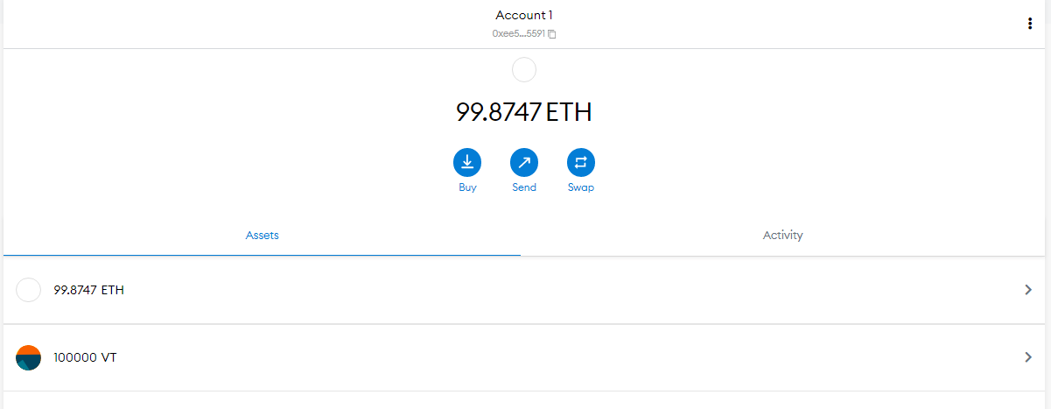
Example of Election
After running run.cmd: Import the Elections contract address into MetaMask and you’ll see that the admin address has VT Tokens
Content Here

Slide 7
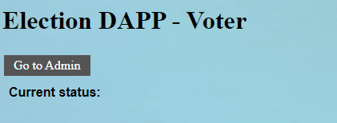
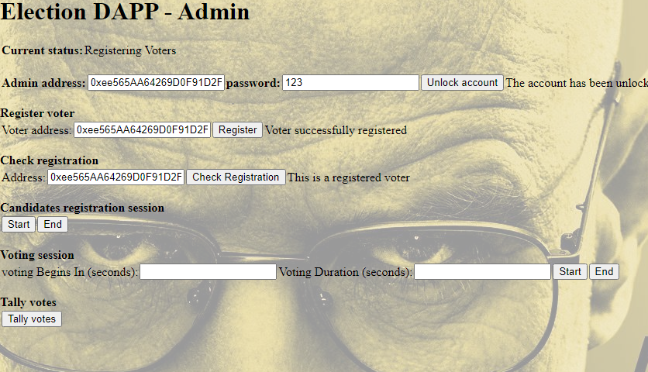
Example of Election (continued)
Go to the admin GUI by pressing the grey “Go to Admin” button
Enter the Admin address and password (the first Ganache address)
Register all voters by inserting their addresses one by one and clicking “register”
You can check that an address is registered
Content Here

Slide 8

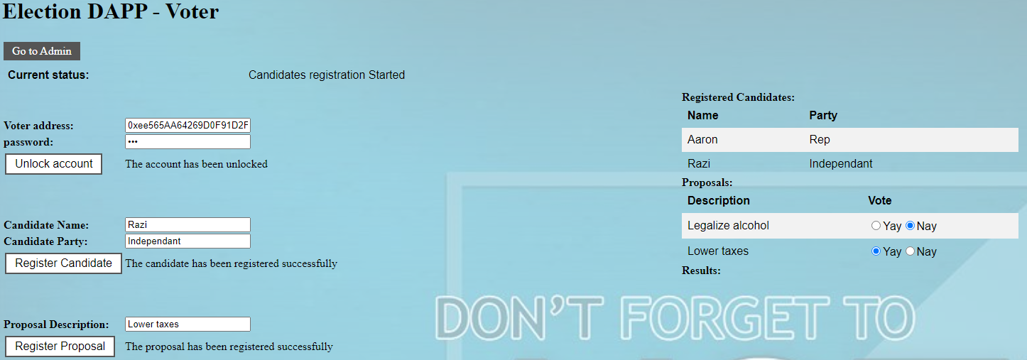
Example of Election (continued)
Start the registration session
Switch to the voter GUI
Insert a registered voter’s address and password
Add a candidate and party
Add a proposal
Content Here

Slide 9
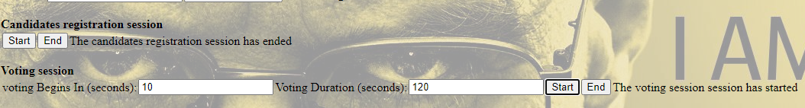
Example of Election (continued)
In the admin GUI end the registration sesstion
Schedule the voting session to begin and end in X seconds
Content Here

Slide 10
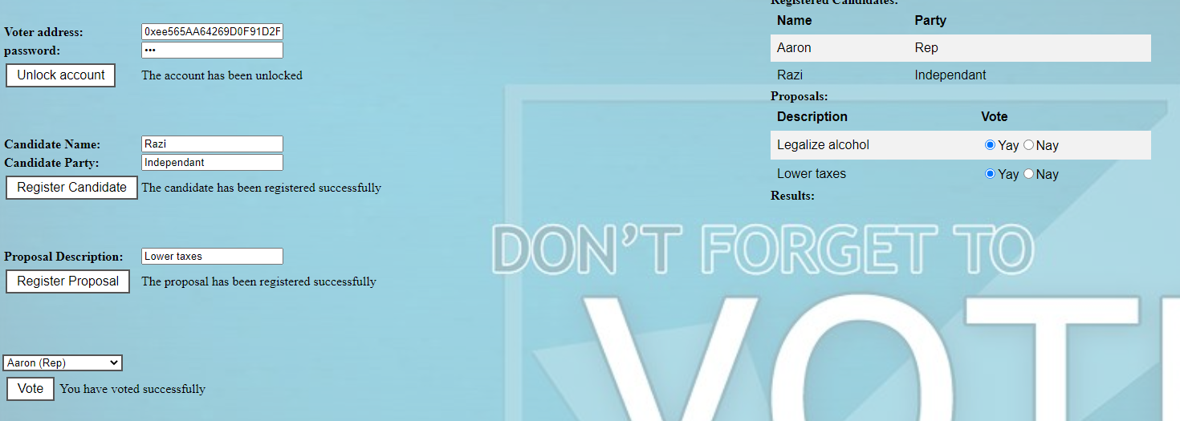
Example of Election (continued)
After the voting session has begun, go the voter GUI
Enter a voter address and password
Toggle the proposal “yay” or “nay”
Choose a candidate from the dropdown list
Click “vote”
Repeat from the beginning for all voters
Content Here

Slide 11
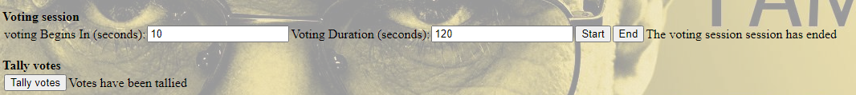
Example of Election (continued)
After the voting session has ended, go the admin GUI
Click “End”
Click “Tally votes”
Content Here

Slide 12
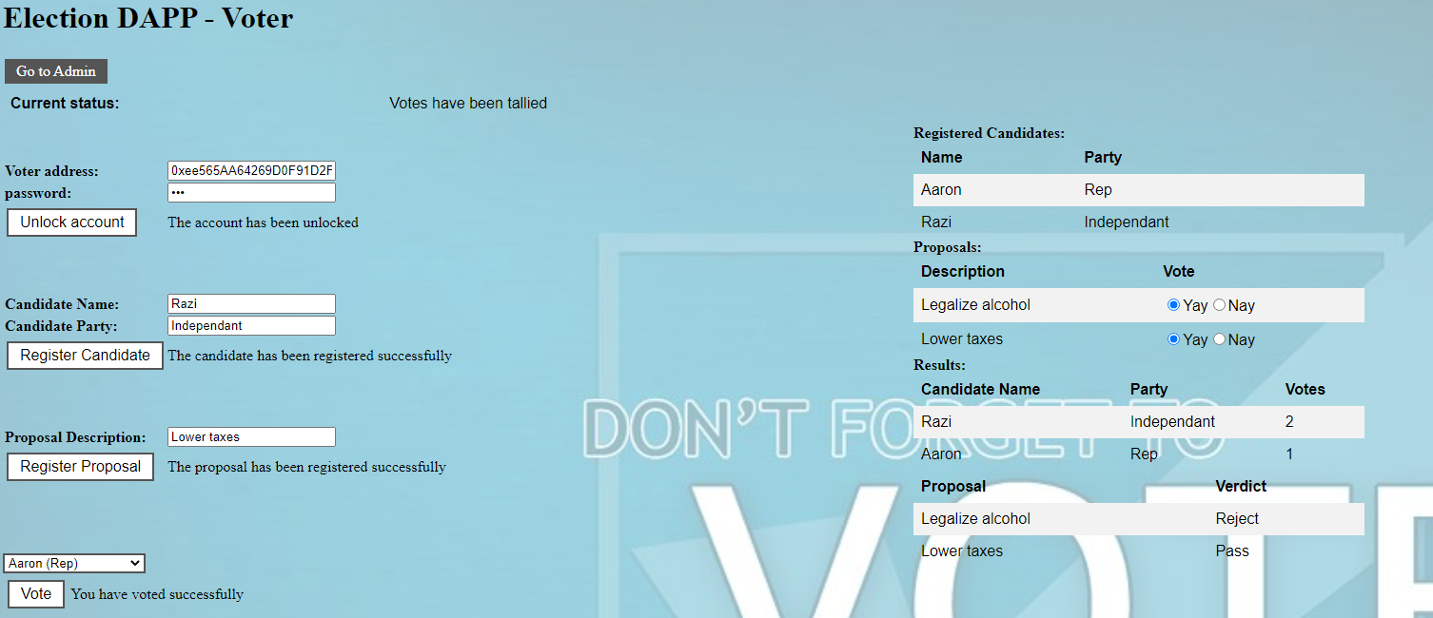
Example of Election (continued)
In the voter GUI you’ll see the results
In this example 2 voters voted for Razi and only 1 for Aaron and therefore Razi won
In addition, 2 voters approved lowering taxes but only 1 voter approved Legalizing alcohol. Therefore, only the taxes proposal passed and the alcohol proposal was rejected.
Content Here

Slide 13
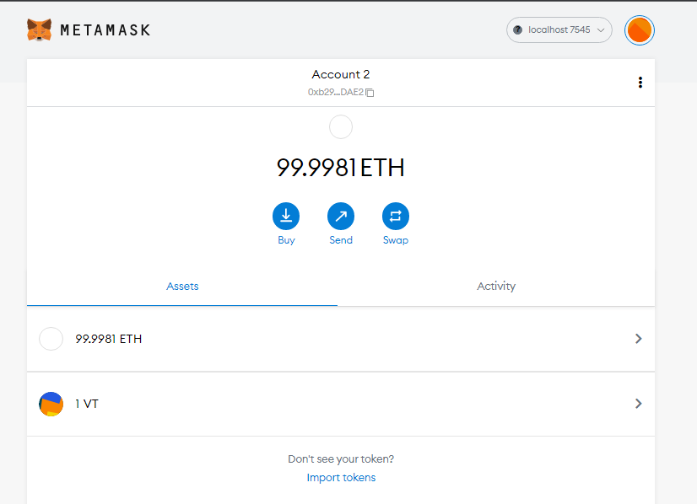
Example of Election (continued)
You’ll see in MetaMask that each voter has received a VT token
Content Here

