Slide 1
L-DIVERSITY IMPLEMENTATION AND TESTING
Data Protection and Privacy
Leonardo Giacobbe
Lorenzo Giampietro
Aaron Kromer

Slide 2
CONTENTS
The following is a list of the steps followed during the creation of the project:
Creation of a realistic fake dataset.
Implementation of l-diversity as an algorithm.
Algorithm testing on our fake dataset.
Analisys of the performance of the tool on the generated dataset with focus on:
- performance and efficiency
- privacy and utility level
- statistical information before and after.

Slide 3
CREATION OF A FAKE DATASET (1)
Creation of a fake dataset using Python and Faker library
Focused on creating weighted attributes in order to keep data distribution under control
Used seeds for random function and faker to keep repeatability of results
The generated dataset contains the following attributes:
First name
Last name
Gender
Age
Zip code
Education
Role
Salary

Slide 4
CREATION OF A FAKE DATASET (2)
In the dataset are present all types of attributes: explicit identifiers, quasi identifiers and sensitive data
We classified our attributes in the following way:
Explicit identifiers (EI): first name, last name
Quasi identifiers (QI): gender, age, zip code, education, role
Sensitive data (SD): salary
The number of generated records can be set as desired by modifying the default value or by specifying the desired value inside the terminal
At the moment the default value is set to 10000 records

Slide 5
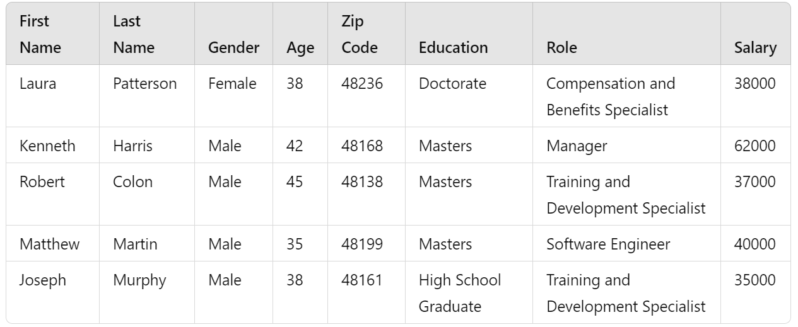
CREATION OF A FAKE DATASET (3)
The following is a part of a sample of our generated dataset:

Slide 6
GENERALIZATION (1)
We split our quasi identifier attributes into categorical and numerical:
Categorical: gender, role, education
Numerical: age, zip code
Categorical attributes will be generalized using a generalization tree
Numerical attributes are generalized as follows:
- Zip code: generalized suppressing the last cipher and substituting it with *
- Age: generalized inside a range of ages

Slide 7
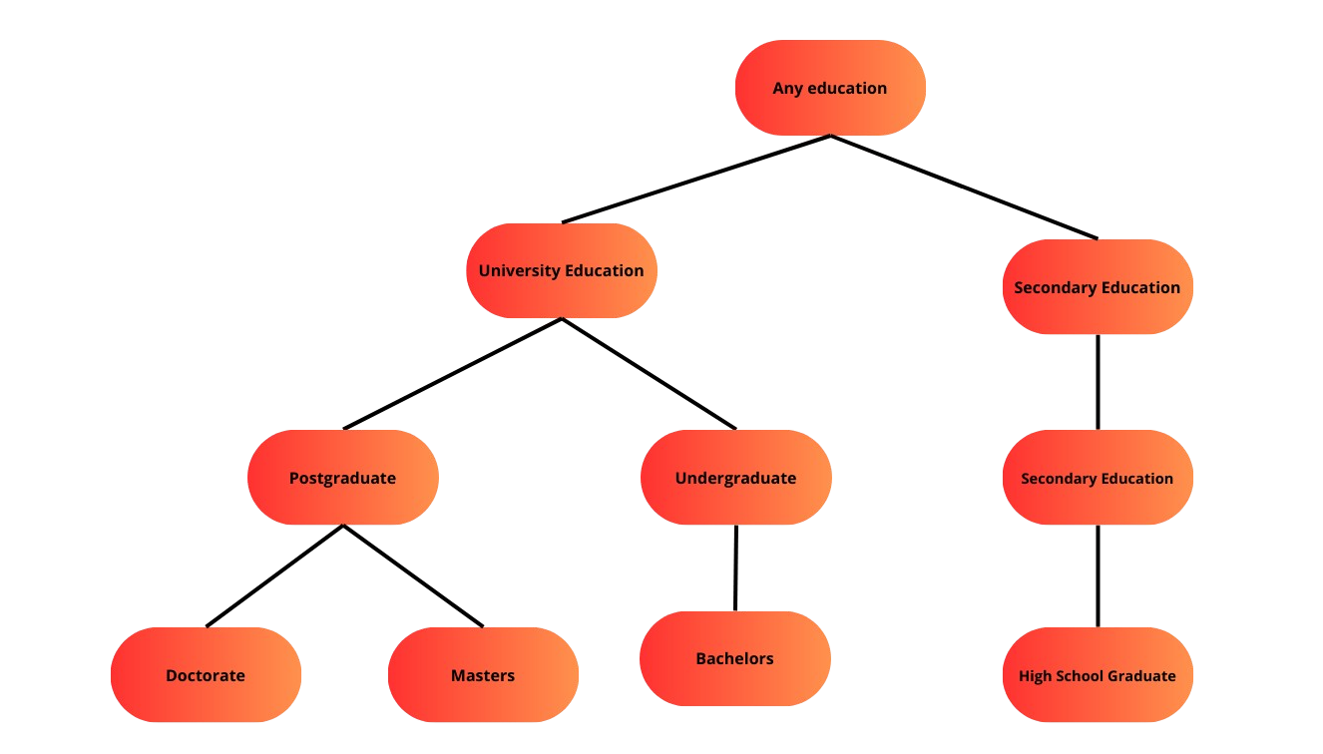
GENERALIZATION (2)
This is how we implemented generalization on our categorical attributes:
As shown in the image on the left, we can see three different levels of generalization, plus the first original level

Slide 8
GENERALIZATION (3)
This is how we implemented generalization on our numerical attributes.
Zip codes’ generalization:
16011 -> 1601*
Age generalization:
- 26 -> 25-30
We have the following intervals for ages: 20-25, 25-30, 30-35, 35-40, 40-45, 45-50, 50-55, 55-60, 60-65
If there is a value equal to the boundary it falls automatically in the upper generalization class
If needed, generalization can generalize more and create less intervals, in the same way we can suppress more ciphers in the zip code

Slide 9
K-ANONYMITY
Since we have to implement l-diversity, we first need to implement k-anonymity
Obtaining k anonymity is a NP-HARD problem and it requires generalization of quasi identifiers attributes
Generalization transforms specific attributes into broader and more general categories
Then we have to group records into equivalence classes (classes with the same values of Qis) containing at least k records
K-anonymity is ensured if quasi identifiers of one record are indistinguishable from at least k-1 other records inside the same equivalence class. In this case we can say that the equivalence class is k-anonymous
The table will be k-anonymous if all the equivalence classes are k-anonymous

Slide 10
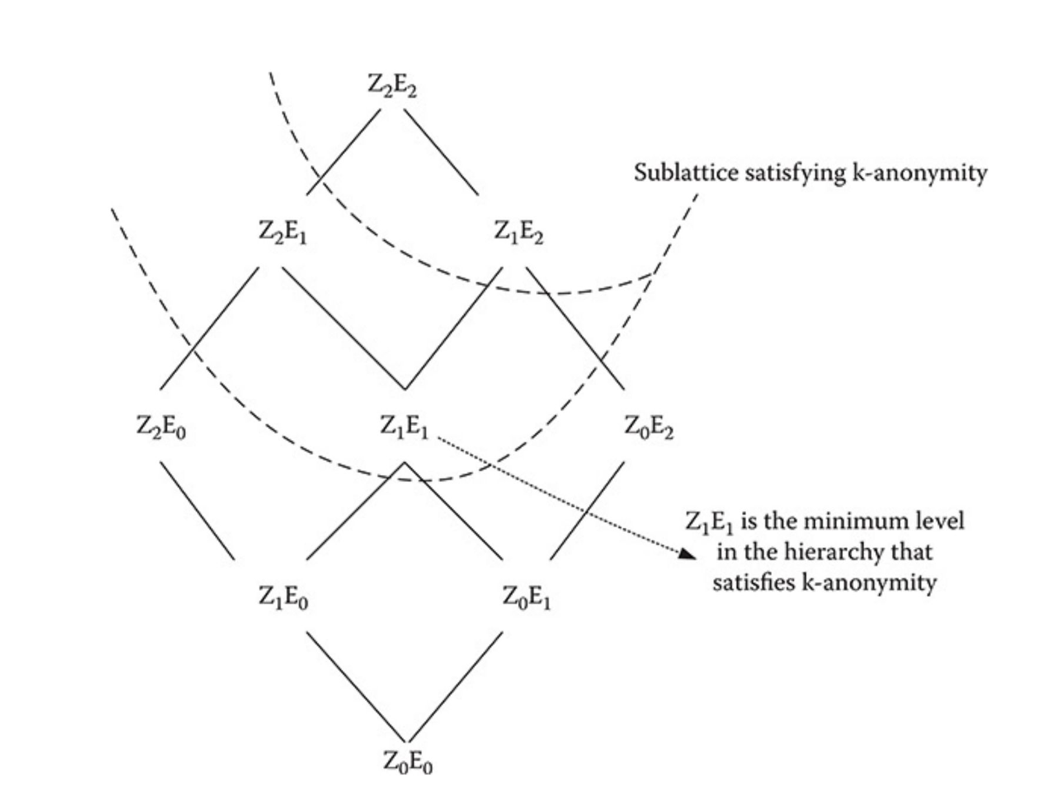
SAMARATI’S APPROACH
To implement K-anonymity we used Samarati’s approach
Starting from the highest level of anonymization possible
Then lowering the level of anonymization until we find the minimum sublattice which satisfies k-anonymity and l-diversity

Slide 11
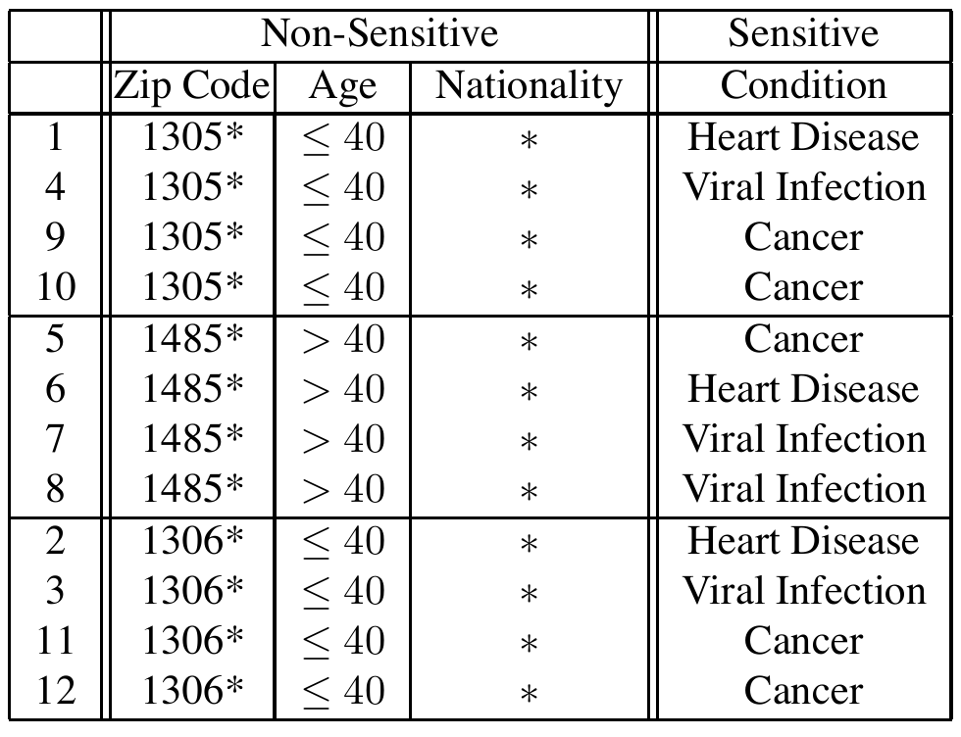
L-DIVERSITY
K-anonymity suffers homogeneity attacks and here is where l-diversity comes into play
L-diversity is an extension of k-anonymity and it ensures that within each homogeneous group of quasi identifiers there are at least l different categories of sensitive attributes
Example of 3-diverse and 4-anonymous table

Slide 12
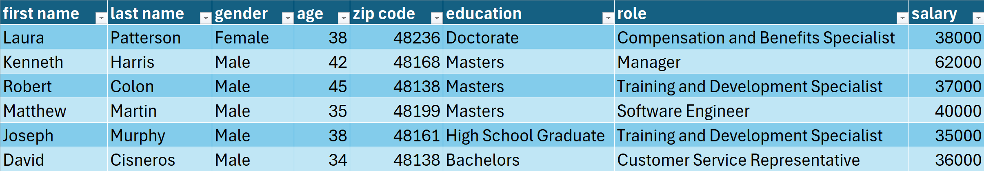
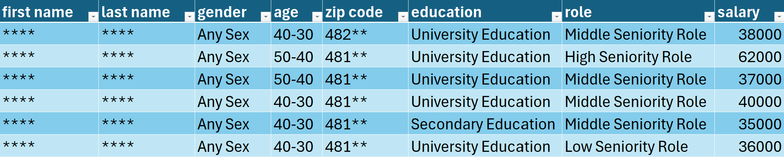
ALGORITHM TESTING ON FAKE DATASET
Here we can see a comparison of the same records both in the initial non-anonymized dataset and after the anonymization process
First 6 records of the original dataset
First 6 records of anonymized dataset

Slide 13
PERFORMANCE AND EFFICIENCY
K-anonymity is NP-HARD to achieve
L-diversity is APX-HARD (set of NP optimization problems that allow polynomial-time approximation algorithms)
K-anonymity and l-diversity are complex to achieve and really expensive in terms of time and computational power
Samarati’s approach is easy to implement and aims at obtaining an optimal result
The search for optimality requires more time and makes the algorithm less efficient with respect to other k-anonymization algorithms

Slide 14
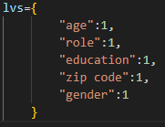
PRIVACY AND UTILITY
In Samarati’s approach it is possible to set the anonymization’s value of quasi identifiers in different ways
Inside our tool we created an lv variable which allows to manually set the desired level of anonymization for our dataset
It is also possible to decide which quasi identifiers attributes will be anonymized the most based on our privacy and utility goals of the dataset
By changing the order inside this dictionary we can give priority to utility preservation.
The higher we put an attribute and the most its utility will be preserved

Slide 15
STATISTICAL INFORMATION BEFORE AND AFTER
Salaries median value remains the same before and after the anonymization since sensitive data are not anonymized
We will analyze how the correlation between salary and education, and salary and age changes before and after the anonymization process
We used Python and matplotlib to create two different boxplots comparing:
Salary and age before and after the anonymization
Salary and education before and after the anonymization

Slide 16
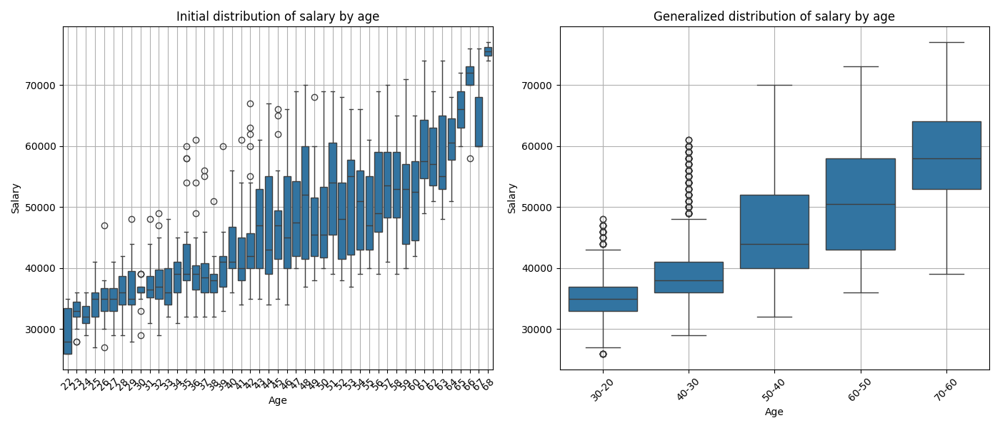
SALARY AND AGE COMPARISON

Slide 17
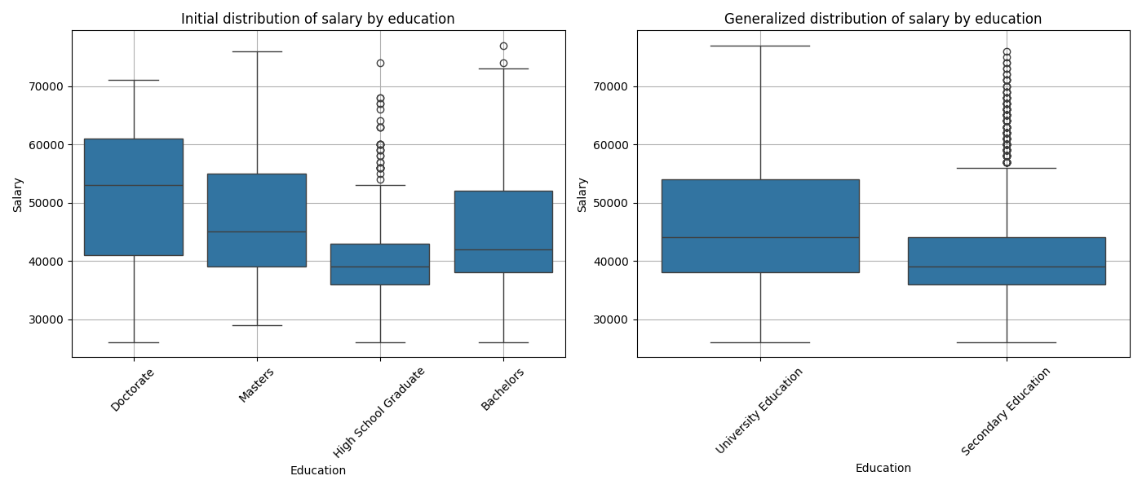
SALARY AND EDUCATION COMPARISON

Slide 18
GRAZIE PER L’ATTENZIONE

