Slide 1
Cold Start
Group 9

Slide 2
1.
definition

Slide 3
Use charts to explain your ideas
New community
New item
New user

Slide 4
How to tackle cold start
Random Start
Prediction
Ask users directly

Slide 5
Random Start
Collection of all types
Collection of hot items

Slide 6
Prediction
Representative based
use subset of items and users that represents the population
Content based
use side information such as text, social networks

Slide 7
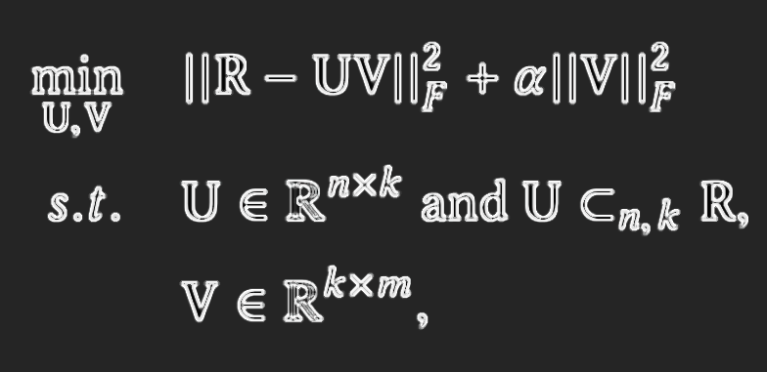
Representative Based Matrix Factorization (RBMF)

Slide 8
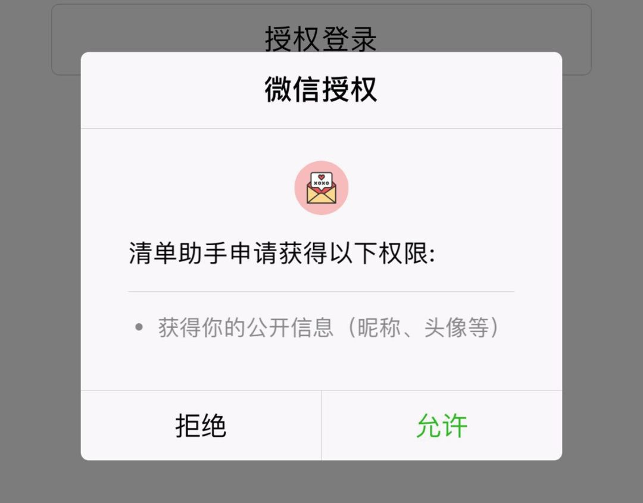
Content based
Profile completion

Slide 9
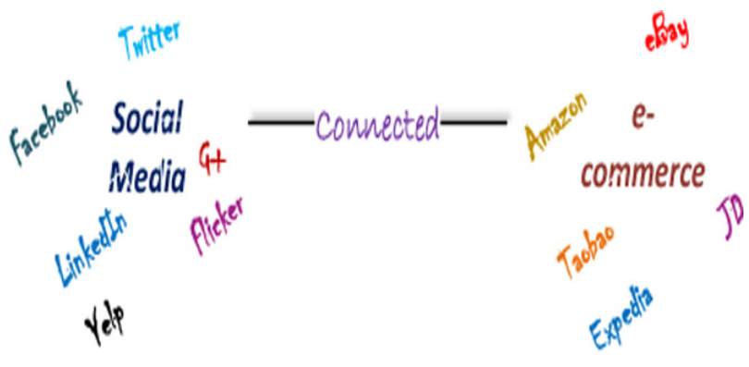
Content based

Slide 10
Prediction
Feature mapping
matrix factorization, latent factors, machine learning
Hybrid feature weighting
different attributes will have different importance
(e.g. which are the actors, director, country, title)
Differentiating regularization weights
assign lower constraints to the latent factors associated with the items or users that reveal more information, and set higher constraints to the others

Slide 11
Reference
S
D
X
L
https://en.wikipedia.org/wiki/Cold_start_(recommender_systems)#cite_note-33
Chen(2019-01-09). "Differentiating Regularization Weights -- A Simple Mechanism to Alleviate Cold Start in Recommender Systems". ACM Transactions on Knowledge Discovery from Data (TKDD). 13: 1–22.
https://kojinoshiba.com/recsys-cold-start/

