Slide 1
Why evaluation of recommendation engine is tricky
Group 9

Slide 2
Instructions for use
S
X
L
EDIT IN GOOGLE SLIDES
Click on the button under the presentation preview that says "Use as Google Slides Theme".
You will get a copy of this document on your Google Drive and will be able to edit, add or delete slides.
You have to be signed in to your Google account.
EDIT IN POWERPOINT®
Click on the button under the presentation preview that says "Download as PowerPoint template". You will get a .pptx file that you can edit in PowerPoint.
Remember to download and install the fonts used in this presentation (you’ll find the links to the font files needed in the Presentation design slide)
More info on how to use this template at www.slidescarnival.com/help-use-presentation-template
This template is free to use under Creative Commons Attribution license. You can keep the Credits slide or mention SlidesCarnival and other resources used in a slide footer.

Slide 3
hello!
I am Gale
I am here because I love to give presentations.
You can find me at @UxxUnet

Slide 4
1
Evaluation Method

Slide 5
offline measures
Mean Absolute Error(MAE)
Root Mean Square Error(RMSE)
Precision and Recall
Mean Average Precision (MAP)
Mean Average Recall at K(MAR@K)
Accuracy
Precision at N (P@N)
Mean Reciprocal Rank(MRR)
Discounted Cumulative Gain (DCG)
novelty, diversity and serendipity
Kendall’s Tau of the recommended item list

Slide 6
online evaluation
A/B-testing
Click-Through Rate(CTR)
Conversion Rate

Slide 7
Problems of them
2

Slide 8
Number of ratings
Movie 1
Movie 9
Notes:
The problem of top-K recommendation:
the training focused on items with the most ratings, achieving a good fit for those. The items with few ratings don’t mean much in terms of their impact on the loss.

Slide 9
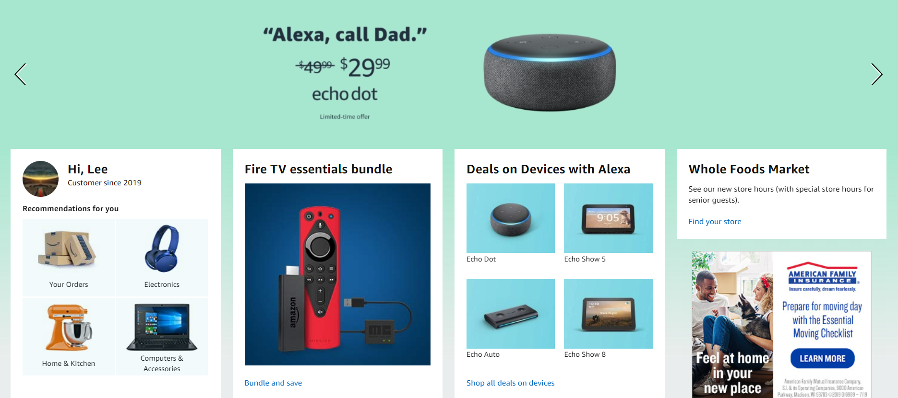
Click-Through Rate(CTR)

Slide 10
Sparse

Slide 11
Humanity

Slide 12
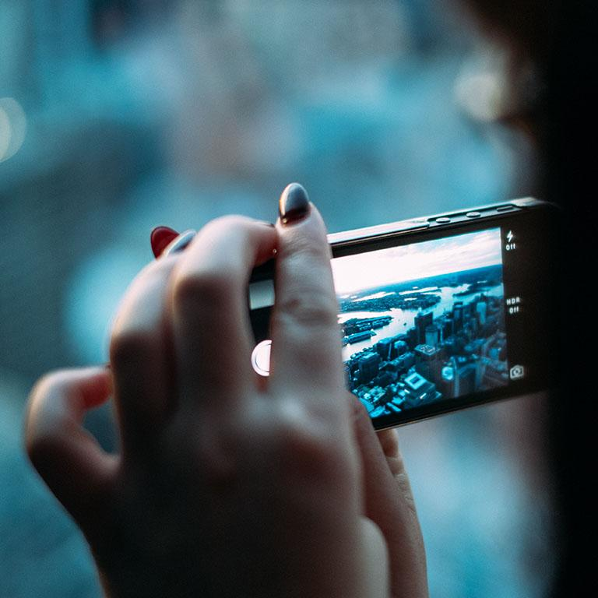
A picture is worth a thousand words
A complex idea can be conveyed with just a single still image, namely making it possible to absorb large amounts of data quickly.

Slide 13
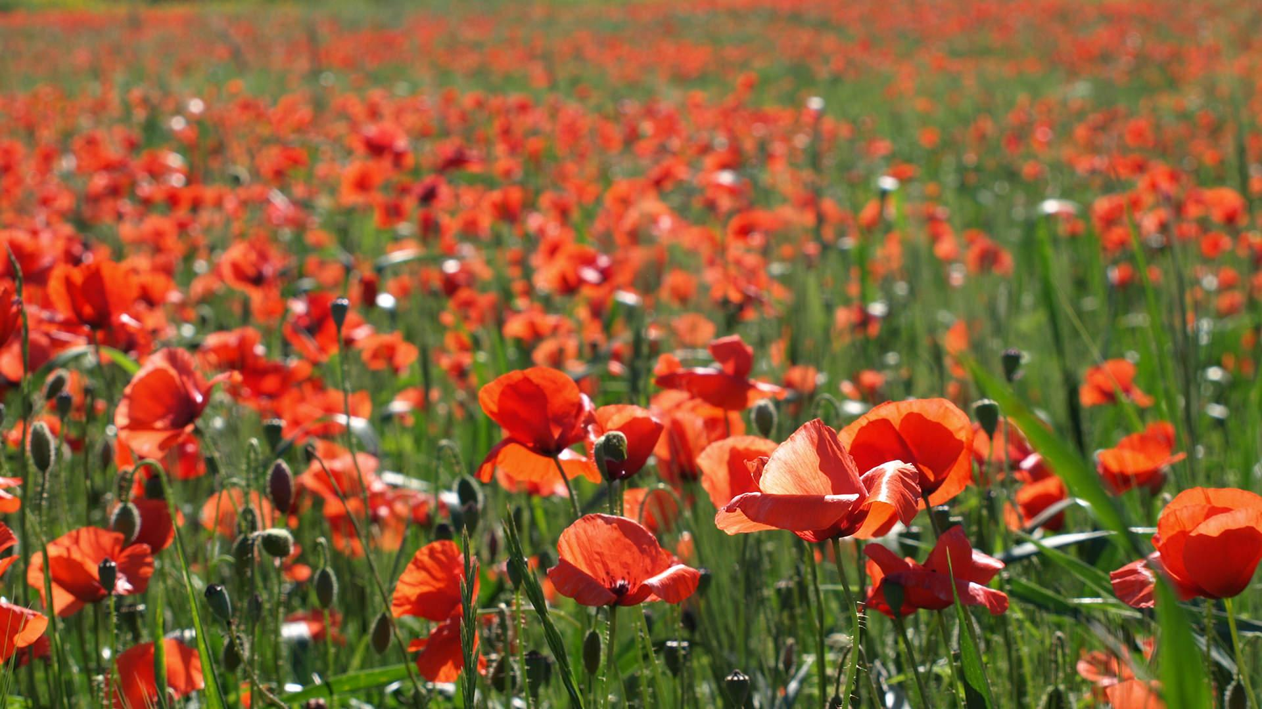
Want big impact?
Use big image.

Slide 14
Use charts to explain your ideas
White
Gray
Black

Slide 15
And tables to compare data
 | A | B | C
Yellow | 10 | 20 | 7
Blue | 30 | 15 | 10
Orange | 5 | 24 | 16

Slide 16
Maps
our office

Slide 17
89,526,124
Whoa! That’s a big number, aren’t you proud?

Slide 18
89,526,124$
185,244 users
100%
S
D
X
L
That’s a lot of money
And a lot of users
Total success!

Slide 19
Our process is easy
S
D
X
L
first
second
last

Slide 20
Let’s review some concepts
S
D
X
L
Yellow
Is the color of gold, butter and ripe lemons. In the spectrum of visible light, yellow is found between green and orange.
Blue
Is the colour of the clear sky and the deep sea. It is located between violet and green on the optical spectrum.
Red
Is the color of blood, and because of this it has historically been associated with sacrifice, danger and courage.
Yellow
Is the color of gold, butter and ripe lemons. In the spectrum of visible light, yellow is found between green and orange.
Blue
Is the colour of the clear sky and the deep sea. It is located between violet and green on the optical spectrum.
Red
Is the color of blood, and because of this it has historically been associated with sacrifice, danger and courage.

Slide 21
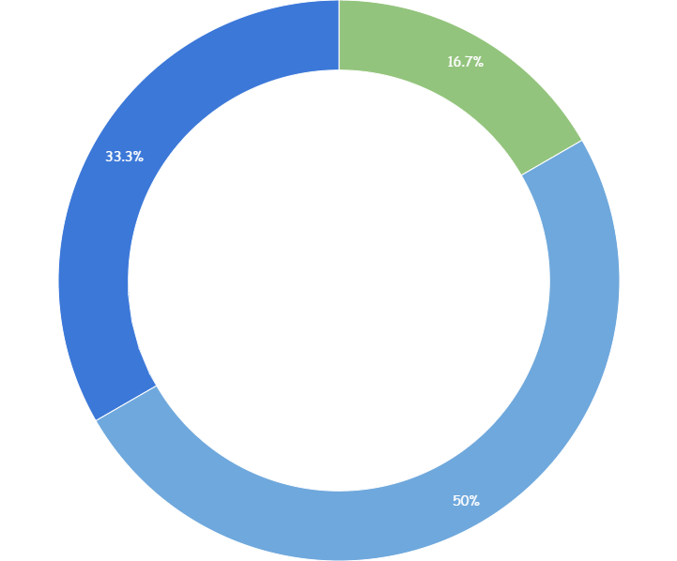
S
D
X
L
You can copy&paste graphs from Google Sheets

Slide 22
S
D
X
L
Place your screenshot here
Android project
Show and explain your web, app or software projects using these gadget templates.

Slide 23
S
D
X
L
Place your screenshot here
iPhone project
Show and explain your web, app or software projects using these gadget templates.

Slide 24
S
D
X
L
Place your screenshot here
Tablet project
Show and explain your web, app or software projects using these gadget templates.

Slide 25
S
D
X
L
Place your screenshot here
Desktop project
Show and explain your web, app or software projects using these gadget templates.

Slide 26
thanks!
S
D
X
L
Any questions?
You can find me at
@username
user@mailme

Slide 27
Credits
S
D
X
L
Special thanks to all the people who made and released these awesome resources for free:
Presentation template by SlidesCarnival
Photographs by Unsplash

Slide 28
Presentation design
S
D
X
L
This presentation uses the following typographies:
Titles: Walter Turncoat
Body copy: Sniglet
You can download the fonts on these pages:
https://www.fontsquirrel.com/fonts/walter-turncoat
https://www.fontsquirrel.com/fonts/sniglet
You don’t need to keep this slide in your presentation. It’s only here to serve you as a design guide if you need to create new slides or download the fonts to edit the presentation in PowerPoint®

Slide 29
Extra graphics
S
D
X
L

Slide 30

SlidesCarnival icons are editable shapes.
This means that you can:
Resize them without losing quality.
Change fill color and opacity.
Isn’t that nice? :)
Examples:

Slide 31
😉
Now you can use any emoji as an icon!
And of course it resizes without losing quality and you can change the color.
How? Follow Google instructions https://twitter.com/googledocs/status/730087240156643328
✋👆👉👍👤👦👧👨👩👪💃🏃💑❤😂😉😋😒😭👶😸🐟🍒🍔💣📌📖🔨🎃🎈🎨🏈🏰🌏🔌🔑 and many more...

