Slide 1
Cold Start
Group 9

Slide 2
Resources
New community
New item
New user
Training-testing data splitting

Slide 3
How to tackle cold start
Random Start
Prediction
Ask users directly
Spark
nan
Drop

Slide 4
Random Start
Collection of all types
Collection of hot items

Slide 5
Prediction
Representative based
use subset of items and users that represents the population
Content based
use side information such as text, social networks

Slide 6
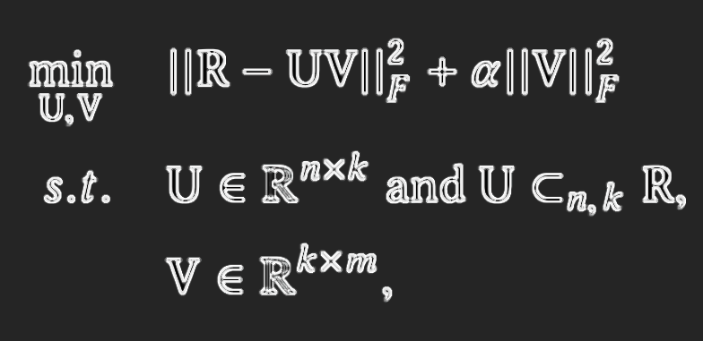
Representative Based Matrix Factorization (RBMF)

Slide 7
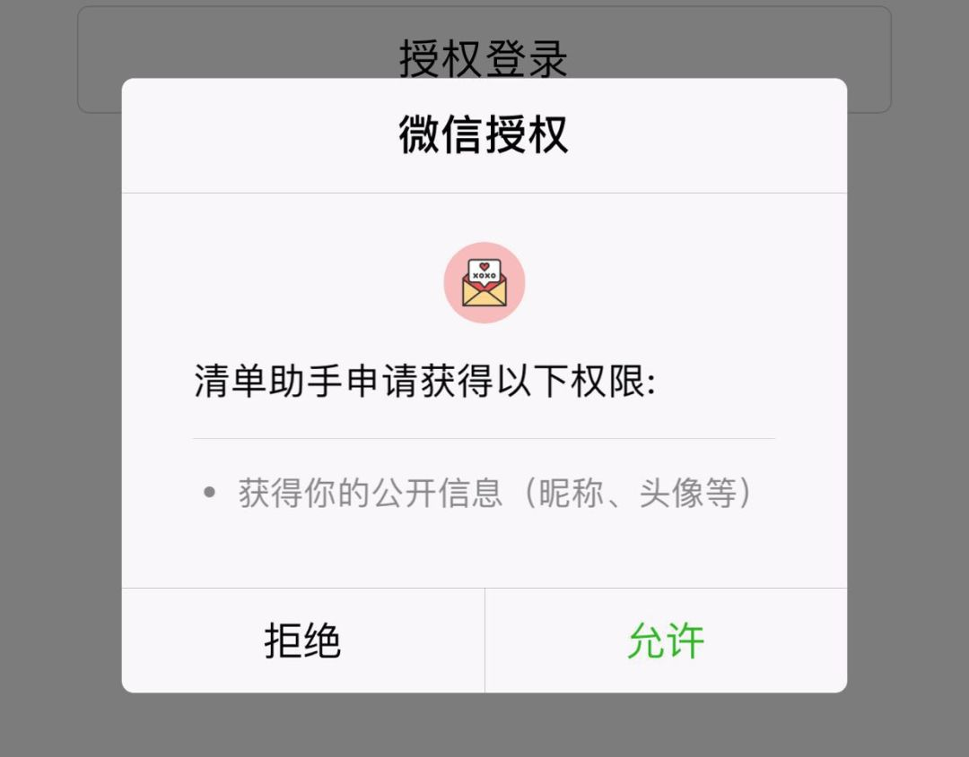
Content based
Profile completion

Slide 8
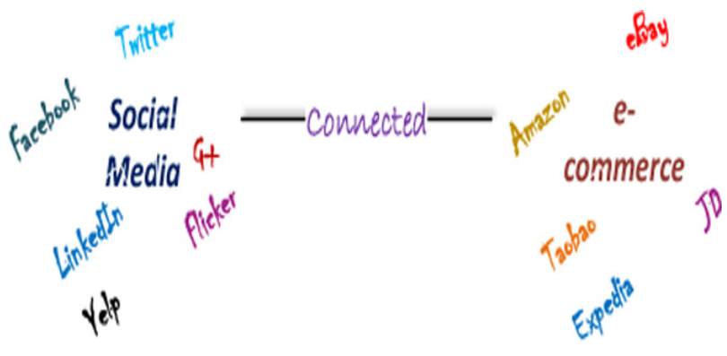
Content based

Slide 9
Prediction
Feature mapping
matrix factorization, latent factors, machine learning
Hybrid feature weighting
different attributes will have different importance
(e.g. which are the actors, director, country, title)
Differentiating regularization weights
assign lower constraints to the latent factors associated with the items or users that reveal more information, and set higher constraints to the others

Slide 10
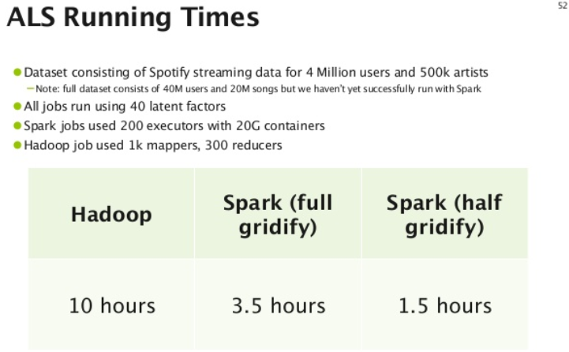
Runtime

Slide 11
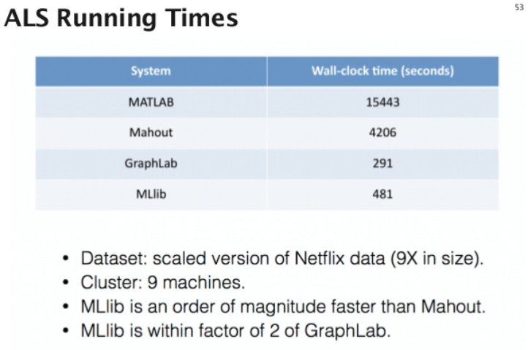

Slide 12
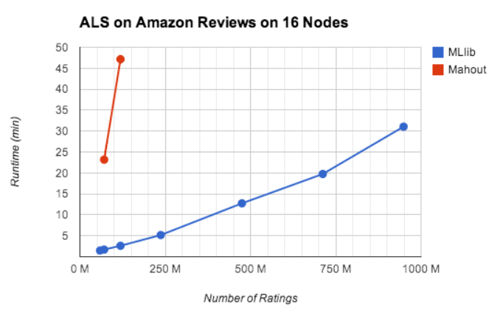

Slide 13
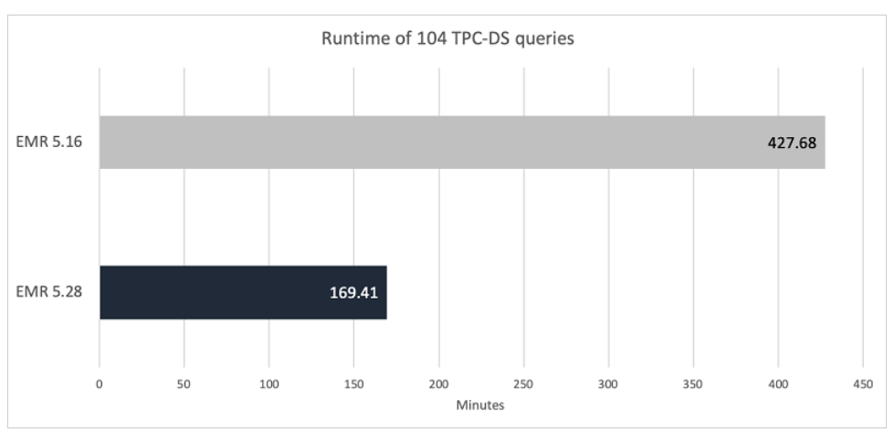
Amazon EMR introduces EMR runtime for Apache Spark

Slide 14
parameter values rank=15; lambdas=0.1; numOfIteration=15; ~15M Rating triplets, consisting of 3.6M unique users and 2.26M unique items. on one machine with 96GB resource node and 6 executors with 10G each; evaluating a dataset of ~27M
around 6 hours

Slide 15
Reference
S
D
X
L
https://en.wikipedia.org/wiki/Cold_start_(recommender_systems)#cite_note-33
Chen(2019-01-09). "Differentiating Regularization Weights -- A Simple Mechanism to Alleviate Cold Start in Recommender Systems". ACM Transactions on Knowledge Discovery from Data (TKDD). 13: 1–22.
https://kojinoshiba.com/recsys-cold-start/

