Slide 1
Cold Start
Group 9

Slide 2
Resources
New community
New item
New user
Training-testing data splitting
Notes:
The world “cold-start” derives from cars. When it’s really cold, the engine has problems with starting up, but once it reaches its optimal operating temperature, it will run very smoothly.
Other than the new community, new item and new user, there’ also the cold start problem with returning user. For example, Robert is looking for desks on your site. He’ll be interested in ads for desks for around a week, but after he finds the right one, he will move on. When he visits again in a month, he may be looking for lawn mowers.
There are basically two situations in the cold start problem.
In production, for new users or items that have no rating history and on which the model has not been trained (this is the “cold start problem”).
During cross-validation, the data is split between training and evaluation sets. It is very common to encounter users and/or items in the evaluation set that are not in the training set
As we have seen before, there are two general method in recommendation system: 1. collaborative filtering, 2. content-based. In general, collaborative filtering suffers more from the cold start problem due to its inability to address the system’s new products and users. In this aspect, content based is superior.

Slide 3

SPARK
NaN
ALSModel.transform
Drop
coldStartStrategy
Notes:
SPARK -NaN:
By default, Spark assigns NaN predictions during ALSModel.transform when a user and/or item factor is not present in the model. This can be useful in a production system, since it indicates a new user or item, and so the system can make a decision on some fallback to use as the prediction.
However, this is undesirable during cross-validation, since any NaN predicted values will result in NaN results for the evaluation metric (for example when using RegressionEvaluator). This makes model selection impossible.
SPARK - DROP:
Spark allows users to set the coldStartStrategy parameter to “drop” in order to drop any rows in the DataFrame of predictions that contain NaN values. The evaluation metric will then be computed over the non-NaN data and will be valid.

Slide 4
HOW TO TACKLE COLD START?
Incorporate additional Sources
Random Start
Prediction
Ask users directly

Slide 5
Incorporate additional info
Implicit Feedback
User attribute
demographic
gender
age group
income level
Notes:
As we have seen before, the implicit feedback can give some insights into user’s preference. For example, a retailer can use its customers’ past purchases, browsing history, search pattern or sometimes even the movement of the mouse.
On the other hand, for a new user, we can try to use his or her attribute, such as demographic, gender, age group, income level and so on to build an initial user profile.

Slide 6
Random Start
Collection of all types
Collection of hot items

Slide 7
Prediction
Representative based
use subset of items and users that represents the population
Content based
use side information such as text, social networks

Slide 8
Global Baseline Approach
Global Baseline Approach:
Average movie rating: 4 stars
Average rating for Harry Potter movie is 0.5 star above average
User X mean rating is 0.2 star below average
Baseline estimate : 3.7+0.5-0.2 = 4 stars
Combine Global Baseline and Collaborative filtering
Notes:
We can also use combination of global baseline and collaborative filtering to estimate user’s preference

Slide 9
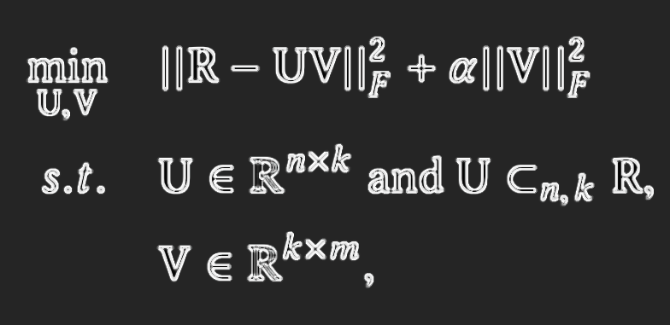
Representative Based Matrix Factorization (RBMF)
Notes:
If we do not have enough information about users and items, we can rely more on those who “represent” the set of items and users.
Representatives can be users whose linear combinations of preferences accurately approximate other users’. For example, a famous representative based method, Representative Based Matrix Factorization (RBMF)1 is an extension of MF methods with an additional constraint that m items should be represented by a linear combination of k items, as can be seen from the objective function below:

Slide 10
Representative Based Matrix Factorization (RBMF)
Advantages
More interpretability
If we are using matrix factorization already, this would just be a simple extension
Disadvantages:
Need to change UI and front end logic to ask the users to rate the representative items
Notes:
MORE INTERPRETABILITY: because new users can be expressed in terms of few representative items.

Slide 11
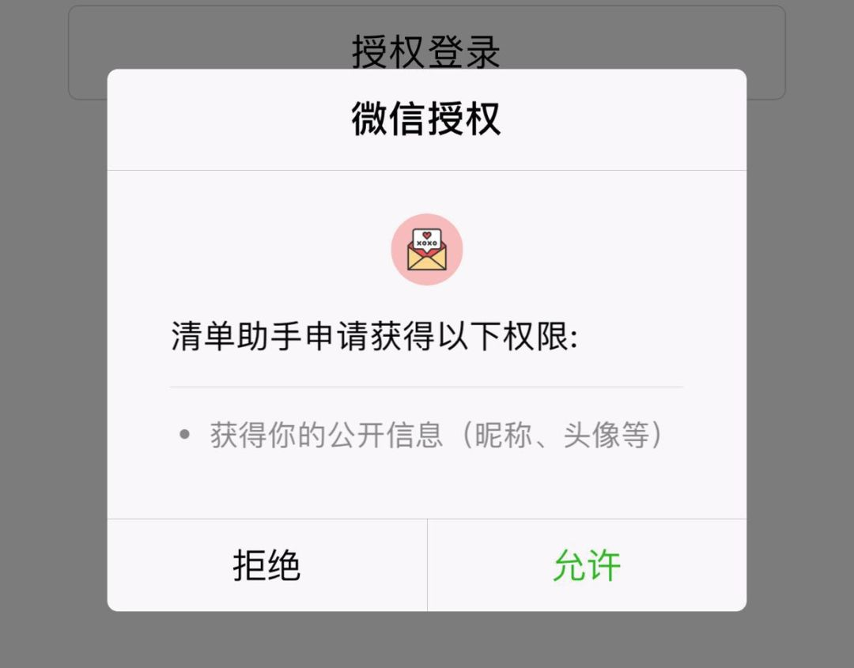
Content based
Profile completion

Slide 12
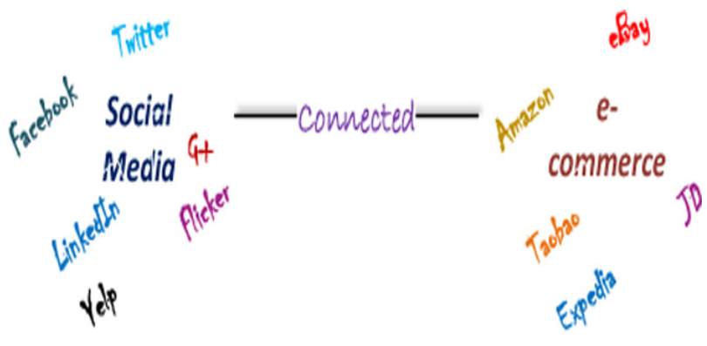
Content based
Notes:
Advantages
Can incorporate a wide range of content information.
Hybrid methods are extensions of Matrix factorization.
Disadvantages
Objective functions get cluttered. This is solved with deep methods, with a different downside.
Lots of feature engineering? Depends on whether you have ready to plug-in user/item features in your db.

Slide 13
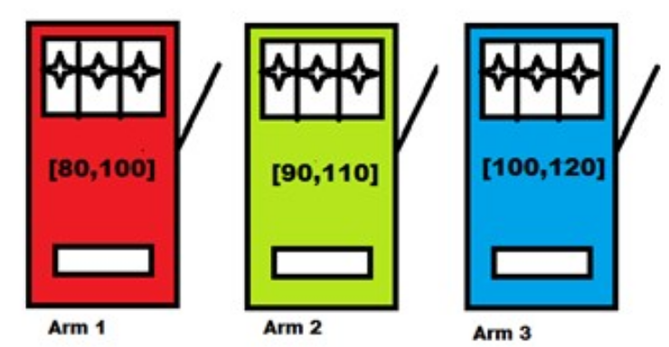
BANDIT PROBLEM
Notes:
cold start can be reframed and solved as a bandit problem
Bandit problem is a classical problem that models an agent (or planner or center) who wants to maximize its total reward by which it simultaneously desires to acquire new knowledge(“exploration”) and optimize his or her decisions based on existing knowledge(“exploitation”). MAB problem captures the scenario where the gambler is faced with a trade-off between exploration, pulling less explored arms optimistically in search of an arm with better reward, and exploitation, pulling the arm known to be best till the current time instant, in terms of yielding the maximum reward.

Slide 14

BANDIT PROBLEM - solution
epsilon greedy
Upper Confidence Bound (UCB): Select item that maximizes
where uj is the average sales / clicks / views of tiem j so far
t: number of times you’ve shown the new items
tj: number of times item j was shown
Thompson Sampling(TS): Bayesian version of the approach above
Notes:
GREEDY: the simplest approach. Show an item that’s discovered to be most popular (e.g. highest average sales / clicks / views among users so far) with probability epsilon Show a random item with controls whether to focus more on exploitation vs exploration.
Clearly, uj is the criteria for exploitation (e.g. favor items with more average sales) and the square root part for exploration (e.g. favor item with less exposure so far) The log and sqrt coms from the confidence interval of E[u_i,j]
You define some prior (e.g. gaussian) with parameters, obtain some observations to calculate the likelihood, and then update the prior with the posterior. We can then choose an action that maximizes the reward based on the posterior distribution of the parameters.

Slide 15
Prediction
Feature mapping
matrix factorization, latent factors, machine learning
Hybrid feature weighting
different attributes will have different importance
(e.g. which are the actors, director, country, title)
Differentiating regularization weights
assign lower constraints to the latent factors associated with the items or users that reveal more information, and set higher constraints to the others

Slide 16
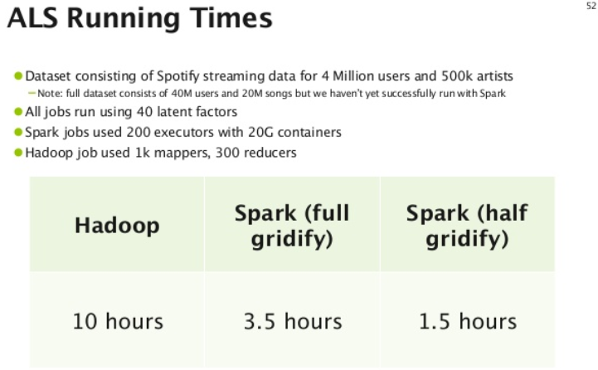
Runtime

Slide 17
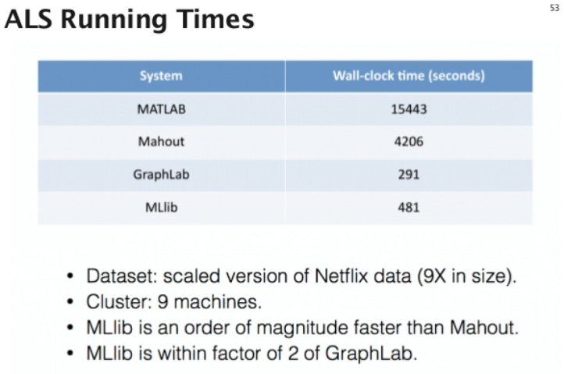

Slide 18
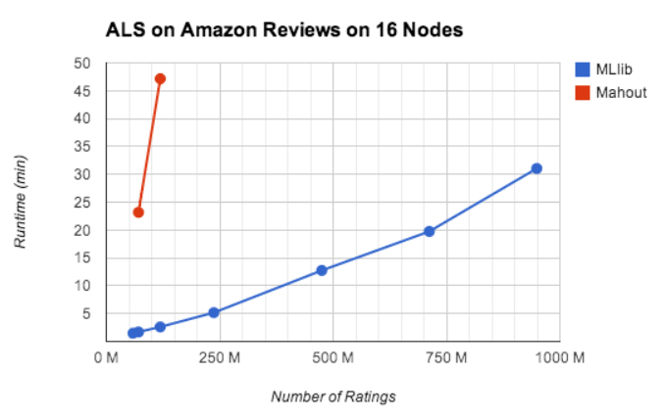

Slide 19
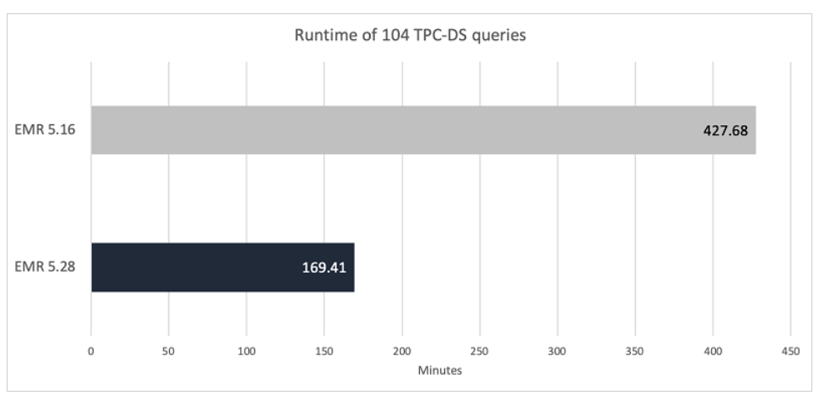
Amazon EMR introduces EMR runtime for Apache Spark

Slide 20
parameter values rank=15; lambdas=0.1; numOfIteration=15; ~15M Rating triplets, consisting of 3.6M unique users and 2.26M unique items. on one machine with 96GB resource node and 6 executors with 10G each; evaluating a dataset of ~27M
around 6 hours

Slide 21
Reference
S
D
X
L
https://en.wikipedia.org/wiki/Cold_start_(recommender_systems)#cite_note-33
Chen(2019-01-09). "Differentiating Regularization Weights -- A Simple Mechanism to Alleviate Cold Start in Recommender Systems". ACM Transactions on Knowledge Discovery from Data (TKDD). 13: 1–22.
https://kojinoshiba.com/recsys-cold-start/

