Slide 1
SPARK ALS
functions

Slide 2
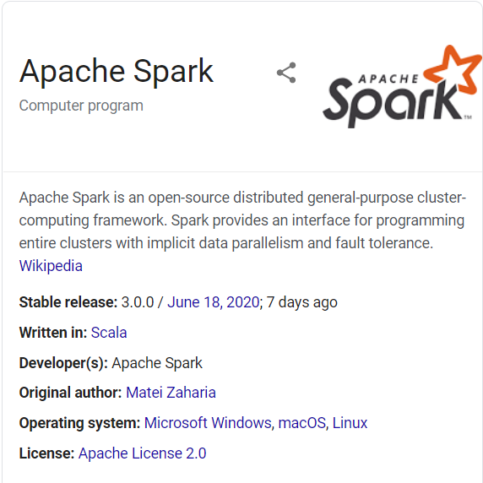
Instructions for SPARK
S
X
L
Apache Spark is a unified analytics engine for big data processing, with built-in modules for streaming, SQL, machine learning and graph processing.
Focus on Computation, In Memory Computing
API: Scala, Java, Python, R, SQL
Storage: HDFS, Cloud (AWS, AZURE)
Columnar format Parquet file for better performance
Notes:
Cache() has default storage level of MEMORY_ONLY, persist() has various storage levels. MEMORY_ONLY
MEMORY_AND_DISK,MEMORY_ONLY_SER,MEMORY_AND_DISK_SER,DISK_ONLY,MEMORY_ONLY_2 and MEMORY_AND_DISK_2
Model development stage：python, Production Stage: Scala //Personal assumption, it’s would be great if anyone could help to confirm.

Slide 3
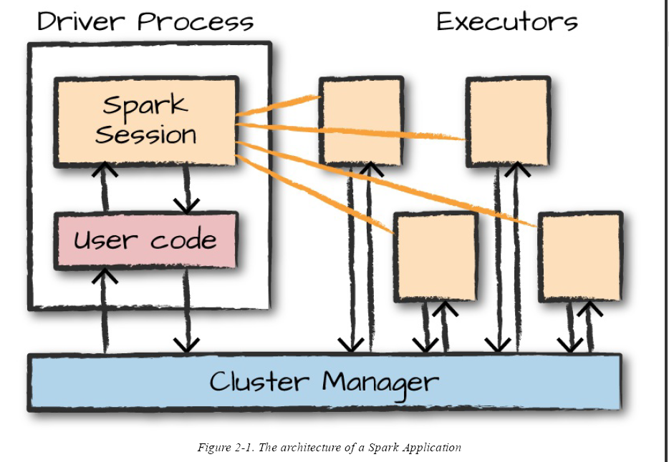
SPARK Architecture

Slide 4
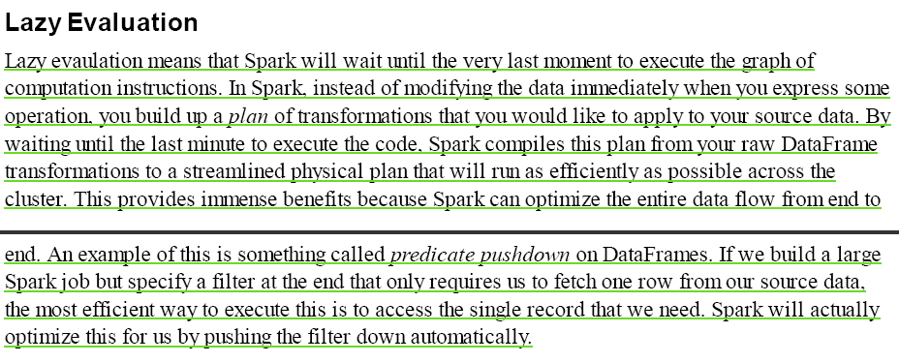
LAZY EVALUATION

Slide 5
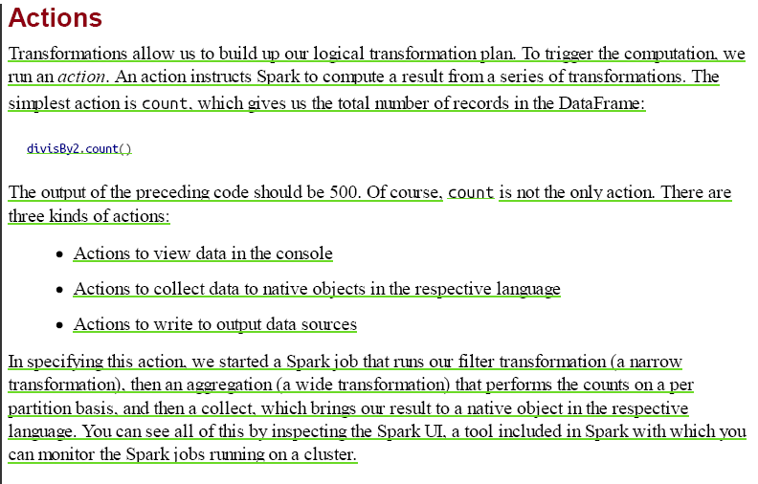
SPARK ACTIONS

Slide 6
als
Alternating Least Square
Main function in Spark for Matrix Factorization
Notes:
According to last week’s discussion, Matrix Factorization is to find latent factors that are not necessarily apparent in the data.
Spark ALS is neither user based nor item based collaborative filtering, it’s finding the optimal representation of a user and a product matrix and this matrix could accurately represent the original data set.

Slide 7


1.
Sample Code
Cache() for In-Memory Computing
Parameters: rank, numIterations

Slide 8
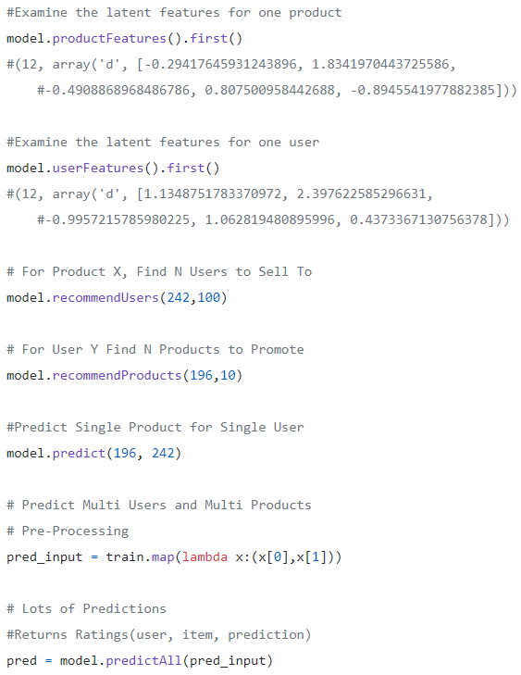
S
D
X
L
Two Angles:
USER
OR
PRODUCT

Slide 9
2.
Parameters
numBlocks: defaults 10; an integer multiple of the number of cores
Rank: defaults 10
maxIter: defaults 10
regParam: defaults 1.0
implicitPrefs: defaults false
alpha: defaults 1.0
nonnegative: defaults false
coldStartStrategy, defaults “nan”
Parameters: rank, numIterations
Notes:
numBlocks is the number of blocks the users and items will be partitioned into in order to parallelize computation (defaults to 10).
rank is the number of latent factors in the model (defaults to 10).
maxIter is the maximum number of iterations to run (defaults to 10).
regParam specifies the regularization parameter in ALS (defaults to 1.0).
implicitPrefs specifies whether to use the explicit feedback ALS variant or one adapted for implicit feedback data (defaults to false which means using explicit feedback).
alpha is a parameter applicable to the implicit feedback variant of ALS that governs the baseline confidence in preference observations (defaults to 1.0).
nonnegative specifies whether or not to use nonnegative constraints for least squares (defaults to false).
Cold-start strategy, current options:”nan”,“drop”

Slide 10
Documentation
S
D
X
L
SCALA
PYTHON
Source Code

