Slide 1
A.2 Forces and momentum

Slide 2
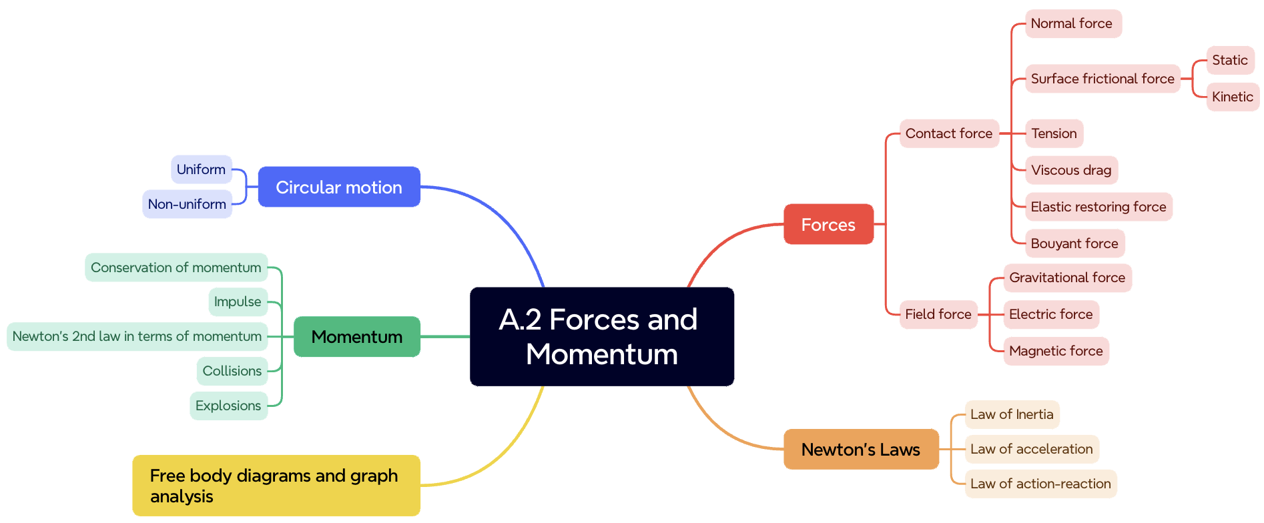
Newton’s Laws of
Motion

Slide 3
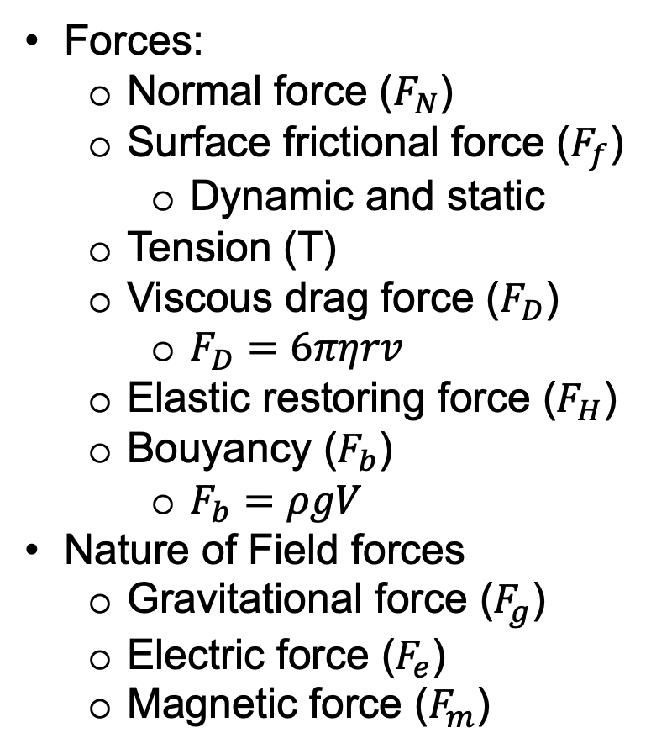
Forces:
  Normal force ($F_{N}$)
  Surface frictional force ($F_{f}$)
    Dynamic and static
  Tension (T)
  Viscous drag force ($F_{D}$)
    $F_{D}=6πηrv$
  Elastic restoring force ($F_{H}$)
  Bouyancy ($F_{b}$)
    $F_{b}=ρgV$
Nature of Field forces
  Gravitational force ($F_{g}$)
  Electric force ($F_{e}$)
  Magnetic force ($F_{m}$)

Slide 4
Free body diagrams:

Slide 5
Free body diagrams:

Slide 6
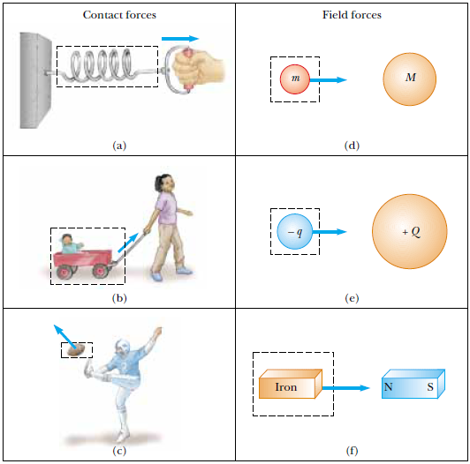
The concept of FORCE

Slide 7
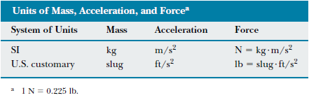

Slide 8
Newton’s 1st Law (INERTIA)
A body at rest remains at rest, and a body in motion continues to move with constant speed in a straight line, unless acted upon by a net external force.
The property of a body which measures its resistance to a change in its state of rest, or of constant velocity along a straight line, is called INERTIA.

Slide 9
Newton’s 2nd Law (Acceleration)
The unbalanced external force acting on a body imparts an acceleration which is proportional to the applied force, the direction of the acceleration being the same as that of the force.

Slide 10
Newton’s 3rd Law (Action and Reaction)
When one body exerts a force on another body, the latter also exerts a force on the first, that is, forces always occur in pairs.
For every action, there is always an equal and opposite reaction.

Slide 11
1) The initial speed of a car of mass 1500 kg is 60 km/h. A constant retarding force act on the car by applying the brakes. If the car is brought to stop in exactly 72 seconds, find the retarding force.

Slide 12
2. A body starting from rest acquires a velocity of 18cm/s in 3 sec. If the body has a mass of 15g, what force is exerted by the body?

Slide 13
3. What constant force is needed in order to increase the speed of a car from 30 km/h to 60 km/h in a time of 6 seconds, if the mass of the car is 2400 kg?

Slide 14
4. A box weighing 20N is pulled vertically upward by means of a cord. Find the acceleration of the box if the tension in the cord is 30 N.

Slide 15
5. An elevator weighing 9800N is supported by a steel cable. Find the tension in the cable at rest, when the elevator is moving up at a uniform speed of 1 m/s, and when it is descending at a constant speed of 3 m/s. Find the tension in the cable when the elevator is accelerated upward at 5 m/s². Find the tension in the cable when it is descending with an acceleration of 5 m/s².

Slide 16
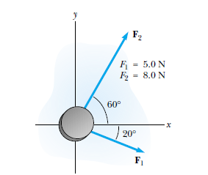
6. Find the resultant force applied on the puck.

Slide 17
7. A box starting from rest from the top of a frictionless plane which is 3 m long and inclined 30⁰ with the horizontal. (a) find the velocity of the box as it reaches the foot of the plane. (b) How long does it take the box to reach the bottom of the plane?

Slide 18
8. A 2kg block is pulled up along an inclined plane by a force of 15N, the force being parallel to the plane which makes 30 deg with the horizontal. If the block started from rest, how far did it go during the first 5 seconds?
x = 32.5m

Slide 19
9) A 5kg block lies on a smooth table top. A horizontal string connected to the block is passed over a small pulley at the edge of the table, and a body of mass 8 kg is hung from the other end of the string. Find the tension in the string and , the acceleration of the bodies when the system is released.
a = 6.03 m/s²
T = 30.15 N

Slide 20
4. A box starting from rest is pulled by means of a string which makes an angle of 30 deg with the horizontal. If the box travels a distance of 10m in 2s, what is the force exerted by the string if the box weighs 4.9 N? What is the work done by the string on the box? And Determine the power produced by the force.
F = 2.9N

Slide 21
An object is moving along a circular path of radius 286 cm. If the centripetal force on the object is 3 times its weight, find the period of the motion.

Slide 22
6. A 50 kg crate sliding with a speed of 10 m/s along a horizontal floor reaches the bottom of an inclined plane. How far up the plane will it go if the plane is inclined at 20 deg with the horizontal?

Slide 23
7. Two bodies, one of mass 4kg and the other of mass m, are fastened to the two ends of a string which is passed over a smooth pulley so that the two masses hang vertically, with the 4kg mass 4 meters above the ground. One second after the bodies are released, the 4kg mass hits the floor. Find the mass m of the other body.

Slide 24
The two masses in Atwood’s Machine are M kg and m kg, where M > m. When the system is released, find the acceleration of each body and the tension in the string.

Slide 25
1. A body of mass 50 g is at rest on a horizontal surface. A constant horizontal force is applied for 10s. Find the net force if the final velocity acquired is 36 m/s.
2. At the instant, a 6 kg body is moving with a velocity of 9 m/s, a constant retarding force of 18N is applied. How far will the body move in 2s from the instant the force is applied?

Slide 26
3. The initial speed of a car of mass 1500 kg is 60 km/h. A constant retarding force acts on the car by applying the brakes. If the car is brought to stop in exactly 72s, find the retarding force.

Slide 27
4. How long should a constant retarding force of 120N act on a body of mass 10 kg to stop the body if it is initially moving with a velocity of 24 km/h?
5. A 10kg body is initially at rest. It is acted upon by two forces, 40N to the north and 30N to the east. Find the velocity of the body after 1 second.

Slide 28
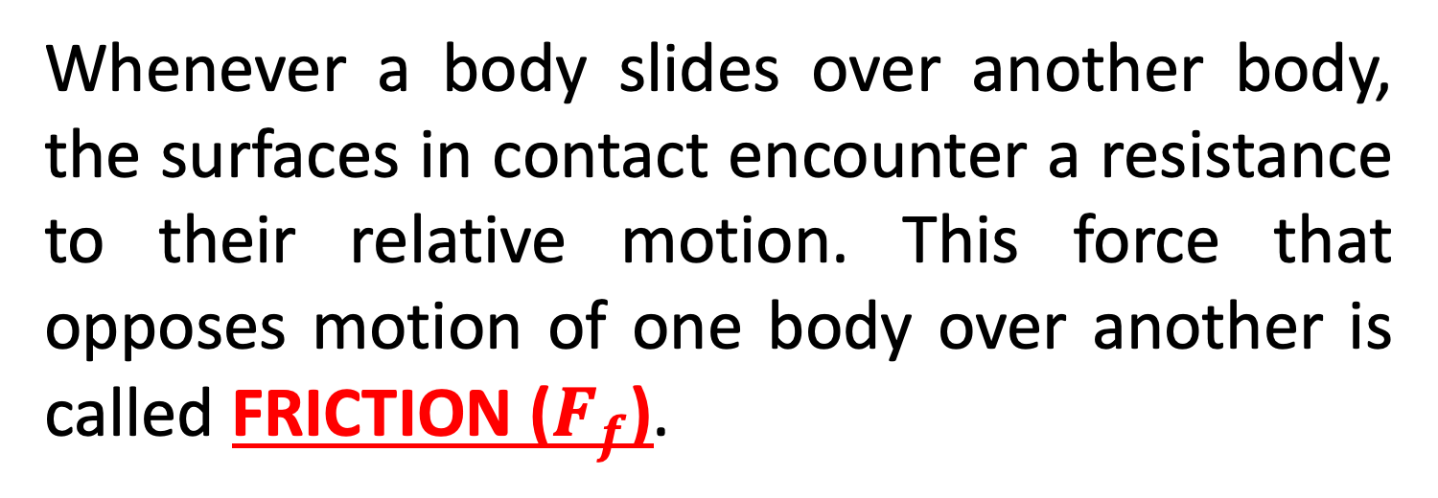
Whenever a body slides over another body, the surfaces in contact encounter a resistance to their relative motion. This force that opposes motion of one body over another is called FRICTION ($F_{f}$).
Static Friction
Kinetic Friction
N
F
f
W

Slide 29
Static Friction
Exactly equal to the applied force as long as the block is still at rest.
Its maximum value occurs when the block is just about to move (limiting value).
Kinetic Friction
Frictional force when the body is already moving.
** Static Friction > Kinetic Friction

Slide 30
Normal Force
Coefficient of static friction
Normal Force
Coefficient of kinetic friction

Slide 31
1. A box weighing 200 N starts to move across a horizontal surface when a horizontal force of 50 N is applied on it, and to maintain uniform motion the force decreases to 45 N. What are the coefficients of static and kinetic friction?

Slide 32
2. A 5 kg wooden block is pulled with a uniform horizontal velocity along a floor by means of a chord which makes an angle of 30⁰ above the horizontal. Find the tension if the coefficient of kinetic friction is 0.15.

Slide 33
3. A 5 kg block is on an inclined plane which makes 30⁰ with the horizontal. If the coefficient of static friction is 0.5, and the coefficient of kinetic friction is 0.3, what force parallel to the body will: (a) just start the body up the incline? (b) move the body up the plane with uniform velocity? (c) move the body up the plane with an acceleration of 2 m/s²?

Slide 34
Friction on an Inclined Plane
N
W
Angle of Repose – when a body slides downward with uniform acceleration on an inclined plane, the coefficient of friction is equal to the tangent of the angle of inclination of the plane. This angle is called the angle of repose.

Slide 35
4. The angle of repose for a block on an inclined plane is 40⁰ and the coefficient of kinetic friction is 0.3. What is the coefficient of static friction? If the plane is inclined 42⁰ with the horizontal, find the acceleration of the block.

Slide 36
5. A 40 kg body on an inclined plane 5 ft long and 3 ft high is pulled upward by force F, making 30⁰ above the plane until the body moves upward with uniform speed. Determine the force F if the coefficient of friction is 0.2.

Slide 37
F
N
W

Slide 38
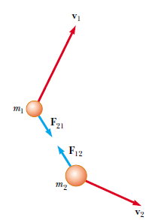
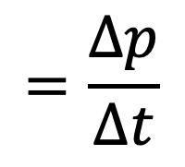
$$=\frac{∆p}{∆t}$$

Slide 39
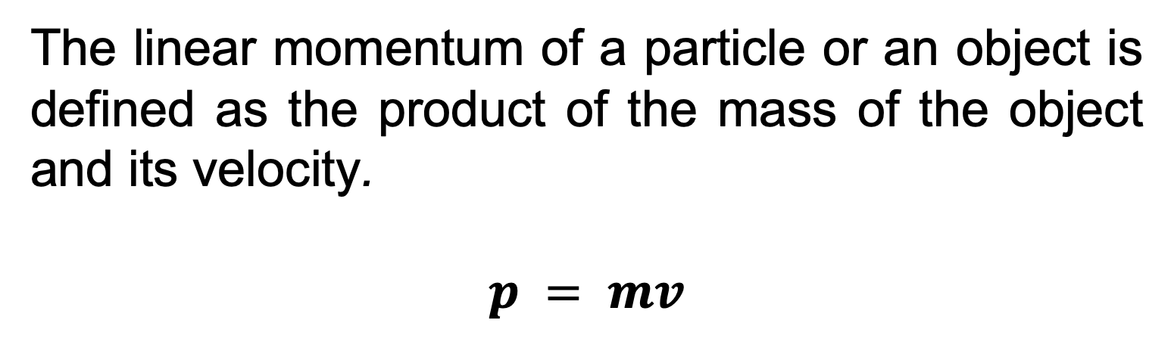
The linear momentum of a particle or an object is defined as the product of the mass of the object and its velocity.
$$p = mv$$

Slide 40
LAW OF CONSERVATION OF LINEAR MOMENTUM
Whenever two or more particles in an isolated system interact, the total momentum of the system remains constant.
Within a closed system, the total momentum in any direction is constant.

Slide 41
A 60-kg archer stands on frictionless ice and fires a 0.50-kg arrow horizontally at 50 m/s. This caused the archer to slide backward on the ice. Determine the velocity at which the man slid backwards.

Slide 42
A 60-kg archer stands on frictionless ice and fires a 0.50-kg arrow horizontally at 50 m/s. This caused the archer to slide backward on the ice. Determine the velocity at which the man slid backwards.

Slide 43
Collisions
•Consider two colliding pool balls…
FYI
•A system boundary is the “area of interest” used by physicists in the study of complex processes.
•A closed system has no work done on its parts by external forces.
“Before” phase
system boundary
“During” phase
system boundary
“After” phase
system boundary

Slide 44
Collisions
•If we take a close-up look at a collision between two bodies, we can plot the force acting on each mass during the collision vs. the time :
v_{Ai}
v_{Bi}
“Before” phase
A
B
F
During
Before
After
F_{AB}
F_{BA}
A
B
t
“During” phase
F_{AB}
A
B
F_{BA}
F_{AB}
F_{BA}
FYI
•Note the perfect symmetry of the action-reaction force pairs.
A
B
v_{Af}
v_{Bf}
“After” phase
A
B

Slide 45
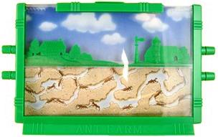

Impulse and force – time graphs
•Although the force varies with time, we can simplify it by “averaging it out” as follows:
•Imagine an ant farm (two sheets of glass with sand in between) filled with the sand in the shape of the above force curve:
•We now let the sand level itself out (by tapping or shaking the ant farm):
•The area of the rectangle is the same as the area under the original force vs. time curve.
•The average force F is the height of this rectangle.
Force
F
t
∆t

Slide 46
Impulse and force – time graphs
•We define a new quantity called impulse J as the average force times the time.
•This amounts to the area under the force vs. time graph.
•Since F = Δp / Δt we see that F ∆t = Δp and so we can interpret the impulse as the change in momentum of the object during the collision.
Force
F
t
∆t
Force
t
J = F ∆t area under F vs. t graph
impulse
J = F ∆t = Δp = area under F vs. t graph
impulse

Slide 47
Impulse and force – time graphs
•It is well to point out here that during a collision there are two objects interacting with one another.
•Because of Newton’s third law, the forces are equal but opposite so that F = - F.
•Thus for one object, the area (impulse or momentum change) is positive, while for the other object the area (impulse or momentum change) is negative.
J = F ∆t = Δp = area under F vs. t graph
impulse
F
t
F
FYI
•Thus impulse can be positive or negative.

Slide 48
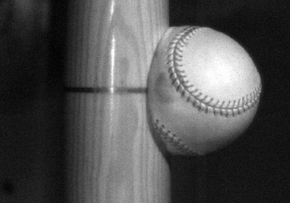


Impulse and force – time graphs
EXAMPLE: A 0.140-kg baseball comes in at 40.0 m/s, strikes the bat, and goes back out at 50.0 m/s. If the collision lasts 1.20 ms (a typical value), find the impulse imparted to the ball from the bat during the collision.
SOLUTION:
•We can use J = Δp:
J = p_{f} – p₀
= 7 – ⁻ 5.6
= 12.6 Ns.
v₀ = ⁻40 m s⁻¹
p₀ = ⁻40( 0.14 )
Before
p₀ = ⁻5.6 kg m s⁻¹
v_{f} = ⁺50 m/s
p_{f} = ⁺50( 0.14 )
After
p_{f} = ⁺7 kg m s⁻¹
FYI •The units for impulse can also be kg m s⁻¹.

Slide 49
Impulse and force – time graphs
EXAMPLE: A 0.140-kg baseball comes in at 40.0 m/s, strikes the bat, and goes back out at 50.0 m/s. If the collision lasts 1.20 ms (a typical value), find the average force exerted on the ball during the collision.
SOLUTION: We can use J = F Δt. Thus
F = J / Δt
= 12.6 / 1.20×10⁻³
= 10500 N.
F_{max}
F
FYI
•Since a Newton is about a quarter-pound, F is about 10500 / 4 = 2626 pounds – more than a ton of force!
•Furthermore, F_{max} is even greater than F!

Slide 50
Sketching and interpreting force – time graphs
J = F ∆t = Δp = area under F vs. t graph
impulse
PRACTICE: A bat striking a ball imparts a force to it as shown in the graph. Find the impulse.
SOLUTION:
Break the graph into simple areas of rectangles and triangles.
A₁ = (1/2)(3)(9) = 13.5 N s
A₂ = (4)(9) = 36 N s
A₃ = (1/2)(3)(9) = 13.5 N s
A_{tot} = A₁ + A₂ + A₃
A_{tot} = 13.5 + 36 + 13.5 = 63 N s.
9
6
Force F / n
3
0
0
5
10
Time t / s

Slide 51
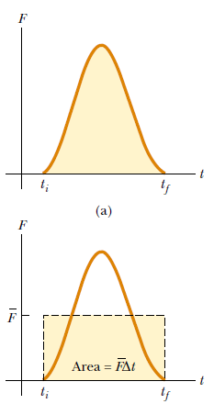
The impulse of the force F acting on a particle equals the change in the momentum of the particle.

Slide 52
A small force applied for a long time can produce the same momentum change as a large force applied briefly.
Impulse is not a property of a particle; rather, it is a measure of the degree to which an external force changes the momentum of the particle.
When we say that an impulse is given to a particle, we mean that momentum is transferred from an external agent to that particle.

Slide 53
In a particular crash test, a car of mass 1 500 kg collides with a wall. The initial and final velocities of the car are -15 m/s and 2.60 m/s, respectively. If the collision lasts for 0.150 s, find the impulse caused by the collision and the average force exerted on the car.

Slide 54
An elastic collision between two objects is one in which the total kinetic energy (as well as total momentum) of the system is the same before and after the collision.
An inelastic collision is one in which the total kinetic energy of the system is not the same before and after the collision (even though the momentum of the system is conserved).

Slide 55
When the colliding objects stick together after the collision, the collision is called perfectly inelastic.
When the colliding objects do not stick together, but some kinetic energy is lost, the collision is called inelastic.

Slide 56
Momentum of the system is conserved in all collisions, but kinetic energy of the system is conserved only in elastic collisions.

Slide 57


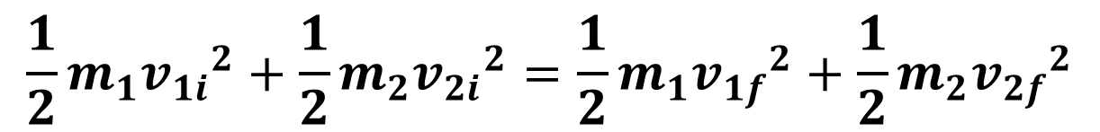
Perfectly Inelastic
$$m_{1}v_{1i}+m_{2}v_{2i}=\left(m_{1}+m_{2}\right)v_{f}$$
Elastic
$$m_{1}v_{1i}+m_{2}v_{2i}=m_{1}v_{1f}+m_{2}v_{2f}$$
$$\frac{1}{2}m_{1}{v_{1i}}^{2}+{\frac{1}{2}m}_{2}{v_{2i}}^{2}=\frac{1}{2}m_{1}{v_{1f}}^{2}+{\frac{1}{2}m}_{2}{v_{2f}}^{2}$$

Slide 58
Comparing elastic collisions and inelastic collisions
•In an elastic collision, kinetic energy is conserved (it does not change). Thus E_{K,f} = E_{K,0}.
EXAMPLE:
Two billiard balls colliding in such a way that the speeds of the balls in the system remain unchanged.
•The red ball has the same speed as the white ball…
•Both balls have same speeds both before and after…

Slide 59
Comparing elastic collisions and inelastic collisions
•In an inelastic collision, kinetic energy is not conserved (it does change). Thus E_{K,f} ≠ E_{K,0}.
EXAMPLE:
A baseball and a hard wall colliding in such a way that the speed of the ball changes.

Slide 60
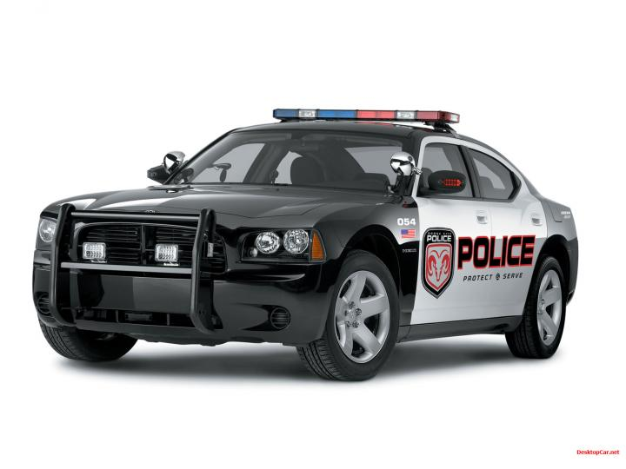
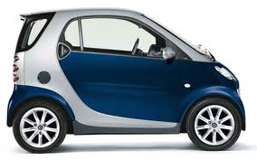
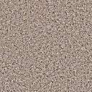
Comparing elastic collisions and inelastic collisions
•In a completely inelastic collision the colliding bodies stick together and end up with the same velocities, but different from the originals. E_{K,f} ≠ E_{K,0}.
EXAMPLE:
Two objects colliding and sticking together.
•The train cars hitch and move as one body…
•The cars collide and move (at first) as one body…
u₁
v
u₂
v

Slide 61
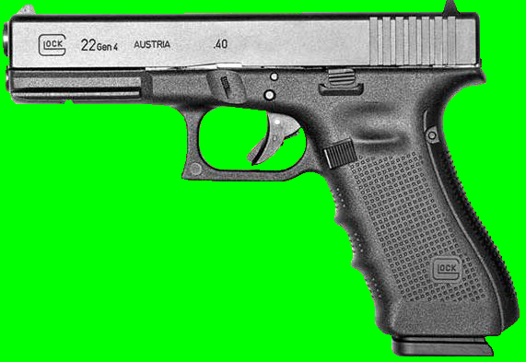

Comparing elastic collisions and inelastic collisions
• An explosion is similar to a completely inelastic collision in that the bodies were originally stuck together and began with the same velocities. E_{K,f} ≠ E_{K,0}.
EXAMPLE:
Objects at rest suddenly separating into two pieces.
•A block of ice broken in two by a hammer stroke…
•A bullet leaving a gun

Slide 62
Quantitatively analysing inelastic collisions
If F_{ext} = 0 then p = CONST
conservation of linear momentum
EXAMPLE: Two train cars having equal masses of 750 kg and velocities u₁ = 10. m s⁻¹ and u₂ = 5.0 m s⁻¹ collide and hitch together. What is their final speed?
SOLUTION: Use momentum conservation p₀ = p_{f}. Then
p_{1,0} + p_{2,0} = p_{1,f} + p_{2,f}
mu₁ + mu₂ = mv + mv
m(u₁ + u₂) = 2mv
10 + 5 = 2v → v = 7.5 m s⁻¹.
u₁
v
u₂
v

Slide 63
Quantitatively analysing inelastic collisions
If F_{ext} = 0 then p = CONST
conservation of linear momentum
EXAMPLE: Two train cars having equal masses of 750 kg and velocities u₁ = 10. m s⁻¹ and u₂ = 5.0 m s⁻¹ collide and hitch together. Find the change in kinetic energy.
SOLUTION: Use E_{K} = (1/2) mv ². Then
E_{K,f} = (1/2) (m + m) v ²
= (1/2) (750 + 750) 7.5 ² = 42187.5 J.
E_{K,0} = (1/2) (750) 10 ² + (1/2) (750) 5 ² = 46875 J.
ΔE_{K} = E_{K,f} – E_{K,0} = 42187.5 – 46875 = - 4700 J.
u₁
v
u₂
v

Slide 64
Quantitatively analysing inelastic collisions
If F_{ext} = 0 then p = CONST
conservation of linear momentum
EXAMPLE: Two train cars having equal masses of 750 kg and velocities u₁ = 10. m s⁻¹ and u₂ = 5.0 m s⁻¹ collide and hitch together. Determine the type of collision.
SOLUTION:
•Since E_{K,f} ≠ E_{K,0}, this is an inelastic collision.
•Since the two objects travel as one (they are stuck together) this is also a completely inelastic collision.
u₁
v
u₂
v

Slide 65
Quantitatively analysing inelastic collisions
If F_{ext} = 0 then p = CONST
conservation of linear momentum
EXAMPLE: Two train cars having equal masses of 750 kg and velocities u₁ = 10. m s⁻¹ and u₂ = 5.0 m s⁻¹ collide and hitch together. Was mechanical energy conserved?
SOLUTION:
•Mechanical energy E = E_{K} + E_{P}.
•Since the potential energy remained constant and the kinetic energy decreased, the mechanical energy was not conserved.
u₁
v
u₂
v

Slide 66
Quantitatively analysing inelastic collisions
If F_{ext} = 0 then p = CONST
conservation of linear momentum
EXAMPLE: Two train cars having equal masses of 750 kg and velocities u₁ = 10. m s⁻¹ and u₂ = 5.0 m s⁻¹ collide and hitch together. Was total energy conserved?
SOLUTION:
•Total energy is always conserved.
•The loss in mechanical energy is ΔE_{K} = - 4700 J.
•The energy lost is mostly converted to heat (there is some sound, and possibly light, but very little).
u₁
v
u₂
v

Slide 67

Quantitatively analysing inelastic collisions
EXAMPLE: Suppose a .020-kg bullet traveling horizontally at 300. m/s strikes a 4.0-kg block of wood resting on a wood floor. How fast is the block/bullet combo moving immediately after collision?
SOLUTION:
•If we consider the bullet-block combo as our system, there are no external forces in the x-direction at collision. Thus p_{f} = p₀ so that
mv_{f} + MV_{f} = mv_{i} + MV_{i}
.02v + 4 v = (.02)(300) + 4(0)
4.02v = 6
v = 1.5 m/s
the bullet and the block move at the same speed after collision (completely inelastic)

Slide 68
f
s
Quantitatively analysing inelastic collisions
EXAMPLE: Suppose a .020-kg bullet traveling horizontally at 300. m/s strikes a 4.0-kg block of wood resting on a wood floor. The block/bullet combo slides 6 m before coming to a stop. Find the friction f between the block and the floor.
SOLUTION: Use the work-kinetic energy theorem:
∆E_{K} = W
(1/2)mv ² – (1/2)mu ² = f s cos θ
(1/2)(4.02)(0)² – (1/2)(4.02)(1.5)² = f (6) cos 180°
- 4.5225 = - 6f
f = - 4.5225 / - 6
f = 0.75 N.

Slide 69
f
s
Quantitatively analysing inelastic collisions
EXAMPLE: Suppose a .020-kg bullet traveling horizontally at 300. m/s strikes a 4.0-kg block of wood resting on a wood floor. The block/bullet combo slides 6 m before coming to a stop. Find the dynamic friction coefficient µ_{d} between the block and the floor.
SOLUTION: Use f = µ_{d}R:
•Make a free-body diagram to find R:
•Note that R = W = mg
= (4.00 + 0.020)(10) = 40.2 N.
•Thus
µ_{d} = f / R = 0.75 / 40.2 = 0.19.
R
f
W

Slide 70
F
s
Quantitatively analysing inelastic collisions
EXAMPLE: Suppose a .020-kg bullet traveling horizontally at 300. m/s strikes a 4.0-kg block of wood resting on a wood floor. If the bullet penetrates .060 m of the block, find the average force F acting on it during its collision.
SOLUTION: Use the work-kinetic energy theorem on only the bullet:
∆E_{K} = W
(1/2)mv ² – (1/2)mu ² = F s cos θ
(1/2)(.02)(1.5)² – (1/2)(.02)(300)² = - F (.06)
- 900 = - 0.06F
F = 15000 n.

Slide 71
Two bodies, one of mass 4kg and the other 6 kg, approach each other with speeds of 2m/s and 8m/s respectively. They collide head on in a perfectly elastic collision. Find their velocities after collision.

Slide 72
A 100 g mass moving with a velocity of 20 m/s strikes a wall and is brought to rest in 0.15 s. Find the impulse due to the force exerted on the body by the wall. Calculate the average stopping force on the body.

Slide 73
An 1 800-kg car stopped at a traffic light is struck from the rear by a 900-kg car, and the two become entangled, moving along the same path as that of the originally moving car. If the smaller car were moving at 20.0 m/s before the collision, what is the velocity of the entangled cars after the collision?

Slide 74
A block of mass m1 = 1.60 kg initially moving to the right with a speed of 4.00 m/s on a frictionless horizontal track collides with a spring attached to a second block of mass m2 = 2.10 kg initially moving to the left with a speed of 2.50 m/s. The spring constant is 600 N/m.
Find the velocities of the two blocks after the collision.
(B) During the collision, at the instant block 1 is moving to the right with a velocity of 3.00 m/s, determine the velocity of block 2.
(C) Determine the distance the spring is compressed at that instant.

Slide 75
Two oxygen molecules in air are moving toward a head on collision. Before collision, molecule A is moving to the right with a velocity of 200 m/s, and molecule B is moving to the left with a velocity of 1200 m/s. Find the velocity of B after collision if A bounces back with velocity of 1200 m/s.

Slide 76
A skier slides down a ski trail that makes a vertical descent of 78 m. What is his speed at the bottom of the trail, ignoring air resistance and friction?

Slide 77
Density($ρ$) – Mass per unit volume
Uniform Density
Unit of Density:

Slide 78
Some Densities:
Material Density(kg/m³)
Interstellar space 10⁻²⁰
Best lab vacuum 10⁻¹⁷
Air: 20⁰C, 1 atm 1.21
20⁰C, 50 atm 60.5
Water: 20⁰C, 1 atm 0.998x10³
20⁰C, 50 atm 1.00x10³

Slide 79
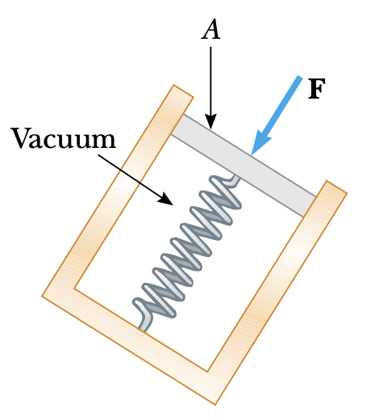
A fluid is a collection of molecules that are randomly arranged and held together by weak cohesive forces and by forces exerted by the walls of a container.
Both liquids and gases are fluids.
Fluids do not sustain shearing stresses or tensile stresses, only stress that can be exerted on an object submerged in a static fluid is one that tends to compress the object from all sides.
The force exerted by a static fluid on an object is always perpendicular to the surfaces of the object – PRESSURE.
Pressure is defined as the normal force acting per unit cross-sectional area.
F
A
Definition of Pressure
p =

Slide 80
F
A
Definition of Pressure
p =
The SI unit for pressure is the pascal (Pa) in honor of the French scientist and philosopher Blaise Pascal (1623-1662). 1 Pa = 1 N/m².
A nickel (diameter 2.1 cm) has a 16-lb bowling ball placed on it. What is the pressure, in Pa, between the nickel and the floor?
1 kg
2.2 lb
9.8 N
kg
d²
4
0.021²
4
•F = 16 lb
•A = π
= π
F = 71 N
A = 0.00035 m²
F
A
71
0.00035
p =
=
p = 2.03×10⁵ Pa
Notes:
© 2006 By Timothy K. Lund

Slide 81
A mattress of a water bed is 2.00 m long by 2.00 m wide and 30.0 cm deep.
Find the weight of the water in the mattress given that the density of water is $1.00×{10}^{3} kg m^{−3}$.
Calculate the pressure exerted by the water on the floor when the bed rests in normal position.
$$W=mg$$
$$W=ρVg$$
$$ρ=\frac{m}{V}$$
$$=(1.00×{10}^{3})(2×2×0.3)(9.81)$$
$$=(1.00×{10}^{3})(2×2×0.3)(9.81)$$
$$m=ρV$$
$$=1.18×{10}^{4} N$$
$$P=\frac{F}{A}=\frac{W}{A}$$
$$=\frac{1.18×{10}^{4}}{4}$$
$$=2.95×{10}^{3} Pa$$

Slide 82
PRESSURE AND DEPTH
Consider the tank of water shown here:
The tank has a height h and a bottom area A
The area A is supporting the full weight W of the water.
Since W = mg, we see that the water pressure on the bottom of the tank is just
h
F
A
mg
A
p =
=
Since density ρ = m/V, and since volume V = Ah, we can write
m = ρV
= ρAh
•so that
mg
A
ρAhg
A
A
p =
=
p = ρgh
Pressure Due to Weight of Fluid
Notes:
© 2006 By Timothy K. Lund

Slide 83
PRESSURE AND DEPTH
What is the pressure due to the weight of water if you are diving to a depth of 30 m?
p = ρgh
p = 1000(10)(30)
p = 300000 Pa
What is the pressure due to the weight of blood in your feet if you are standing up and you are 175 cm tall. Assume the density of blood is that same as that of water.
p = ρgh
p = 1000(10)(1.75)
p = 17500 Pa
Notes:
© 2006 By Timothy K. Lund

Slide 84
PRESSURE AND DEPTH
We have only considered the weight of the water as our source of pressure, but on the surface of that water lies the weight of a column of atmosphere having the same area.
$$p_{0}A$$
$$\sum{F}=$$
$$pA$$
$$− p_{0}A$$
$$− ρAhg$$
$$=0$$
$$pA−p_{0}A=ρAhg$$
d
A
$$pA−p_{0}A=ρAhg$$
$$ρAhg$$
p = p₀ + ρgh
Pressure-Depth Relationship
h
If the body of liquid is open to the atmosphere, and $p_{0}$ is pressure at the surface of the liquid, then $p_{0}$ is the atmospheric pressure.
FYI: We call p the ABSOLUTE PRESSURE and ρgh the GAUGE PRESSURE. We can write p_{gauge} = p - p_{a}. When you measure the pressure in your tire you are measuring gauge pressure.
$$pA$$
What pressure do you feel if you are swimming at a depth of 30 m?
FYI: Atmospheric pressure (at sea level) is about 101.325 kPa (= 1.01325×10⁵ n/m² = 14.7 lb/in²)
p = p₀ + ρgh
= 1.01×10⁵ + 1000(10)(30)
p = 4.01×10⁵ Pa
Notes:
© 2006 By Timothy K. Lund

Slide 85
PASCAL'S PRINCIPLE
Blaise Pascal studied, among other things, pressure in liquids. He observed the following effect, which we call Pascal's principle:
"Pressure applied to an enclosed fluid is transmitted undiminished to every point in the fluid and to the walls of the container."
F_{o}
F_{i}
A_{i}
= p_{i}
F_{i}
F_{o}
A_{o}
= p_{o}
A_{o}
A_{i}
p_{i} = p_{o}
Pascal's principle
p
F_{i}
A_{i}
F_{o}
A_{o}
=
p
p
A_{o}
A_{i}
The Lift Formula
F_{o} = F_{i}
Notes:
© 2006 By Timothy K. Lund

Slide 86
PASCAL'S PRINCIPLE
In a car lift used in a service station, compressed air exerts a force on a small piston that has a circular cross section and a radius of 5.00 cm. This pressure is transmitted by a liquid to a piston that has a radius of 15.0 cm.
What force must the compressed air exert to lift a car weighing 13 300 N? What air pressure produces this force?
$$\frac{F_{i}}{A_{i}}=\frac{F_{o}}{A_{o}}$$
$$p=\frac{F_{i}}{A_{i}}$$
$$\frac{F_{i}}{π(5×{{10}^{−2})}^{2}}=\frac{13300}{π(15×{{10}^{−2})}^{2}}$$
$$=\frac{1.48×{10}^{3} N}{π(5×{{10}^{−2})}^{2}}$$
$$F_{i}=1.48×{10}^{3} N$$
$$=1.88×{10}^{5} Pa$$
Notes:
© 2006 By Timothy K. Lund

Slide 87
PASCAL'S PRINCIPLE
If the lift below is needed to raise a metric ton with an input force of 200 N, and the diameter of the input piston is 10 cm, what must the diameter of the output piston be?
1000(10)
200
A_{o}
A_{i}
d_{o}² = 10²
F_{o} = F_{i}
d_{o} = 70.7 cm
F_{o}
F_{o}
F_{i}
F_{i}
A_{o} = A_{i}
F_{o}
F_{i}
A_{o}
(π/4)d_{o}² = (π/4)d_{i}²
A_{i}
F_{o}
F_{i}
p
d_{o}² = d_{i}²
p
p
Notes:
© 2006 By Timothy K. Lund

Slide 88
ARCHIMEDES' PRINCIPLE
Suppose we lower a cube of some material into a beaker of water:
•We may have to hold it in place.
•Note that all of the horizontal forces cancel each other out.
F₁
h₁
•We can calculate the pressure on the bottom and the top of the cube:
h₂
p₁ = ρgh₁
p₂ = ρgh₂
F₁ = p₁A
F₂ = p₂A
F₂
F₁ = ρgh₁A
F₂ = ρgh₂A
•The upthrust (buoyant force F_{b} )is the net upward force acting on the cube, and is the difference between the two forces:
F_{b} = F₂ - F₁
= ρgh₂A - ρgh₁A
= ρg(h₂-h₁)A
F_{b} = ρgV_{f}
Archimedes' Principle
"A body immersed wholly or partially in a fluid is buoyed up by a force equal in magnitude to the weight of the volume of liquid displaced."
Notes:
© 2006 By Timothy K. Lund

Slide 89
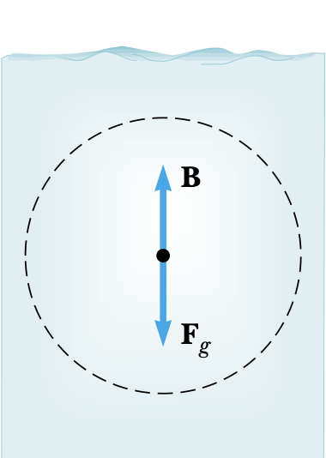
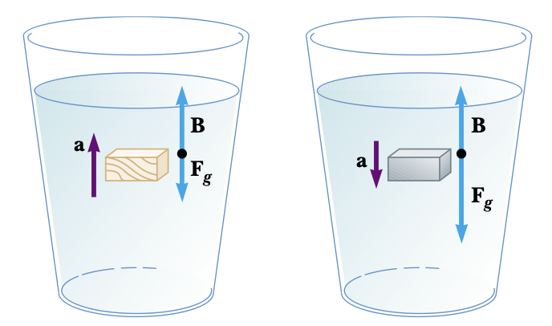
ARCHIMEDES' PRINCIPLE
When the object is fully submerged:
$$B=ρ_{f}Vg$$
$$B−W=ρ_{f}V_{obj}g−ρ_{obj}V_{obj}g$$
$$=ρ_{f}V_{obj}g$$
$$B−W=(ρ_{f}−ρ_{obj}) gV_{obj}$$
$$W=mg$$
$$=ρ_{obj}V_{obj}g$$
If $ρ_{f}>ρ_{obj}$, the unsupported object accelerates upward
If $ρ_{f}<ρ_{obj}$, the unsupported object sinks
If $ρ_{f}=ρ_{obj}$, the object is in equilibrium (hover)

Slide 90
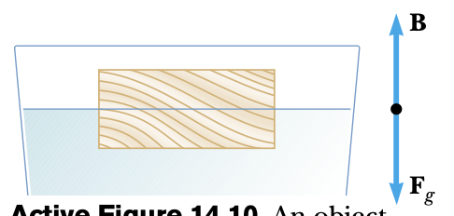
ARCHIMEDES' PRINCIPLE
When the object is partially submerged (floating):
$$B=ρ_{f}V_{f displaced} g$$
$$B=W$$
$$B=W$$
$$ρ_{f}V_{f displaced} g=ρ_{obj}V_{obj}g$$
$$W=mg$$
$$W=ρ_{obj}V_{obj}g$$
$$\frac{V_{f displaced}}{V_{obj}}= \frac{ρ_{obj}}{ρ_{f}}$$
volume of part of the object submerged in the fluid
$$V_{f displaced}=$$
the fraction of the volume of a floating object that is below the fluid surface is equal to the ratio of the density of the object to that of the fluid

Slide 91
ARCHIMEDES' PRINCIPLE
A 20-N object is lowered into an unknown liquid in a graduated cylinder using a spring scale. While in the liquid the spring scale reads 16.5 N. The initial volume of the liquid is 50 mL. When the object is completely submerged the volume reads 125 mL.
(a) What is the buoyant force acting on the object?
F_{b} = 20 - 16.5
= 3.5 N.
(b) What is volume of the object in m³?
V_{f} = 125 - 50 = 75 mL
V_{f} = 75 mL
1 cm³
1 mL
1 m
100 cm
3
= 7.5×10⁻⁵ m³
(c) What is density of the object?
ρ = m/V
= 2 kg/7.5×10⁻⁵ m³
= 26667 kg/m³
(d) What is density of the fluid?
F_{b} = ρgV_{f} ⇒
ρ = F_{b}/gV_{f}
= 3.5/(10)(7.5×10⁻⁵)
= 4667 kg/m³
FYI: Apparent weight = $W_{actual}−B$
Notes:
© 2006 By Timothy K. Lund

Slide 92
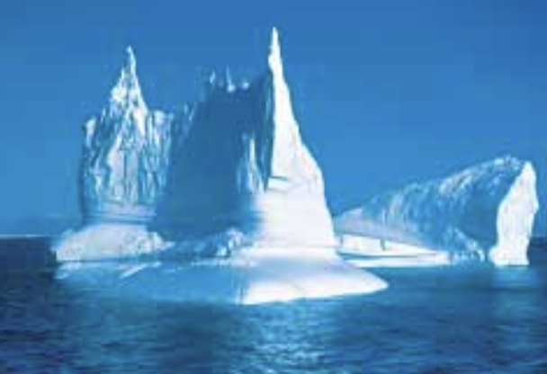
What fraction of the iceberg is submerged in water?
$$ρ_{i}=917 kgm^{−3}$$
$$ρ_{w}=1030 kgm^{−3}$$
$$B=W_{f displaced}=ρ_{f}V_{f displaced} g$$
$$W=ρ_{obj}V_{obj} g$$
$$ρ_{f}V_{f displaced} g=ρ_{obj}V_{obj} g$$
$$\frac{V_{f displaced}}{V_{obj}}= \frac{ρ_{obj}}{ρ_{f}}$$
$$\frac{V_{f displaced}}{V_{obj}}= \frac{917}{1030}$$
$$\frac{V_{f displaced}}{V_{obj}}=0.89$$
89% of the iceberg is submerged in water.

Slide 93
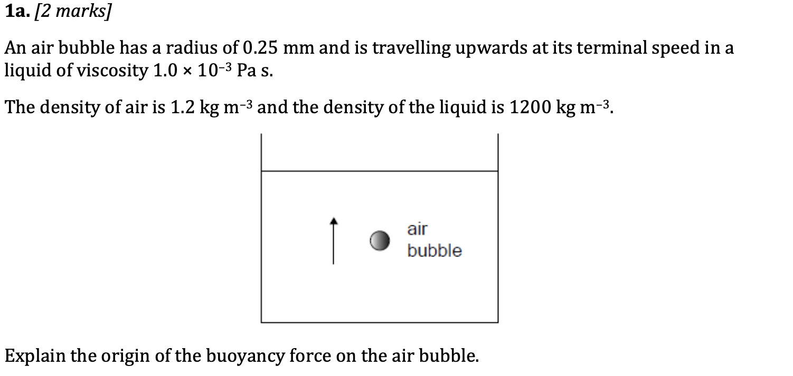
Pressure in a liquid increases with depth, therefore the pressure at the bottom of the bubble is greater than the pressure at top of the bubble. This difference produces the buoyant force.

Slide 94
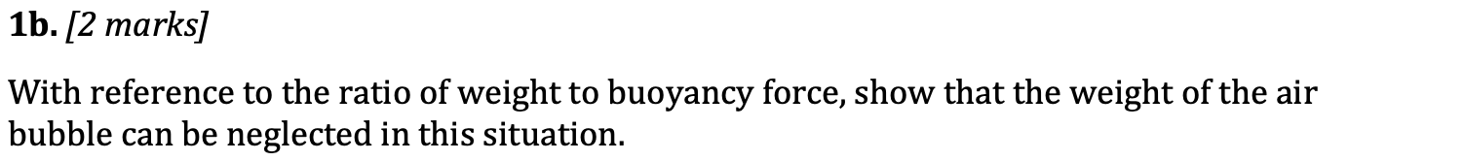
$$\frac{W_{air}}{B}$$
$$\frac{ρ_{air}Vg}{ρ_{f}Vg}$$
$$=\frac{ρ_{air}}{ρ_{f}}$$
$$=\frac{1.2}{1200}$$
$$=0.001$$
$$=$$
Ratio is very small so it can be neglected.

Slide 95
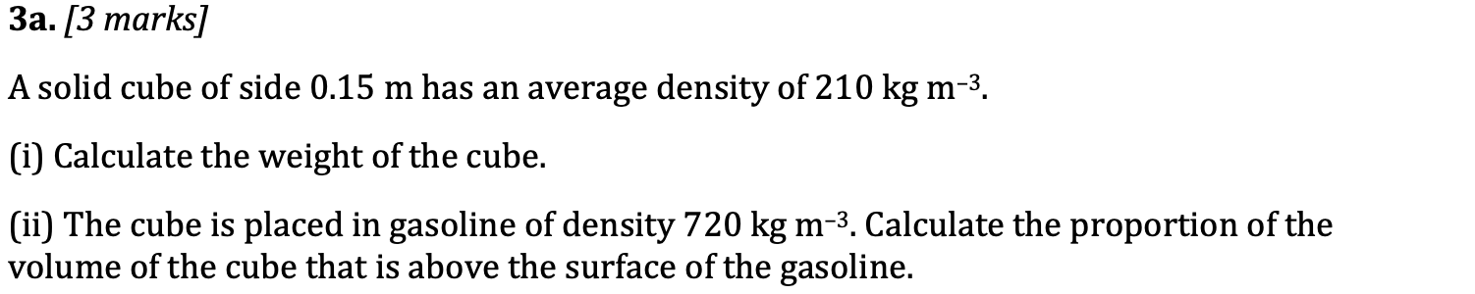
$$W=mg=ρVg$$
$$\frac{V_{f displaced}}{V_{obj}}= \frac{ρ_{obj}}{ρ_{f}}$$
$$=\left(210\right)({0.15}^{3})(9.8)$$
$$=6.9N or 6.95N$$
$$= \frac{210}{720}$$
$$=0.29$$
$$=About 71\% of the cube is$$
$$above the surface of the$$
$$gasoline.$$

