Slide 1
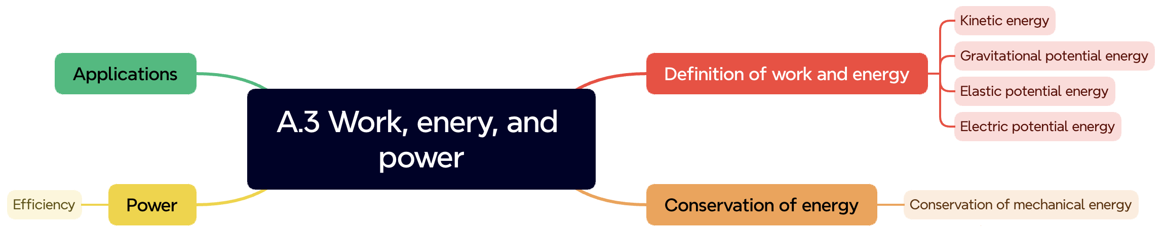

Slide 2
Understandings:
• Kinetic energy
• Gravitational potential energy
• Elastic potential energy
• Work done as energy transfer
• Power as rate of energy transfer
• Principle of conservation of energy
• Efficiency

Slide 3
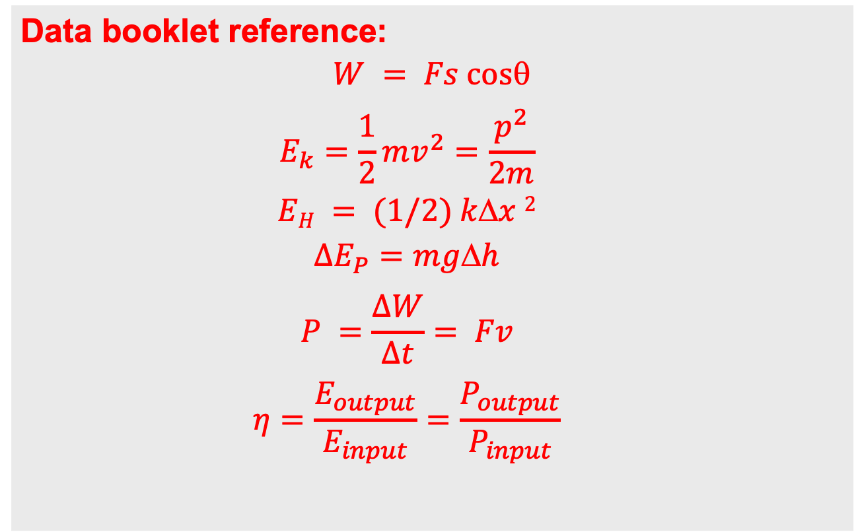
Data booklet reference:
$$W = Fs cos$$
$$E_{k}=\frac{1}{2}mv^{2}=\frac{p^{2}}{2m}$$
$$EH = (1/2) kx 2$$
$$∆E_{P}=mgh$$
$$P =\frac{∆W}{∆t}= Fv$$
$$η=\frac{E_{output}}{E_{input}}=\frac{P_{output}}{P_{input}}$$

Slide 5
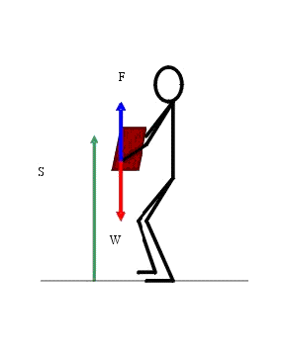
Work – is an energy transfer that occurs when a force acts on an object that moves.
Units: N x m = Joule

Slide 6
Work (+) - if the angle between the direction of displacement and the force is acute.
Work (-) - if the angle between the direction of displacement and the force is obtuse.
Work (0) - if the angle between the direction of displacement and the force is 90.

Slide 7
A force of 160 N making an angle of 30 degrees above the horizontal is applied to an object which moves across the horizontal frictionless surface a distance of 20 m. Find the work done by the force.

Slide 8
A 30 kg box is dragged with uniform speed along a horizontal surface with a force which makes 20 degrees with the horizontal. If the coefficient of friction is 0.20, find the work done in moving the box a distance of 6 meters.

Slide 9
A 1 kg block is dragged 40 cm upward with uniform velocity along a plane inclined 30 degrees with the horizontal, by a force parallel to the incline. The coefficient of kinetic friction is 0.2. (a) How much work is done by the applied force? (b) What is the total work done?

Slide 10
Diane pulls a sled along a snowy path on level ground with her little brother riding on the sled. The total mass of Jasper and the sled is 26 kg. The cord makes a 20 degree angle with the ground. As a simplified model, assume that the is 0.16. Find (a) the work done by Diane. (b) work done by the ground on the sled while it moves 120 m at 3 km/hr. (c) What is the total work done?

Slide 11
An antique chest 1400N heavy is to be moved to a truck. To get the chest from the ground onto the truck bed which is 1 m high, the movers have to decide what to do. Should they lift it straight up, or should they push it up their 4.0 m ramp? Assume no friction.
Find the work by lifting it straight up.
Find the work by using the ramp.

Slide 12
Energy
The capacity or ability of a body to do work.

Slide 13
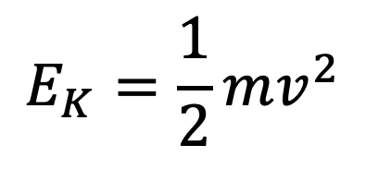
Kinetic Energy
Kinetic Energy – is the energy associated with motion of the object as a whole.
$$E_{K}=\frac{1}{2}mv^{2}$$

Slide 14

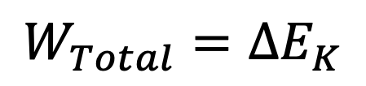
Work – Kinetic Energy Theorem
$$W_{Total}=∆E_{K}$$
In the case in which work is done on a system and the only change in the system is in its speed, the work done by the net force equals the change in kinetic energy of
the system.

Slide 15
A constant force acts on a body of mass 4kg and changes its speed from 4 m/s to 8 m/s in a distance of 20 meters. Find the force.

Slide 16
A constant force acts on a body of mass 4kg and changes its speed from 4 m/s to 8 m/s in a distance of 20 meters. Find the force.

Slide 17
A 6.0-kg block initially at rest is pulled to the right along a horizontal, frictionless surface by a constant horizontal force of 12 N. Find the speed of the block after it has moved 3.0 m.

Slide 18
A 6.0-kg block initially at rest is pulled to the right along a horizontal, frictionless surface by a constant horizontal force of 12 N. Find the speed of the block after it has moved 3.0 m.

Slide 19
A brick of mass 1 kg is thrown along a horizontal surface with an initial velocity of 2m/s. the coefficient of friction is 0.2. What is the kinetic energy and speed of the brick after traveling a distance of 80 cm? How far does the brick go before coming to rest?

Slide 20
A brick of mass 1 kg is thrown along a horizontal surface with an initial velocity of 2m/s. the coefficient of friction is 0.2. What is the kinetic energy and speed of the brick after traveling a distance of 80 cm? How far does the brick go before coming to rest?

Slide 21
A 6.0-kg block initially at rest is pulled to the right along a horizontal surface by a constant horizontal force of 12 N.
Find the speed of the block after it has moved 3.0 m if the surfaces in contact have a coefficient of kinetic friction of 0.15.

Slide 22
Gravitational Potential
Energy
Stored energy due to the interaction of an object with something else that can easily be recovered as kinetic energy.

Slide 23
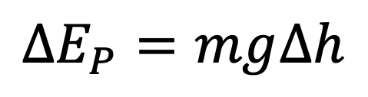
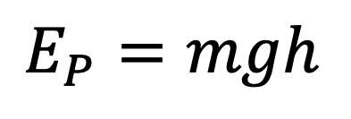
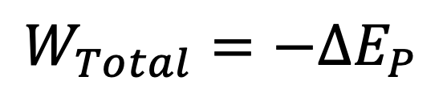
Gravitational Potential Energy:
$$E_{P}=mgh$$
$$∆E_{P}=mg∆h$$
$$W_{Total}=−∆E_{P}$$

Slide 24
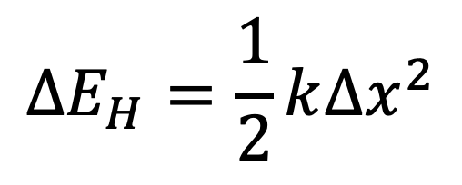
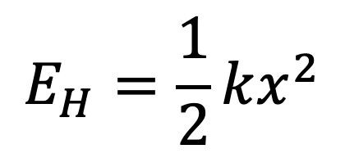
Elastic Potential Energy:
$$E_{H}=\frac{1}{2}kx^{2}$$
$$∆E_{H}=\frac{1}{2}k∆x^{2}$$

Slide 25
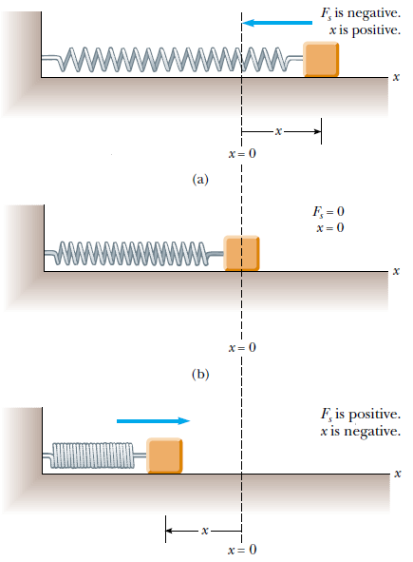
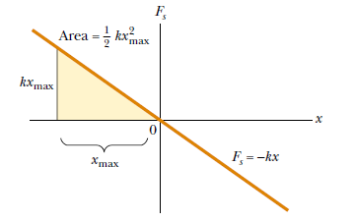

Slide 26
Forces that have potential energies associated with them are called Conservative Forces.
Any change in the kinetic energy of the body is compensated for by an equal and opposite change in potential energy, so that the sum of the two remains constant. The constant sum is the total mechanical energy.

Slide 28
The sum of kinetic and potential energies (K + U) is called the Mechanical Energy.
If the only force acting on a particle is a conservative force, the sum of the K and U of the particle remains constant.

Slide 29
What is the increase in gravitational potential energy if a person 70 kg in mass, climbs a building 50 m high?

Slide 30
A 200g body is thrown up with an initial velocity of 1.5 m/s. If friction is neglected, find (a) the body’s total mechanical energy, (b) the maximum height reached, (c) its kinetic and potential energy one – fourth the way up?

Slide 31
A spring has a force constant of 10 Newtons per cm. it is compressed 4 cm from its natural length, and a block of mass 100g is placed against the horizontal compressed spring. When the spring is released, the block slides across the smooth horizontal surface. With what velocity does the block leave the spring?

Slide 32
1. A 0.300-kg ball has a speed of 15.0 m/s. (a) What is its kinetic energy? (b) If its speed were doubled, what would be its kinetic energy?
2. A brick of mass 1 kg is thrown along a horizontal surface with an initial velocity of 2m/s. the coefficient of friction is 0.2. What is the kinetic energy and speed of the brick after traveling a distance of 80 cm? How far does the brick go before coming to rest?

Slide 33
3. A block of mass 0.250 kg is placed on top of a light vertical spring of force constant 5 000 N/m and pushed downward so that the spring is compressed by 0.100 m. After the block is released from rest, it travels upward and then leaves the spring. To what maximum height above the point of release does it rise?

Slide 34
Total energy is always conserved.
Non conservative forces do not conserve mechanical energy, but they conserve total energy.

Slide 35
Power
Rate of doing work.

Slide 36
Units of Power
1 hp = 746 watts = 746 J/s
0.746 kW

Slide 37
A motor lifts an object of mass 30 kg a vertical height of 5 m in a time of 4 minutes. Find the horsepower developed by the motor.

Slide 38
A man exerts a force of 50 N on a heavy cart and pushes it 60m in 100 seconds. A machine can exert a force of 250N and push it the same distance in 20 seconds. What is the power in each case?

Slide 39
A 70 kg person runs up three flights of stairs in 9 seconds. He stops at the end of this time, after traveling 10 meters. What is his average output power for the 9 seconds?

Slide 40
To push a box across the floor at a constant speed of 0.5 m/s requires the application of 200N force in the direction of motion to overcome friction. What is the power required?

Slide 41
An engine can pull a 50,000 kg load on a level ground where the coefficient of friction is 0.2 with a constant velocity of 15 km/h. What horsepower rate is the engine working?

Slide 42
An elevator car has a mass of 1 600 kg and is carrying passengers having a combined mass of 200 kg. A constant friction force of 4 000 N retards its motion upward
(a) What power delivered by the motor is required to lift the elevator car at a constant speed of 3.00 m/s?
(b) What power must the motor deliver at the instant the speed of the elevator is v if the motor is designed to provide the elevator car with an upward acceleration of 1.00 m/s²?

Slide 43
If a 73 kg man runs up a 12 m flight of stairs in 3 seconds, what is his power output in horsepower?
An elevator motor raises a 1000 kg elevator from rest such that it is ascending at 2 m/s at a height of 10 m. How much work is done by the motor?

Slide 44
A skier slides down a ski trail that makes a vertical descent of 78 m. What is his speed at the bottom of the trail, ignoring air resistance and friction?

