Slide 1
A1: Kinematics

Slide 2
Guiding Questions:
How can the motion of a body be described quantitatively and qualitatively?
How can the position of a body in space and time be predicted?
How can the analysis of motion in one and two dimensions be used to solve real-life problems?
Notes:
© 2006 By Timothy K. Lund

Slide 3
Topic A: Space, Time and Motion
A.1 – Kinematics
Applications and skills:
that the motion of bodies through space and time can be described and analysed in terms of position, velocity, and acceleration
velocity is the rate of change of position, and acceleration is the rate of change of velocity
the change in position is the displacement
the difference between distance and displacement
the difference between instantaneous and average values of velocity, speed and acceleration, and how to determine them
the equations of motion for solving problems with uniformly accelerated motion
Notes:
3
© 2006 By Timothy K. Lund

Slide 4
Topic A: Space, Time and Motion
A.1 – Kinematics
Guidance:
A quantitative approach to projectile motion will be limited to situations where fluid resistance is absent or can be neglected.
The trajectory of projectile motion is parabolic in the absence of fluid resistance, but the equation of the trajectory is not required.
Familiarity with projectiles launched horizontally, at angles above, and at angles below the horizontal is required.
Projectile motion will only involve problems using a constant value of g close to the surface of the Earth.
Fluid resistance refers to the effects of gases and liquids on the motion of a body.
Notes:
4
© 2006 By Timothy K. Lund

Slide 5

Topic A: Space, Time and Motion
A.1 – Kinematics
Notes:
5
© 2006 By Timothy K. Lund

Slide 6
Topic A: Space, Time and Motion
A.1 – Kinematics
Linking Questions:
How are the equations for rotational motion related to those for linear motion?
When can certain types of problems on projectile motion be solved by applying conservation of energy instead of kinematic equations?
How effectively do the equations of motion model Newton’s laws of dynamics?
How does a gravitational force allow for orbital motion?
How does the motion of an object change within a gravitational field?
How does graphical analysis allow for the determination of other physical quantities? (NOS)
Notes:
6
© 2006 By Timothy K. Lund

Slide 7
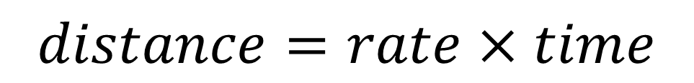

When an object is moving with constant speed / rate, we can use the rule,
Jacky drove at a constant rate of 60 mi/h in 5 hours. What is the total distance he travelled?
Jacky drove at a constant speed and travelled 300 miles. If he drove for 5 hours, what was his speed?
Jacky drove at a constant speed of 60 mi/h and covered a distance of 300 miles. In how many hours did he drive?

Slide 8
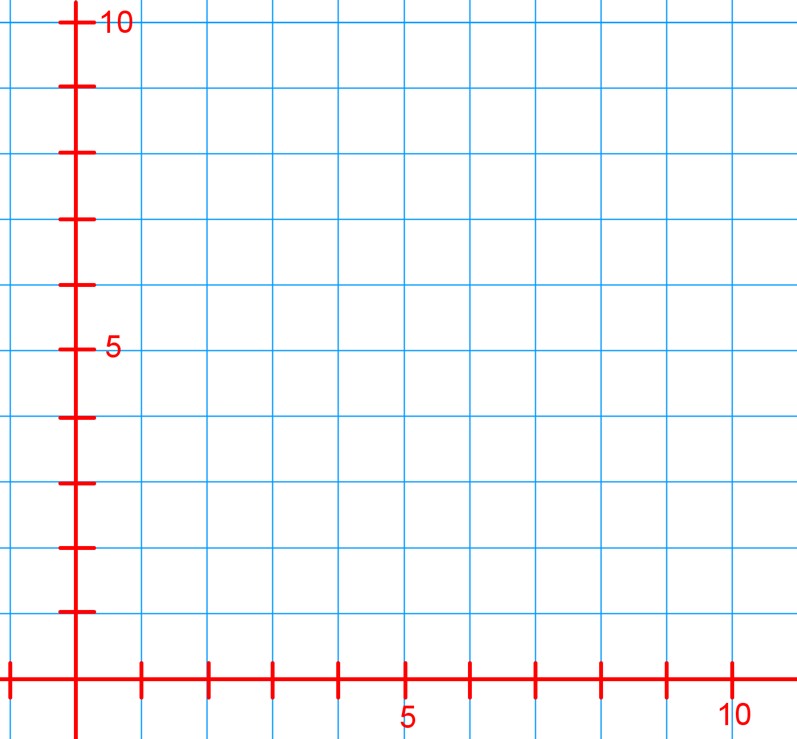
Displacement
time

Slide 9
Displacement
time

Slide 10
Distance
The length of a path followed by a particle.
Average speed
The average speed of a particle is defined as the total distance traveled divided by the time interval required to travel that distance.

Slide 11
Displacement
The displacement of a particle is defined as its change in position in some time interval.
Average Velocity
The average velocity of a particle is defined as the particle’s displacement divided by the time interval during which that displacement occurs.

Slide 12
What is the difference between distance and displacement?
Average speed = magnitude of average velocity?

Slide 13
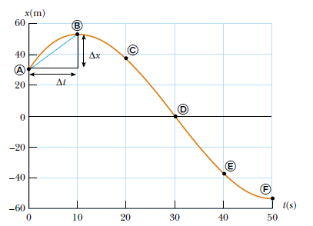
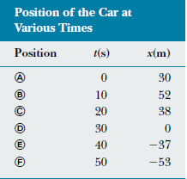
Find the displacement, distance, average velocity, and average speed between positions A and F.

Slide 14
Relative Velocity
The velocity of one object relative to another’s point of view
Reference Frame: the frame of reference for the observer’s point of view—the observer will always be at rest in his/her frame of reference
Relative velocity of an object moving relative to an observer is determined by subtracting vectors

Slide 15
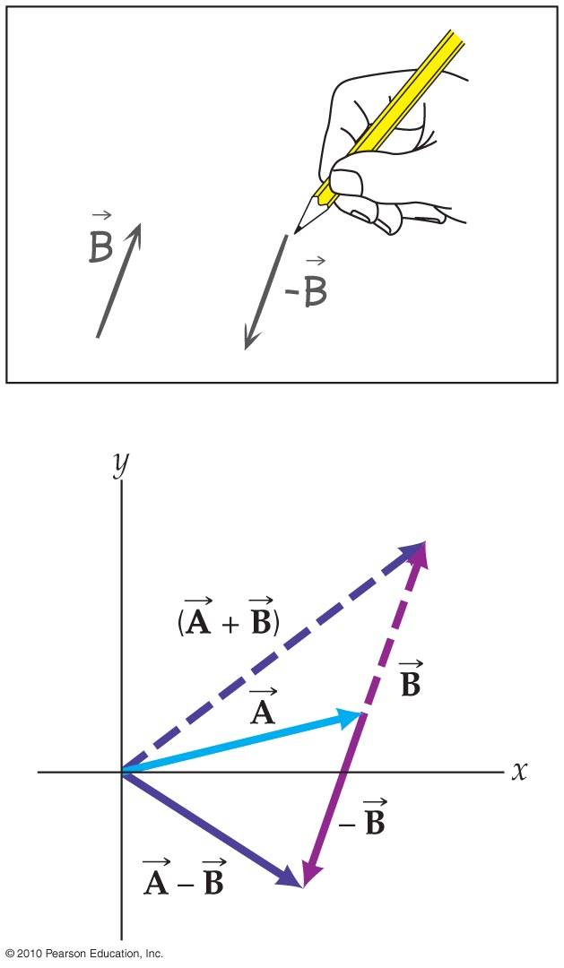
Subtracting Vectors
The second vector quantity’s direction is 180° from it’s given direction
Once you’ve altered the direction, it becomes basic vector addition

Slide 16
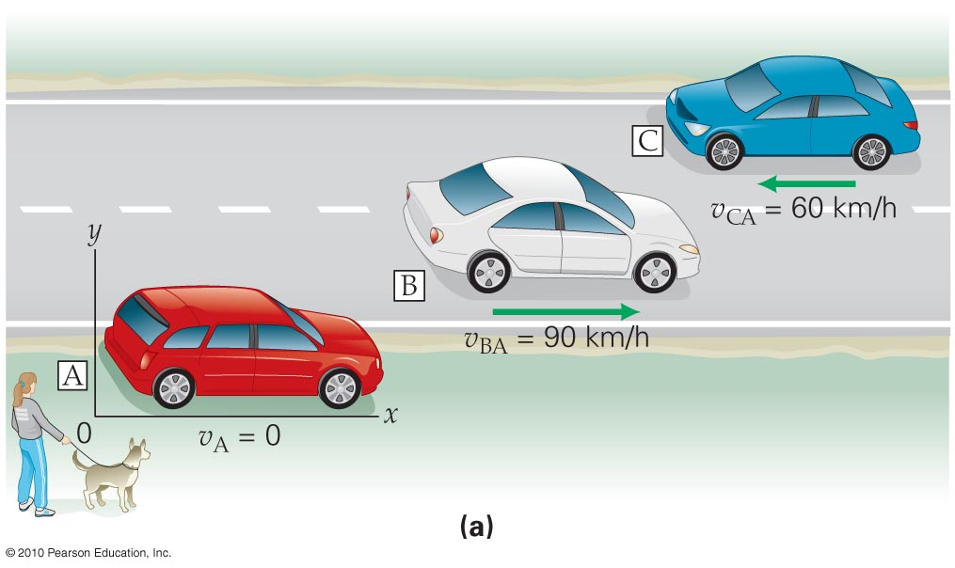
Sample problem 1:
What is the velocity of:
Car B relative to A?
Car C relative to A?
Car C relative to B?
Car B relative to C?
Car A relative to C?
Car A relative to B?

Slide 17
Practice Problem 2:
Car P moves to the left with a speed of 40.0 km·h⁻¹ (with respect to the road) and Car Z moves to the right with a speed of 60.0 km·h⁻¹ (with respect to the road). Find the velocity of car Z relative to car P.

Slide 18
Average Acceleration
The average acceleration of a particle is defined as the change in velocity divided by the time interval during which that change occurs.

Slide 19
1. A 50.0-g superball traveling at 25.0 m/s bounces off a brick wall and rebounds at 22.0 m/s. A high-speed camera records this event. If the ball is in contact with the wall for 3.50 ms, what is the magnitude of the average acceleration of the ball during this time interval? (Note: 1 ms = 1 x 10⁻³ s.)
2. A person walks first at a constant speed of 5.00 m/s along a straight line from point A to point B and then back along the line from B to A at a constant speed of 3.00 m/s. What is (a) her average speed over the entire trip? (b) her average velocity over the entire trip?

Slide 20
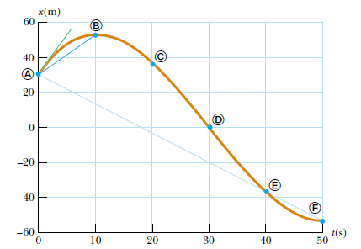
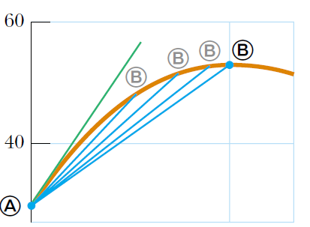
Instantaneous Velocity

Slide 21
Instantaneous Velocity
Instantaneous velocity equals the limiting value of the average velocity, as delta t approaches 0.

Slide 22
Instantaneous Speed
Instantaneous speed equals the magnitude of the instantaneous velocity.

Slide 23
Instantaneous Acceleration
The instantaneous acceleration is the limit of the average acceleration as delta t approaches 0.
- Equals the derivative of the velocity with respect to time.

Slide 24
When the object’s velocity and acceleration are in the same direction, the object is speeding up.
When they are in the opposite direction, the object is slowing down.
Negative acceleration doesn’t mean slowing down. If a and v are both negative, the object is still speeding up.

Slide 25
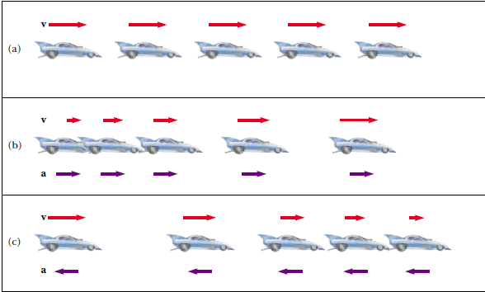


Slide 26
One Dimensional motion with constant acceleration

Slide 27
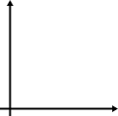
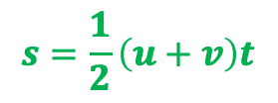
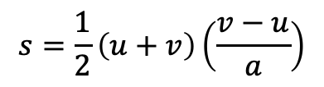


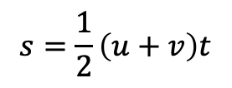


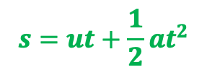


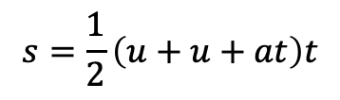

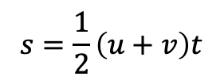

$$s=\frac{1}{2}\left(u+v\right)t$$
$$a=\frac{v−u}{t}$$
$$s=\frac{1}{2}\left(u+v\right)t$$
$$s=\frac{1}{2}\left(u+u+at\right)t$$
$$v=u+at$$
velocity
$$s=ut+\frac{1}{2}at^{2}$$
$$v$$
$$s=\frac{1}{2}\left(u+v\right)t$$
$$s=\frac{1}{2}\left(u+v\right)\left(\frac{v−u}{a}\right)$$
$$2as=\left(u+v\right)\left(v−u\right)$$
$$2as=v^{2}−u^{2}$$
$$u$$
$$v^{2}=u^{2}+2as$$
time
$$t$$

Slide 28
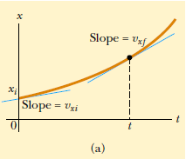
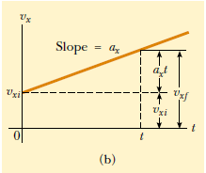
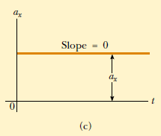

Slide 29
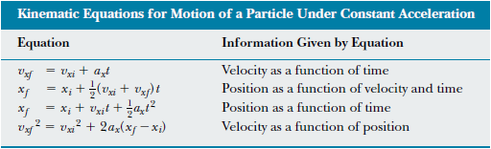
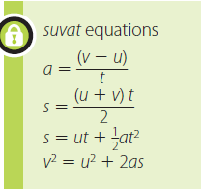

Slide 30
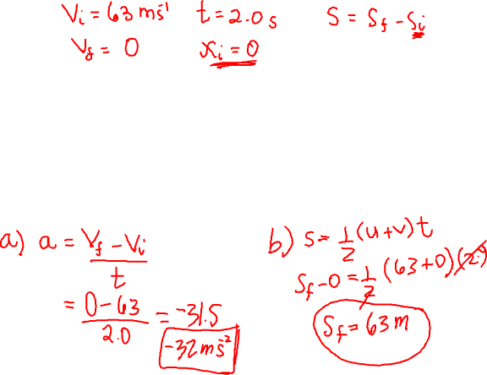
A jet lands on an aircraft carrier at 140 mi/h (63 m/s).
What is its acceleration (assumed constant) if it stops in 2.0 s due to an arresting cable that snags the airplane and brings it to a stop?
If the plane touches down at position x_{i} = 0, what is the final position of the plane?

Slide 31
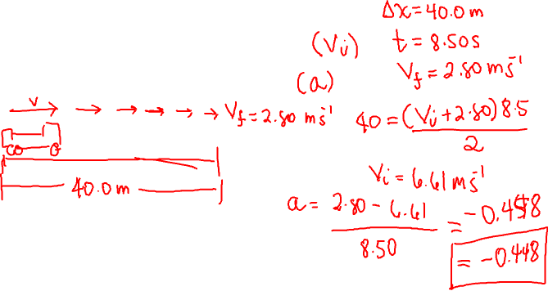
A truck covers 40.0 m in 8.50 s while smoothly slowing down to a final speed of 2.80 m/s.
Find its original speed.
Find its acceleration.

Slide 32
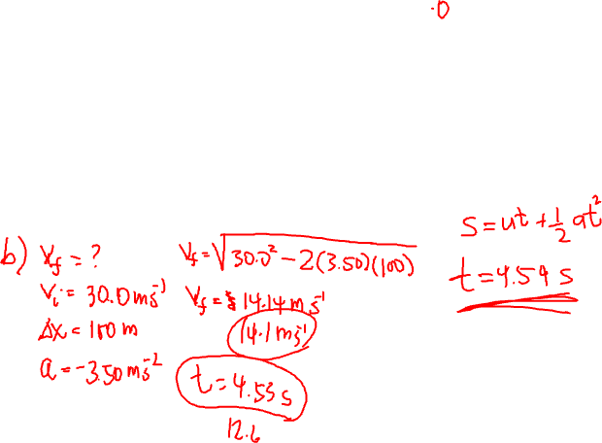
A speedboat moving at 30.0 m/s approaches a no-wake buoy marker 100 m ahead. The pilot slows the boat with a constant acceleration of -3.50 m/s² by reducing the throttle. (a) How long does it take the boat to reach the buoy? (b) What is the velocity of the boat when it reaches the buoy?

Slide 33
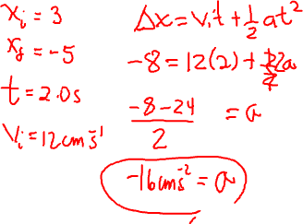
An object moving with uniform acceleration has a velocity of 12.0 cm/s in the positive x direction when its x coordinate is 3.00 cm. If its x coordinate 2.00 s later is -5.00 cm, what is its acceleration?

Slide 34
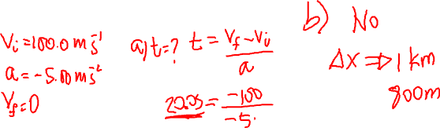
A jet plane lands with a speed of 100.0 m/s and can accelerate at a maximum rate of
-5.00 m/s² as it comes to rest. (a) From the instant the plane touches the runway, what is the minimum time interval needed before it can come to rest? (b) Can this plane land on a small tropical island airport where the runway is 0.800 km long?

Slide 35
A car traveling at a constant speed of 45.0 m/s passes a trooper hidden behind a billboard. One second after the speeding car passes the billboard, the trooper sets out from the billboard to catch it, accelerating at a constant rate of 3.00 m/s². How long does it take her to overtake the car?

Slide 36
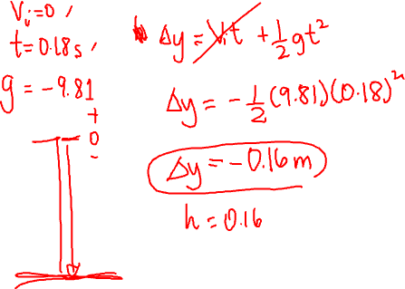
If you drop an aspirin and it takes 0.18s to hit the table, how high above the table was the aspirin dropped?

Slide 37
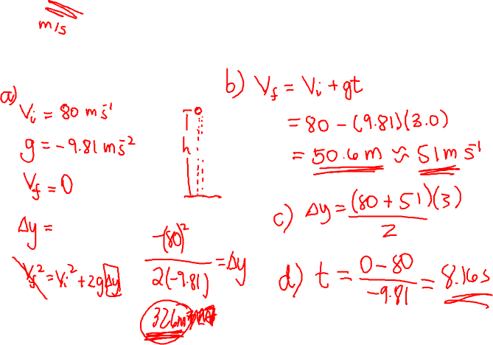
A ball is thrown upward with an initial speed of 80 ft/s. (a) How high does it go up? (b) What is its speed at the end of 3 s? (c) How high is it at that time?

Slide 38
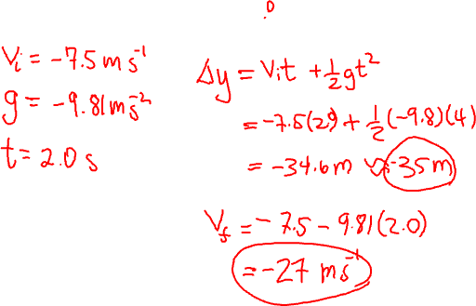
A child throws down a ball straight down off the balcony of an apartment building at a speed of 7.5 m/s. Calculate the position and velocity of the ball 2 s later.

Slide 39

In determining the height of a tower, a stone is dropped from rest at its top. Find the height if the stone hits the ground after 8 seconds.
2. A ball is thrown up and returns to the ground after exactly 6 seconds. (a) How far up did the ball go? (b) With what velocity was the ball thrown?

Slide 40
3. A ball is thrown directly upward, with an initial speed of 8 m/s, from a height of 30 m. After what time interval does the ball strike the ground?
4. A student throws a set of keys vertically upward to her sorority sister, who is in a window 4 m above. The keys are caught 1.5 s later. (a) With what initial velocity were the keys thrown? (b) What was the velocity of the keys just before they were caught?

Slide 41
5. An object is thrown vertically upward from the top of a tower with an initial velocity of 29.4 m/s. Four seconds later, another object is dropped from the top of the tower. How many seconds will the two be at the same level?

Slide 42
A golf ball is released from rest from the top of a very tall building. Neglecting air resistance, calculate (a) the position and (b) the velocity of the ball after 1.00, 2.00, and 3.00 s.
A stone is dropped from a building and takes 5 s to hit the ground. The same stone is dropped from a second building and it takes 10 seconds to hit the ground. How do the heights of the buildings compare? How do the final velocities of the two compare?

Slide 43
An electron in a cathode ray tube accelerates from 2 x 10⁴ m/s to 6 x 10⁶ m/s over 1.5 cm. (a) How long does the electron take to travel this 1.5 cm? (b) What is its acceleration?

Slide 44
A ball starts from rest and accelerates at 0.5 m/s² while moving down an inclined plane 9 m long. When it reaches the bottom, the ball rolls up another plane, where, after moving 15 m, it comes to rest. (a) What is the speed of the ball at the bottom of the first plane? (b) How long does it take to roll down the first plane? (c) What is the acceleration along the second plane? (d) What is the ball’s speed 8 m along the second plane?

Slide 45
A particle moves along the x axis according to the equation x = 2 + 3t – 1t², where x is in meters and t is in seconds. At t = 3s, find:
The position of the particle
its velocity
its acceleration.

Slide 46
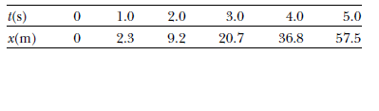
The position of a derby car was observed at various times; the results are summarized in the following table. Find the average velocity of the car for (a) t = 0 to t = 1s, (b) t = 3s to t = 5s, and (c) the entire period of observation, (d) the average speed for the whole period.

Slide 47
An object moves along the x axis according to the equation x(t) = (3.00t² - 2.00t + 3.00) m. Determine (a) the average speed between t = 2.00 s and t = 3.00 s, (b) the instantaneous speed at t = 2.00 s and at t = 3.00 s, (c) the average acceleration between t = 2.00 s and t = 3.00 s, and (d) the instantaneous acceleration at t = 2.00 s and t = 3.00 s.

Slide 48
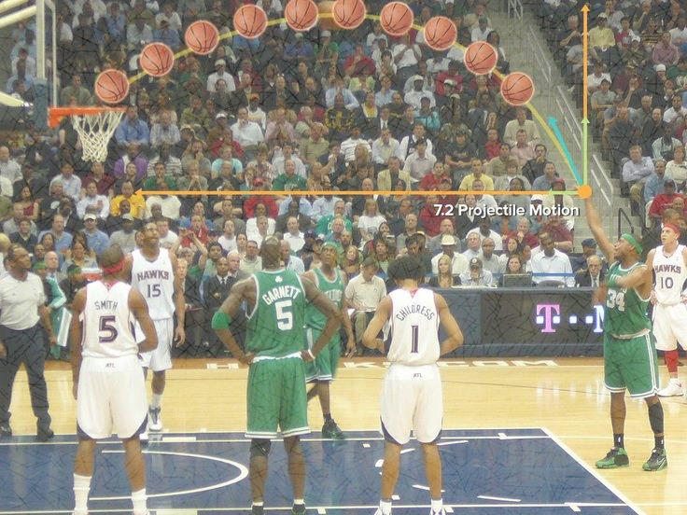
Projectile Motion

Slide 49
https://phet.colorado.edu/sims/projectile-motion/projectile-motion_en.html

Slide 50
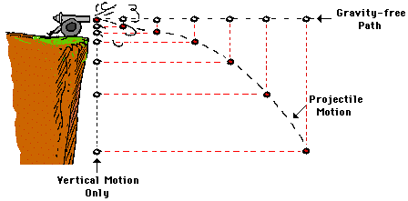
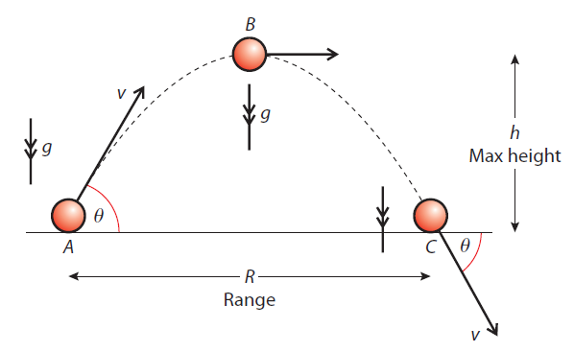

Slide 51
Fired/thrown horizontally

Slide 52
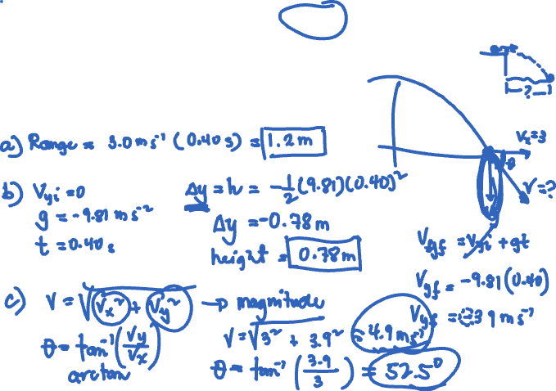
Fired/thrown horizontally
1) A ball rolls off a desk at a speed of 3.0 m/s and lands 0.40 seconds later.
a) How far from the base of the desk does the ball land?
b) How high is the desk?
c) What is the speed and angle of impact?

Slide 53
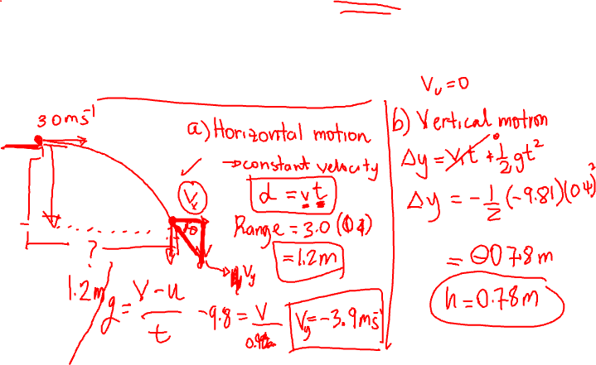
Fired/thrown horizontally
1) A ball rolls off a desk at a speed of 3.0 m/s and lands 0.40 seconds later.
a) How far from the base of the desk does the ball land?
b) How high is the desk?
c) What is the speed and angle of impact?

Slide 54
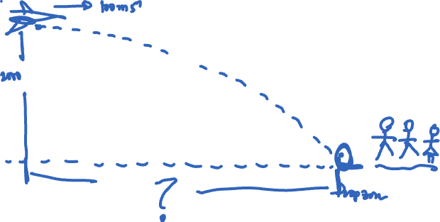
Fired/thrown horizontally
2) A rescue pilot drops a survival kit while her plane is flying at an altitude of 2000.0 m with a forward velocity of 100.0 m/s. If air friction is disregarded, how far in advance of the starving explorer’s drop zone should she release the package?

Slide 55
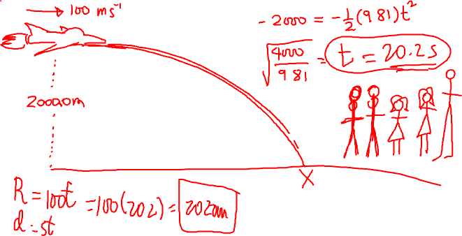
Fired/thrown horizontally
2) A rescue pilot drops a survival kit while her plane is flying at an altitude of 2000.0 m with a forward velocity of 100.0 m/s. If air friction is disregarded, how far in advance of the starving explorer’s drop zone should she release the package?

Slide 56
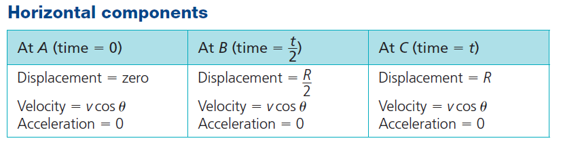
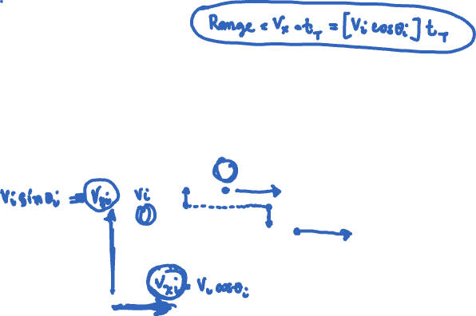
Fired/thrown at an angle

Slide 57
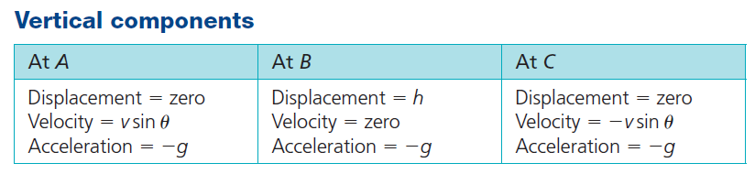
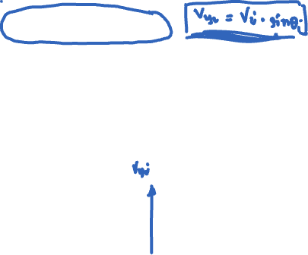
Fired/thrown at an angle

Slide 58
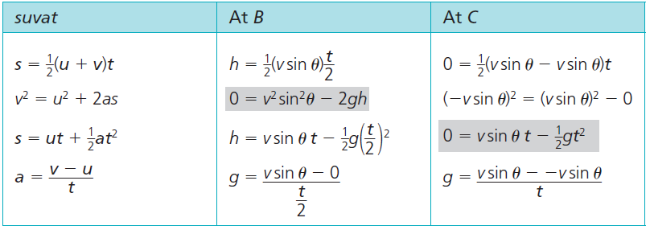

Slide 59
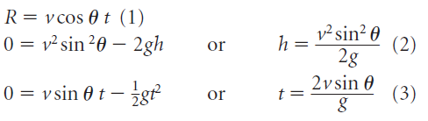
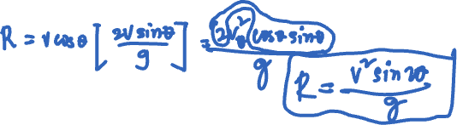

Slide 60
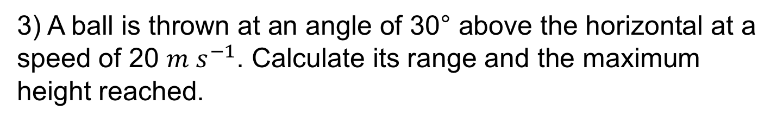
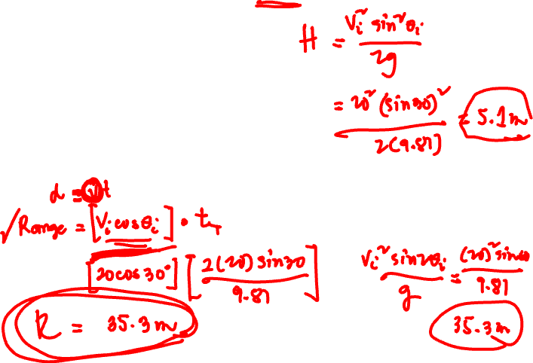
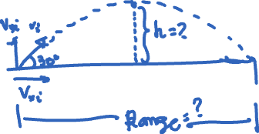
3) A ball is thrown at an angle of 30° above the horizontal at a speed of 20 $m{ s}^{−1}$. Calculate its range and the maximum height reached.

Slide 61

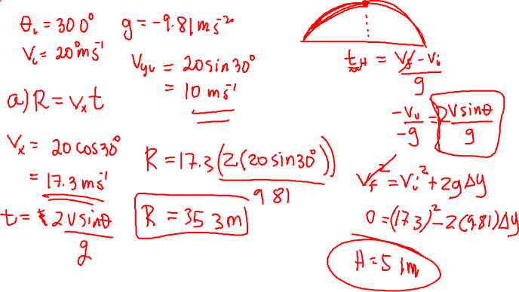
3) A ball is thrown at an angle of 30° above the horizontal at a speed of 20 $m{ s}^{−1}$. Calculate its range and the maximum height reached.

Slide 62
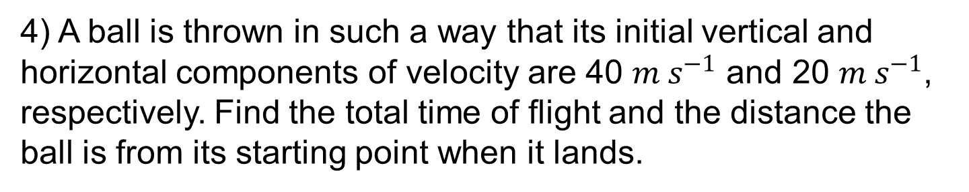
4) A ball is thrown in such a way that its initial vertical and horizontal components of velocity are 40 $m{ s}^{−1}$ and 20 $m{ s}^{−1}$, respectively. Find the total time of flight and the distance the ball is from its starting point when it lands.

Slide 63
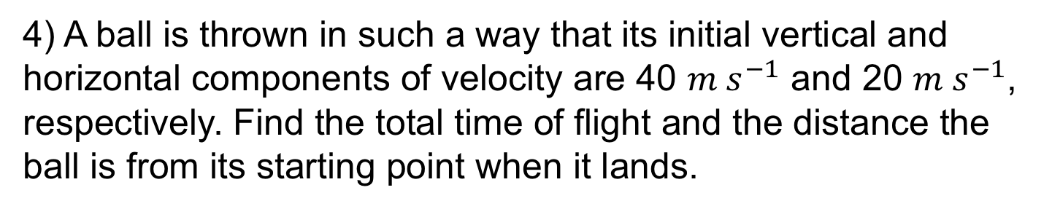


4) A ball is thrown in such a way that its initial vertical and horizontal components of velocity are 40 $m{ s}^{−1}$ and 20 $m{ s}^{−1}$, respectively. Find the total time of flight and the distance the ball is from its starting point when it lands.

Slide 64

1) A ball is thrown horizontally from a cliff top with a horizontal speed of 10.0 $m{ s}^{−1}$. If the cliff is 20.0 m high what is the range of the ball?

Slide 65



1) A ball is thrown horizontally from a cliff top with a horizontal speed of 10.0 $m{ s}^{−1}$. If the cliff is 20.0 m high what is the range of the ball?

Slide 66

2) A gun is aimed so that it points directly at the centre of a target 200 m away. If the bullet travels at 200 $m{ s}^{−1}$ how far below the centre of the target will the bullet hit?

Slide 67


2) A gun is aimed so that it points directly at the centre of a target 200 m away. If the bullet travels at 200 $m{ s}^{−1}$ how far below the centre of the target will the bullet hit?

Slide 68

3) A baseball player leads off the game and hits a long home run. The ball leaves the bat at an angle of 30.0º from the horizontal with a velocity of 40.0 $m{ s}^{−1}$. How far will it travel horizontally?

Slide 69



3) A baseball player leads off the game and hits a long home run. The ball leaves the bat at an angle of 30.0º from the horizontal with a velocity of 40.0 $m{ s}^{−1}$. How far will it travel horizontally?

Slide 70

4) A golfer is teeing off on a 170.0 m long par 3 hole. The ball leaves with a velocity of 40.0 $m{ s}^{−1}$ at 50.0º to the horizontal. Assuming that she hits the ball on a direct path to the hole, how far from the hole will the ball land (no bounces or rolls)?

Slide 71



4) A golfer is teeing off on a 170.0 m long par 3 hole. The ball leaves with a velocity of 40.0 $m{ s}^{−1}$ at 50.0º to the horizontal. Assuming that she hits the ball on a direct path to the hole, how far from the hole will the ball land (no bounces or rolls)?

Slide 72

5) A stone is thrown from the top of a building upward at an angle of 30.0° to the horizontal with an initial speed of 20.0 $m{ s}^{−1}$.. If the height of the building is 45.0 m, how long does it take the stone to reach the ground? What is the speed of the stone just before it strikes the ground?

Slide 73

5) A stone is thrown from the top of a building upward at an angle of 30.0° to the horizontal with an initial speed of 20.0 $m{ s}^{−1}$.. If the height of the building is 45.0 m, how long does it take the stone to reach the ground? What is the speed of the stone just before it strikes the ground?

Slide 74


5) A stone is thrown from the top of a building upward at an angle of 30.0° to the horizontal with an initial speed of 20.0 $m{ s}^{−1}$.. If the height of the building is 45.0 m, how long does it take the stone to reach the ground? What is the speed of the stone just before it strikes the ground?

Slide 75
6) A lovesick lad wants to throw a bag of candy and love notes into the open window of his girlfriend’s bedroom 10.0 m above. Assuming it just reaches the window, he throws the love gifts at 60.0º to the ground:
a) At what velocity should he throw the bag?
b) How far from the house is he standing when he throws the bag?

Slide 76

6) A lovesick lad wants to throw a bag of candy and love notes into the open window of his girlfriend’s bedroom 10.0 m above. Assuming it just reaches the window, he throws the love gifts at 60.0º to the ground:
a) At what velocity should he throw the bag?
b) How far from the house is he standing when he throws the bag?

