Slide 1
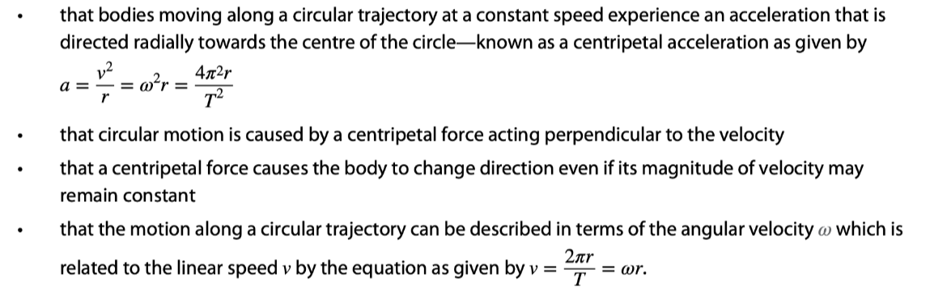

Slide 2
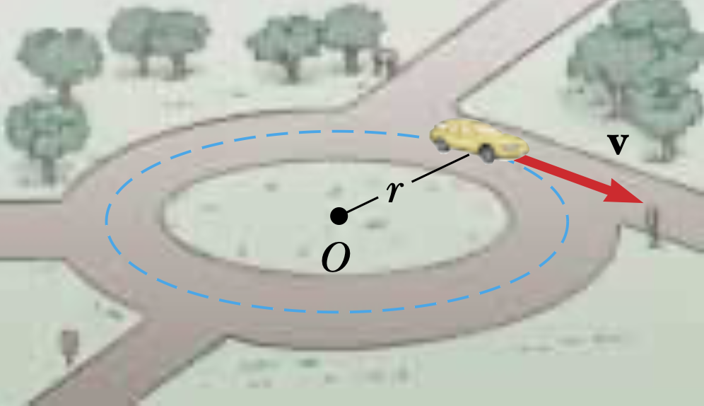
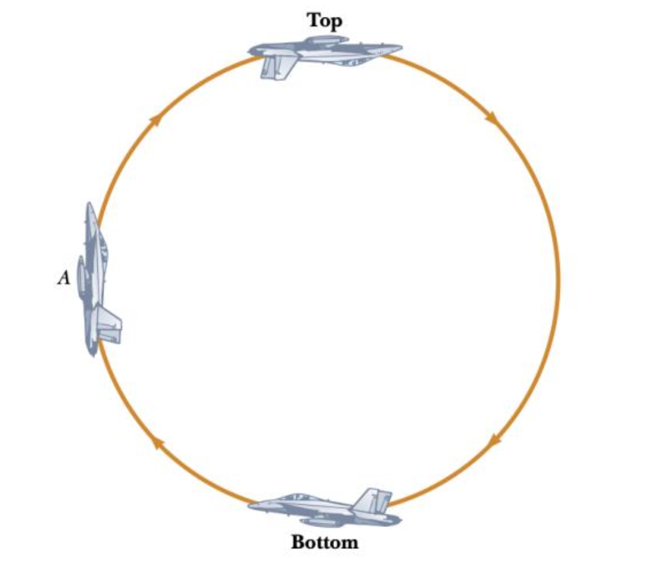
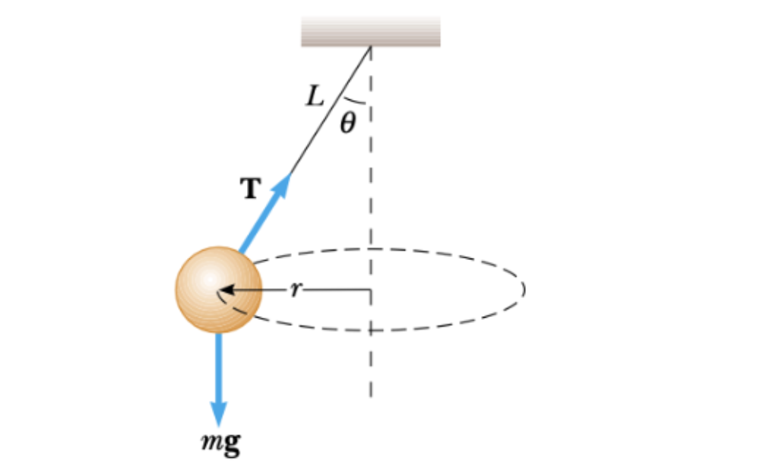
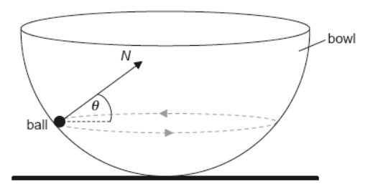
Uniform Circular Motion
Horizontal circle
Vertical circle

Slide 3
Centripetal force and acceleration
•A particle is said to be in uniform circular motion if it travels in a circle (or arc) with constant speed v.
•Observe that the velocity vector is always tangent to the circle.
•Note that the magnitude of the velocity vector is NOT changing.
•Note that the direction of the velocity vector IS changing.
•Thus, there is an acceleration, even though the speed is not changing!
v red
r blue
y
v
r
x

Slide 4
Centripetal force and acceleration
•To find the direction of the acceleration (a = Δv / Δt ) we observe two nearby snapshots of the particle:
•The direction of the acceleration is gotten from Δv = v₂ – v₁ = v₂ + (-v₁):
•The direction of the acceleration is toward the center of the circle - you must be able to sketch this.
v red
r blue
v₂
v₂
v₂
y
v₁
-v₁
v₁
v₁
-v₁
Δv
Δv
x
FYI
•Centripetal means center-seeking.

Slide 5
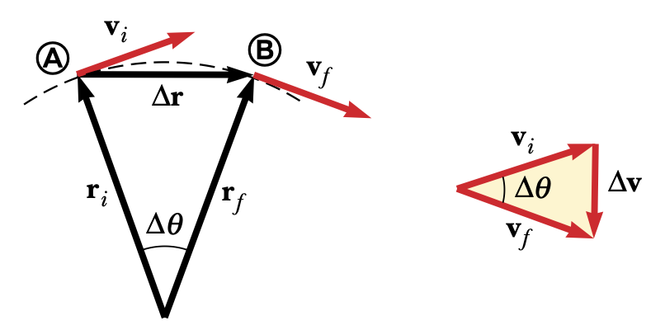
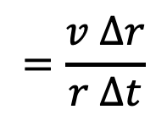
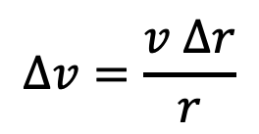
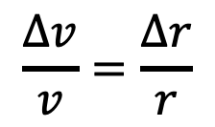
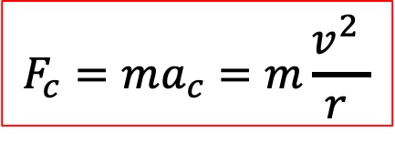
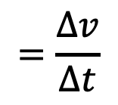
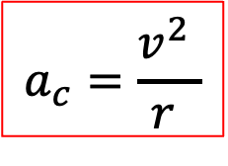
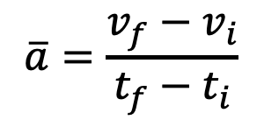
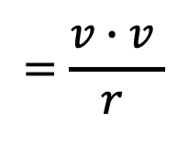
Uniform Circular Motion
$$\overline{a}=\frac{v_{f}−v_{i}}{t_{f}−t_{i}}$$
$$=\frac{Δv}{∆t}$$
$$=\frac{v Δr}{r ∆t}$$
$$\frac{Δv}{v}=\frac{∆r}{r}$$
$$=\frac{v∙v }{r }$$
$$∆v=\frac{v ∆r}{r}$$
$$a_{c}=\frac{v^{2} }{r }$$
$$F_{c}=ma_{c}=m\frac{v^{2} }{r }$$

Slide 6

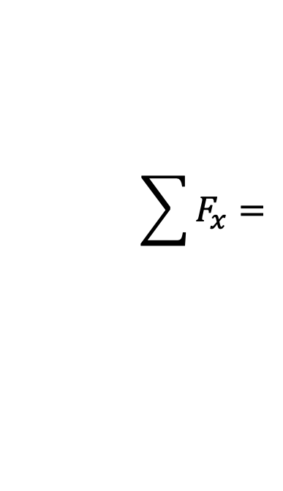


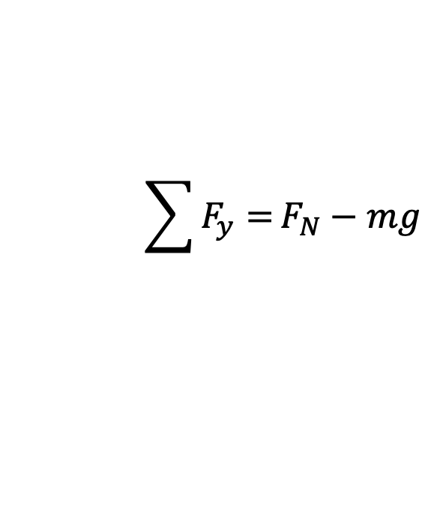

Uniform Circular Motion
normal force
friction
weight
$$\sum{F_{y}=}F_{N}−mg$$
$$=$$
$$0$$
$$\sum{F_{x}=}$$
$$m\frac{v^{2}}{r}$$
$$f$$
$$=$$

Slide 7



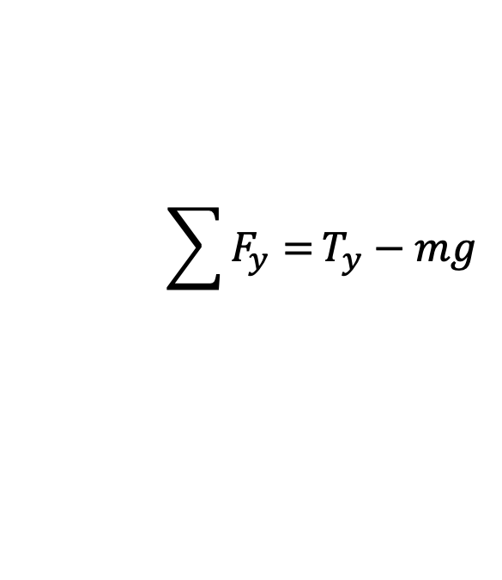
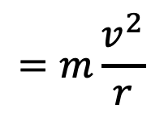



Uniform Circular Motion
$$T_{y}$$
$$T_{x}$$
$$\sum{F_{y}=}T_{y}−mg$$
$$=$$
$$T\cos{θ}−mg$$
$$=0$$
$$\sum{F_{x}=}$$
$$=m\frac{v^{2}}{r}$$
$$T_{x}$$
$$T\sin{θ}$$
$$=$$

Slide 8
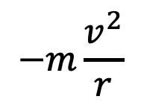


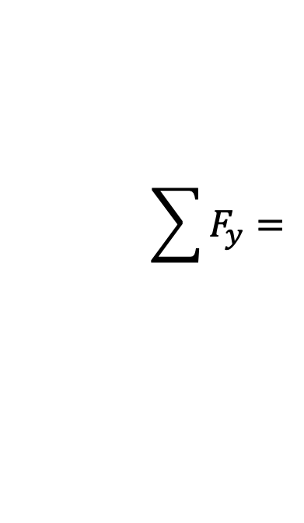
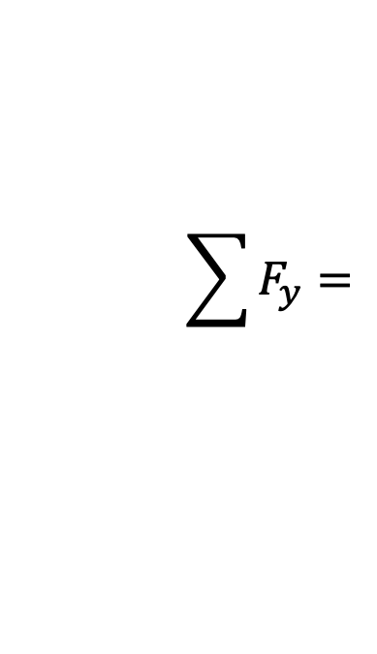


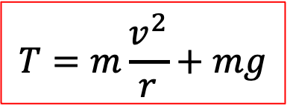


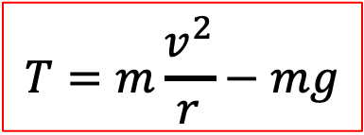
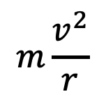
$$\sum{F_{y}=}$$
$$−m\frac{v^{2}}{r}$$
$$−T−mg=$$
$$mg$$
$$T=m\frac{v^{2}}{r}−mg$$
$$T$$
$$T$$
$$\sum{F_{y}=}$$
$$m\frac{v^{2}}{r}$$
$$mg$$
$$T−mg=$$
$$T=m\frac{v^{2}}{r}+mg$$

Slide 9
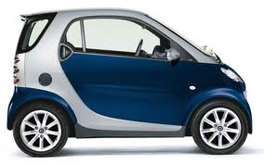
Solving centripetal acceleration and force problems
F_{c} = ma_{c}
centripetal force
a_{c} = v ² / r
centripetal acceleration
EXAMPLE: A 730-kg Smart Car negotiates a 30. m radius turn at 25. m s⁻¹. What is its centripetal acceleration and force? What force is causing this acceleration?
SOLUTION:
a_{c} = v² / r = 25² / 30 = 21 m s⁻².
F_{c} = ma_{c} = (730)(21) = 15000 n.
The centripetal force is caused by the friction force between the tires and the pavement.

Slide 10

Period and frequency
•The period T is the time for one complete revolution.
•The frequency f (measured in Hz or cycles / s) is defined as how many cycles (oscillations, repetitions, revolutions) occur each second.
•Since period T is seconds per revolution, frequency must be 1 / T.
f = 1 / T
or T = 1 / f
relation between T and f
EXAMPLE: Find the period and the frequency of a day.
SOLUTION:
•The period is T = (24 h)(3600 s h⁻¹) = 86400 s.
•The frequency is f = 1 / T = 1 / 86400 = 1.16×10⁻⁵ Hz.

Slide 11
Period and centripetal acceleration
•Sometimes the period of a revolution is given, rather than a velocity.
•One revolution is one circumference C = 2πr.
•Therefore v = distance / time = 2πr / T.
•Thus v ² = 4π ² r ² / T ² so that
a_{c} = v ² / r
= 4π ² r ² / T ²r
= 4π ² r / T ².
a_{c} = v ² / r
centripetal acceleration
a_{c} = 4π ² r / T ²

Slide 12
Solving centripetal acceleration and force problems
a_{c} = v ² / r
centripetal acceleration
a_{c} = 4π ² r / T ²
EXAMPLE: Albert the 2.50-kg physics cat is being swung around by a string harness having a radius of 3.00 meters. He takes 5.00 seconds to complete one fun revolution. What are a_{c} and F_{c}?
SOLUTION:
•a_{c} = 4π ² r / T ²
= 4π ² (3) / (5)² = 4.74 m s⁻².
F_{c} = ma_{c} = (2.5)(4.74) = 11.9 n.
•The tension is causing the centripetal force, so the tension is F_{c} = 11.9 n.
Albert the Physics Cat

Slide 13
Angular displacement and arc length
•Consider the rotating arm which has 6 paint cans along its radius.
•Each can has a spout that is opened for exactly a quarter of a revolution.
•We call θ the angular displacement.
•All 6 color trails represent the same angular displacements of 90˚.
•Each color traces out a different displacement s.
•We call s the arc length.
•All 6 color trails represent different arc lengths.
θ
s
s
s
s
s

Slide 14
Angular displacement and arc length
•At this point it is useful to define a new way to measure angles – called radians.
•Looking at the above conversions we see that there are 2π rad in 360˚.
π rad = 180° = 1/ 2 rev
radian-degree-revolution conversions
2π rad = 360° = 1 rev
EXAMPLE:
Convert 30° into radians (rad) and convert 1.75 rad to degrees.
SOLUTION:
• 30°( π rad / 180° ) = 0.52 rad.
• 1.75 rad ( 180° / π rad ) = 100°.

Slide 15
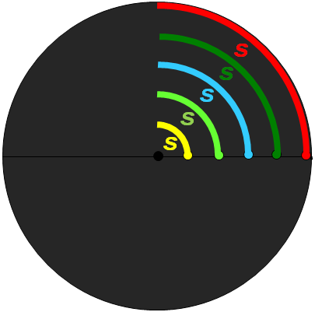
Angular displacement and arc length
•The relationship between angular displacement θ and arc length s is
where r is the radius.
π rad = 180° = 1/ 2 rev
radian-degree-revolution conversions
2π rad = 360° = 1 rev
s = r θ
θ in radians
relation between s and θ
EXAMPLE: Suppose the red line is located at a radius of 1.50 m and the green line is located at 1.25 m. Find their lengths.
SOLUTION: 90°( π rad / 180°) = 1.57 rad.
•s = r θ = 1.50×1.57 = 2.4 m.
•s = r θ = 1.25×1.57 = 2.0 m.

Slide 16
Angular speed and speed
•The arc length s is simply the displacement we learned about in Topic 2, and is the s that is in s = ut + (1/2) at ².
•Because speed is v = s / t, we see that
v = s / t (definition of speed)
= ( r θ ) / t (substitution)
= r ( θ / t ) (associative property)
= r ω (define ω ≡ θ / t )
•Thus
•We call ω the angular speed.
s = r θ
θ in radians
relation between s and θ
v = r ω
ω = θ / t (rad s⁻¹)
relation between v and ω

Slide 17
Angular speed and speed
v = r ω
ω = θ / t (rad s⁻¹)
relation between v and ω
EXAMPLE: Consider the following point mass moving at a constant speed v in a circle of radius r as shown.
Find …
the period T of the point mass, and
(b) the frequency f of the point mass, and
(c) the angular speed ω of the point mass.
SOLUTION: We need a time piece.
•For one revolution the period is T = 12 s.
•Frequency f = 1 / T = 1 / 12 = 0.083 s.
•Angular speed is ω = θ / t = 2π rad / 12 s = 0.52 rad s⁻¹.
v
r

Slide 18

Angular speed and speed
v = r ω
ω = θ / t (rad s⁻¹)
relation between v and ω
EXAMPLE: Find the angular speed of the second hand on a clock. Then find the speed of the tip of the hand if it is 18.0 cm long.
SOLUTION: A second hand turns 2π rad each 60 s.
•Thus it has an angular speed given by
ω = 2π / T = 2π / 60 = 0.105 rad s⁻¹.
•The speed of the tip is given by
v = r ω = 0.180(0.105) = 0.0189 ms⁻¹.
FYI •Speed depends on length or position but angular speed does not.

Slide 19

Angular speed and speed
v = r ω
ω = θ / t (rad s⁻¹)
relation between v and ω
EXAMPLE: A car rounds a 90° turn in 6.0 seconds. What is its angular speed during the turn?
SOLUTION:
•Since ω needs radians we begin by converting θ:
θ = 90°( π rad / 180° ) = 1.57 rad.
•Now we use
ω = θ / t = 1.57 / 6.0 = 0.26 rad s⁻¹.

Slide 20
Banking
•The car is able to round the curve because of the friction between tire and pavement.
•The friction always points to the center of the circle.
•So, how does a plane follow a circular trajectory?
•There is no sideways friction force that the plane can use because there is no solid friction between the air and the plane.

Slide 21
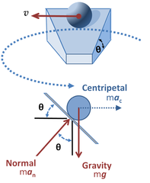
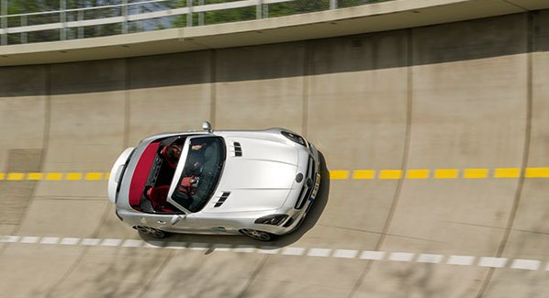
Banking
•Even though cars use friction, roads are banked so that the need for friction is reduced.
•Instead of a component of the LIFT force providing a centripetal force, a component of the NORMAL force does so.
R
FYI •A banked curve can be designed so that a car can make the turn even if it is perfectly frictionless!
F_{C}
W

Slide 22
Angular speed and centripetal acceleration
•Sometimes the angular speed of an object in circular motion is given, rather than its velocity.
•From v = r ω we get v ² = r ² ω ².
•From a_{c} = v ² / r we get
a_{c} = r ² ω ² / r
a_{c} = r ω ².
•Putting it all together we have
a_{c} = v ² / r
F_{c} = mv ² / r
a_{c} and F_{c} (all three forms)
a_{c} = 4π ² r / T ²
F_{c} = 4π ² mr / T ²
a_{c} = r ω ²
F_{c} = m ω ² r

Slide 23
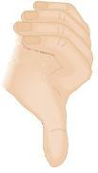
Angular velocity
•As speed with a direction is called velocity, angular speed with a direction is called angular velocity.
•To assign a direction to a rotation we use a right hand rule as follows:
Rest the heel of your right hand on the rotating object.
Make sure your fingers are curled in the direction of rotation.
Your extended thumb points in the direction of the angular velocity.
ω = 2π / T = 2πf = θ / t
relation between ω, T and f
v
r
ω
FYI •Angular velocity always points perpendicular to the plane of motion!

Slide 24
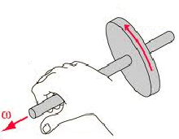
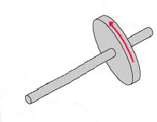
Angular velocity
ω = 2π / T = 2πf = θ / t
relation between ω, T and f
PRACTICE: Find the angular velocity (in rad s⁻¹) of the wheel on the shaft. It is rotating at 30.0 rpm (revolutions per minute).
SOLUTION:
•The magnitude of ω is given by
ω = (30.0 rev / 60 s)(2π rad / rev)
= 3.14 rad s⁻¹.
•The direction of ω is given by the right hand rule:
“Place heel of right hand so fingers are curled in direction of rotation. Thumb gives the direction.”

Slide 25

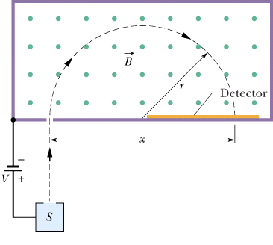
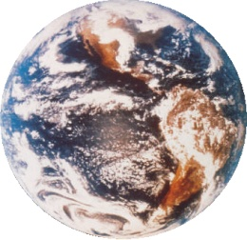


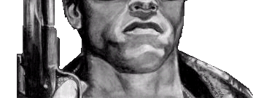
Identifying the forces providing centripetal forces
PRACTICE:
Identify at least five forces that are centripetal in nature:
SOLUTION:
•The tension force (Albert the physics cat and Arnold).
•The friction force (the race car making the turn).
•The gravitational force (the baseball and the earth).
•The electric force (an electron orbiting a nucleus).
•The magnetic force (a moving charge in a B-field).

Slide 26

Solving centripetal acceleration and force problems
PRACTICE: Dobson is watching a 16-pound bowling ball being swung around at 50 m/s by Arnold. If the string is cut at the instant the ball is next to the ice cream, what will the ball do?
(a) It will follow path A and strike Dobson's ice cream.
(b) It will fly outward along curve path B.
(c) It will fly tangent to the original circular path along C.
A
C
B

Slide 27
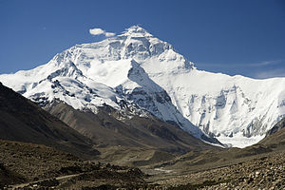


Solving centripetal acceleration and force problems
EXAMPLE: Suppose a 0.500-kg baseball is placed in a circular orbit around the earth at slightly higher that the tallest point, Mount Everest (8850 m). Given that the earth has a radius of R_{E} = 6400000 m, find the speed of the ball.
SOLUTION: The ball is traveling in a circle of radius r = 6408850 m.
•F_{c} is caused by the weight of the ball so that F_{c} = mg = (0.5)(10) = 5 n.
•Since F_{c} = mv ² / r we have
5 = (0.5)v ² / 6408850
v = 8000 m s⁻¹!

Slide 28
Solving centripetal acceleration and force problems
EXAMPLE: Suppose a 0.500-kg baseball is placed in a circular orbit around the earth at slightly higher that the tallest point, Mount Everest (8850 m). How long will it take the ball to return to Everest?
SOLUTION: We want to find the period T.
•We know that v = 8000 m s⁻¹.
•We also know that r = 6408850 m.
•Since v = 2πr / T we have
T = 2πr / v
T = 2π(6408850)/ 8000
= (5030 s)(1 h / 3600 s) = 1.40 h.

Slide 29

Solving centripetal acceleration and force problems
EXAMPLE: Explain how an object can remain in orbit yet always be falling.
SOLUTION:
•Throw the ball at progressively larger speeds.
•In all instances the force of gravity will draw the ball toward the center of the earth.
•When the ball is finally thrown at a great enough speed, the curvature of the ball’s path will match the curvature of the earth’s surface.
•The ball is effectively falling around the earth!

Slide 30
Solving centripetal acceleration and force problems
PRACTICE: Find the angular speed of the minute hand of a clock, and the rotation of the earth in one day.
SOLUTION:
•The minute hand takes 1 hour to go around one time. Thus
ω = 2π / T = 2π / 3600 s = 0.00175 rad s⁻¹.
•The earth takes 24 h for each revolution so that
ω = 2π / T
= ( 2π / 24 h )( 1 h / 3600 s )
= 0.0000727 rad s⁻¹.
•This small angular speed is why we can’t really feel the earth as it spins.

Slide 31
Solving centripetal acceleration and force problems
90˚
ω
EXAMPLE: Find the apparent weight of someone standing on an equatorial scale if his weight is 882 N at the north pole.
SOLUTION: Recall that ω = 0.0000727 rad s⁻¹ anywhere on the earth.
•The blue arcs represent the lines of latitude.
•The white line R represents the earth’s radius.
•The yellow line r represents the radius of the circle a point at a latitude of θ follows.
•Note that r = R cos θ, and that at the equator, θ = 0˚ and at the pole, θ = 90˚.
r
R
θ
0˚
θ

Slide 32
Solving centripetal acceleration and force problems
ω
EXAMPLE: Find the apparent weight of someone standing on an equatorial scale if his weight is 882 N at the north pole.
SOLUTION: Recall that ω = 0.0000727 rad s⁻¹ anywhere on the earth.
•Thus, at the equator, r = R, and at the pole, r = 0. Furthermore, R = 6400000 m.
•Then, at the equator,
a_{c} = r ω² = 6400000× 0.0000727² = 0.0338 ms⁻².
•Then, at the pole,
a_{c} = r ω² = 0× 0.0000727² = 0.000 ms⁻².
r
R
θ
θ

Slide 33
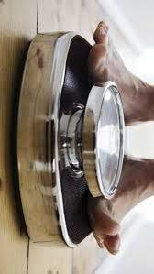
Solving centripetal acceleration and force problems
EXAMPLE: Find the apparent weight of someone standing on an equatorial scale if his weight is 882 N at the north pole.
SOLUTION: Make a free-body diagram at the equator…
•Scales read the normal force R:
ΣF = ma
R – W = - ma_{c}
R = W – ma_{c}
•Then, R = 882 – ( 882 / 9.8 ) × 0.0338 = 879 N.
•The man has apparently “lost” about 3 N!
W
R
a_{c}

Slide 34
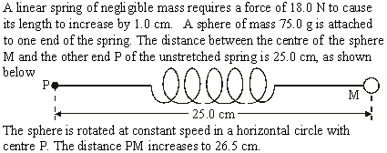

Solving centripetal acceleration and force problems
•Use F = kx (k = CONST).
•kx = F_{C} = mv ²/ r implies that as v increases, so does the centripetal force F_{C} needed to move it in a circle.
•Thus, x increases.

Slide 35

Solving centripetal acceleration and force problems
•kx = F → k = F / x = 18 / 0.010 = 1800 Nm⁻¹.
•F_{C} = kx = 1800( 0.265 – 0.250 ) = 27 N.
•F_{C} = v ²/ r → v ² = r F_{C} = 0.265(27) = 7.155
•v = 2.7 ms⁻¹.

Slide 36
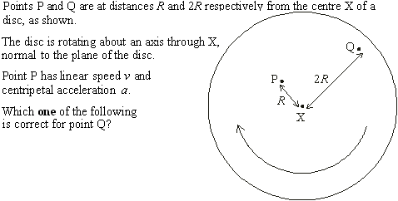
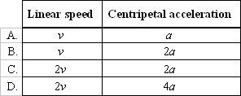
•Use v = r ω (ω = CONST).
•Use a = r ω ² (ω = CONST).
Solving centripetal acceleration and force problems
•At P
r = R
v = Rω
a = R ω ²
•At Q
r = 2R
v = 2Rω = 2v
a = 2Rω ² = 2a

Slide 37
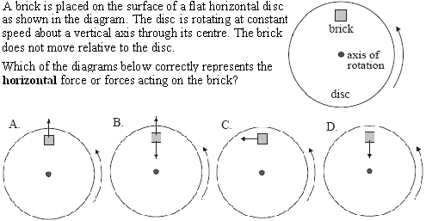
Solving centripetal acceleration and force problems
•Objects moving in uniform circular motion feel a centripetal (center-seeking) force.

