Slide 1
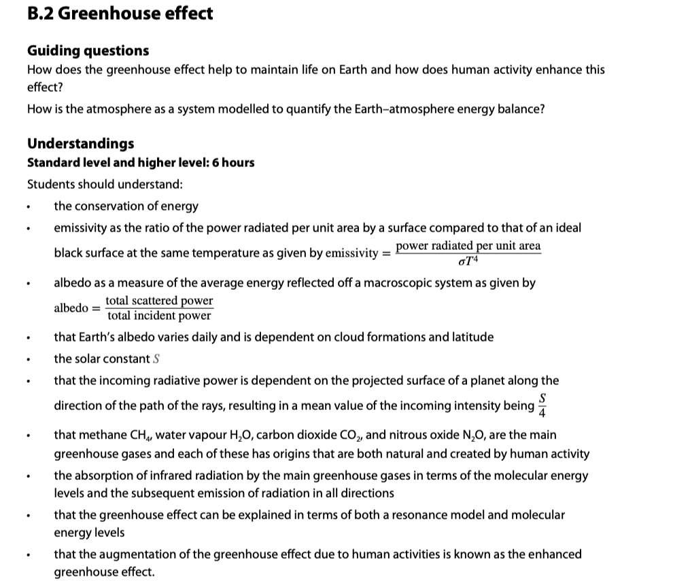

Slide 2

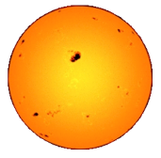
The solar constant
PRACTICE: The sun radiates energy at a rate of 3.90×10²⁶ W. What is the rate at which energy from the sun reaches Earth if our orbital radius is 1.5×10¹¹ m?
SOLUTION: A_{SPHERE} = 4πr².
•Recall that intensity is the rate at which energy is being gained per unit area.
•Then I = P / [ 4πr² ]
= 3.90×10²⁶ / [ 4π(1.5×10¹¹)² ]
= 1380 W m⁻².
•This value is called the solar constant.
intensity = power / A
intensity
P_{sun} = 1380 W m⁻²
the solar constant

Slide 3
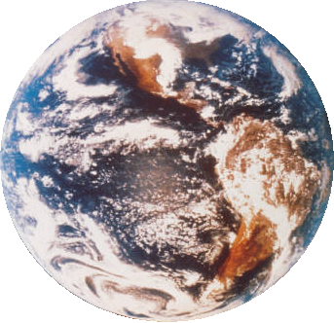
The solar constant
PRACTICE:
Explain why the solar intensity is different for different latitudes.
SOLUTION:
•The following diagram shows how the same intensity is spread out over more area the higher the latitude.
1380 W/m²
Notes:
3

Slide 4
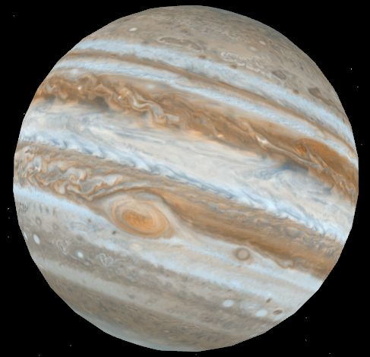
The solar constant
PRACTICE: The sun radiates energy at a rate of 3.90×10²⁶ W. What is the rate at which energy from the sun reaches Jupiter if its orbital radius is 7.8×10¹¹ m? (This is Jupiter’s solar constant.)
SOLUTION: Use I = P / [ 4πr² ]
I = P / [ 4πr² ] = 3.90×10²⁶ / [ 4π(7.8×10¹¹)² ]
I = 51 W m⁻².
•This is 51 J / s per m².

Slide 5


Emissivity
•The emissivity e of a body is a number between 0 and 1 that quantifies the emission and absorption properties of that body as compared to a blackbody of equal size.
•A black-body is a perfect emitter / absorber of radiation and has an emissivity of e = 1.
•A body that can’t emit / absorb radiation at all has an emissivity of e = 0.
•The emissivity of a body is the ratio of the power emitted by the body, to the power emitted by a black-body of the same size.
charcoal
e = 0.95
mirror
e = 0.05
e = P_{BODY} / P_{BLACK-BODY}
emissivity
e = P_{BODY} / [ σAT ⁴ ]

Slide 6
Emissivity
•A black-body is a perfect emitter/absorber (e = 1).
•A small sphere covered with lamp black makes a pretty good black-body and has an emissivity somewhat close to 1.
•An even better black- body is the metal- cavity black-body:
•If we know e, the Stefan-Boltzmann law can be amended:
e = 0.9
e = 0.5
better black-body
tallow candle
incident thermal radiation
P = eσAT ⁴
the Stefan-Boltzmann law
where σ = 5.67×10⁻⁸ W m⁻² K⁻⁴.

Slide 7

P_{INCIDENT}
Albedo
•When light strikes an object, some of it is absorbed, and some of it is scattered.
•If light strikes a mirror, nearly all of it will be scattered:
•If light strikes a surface covered with lamp black, nearly all of it will be absorbed:
•We define albedo in terms of scattered and incident power:
P_{SCATTERED}
heat
P_{SCATTERED}
P_{INCIDENT}
heat
albedo = P_{SCATTERED} / P_{INCIDENT}
albedo
FYI
•The mirror has an albedo of almost 1.
•The black-body has an albedo of almost 0.
Notes:
7

Slide 8
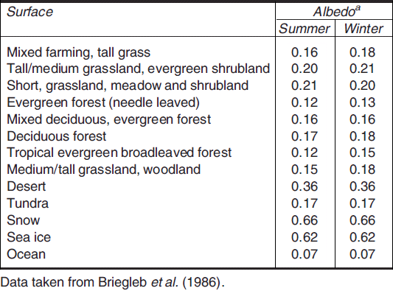
Albedo
•Landforms, vegetation, weather, and seasons affect a planet’s albedo.
•The table shows that different terrains have different albedos.
•Ocean water scatters little light (7%).
•Snow and ice scatter a lot of light (62% to 66%).
•Desert (36%).
Notes:
8

Slide 9
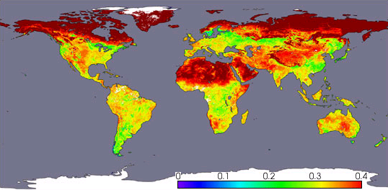
Albedo
EXAMPLE: Satellites are used to map out monthly albedos.
White and gray areas: No data.
Albedo
April, 2002, Terra satellite, NASA
Notes:
9

Slide 10
Albedo
•From the previous table and satellite map it is clear that calculating the overall albedo of a planet is quite complex.
•Clouds (and even contrails) also contribute to the albedo.
•Overall, Earth’s mean yearly albedo is about 0.3 (or 30%).
•The actual albedo depends on season, latitude, cloud cover, and snow cover.
•It varies daily!
Notes:
10

Slide 11
Solving problems involving albedo
EXAMPLE: Assuming an albedo of 0.30, find, for Earth:
(a) the power of the sunlight received.
SOLUTION: Use I = 1380 W m⁻² and I = P / A.
•The radius of Earth is r = 6.37×10⁶ m so its cross-sectional area is
A = πr² = π(6.37×10⁶)² = 1.27×10¹⁴ m².
•An albedo of 0.30 means that 70% of the sunlight is absorbed (because 30% is scattered). Thus
P =(0.70)IA =(0.70)(1380)(1.27×10¹⁴) = 1.23×10¹⁷ W.
•Thus Earth intercepts energy from the sun at a rate of 1.23×10¹⁷ W.

Slide 12
Solving problems involving albedo
EXAMPLE: Assuming an albedo of 0.30, find, for Earth:
(b) the predicted temperature due to the sunlight reaching it.
SOLUTION:
•From the previous example P = 1.23×10¹⁷ W.
•But this power is distributed over the whole rotating planet, which has an area A_{sphere} = 4πr².
•From Stefan-Boltzmann we have
P = σAT⁴
1.23×10¹⁷ = (5.67×10⁻⁸)4π(6.37×10⁶)²T⁴
T = 255 K (-18°C).

Slide 13
Solving problems involving emissivity and Earth’s average temperature
EXAMPLE: If the average temperature of Earth is 289 K, find its emissivity.
SOLUTION: We determined that Earth absorbs energy from the sun at a rate of P = 1.23×10¹⁷ W.
•Since the temperature of Earth is relatively constant, we can assume it is radiating power at the same rate of P_{BODY} = 1.23×10¹⁷ W.
•At 289 K the power radiated by a black-body of the same size as Earth is:
P_{B-B} = (5.67×10⁻⁸)4π(6.37×10⁶)²289⁴ = 2.02×10¹⁷ W.
•Thus e = P_{BODY} / P_{BLACK-BODY} = 1.23 / 2.02 = 0.61.

Slide 14
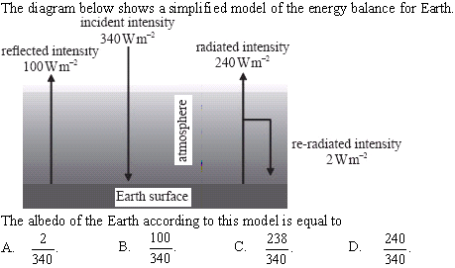
Solving problems involving albedo
•albedo = P_{SCATTERED} / P_{INCIDENT}
•P_{INCIDENT} = 340 W m⁻²
•P_{SCATTERED} = 100 W m⁻²
•albedo = 100 / 340
Notes:
14

Slide 15
net heat gain
The greenhouse effect
•When solar radiation strikes a planet that has a gaseous atmosphere, the gases comprising the atmosphere can absorb infrared radiation (heat).
•The remainder of the incoming radiation then reaches the ground to either be scattered back into the atmosphere, or absorbed.
•Solids can absorb all frequencies of radiation, and convert them to infrared wavelengths.
•The heated ground can then emit infrared radiation back into the atmosphere, which then intercepts more of the energy on the way out.
•The result is that the atmosphere traps heat and causes the temperature of the planet to rise.

Slide 16
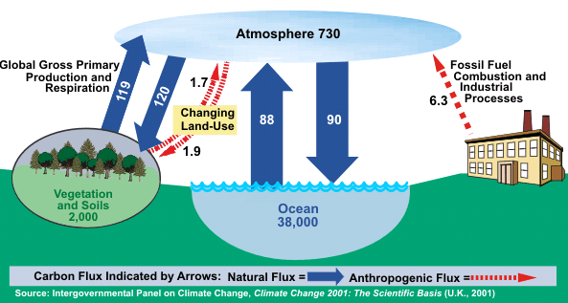
The greenhouse effect
•The process outlined on the previous slide is the so-called greenhouse effect.
•The main gases that are particularly effective in absorbing infrared radiation are methane (CH₄), water vapor (H₂O), carbon dioxide (CO₂), and nitrous oxide (N₂O).
•Note that there are both natural and man-made (anthropogenic) contributions and changes (flux).
C-sink
Global Carbon Cycle (Billion Metric Tons Carbon)
C-sink
C-sink

Slide 17
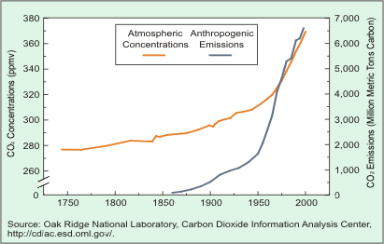
Greenhouse gases – CO₂
•This graph shows the correlation between increasing atmospheric concentration of CO₂ and our fossil fuel emissions of CO₂.
•Anthropogenic means “human.”
Trends in Atmospheric Concentrations and Anthropogenic Emissions of Carbon Dioxide

Slide 18
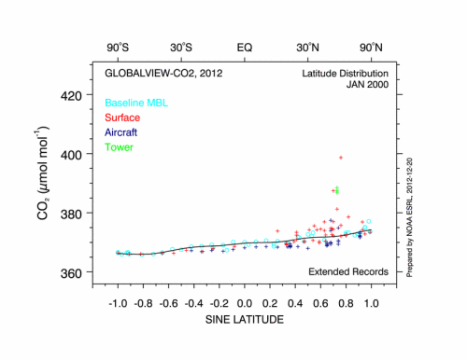
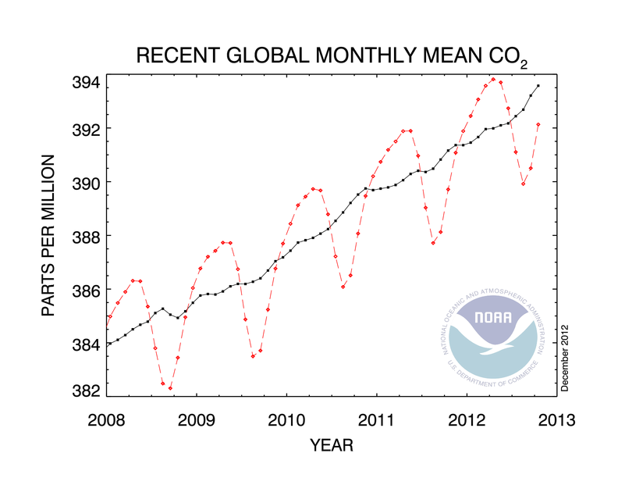
Greenhouse gases – CO₂
EXAMPLE: How are the levels of CO₂ determined?
SOLUTION: Observatories and aircraft.
cooling months
warming months

Slide 19
Absorption of infrared radiation by greenhouse gases
•Recall that solar radiation strikes the earth at a rate of 1380 W m⁻² or less, the farther from the equator you are.
•That energy is carried in the form of photons, which are quanta of light.
•The atmosphere is made up of gases, which are the first layer of matter that the sun's rays interact with.
•If a photon is at the precise energy for an electron to jump to a different energy level in an atom, it will be absorbed.
Small, medium and large electron jumps may occur, even to the point of ionization

Slide 20
Absorption of infrared radiation by greenhouse gases
•The excited gases will eventually de-excite and release photons.
•The absorption and release of photons by the gases is called scattering.
•Scattering does not produce a net increase in heat energy in the atmosphere.
•However, some of the scattered photons may be in the infrared region – able to be absorbed as internal energy and kinetic energy via the mechanisms illustrated on the next slides:

Slide 21

Absorption of infrared radiation by greenhouse gases
•Greenhouse gases are all molecular in nature, (meaning comprised of more than one atom).
•For our purposes we will consider the triatomic molecule CO₂.
•A simple model of CO₂ has springs connecting the two oxygen atoms to the carbon atom:
•Recall that heat energy can be stored in molecules as internal energy in the form of potential (the springs) and kinetic (the vibrations).
O
C
O

Slide 22
Absorption of infrared radiation by greenhouse gases
•The difference between these two CO₂ molecules is in their internal potential energies:
•The above E_{P} storage does not contribute to the increase in temperature of the CO₂. Rather, it is the kinetic energy E_{K} of the molecule that determines its temperature.
•There are three ways an extended molecule such as CO₂ can store kinetic energy: Via vibration, via translation, and via rotation.
O
C
O
O
C
O
E_{P} big
E_{P} small

Slide 23
Absorption of infrared radiation by greenhouse gases
•Vibration refers to the molecules oscillating in conjunction with the springs:
•The natural frequency of greenhouse gases is in the infrared region of the spectrum and thus greenhouse gases are prone to absorb such frequencies.
C
O
O
C
O
O
vibration

Slide 24
Absorption of infrared radiation by greenhouse gases
•Translation refers to the molecule moving as a unit in a straight line:
•Rotation refers to the molecule spinning about its center of mass.
•All three E_{K} modes can absorb and hold infrared radiation simultaneously.
O
C
O
translation
O
C
O
rotation

Slide 25

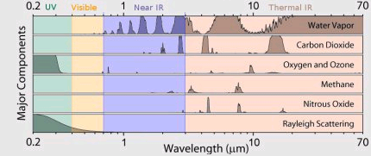
Absorption of infrared radiation by greenhouse gases
•Different gases absorb different wavelengths:

Slide 26
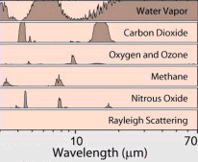
Absorption of infrared radiation by greenhouse gases
PRACTICE: Consider the absorption graphs below:
(a) Which portion of the electromagnetic spectrum is represented?
(b) Which greenhouse gas contributes the most to the greenhouse effect?
(c) Which gas is the least significant contributor?
SOLUTION:
(a) Infrared (heat).
(b) Water vapor!
(c) Oxygen and ozone.

Slide 27
Energy balance in Earth surface / atmosphere system
•Although we calculated the intensity of solar radiation to be 1380 W m⁻² by the time it reaches Earth, the earth is spherical, and so not all surfaces will receive this intensity.
•We will take the average for our models to be
I_{AVG} = 340 W m⁻²
average incident solar radiation
1380 W/m²

Slide 28
Energy balance in Earth surface / atmosphere system
EXAMPLE: Draw a Sankey diagram for a model of the earth without greenhouse gases.
SOLUTION: First draw Earth/atmosphere blocks:
•Draw incoming solar energy (340 W m⁻²):
•Draw energy reflected by atmosphere (clouds):
•Draw energy reflected by ground (snow, etc.):
•Draw energy absorbed by ground (Q = mcΔT):
•Draw energy radiated by ground (P = σAT⁴):
340
75
235
30
235
NON-GREENHOUSE ATMOSPHERE
235
GROUND

Slide 29
Energy balance in Earth surface / atmosphere system
PRACTICE: Show that at the space/atmosphere interface and at the ground/atmosphere interface the net power flow is zero.
SOLUTION:
•Space/atmosphere interface:
= 340 IN
235 + 75 + 30 = 340 OUT.
•Ground/atmosphere interface:
235 IN and 235 OUT.
340
75
235
30
FYI
•Since I_{IN} = I_{OUT}, the temperature in each region is constant.
235
NON-GREENHOUSE ATMOSPHERE
235
GROUND

Slide 30
Energy balance in Earth surface / atmosphere system
EXAMPLE: Draw a Sankey diagram for a model of the earth with greenhouse gases.
SOLUTION: Put in the blocks (or sinks) first (Greenhouse gases):
•I_{IN} (340 W m⁻²):
•I_{REFLECT}(105 W m⁻²):
•I_{GND,abs} (165 W m⁻²):
•I_{ATMOS,abs} (70 W m⁻²):
•I_{GND,radiate} (390 W m⁻²):
•I_{convection} (100 W m⁻²):
•I_{ATM,radiate} (195 W m⁻²):
340
75
195
30
165
70
GREENHOUSE ATMOSPHERE
350
325
40
100
GROUND
490

Slide 31
Energy balance in Earth surface / atmosphere system
PRACTICE: Find the net power flow at the space / atmosphere interface and at the ground / atmosphere interface.
SOLUTION:
•Space/atmosphere interface: 340 IN.
195 + 75 + 30 + 40 = 340 OUT.
•Ground/atmosphere interface:
165 + 325 = 490 IN
350 + 40 + 100
= 490 OUT.
Net = 0 W m⁻².
340
75
195
30
165
70
FYI
•This model also shows stable temperatures.
Net = 0 W m⁻².
GREENHOUSE ATMOSPHERE
350
100
325
40
490
GROUND

Slide 32
Energy balance in Earth surface / atmosphere system
PRACTICE: Find the net power flow at the ground / atmosphere interface.
SOLUTION:
•We have:
I_{IN} = 165 + 335
= 500 W m⁻².
I_{OUT} = 360 + 20 + 110
= 490 W m⁻².
•The net power flow is thus
I_{IN} – I_{OUT} = 500 – 490 = + 10 W m⁻².
340
75
195
30
165
540
70
GREENHOUSE ATMOSPHERE
360
335
20
110
500
GROUND
FYI
•This model shows increasing ground temperatures.

Slide 33
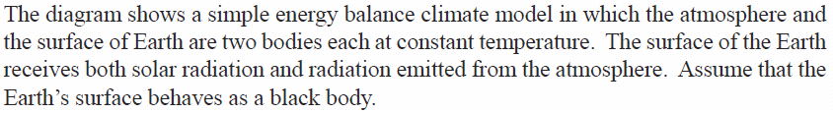
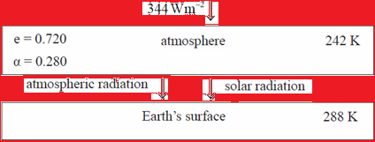
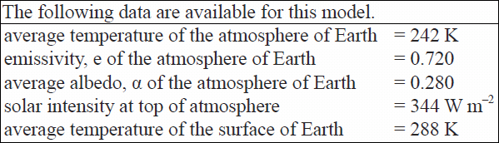
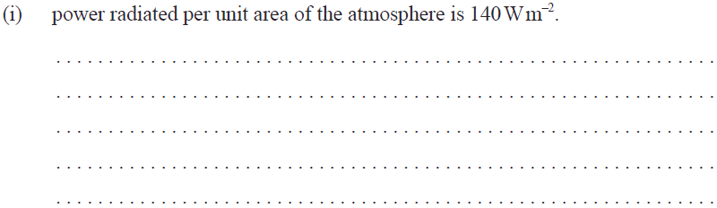
Energy balance in Earth surface / atmosphere system
•From Stefan-Boltzmann we have P = eσAT⁴ so that
P / A = (0.72)(5.67×10⁻⁸)242⁴ = 140 W m⁻².

Slide 34
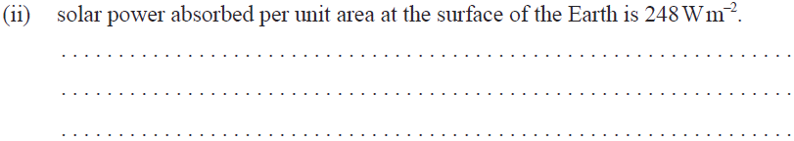
Energy balance in Earth surface / atmosphere system
•P / A = (1)(5.67×10⁻⁸)288⁴ = 390 W m⁻² (amount radiated)
•P / A = 140 W m⁻² (amount absorbed from atmosphere)
•390 – 140 = 250 W m⁻² (amount absorbed from sun).

Slide 35

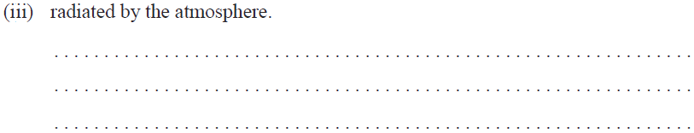
Energy balance in Earth surface / atmosphere system
•P / A = (0.72)(5.67×10⁻⁸)(242 + 6)⁴ = 154 W m⁻².

Slide 36
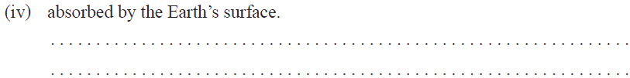
Energy balance in Earth surface / atmosphere system
•Amount absorbed from sun 250 W m⁻² is still same.
•P / A = 154 W m⁻² + 250 W m⁻² = 404 W m⁻².

Slide 37
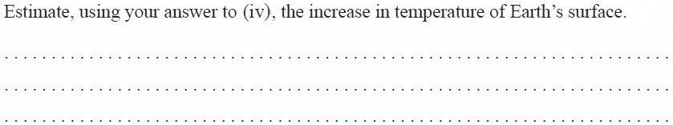
Energy balance in Earth surface / atmosphere system
•From Stefan-Boltzmann we have P = σAT⁴.
•Thus P / A = σT⁴ or 404 = 5.67×10⁻⁸T⁴, and
•T = 291 K, or an increase of 291 – 288 = 3 K.

Slide 38
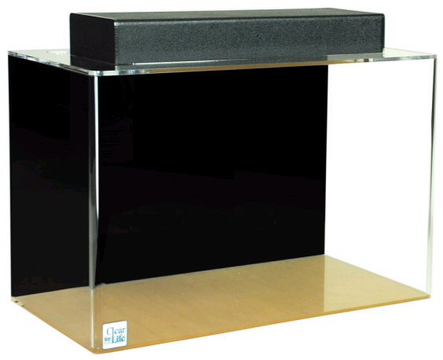
A simple Excel global warming model
•Real global warming models are complex, because the earth and all of its energy-exchanging and storing systems are extremely complex. Supercomputers are used with some success.
•To gain some sort of insight into computer modeling, consider the following simple model:
•5 kg of water is added to an aquarium once each second.
•10% of the water is removed from the aquarium once each second.
FYI •Water IN represents the incoming energy and water OUT represents the outgoing energy.

Slide 39
A simple Excel global warming model
•At first glance it might appear that the water level will never stop increasing.
•But consider the time when 5 kg is exactly 10% of the total water in the aquarium.
•From that time on, the water will be removed exactly as fast as it is added.
•Thus, at that time the “energy” represented by the water mass will have reached equilibrium.
•The challenge is to find out how long it takes to reach equilibrium.
•Hand calculations are tedious but possible:

Slide 40
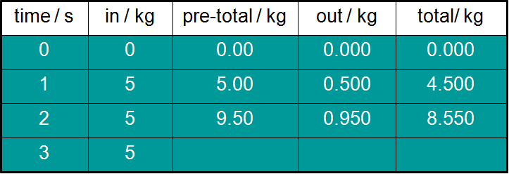
A simple Excel global warming model
PRACTICE: For the water model just proposed, complete the table:
SOLUTION:
•The next cell would be 8.55 + 5 = 13.55.
•The next cell would be 0.10(13.55) = 1.355.
•The next cell would be 13.55 – 1.355 = 12.195.
13.55
1.355
12.195

Slide 41


A simple Excel global warming model
EXAMPLE: Create a spreadsheet to determine what the mass will be when the aquarium reaches equilibrium and how many seconds it will take.
SOLUTION: Create a new spreadsheet with five columns as shown here:
•Highlight cell A3 and type in =A2+1 as shown.
•This will increment the A cells by 1 second.

Slide 42

A simple Excel global warming model
EXAMPLE: Create a spreadsheet to determine what the mass will be when the aquarium reaches equilibrium and how many seconds it will take.
SOLUTION:
•Highlight cell B2 and enter 5.
•Highlight cell C3 and type in =B3+E2 as shown.
•This will add the new input of 5 to the previous total.

Slide 43


A simple Excel global warming model
EXAMPLE: Create a spreadsheet to determine what the mass will be when the aquarium reaches equilibrium and how many seconds it will take.
SOLUTION:
•Highlight cell D3 and enter =0.1*C3.
•Highlight cell E3 and enter =C3-D3.

Slide 44
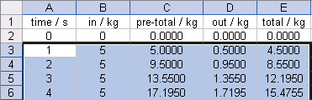
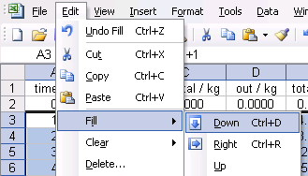
A simple Excel global warming model
EXAMPLE: Create a spreadsheet to determine what the mass will be when the aquarium reaches equilibrium and how many seconds it will take.
SOLUTION:
•Highlight cells A3 through E3 all the way down to about row 100.
•Then select Edit→Fill →Down (or Ctrl+D) to copy down all of the formulas to each cell for all 100 rows.

Slide 45
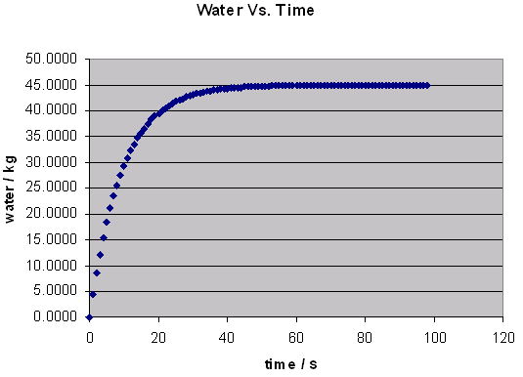
A simple Excel global warming model
EXAMPLE: Create a spreadsheet to determine what the mass will be when the aquarium reaches equilibrium and how many seconds it will take.
SOLUTION:
•Finally, make a graph or read the spreadsheet:
•The graph shows that the mass of water will be 45 kg at equilibrium.
•This will occur after about 60 seconds.
equilibrium

