Slide 1
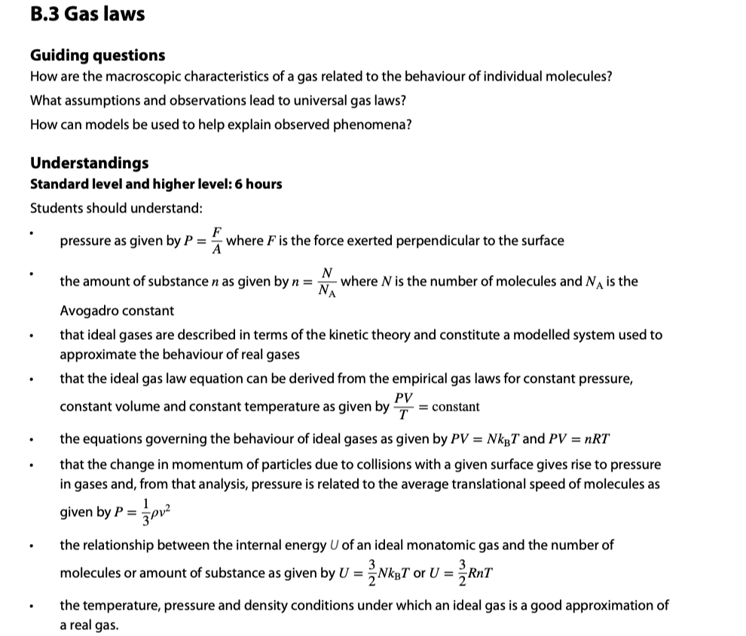

Slide 3
Pressure
•Consider a gas molecule confined in a closed box as shown.
•Since the molecule’s direction is always changing, it is accelerating, and thus feeling a force from the walls of the box.
•From Newton’s third law, the molecule is exerting an equal and opposite force on the walls of the box.
•The walls of the box feel a pressure p, given by the formula below:
•From the formula we can see that the units of pressure are (N m⁻²), also known as Pascals (Pa).
p = F / A
pressure

Slide 4
Pressure
p = F / A
pressure
PRACTICE:
A 150-kg man stands on one foot on some ice. Given that his foot is about 9.0 cm by 10. cm in rectangular cross-section, find the pressure on the ice.
SOLUTION:
•First, find the force:
F = mg = 150(10) = 1500 n.
•Then find the area:
A = LW = (.09)(.10) = 0.009 m².
•Finally
p = F / A = 1500 / .009 = 170000 N m⁻² = 170000 Pa.

Slide 5
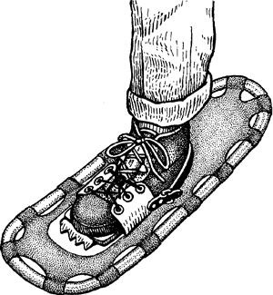
Pressure
p = F / A
pressure
PRACTICE:
If the ice is thin enough that it will break under a pressure of 1.0×10⁵ Pa, what should be the area of a snowshoe that will just prevent him from breaking through when on one foot?
SOLUTION:
•From p = F / A we have:
A = F / p = 1500 / 100000 = 0.015 m².

Slide 6
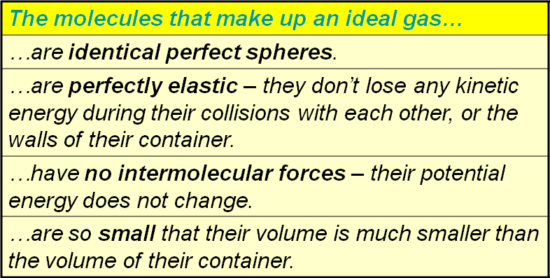
Differences between real and ideal gases
•Recall the properties of an ideal gas:
•The kinetic theory of gases is, of course, a model.
•As such, it doesn’t apply perfectly to real gases.

Slide 7
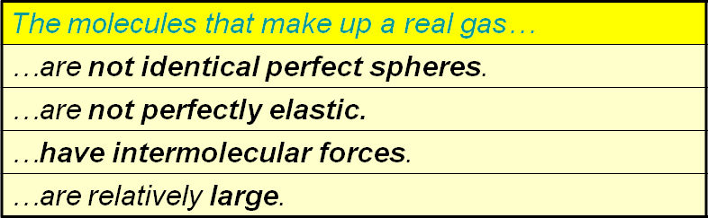
Differences between real and ideal gases
• Here are the properties of a real gas.
FYI
•Real gases are often polyatomic (N₂, O₂, H₂O, NH₄, etc.) and thus not spherical.
•Ideal gases cannot be liquefied, but real gases have intermolecular forces and non-zero volume, so they can be liquefied.

Slide 8
The kinetic model of an ideal gas
•Just as temperature was a measure of the random kinetic energy of molecules for solids and liquids, so it is for an ideal gas.
•If the temperature of a gas increases, so does the average speed (and hence kinetic energy) of the molecules.
low T
medium T
high T

Slide 9
The kinetic model of an ideal gas
•Looking at this animation again we can see that if the speed of the molecules increases, then the number of collisions with the container walls will also increase.
•Thus the pressure will increase if the temperature increases.
low T
medium T
high T
low p
medium p
high p

Slide 10
The kinetic model of an ideal gas
•Consider small, medium and large containers.
•In a smaller volume the molecules have less distance to travel to hit a wall. Thus the wall is hit more often.
•Thus the pressure will be bigger if the volume is smaller.
small V
medium V
high p
large V
medium p
low p

Slide 11
The kinetic model of an ideal gas
•Consider a syringe full of an ideal gas.
•If we make the volume less we see that the temperature will increase.
•Since the plunger exerts a force on the gas, and executes a displacement, it does work on the gas.
•From the work-kinetic energy theorem we know that if we do work on the gas, its kinetic energy must increase.
•Thus its speed will increase, which means its temperature increases.
•On the other hand, if the process is reversed the gas will do the work, lose E_{K} and cool.

Slide 12
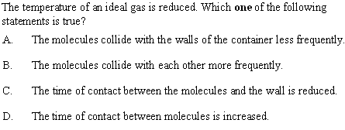
The kinetic model of an ideal gas
•Temperature is a measure of the E_{K} of the gas.
•Reducing the E_{K} reduces the frequency of collisions.
•For perfectly elastic collisions (as in an ideal gas) contact time is zero regardless of E_{K.}
Notes:
12

Slide 13
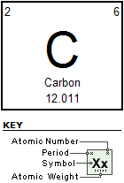
The mole and molar mass
•Recall from the periodic table of the elements that each element has certain numbers associated with it.
•We define the mole of a homogeneous substance as follows:
1 mole is the number of atoms of an element that will have a mass in grams equal to its gram atomic weight.
definition of mole and molar mass
EXAMPLE: Find the mass (in kg) of one mole of carbon.
SOLUTION:
From the periodic table we see that it is just 1 mole C = 12.011 grams = 0.012011 kg.

Slide 14
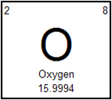
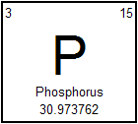
The mole and molar mass
PRACTICE:
What is the gram atomic weight of oxygen?
SOLUTION:
It is 15.9994 g, or if you prefer,
(15.9994 g)(1 kg / 1000 g) = 0.015994 kg.
PRACTICE:
What is the molar mass of phosphorus in kilograms?
•From the periodic table we see that the molar mass of phosphorus is 30.973762 grams.
•The molar mass in kilograms is 0.030973762 kg.

Slide 15
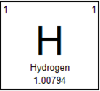
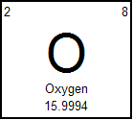
The mole and molar mass
PRACTICE: Water is made up of 2 hydrogen atoms and 1 oxygen atom and has a molecular formula given by H₂O. Find
the gram atomic weight of water.
(b) the mass in grams of 1 mole of water.
(c) how many moles of hydrogen and oxygen there are in 1 mole of water.
SOLUTION:
(a) The GAW of H₂O is given by
2(1.00794) + 1(15.9994) = 18.01528 g per mole.
(b) Thus the mass of 1 mole of H₂O is 18.01528 g.
(c) Since each mole of H₂O has 2H and 1O, there are 2 moles of H and 1 mole of O for each mole of water.

Slide 16

The mole and molar mass
PRACTICE:
Suppose we have 12.25 g of water in a DixieTM Cup? How many moles of water does this amount to?
SOLUTION:
•We determined that the GAW of H₂O is 18.01528 g per mole in the previous problem.
•Thus
(12.25 g)(1 mol / 18.01528 g)
= 0.6800 mol.
FYI
•Maintain your vigilance regarding significant figures!

Slide 17
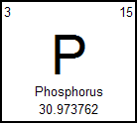
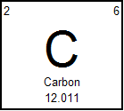
The Avogadro constant
•It turns out the a mole of carbon (12 g) and a mole of phosphorus (31 g) has the same number of atoms.
•This means that 30.973762 g of P has the same number of atoms and 12.011 g of C.
•That number N_{A} is given here:
N_{A} = 6.02×10²³ molecules.
the Avogadro constant
EXAMPLE: How many atoms of P are there in 31.0 g of it? How many atoms of C are there in 12.0 g of it?
SOLUTION:
There are N_{A} = 6.02×10²³ atoms of P in 31.0 g of it.
There are N_{A} = 6.02×10²³ atoms of C in 12.0 g of it.

Slide 18
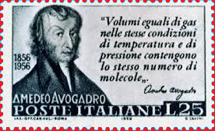
The Avogadro constant
•To find the number of atoms in a sample, simply convert sample to moles, then use the conversion
1 mol = 6.02×10²³ molecules.
N_{A} = 6.02×10²³ molecules.
the Avogadro constant
EXAMPLE: How many atoms of P are there in 145.8 g of it?
SOLUTION: It is best to start with the given quantity.
(145.8 g)(1 mol / 30.984 g)(6.02×10²³ atoms / 1 mol)
= 2.83×10²⁴ atoms of P.

Slide 19

The Avogadro constant
•To find the number of moles n in a sample containing N atoms, use this formula:
n = N / N_{A}
the molar ratio
EXAMPLE: A sample of carbon has 1.28×10²⁴ atoms as counted by Marvin the Paranoid Android.
a) How many moles is this?
b) What is its mass?
SOLUTION: It is best to start with the given quantity.
a) (1.28×10²⁴ atoms)(1 mol / 6.02×10²³ atoms)
= 2.13 mol.
b) (2.13 mol)(12.011 g / mol) = 25.5 g of C.
Notes:
19

Slide 20

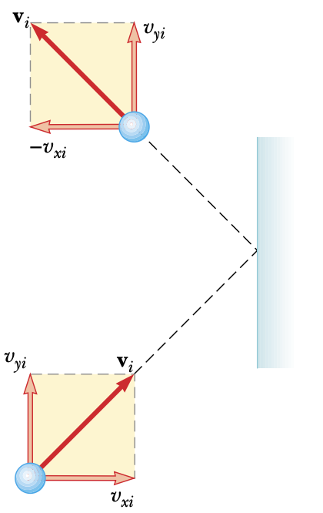
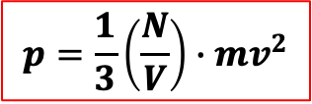
$$∆p_{m}=$$
$$m\left(−v_{x}−v_{x}\right)$$
$$=−2mv_{x}$$
Momentum change
of molecule
$$2mv_{x}$$
Momentum change on wall
$$∆t=\frac{2L}{v_{x}}$$
Time for consecutive collisions
One molecule
$$F_{on wall}=\frac{∆p_{x}}{∆t}$$
$$=\frac{2mv_{x}}{\frac{2L}{v_{x}}}$$
$$=\frac{m{v_{x}}^{2}}{L}$$
$N$ molecules
$$F_{on wall}=\sum_{i=1}^{N}{\frac{m{v_{xi}}^{2}}{L}}$$
$$=\frac{m}{L}\sum_{i=1}^{N}{{v_{xi}}^{2}}$$
$$L$$
$$L$$
$$\overline{{v_{x}}^{2}}=\frac{\sum_{i=1}^{N}{{v_{x}}^{2}}}{N}$$
$$F_{on wall}=\frac{m}{L}$$
$$∙N\overline{{v_{x}}^{2}}$$
$$=\frac{\frac{m}{L}∙N\overline{{v_{x}}^{2}}}{L^{2}}$$
$$=\frac{m∙N\overline{{v_{x}}^{2}}}{L^{3}}$$
$$Pressure (p)=\frac{F}{A}$$
$$=\frac{m∙N\overline{v^{2}}}{3L^{3}}$$
$$\overline{v^{2}}=\overline{{v_{x}}^{2}}+\overline{{v_{y}}^{2}}+\overline{{v_{z}}^{2}}$$
$$\overline{v^{2}}=3\overline{{v_{x}}^{2}}$$
$$p=\frac{N}{V}∙\frac{m\overline{v^{2}}}{3}$$
$$\frac{\overline{v^{2}}}{3}=\overline{{v_{x}}^{2}}$$
$$p=\frac{1}{3}\left(\frac{N}{V}\right)∙mv^{2}$$

Slide 21
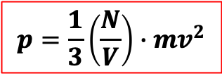
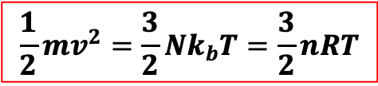
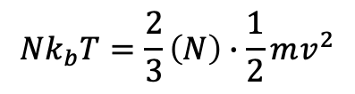
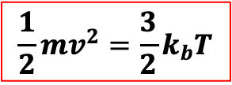
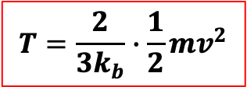
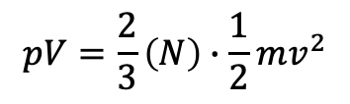
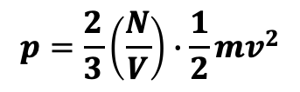
$$p=\frac{1}{3}\left(\frac{N}{V}\right)∙mv^{2}$$
$$p=\frac{2}{3}\left(\frac{N}{V}\right)∙\frac{1}{2}mv^{2}$$
$$pV=\frac{2}{3}\left(N\right)∙\frac{1}{2}mv^{2}$$
$$Nk_{b}T=\frac{2}{3}\left(N\right)∙\frac{1}{2}mv^{2}$$
$$L$$
$$T=\frac{2}{3k_{b}}∙\frac{1}{2}mv^{2}$$
$$L$$
$$\frac{1}{2}mv^{2}=\frac{3}{2}k_{b}T$$
Ave. KE of one particle
Total KE of N particles
$$\frac{1}{2}mv^{2}=\frac{3}{2}Nk_{b}T=\frac{3}{2}nRT$$

Slide 22
Equation of state for an ideal gas
•Without proof, here is the equation of state for an ideal gas.
•We will explain what an ideal gas is a bit later...
•The variables p (pressure), V (volume), n (number of moles), and T (temperature) are all called the four state variables.
•p is measured in Pascals or Nm⁻².
•V is measured in m³.
•T is measured in K.
pV = nRT
equation of state of an ideal gas
R = 8.31 J / mol·K is the universal gas constant

Slide 23
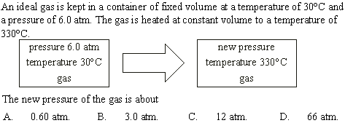
Equation of state for an ideal gas
•Use pV = nRT.
p_{i}V_{i} = nRT_{i},
p_{f}V_{f} = nRT_{f}.
•From T(K) = T(°C) + 273
p_{f}V_{f}
p_{i}V_{i}
nRT_{f}
nRT_{i}
=
T_{i} = 30 + 273 = 303 K.
T_{f} = 330 + 273 = 603 K.
p_{f} = p_{i}T_{f} / T_{i}
•V_{i} = V_{f}.
p_{f} = (6)(603) / 303 = 12
Notes:
23

Slide 24

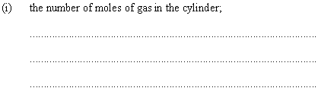
Equation of state for an ideal gas
•For an ideal gas use pV = nRT.
•WANTED: n, the number of moles.
• GIVEN: p = 20×10⁶ Pa, V = 2.0×10⁻² m³.
•From T(K) = T(°C) + 273
T(K) = 17 + 273 = 290 K.
•Then n = pV / (RT)
n = (20×10⁶)(2×10⁻²) / [ (8.31)(290) ]
n = 170 mol.
Notes:
24

Slide 25
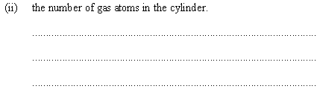
Equation of state for an ideal gas
•Use n = N / N_{A} where N_{A} = 6.02×10²³ atoms / mol.
•Then N = n N_{A}.
N = 170 mol ×
6.02×10²³ atoms
mol
N = 1.0×10²⁶ atoms.
Notes:
25

Slide 26
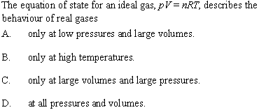
Differences between real and ideal gases
•Under high pressure or low volume real gases’ intermolecular forces come into play.
•Under low pressure or large volume real gases’ obey the equation of state.
Notes:
26

Slide 27
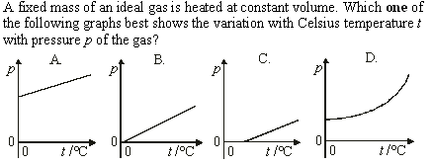
Sketching and interpreting state change graphs
•Fixed mass and constant volume means n and V are constant. Thus
•pV = nRT
→ p = (nR/V)T
→ p = (CONST)T. (LINEAR)
•Since the t axis is in ºC, but T is in Kelvin, the horizontal intercept must be NEGATIVE…

Slide 28
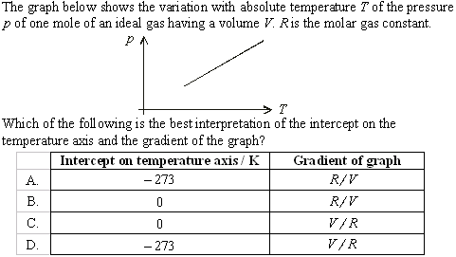
Sketching and interpreting state change graphs
•p = 0 at absolute zero.
•From pV = nRT:
•p = (1R / V )T:

Slide 29
Average kinetic/internal energy of an ideal gas
•Since ideal gases have no intermolecular forces, their internal energy is stored completely as kinetic energy.
•The individual molecules making up an ideal gas all travel at different speeds:
•Without proof, the average kinetic energy E_{K} of each ideal gas molecule has the following forms:
•k_{B} is called the Boltzmann constant.
E_{K} = (3/2) k_{B}T = 3RT / [ 2N_{A} ]
Average kinetic energy of ideal gas
Where k_{B} = 1.38×10⁻²³ J K⁻¹.
Notes:
29

Slide 30
Average kinetic/internal energy of an ideal gas
E_{K} = (3/2) k_{B}T = 3RT / [ 2N_{A} ]
Average kinetic energy of ideal gas
Where k_{B} = 1.38×10⁻²³ J K⁻¹.
EXAMPLE: 2.50 moles of hydrogen gas is contained in a fixed volume of 1.25 m³ at a temperature of 175 °C.
a) What is the average kinetic energy of each atom?
b) What is the total internal energy of the gas?
SOLUTION: T(K) = 175 + 273 = 448 K.
a) E_{K} = (3/2) k_{B}T = (3/2)(1.38×10⁻²³)(448) = 9.27×10⁻²¹ J.
b) From n = N / N_{A} we get N = nN_{A}.
N = (2.50 mol)(6.02×10²³ atoms / mol) = 1.51×10²⁴ atm.
E_{K} = NE_{K} = (1.51×10²⁴)(9.27×10⁻²¹ J) = 14000 J.
Notes:
30

Slide 31
Average kinetic/internal energy of an ideal gas
E_{K} = (3/2) k_{B}T = 3RT / [ 2N_{A} ]
Average kinetic energy of ideal gas
Where k_{B} = 1.38×10⁻²³ J K⁻¹.
EXAMPLE: 2.50 moles of hydrogen gas is contained in a fixed volume of 1.25 m³ at a temperature of 175 °C.
c) What is the pressure of the gas at this temperature?
SOLUTION: T(K) = 175 + 273 = 448 K.
c) Use pV = nRT: Then
p = nRT / V
= 2.50×8.31×448 / 1.25
= 7450 Pa.
Notes:
31

