Slide 1
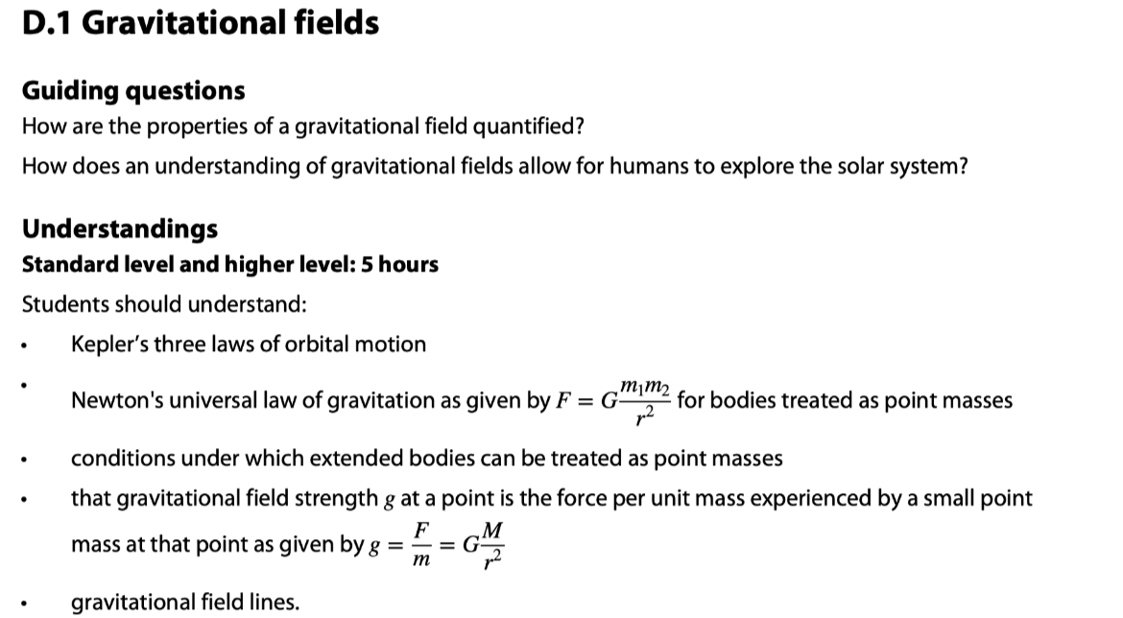

Slide 2
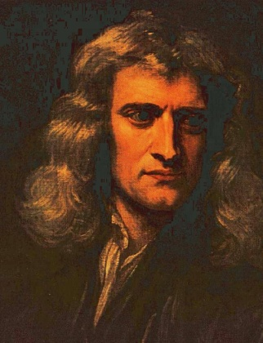
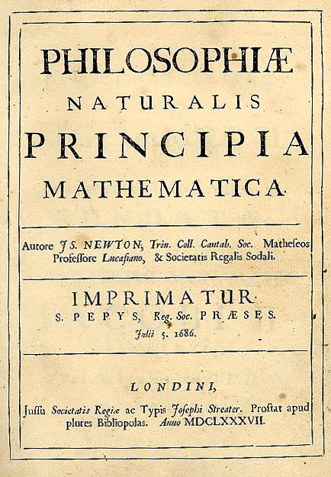
Newton’s law of gravitation
•In 1687 Isaac Newton published what has been called by some the greatest scientific discovery of all time – his universal law of gravitation.
•The law states that the gravitational force between two point masses m₁ and m₂ is proportional to their product, and inversely proportional to the square of their separation r.
•The actual value of G, the universal gravitational constant, was not known until Henry Cavendish conducted a tricky experiment in 1798 to find it.
F = Gm₁m₂ / r ²
Universal law of gravitation
where G = 6.67×10⁻¹¹ N m² kg⁻²

Slide 3
Newton’s law of gravitation
•Newton spent much time developing integral calculus to prove that
“A spherically symmetric shell of mass M acts as if all of its mass is located at its center.”
•Thus F = Gm₁m₂ / r ² works not only for point masses, which have no radii, but for any spherically symmetric distribution of mass at any radius like planets and stars.
M
-Newton’s shell theorem.
m
r

Slide 4
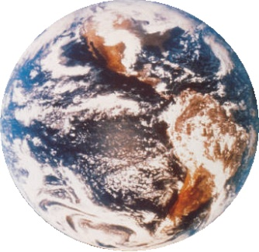
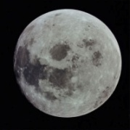
Solving problems involving gravitational force
•Be very clear that r is the distance between the centers of the masses.
FYI
•The radius of each mass is immaterial.
m₁
m₂
F₁₂
F₂₁
r
EXAMPLE: The earth has a mass of M = 5.98×10²⁴ kg and the moon has a mass of m = 7.36×10²² kg. The mean distance between the earth and the moon is 3.82×10⁸ m. What is the gravitational force between them?
SOLUTION: Use F = GMm / r ².
F = (6.67×10⁻¹¹)(5.98×10²⁴ )(7.36×10²² ) / (3.82×10⁸)²
F = 2.01×10²⁰ N.

Slide 5
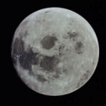
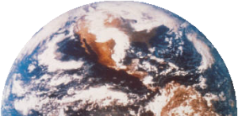
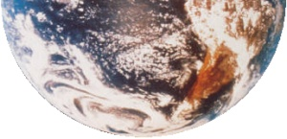
Solving problems involving gravitational force
EXAMPLE: The moon has a mass of m = 7.36×10²² kg. The mean distance between the earth and the moon is 3.82×10⁸ m. What is the speed of the moon in its orbit about earth?
SOLUTION: Use F_{C} = F_{G} = mv ² / r .
•From the previous slide F_{G} = 2.01×10²⁰ N. Then
2.01×10²⁰ = ( 7.36×10²² ) v ² / 3.82×10⁸
•Then v = 1.02×10³ ms⁻¹.
FYI
•For circular orbits, the gravitational force is the centripetal force. Thus F_{C} = F_{G}.

Slide 6
Solving problems involving gravitational force
EXAMPLE: The moon has a mass of m = 7.36×10²² kg. The mean distance between the earth and the moon is 3.82×10⁸ m. What is the period of the moon (in days) in its orbit about earth?
SOLUTION: Use v = d / t = 2πr / T.
•From the previous slide v = 1.02×10³ ms⁻¹. Then
T = 2πr / v = 2π( 3.82×10⁸ ) / 1.02×10³
= (2.35 ×10⁶ s)(1 h / 3600 s)(1 d / 24 h) = 27.2 d.
FYI
•For circular orbits, the gravitational force is the centripetal force. Thus F_{C} = F_{G}.

Slide 7
Gravitational field strength
•Suppose a mass m is located a distance r from a another mass M.
•The gravitational field strength g is the force per unit mass acting on m due to the presence of M. Thus
The units are newtons per kilogram (N kg ⁻¹).
Note that from Newton’s second law, F = ma, we see that a N kg ⁻¹ is also a m s ⁻², the units for acceleration.
Note further that weight has the formula F = mg, and that the g in this formula is none other than the gravitational field strength!
On the earth’s surface, g = 9.8 N kg ⁻¹ = 9.8 m s ⁻².
g = F / m
gravitational field strength

Slide 8
Solving problems involving gravitational field strength
•Suppose a mass m is located on the surface of a planet of radius R. We know that it’s weight is F = mg.
•But from the law of universal gravitation, the weight of m is equal to its attraction to the planet’s mass M and equals F = GMm / R ².
Thus mg = GMm / R ².
This same derivation works for any r.
g = GM / R ²
gravitational field strength at surface of a planet of mass M and radius R
g = GM / r ²
gravitational field strength at distance r from center of a planet of mass M

Slide 9
Solving problems involving gravitational field strength
PRACTICE: The mass of the earth is M = 5.98×10²⁴ kg and the radius of the earth is R = 6.37×10⁶ m. Find the gravitational field strength at the surface of the earth, and at a distance of one earth radius above its surface.
SOLUTION:
•For r = R:
g = GM / R ²
g = (6.67×10⁻¹¹)(5.98×10²⁴)/(6.37×10⁶)²
g = 9.83 N kg⁻¹ (m s⁻²).
•For r = 2R: Since r is squared…just divide by 2² = 4. Thus
g = 9.83 / 4 = 2.46 m s⁻².

Slide 10
Solving problems involving gravitational field strength
PRACTICE: A 525-kg satellite is launched from the earth’s surface to a height of one earth radius above the surface. What is its weight (a) at the surface, and (b) at altitude?
SOLUTION: Use information from the previous slide:
(a) AT SURFACE: g_{surface} = 9.83 m s⁻².
•Then from F = mg we get
F = (525)(9.83) = 5160 N.
(b) AT ALTITUDE: g_{surface+R} = 2.46 m s⁻².
•Then from F = mg we get
F = (525)(2.46) = 1290 N.

Slide 11
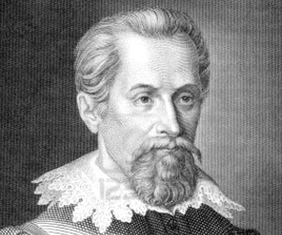
Solving problems involving orbital period
EXAMPLE: Derive Kepler’s law, which states that the period T of an object in a circular orbit about a body of mass M is given by T ² = [ (4π² / (GM) ]r ³.
SOLUTION:
•In circular orbit F_{C} = ma_{C}.
•From Newton’s law of gravitation F_{C} = GMm / r ².
•From Topic 6.1, a_{C} = 4π²r / T ². Then
ma_{C} = GMm / r ²
4π²r / T ² = GM / r ²
4π²r ³ = GMT ²
T ² = [ 4π² / (GM) ]r ³.

Slide 12

Solving problems involving orbital period
EXAMPLE: A satellite in geosynchronous orbit takes 24 hours to orbit the earth. Thus, it can be above the same point of the earth’s surface at all times, if desired. Find the necessary orbital radius, and express it in terms of earth radii. R_{E} = 6.37×10⁶ m.
SOLUTION: T = (24 h)(3600 s h⁻¹) = 86400 s.
•Then from Kepler’s law T ² = [ 4π² / (GM) ]r ³ we have
r ³ = T ²/ [ 4π² / (GM) ]
r ³ = 86400 ²/ [ 4π² / (6.67×10⁻¹¹×5.98×10²⁴) ]
= 7.54×10²²
r = (42250474 m)(1 R_{E} / 6.37×10⁶ m) = 6.63 R_{E}.

Slide 13

Solving problems involving orbital period
T ² = [ 4π²/ (GM) ]r ³
Kepler’s third law
•T ² = [ 4π²/ (GM) ]R ³ → R ³ = [GM / (4π²)] ⁻¹ T ².
•R ³ ∝ T ² with 1 / [ GM / (4π²) ] being the constant of proportionality.
FYI
•Kepler’s third law originally said that the square of the period was proportional to the cube of the radius – and nothing at all about what the constant of proportionality was. Newton’s law of gravitation was needed for that!

Slide 14

Solving problems involving orbital period
T ² = [ 4π²/ (GM) ]r ³
Kepler’s third law
•T ² = [ 4π² / (GM) ]r ³
T = { [ 4π²/ (GM) ]r ³ ] }^{1/2}
T = [ 4π²/ (GM) ] ^{1/2} r ^{3/2}
•Thus T ∝ r ^{3/2}.

Slide 15

Solving problems involving orbital period
T ² = [ 4π²/ (GM) ]r ³
Kepler’s third law
•T_{X}² = [ 4π²/ (GM) ]r_{X}³.
•T_{Y}² = [ 4π²/ (GM) ]r_{Y}³.
• T_{X} = 8T_{Y} → T_{X}² = 64T_{Y}².
T_{X}²/ T_{Y}² = [ 4π²/ (GM) ] r_{X}³/ { [ 4π²/ (GM) ] r_{Y}³ }
64T_{Y}² / T_{Y}² = r_{X}³ / r_{Y}³
64 = (r_{X} / r_{Y})³
r_{X} / r_{Y} = 64^{1/3} = 4

Slide 16
Gravitational field strength
•Compare the gravitational force formula
F = GMm / r ² (Force – action at a distance)
with the gravitational field formula
g = GM / r ² (Field – local curvature of space)
•Note that the force formula has two masses, and the force is the result of their interaction at a distance r.
Note that the field formula has just one mass – namely the mass that “sets up” the local field in the space surrounding it. It “curves” it.
The field view of the universe (spatial disruption by a single mass) is currently preferred over the force view (action at a distance) as the next slides will show.

Slide 17
Gravitational field strength
•Consider the force view (action at a distance).
•In the force view, the masses know the locations of each other at all times, and the force is instantaneously felt by both masses at all times.
•This requires the “force signal” to be transferred between the masses instantaneously.
•As we will learn later, Einstein’s special theory of relativity states unequivocally that the fastest any signal can travel is at the (finite) speed of light c.
SUN

Slide 18
Gravitational field strength
•Thus the action at a distance “force signal” will be slightly delayed in telling the orbital mass when to turn.
•The end result would have to be an expanding spiral motion, as illustrated in the following animation:
•We do not observe planets leaving their orbits as they travel around the sun.
•Thus action at a distance doesn’t work if we are to believe special relativity.
•And all current evidence points to the correctness of special relativity.
SUN

Slide 19
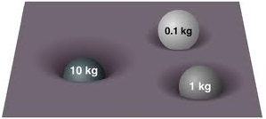
Gravitational field strength
•So how does the field view take care of this “signal lag” problem?
•Simply put – the gravitational field distorts the space around the mass that is causing it so that any other mass placed at any position in the field will “know” how to respond immediately.
•Think of space as a stretched rubber sheet – like a drum head.
•Bigger masses “curve” the rubber sheet more than smaller masses.
•The next slide illustrates this gravitational “curvature” of the space surrounding, for example, the sun.

Slide 20
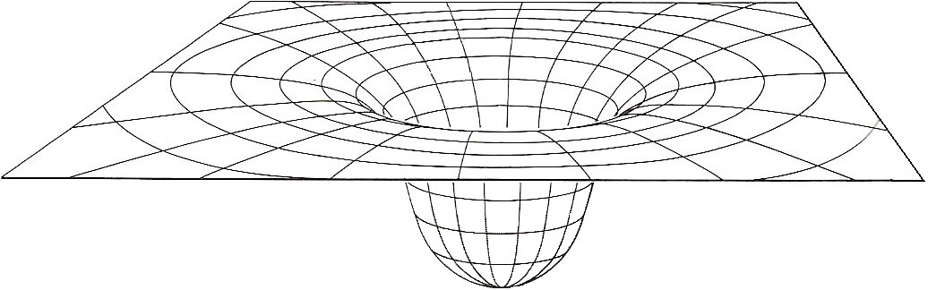
Gravitational field strength
•Note that each mass “feels” a different “slope” and must travel at a particular speed to stay in orbit.
FYI
•The field view eliminates the need for long distance signaling between two masses. Rather, it distorts the space about one mass.

Slide 21
Gravitational field strength
•In the space surrounding the mass M which sets up the field we can release “test masses” m₁ and m₂ as shown to determine the strength of the field.
m₁
m₂
g₁
g₂
(a) Because g = GM / r². It varies as 1 / r².
(b) Because the gravitational force is attractive.
M
FYI
(a) The field arrow is bigger for m₂ than m₁. Why?
(b) The field arrow always points to M. Why?

Slide 22
Gravitational field strength
•By “placing” a series of small test masses about a larger mass, we can map out its gravitational field:
M
FYI
•The field arrows of the inner ring are longer than the field arrows of the outer ring and all field arrows point to the centerline.

Slide 23
Gravitational field strength
•If we take a top view, and eliminate some of the field arrows, our sketch of the gravitational field is vastly simplified:
•In fact, we don’t even have to draw the sun – the arrows are sufficient to denote its presence.
•To simplify field drawings even more, we take the convention of drawing “field lines” as a single arrow.
SUN
SUN

Slide 24
Gravitational field strength
•In the first sketch the strength of the field at a point is determined by the length of the field arrows in the vicinity of that point.
•The second sketch has single arrows, so how do we know how strong the field is at a particular point in the vicinity of a mass?
•We simply look at the concentration of the field lines. The closer together the field lines, the stronger the field.
•In the red region the field lines are closer together than in the green region.
•Thus the red field is stronger than the green field.
SUN
SUN

Slide 25



Solving problems involving gravitational field strength
PRACTICE: Sketch the gravitational field about the earth (a) as viewed from far away, and (b) as viewed “locally” (at the surface).
SOLUTION:
(a)
(b)
or
FYI
•Note that the closer to the surface we are, the more uniform the field concentration.

Slide 26
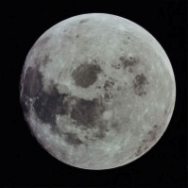
Solving problems involving gravitational field strength
EXAMPLE: Find the gravitational field strength at a point between the earth and the moon that is right between their centers.
SOLUTION:
•Make a sketch.
•Note that r = d / 2 = 3.82×10⁸ / 2 = 1.91 ×10⁸ m.
•g_{m} = Gm / r ²
g_{m} = (6.67×10⁻¹¹)(7.36×10²²)/(1.91×10⁸)² = 1.35×10⁻⁴ N.
•g_{M} = GM / r ²
g_{M} = (6.67×10⁻¹¹)(5.98×10²⁴)/(1.91×10⁸)² = 1.09×10⁻² N.
•Finally, g = g_{M} – g_{m} = 1.08×10 ⁻² N,→.
M = 5.98×10²⁴ kg
m = 7.36×10²² kg
g_{m}
g_{M}
d = 3.82×10⁸ m

Slide 27
Solving problems involving gravitational field strength
PRACTICE: Jupiter’s gravitational field strength at its surface is 25 N kg⁻¹ while its radius is 7.1×10⁷ m.
(a) Derive an expression for the gravitational field strength at the surface of a planet in terms of its mass M and radius R and the gravitational constant G.
SOLUTION: This is for a general planet…
(a) F = Gm₁m₂ / r ² (law of universal gravitation)
F = GMm₂ / R ² (substitution)
g = F / m₂ (gravitational field definition)
g = (GMm₂ / R ²)/ m₂(substitution)
g = GM / R ²

Slide 28
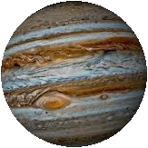
Solving problems involving gravitational field strength
PRACTICE: Jupiter’s gravitational field strength at its surface is 25 N kg⁻¹ while its radius is 7.1×10⁷ m.
(b) Using the given information and the formula you just derived deduce Jupiter’s mass.
(c) Find the weight of a 65-kg man on Jupiter.
SOLUTION:
(b) g = GM / R ² (just derived in (a))
M = gR ² / G (manipulation)
M = (25)(7.1×10⁷)² / 6.67×10⁻¹¹ = 1.9×10²⁷ kg.
(c) F = mg
F = 65(25) = 1600 N.

Slide 29
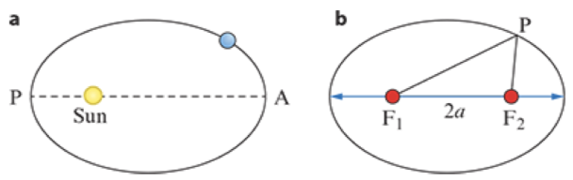
https://www.youtube.com/watch?v=iR1QOZVRNq4
Kepler’s Laws
Kepler’s First Law
Planets move on ellipses with the
sun at one of the foci of the ellipse.
The ellipse has two special points on its major axis, called the foci (singular: focus).
The sum of the distances of any point on the ellipse from each of the foci is a constant.

Slide 30
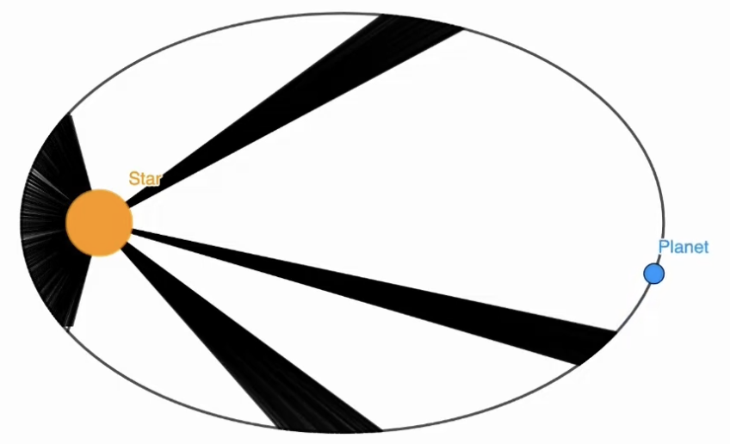
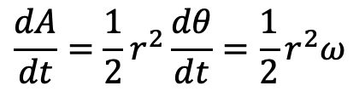
https://www.youtube.com/watch?v=iR1QOZVRNq4
Kepler’s Laws
Kepler’s Second Law
A line that connects a planet to the Sun sweeps out equal areas in the plane of the planet’s orbit in equal time intervals.
$$\frac{dA}{dt}=\frac{1}{2}r^{2}\frac{dθ}{dt}=\frac{1}{2}r^{2}ω$$

Slide 31
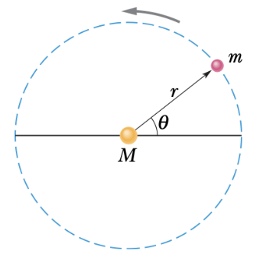


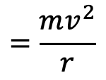

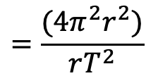
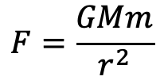

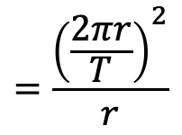
https://www.youtube.com/watch?v=iR1QOZVRNq4
Kepler’s Laws
Kepler’s Third Law
The square of the period of any planet is proportional to the cube of the semimajor axis of its orbit.
$$F=\frac{GMm}{r^{2}}$$
$$=\frac{mv^{2}}{r}$$
$$=\frac{{\left(\frac{2πr}{T}\right)}^{2}}{r}$$
$$\frac{GM}{r^{2}}$$
$$\frac{GM}{r^{2}}$$
$$=\frac{(4π^{2}r^{2})}{rT^{2}}$$
$$=\left(\frac{4π^{2}}{GM}\right)r^{3}$$
$$T^{2}$$

Slide 32
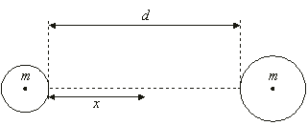
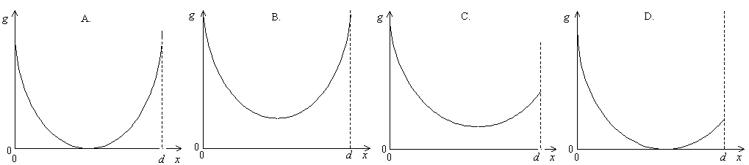
Solving problems involving gravitational field strength
PRACTICE: Two spheres of equal mass and different radii are held a distance d apart. The gravitational field strength is measured on the line joining the two masses at position x which varies. Which graph shows the variation of g with x correctly?
•There is a point between M and m where g = 0.
•Since g = Gm / R ² and R_{left} < R_{right}, then g_{left} > g_{right} at the surfaces of the masses.

Slide 33

Solving problems involving gravitational field
•Since the satellite is in circular orbit F_{C} = mv ²/ r.
•Since the satellite’s weight is holding it in orbit, F_{C} = mg.
•Thus mv ²/ r = mg.
•Finally g = v ²/ r.

Slide 34

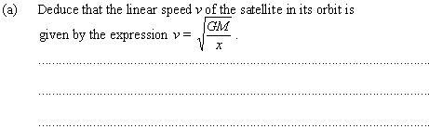
Solving problems involving gravitational field
x
R
•g = GM / x ²
•a_{c} = GM / x ² (since a_{c} = g in circular orbits).
•v ²/ x = GM / x ² (since a_{c} = v ²/ r).
•v ² = GM / x so that v = GM / x.

Slide 35
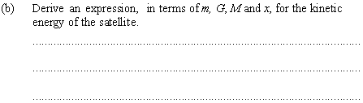
Solving problems involving gravitational field
x
R
•From (a) v ² = GM / x.
•But E_{K} = (1/2)mv ².
•Thus E_{K} = (1/2)mv² = (1/2)m(GM / x) = GMm / (2x).

Slide 36
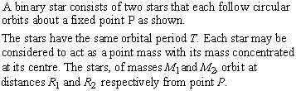

Solving problems involving gravitational force
R₂
R₁
M₁
M₂
P
•It is the gravitational force.

Slide 37
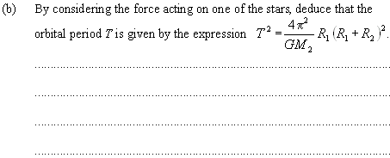
•Note that F_{G} = GM₁M₂ / (R₁+R₂) ².
Solving problems involving gravitational force
R₂
R₁
M₁
M₂
P
•M₁ experiences F_{C} = M₁v₁²/ R₁.
•Since v₁ = 2πR₁/ T, then v₁² = 4π²R₁²/ T ².
•Thus F_{C} = F_{G} → M₁v₁²/ R₁ = GM₁M₂ / (R₁+R₂) ².
M₁(4π²R₁²/ T ²) / R₁ = GM₁M₂ / (R₁+R₂) ²
4π²R₁(R₁+R₂) ² = GM₂T ²
4π²
GM₂
•T ² = R₁(R₁+R₂) ²

Slide 38
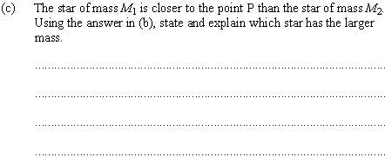
Solving problems involving gravitational force
R₂
R₁
M₁
M₂
P
•From (b) T ² = (4π² / GM₂)R₁(R₁+R₂) ².
•From symmetry T ² = (4π²/ GM₁)R₂(R₁+R₂) ².
(4π²/ GM₂)R₁(R₁+R₂) ² = (4π²/ GM₁)R₂(R₁+R₂) ²
(1 / M₂)R₁ = (1 / M₁)R₂
M₁ / M₂ = R₂ / R₁
•Since R₂ > R₁, we see that M₁ > M₂.

