Slide 1
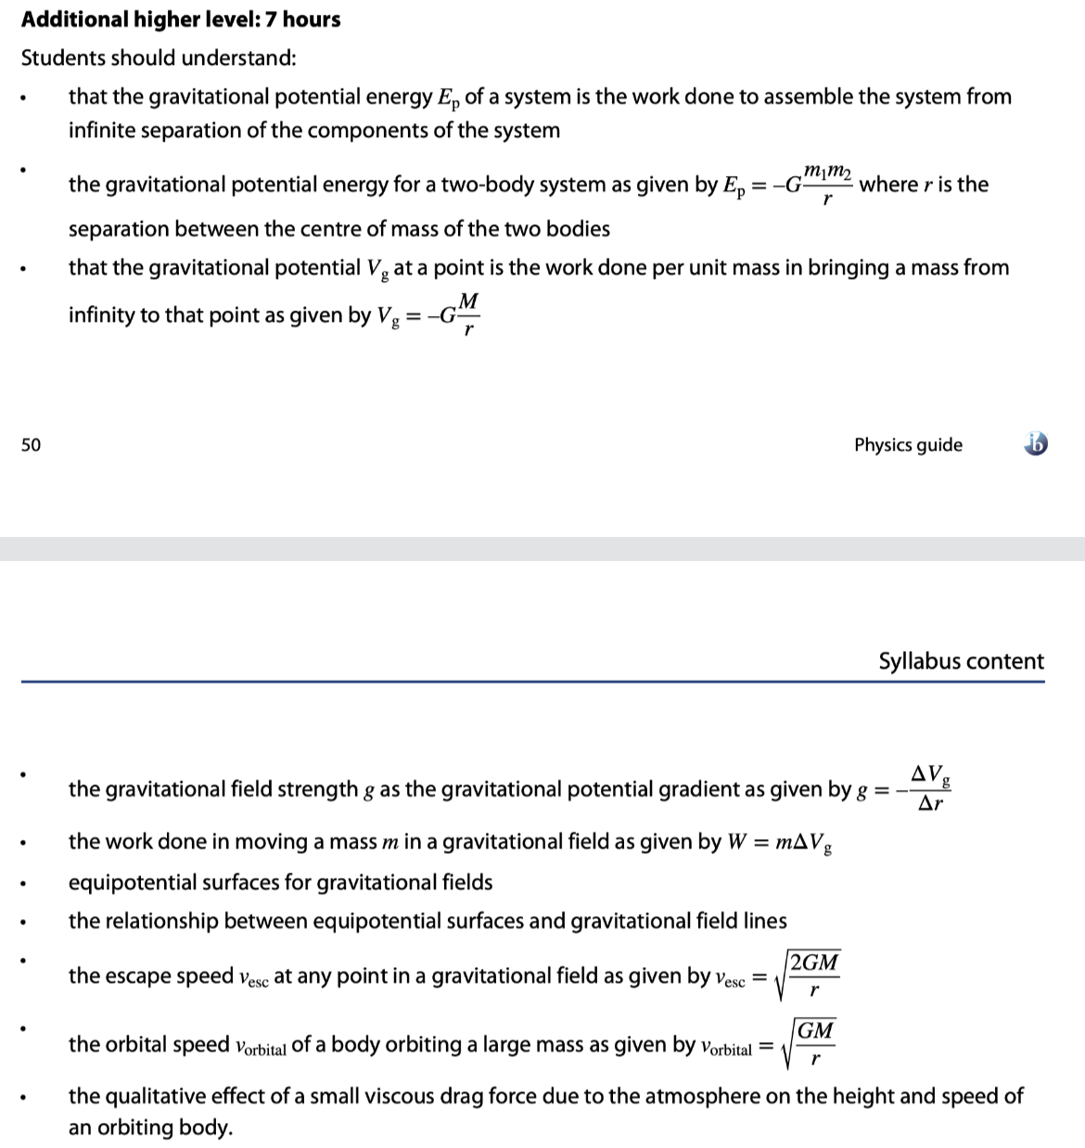

Slide 2
Data booklet reference:
GRAVITATIONAL FIELD ELECTROSTATIC FIELD
• V_{g} = –GM / r V_{e} = kq / r
• g = –∆V_{g} / ∆r E = –∆V_{e} / ∆r
• E_{P} = mV_{g} = – GMm / r E_{P} = qV_{e} = kq₁q₂ / r
• F_{G} = –GMm / r ² F_{E} = kq₁q₂ / r ²
• v_{esc} = 2GM / r
• v_{orbit} = GM / r
Notes:
2

Slide 3
Note that E_{P} is negative. This means that E_{P} is greatest at r = ∞, when E_{P} = 0.
Potential energy – gravitational
•Think of potential energy as the capacity to do work.
•And work is a force F times a displacement d.
•Recall the gravitational force from Newton:
•If we multiply the above force by a distance r we get
W = Fd cos θ
(θ is angle between F and d)
work definition
F_{G} = –Gm₁m₂ / r ²
universal law of gravitation
where G = 6.67×10⁻¹¹ N m² kg⁻²
E_{P} = –GMm / r
gravitational potential energy
where G = 6.67×10⁻¹¹ N m² kg⁻²
FYI
•The actual proof is beyond the scope of this course.
•Note, in particular, the minus sign.

Slide 4
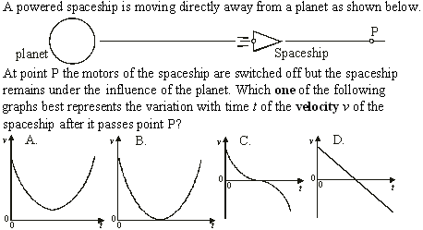
•Use F_{G} = GMm / r ².
•Recall that a is the slope of the v vs. t graph.
Potential energy – gravitational
•The ship MUST slow down and reverse (v becomes – ).
•The force varies as 1 / r ² so that a is NOT linear.

Slide 5
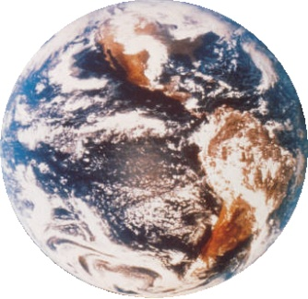
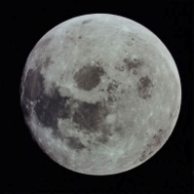
Note that E_{P} is negative. Note also that E_{P} = 0 when r = ∞.
Potential energy – gravitational
E_{P} = –GMm / r
gravitational potential energy
where G = 6.67×10⁻¹¹ N m² kg⁻²
EXAMPLE: Find the gravitational potential energy stored in the Earth-Moon system.
SOLUTION: Use E_{P} = –GMm / r.
E_{P} = –GMm / r
= –(6.67×10⁻¹¹)(5.98×10²⁴)(7.36×10²²) / 3.82×10⁸
= -7.68×10²⁸ J.
M = 5.98×10²⁴ kg
m = 7.36×10²² kg
d = 3.82×10⁸ m

Slide 6


Potential energy – gravitational
•The previous formula is for large-scale gravitational fields (say, some distance from a planet).
•Recall the “local” formula for gravitational potential energy:
•The local formula treats y₀ as the arbitrary “zero value” of potential energy. The general formula treats r = ∞ as the “zero value”.
where g = 9.8 m s⁻²
local ∆E_{P}
∆E_{P} = mg ∆y
FYI
•The local formula works only for g = CONST, which is true as long as ∆y is relatively small (say, sea level to the top of Mt. Everest). For larger distances use ∆E_{P} = –GMm(1 / r_{f} – 1 / r₀).

Slide 7
Note that E_{P} is negative. Note also that E_{P} = 0 when r = ∞.
Potential – gravitational
•We now define gravitational potential as gravitational potential energy per unit mass:
•This is why it is called “potential”.
E_{P} = –GMm / r
gravitational potential energy
where G = 6.67×10⁻¹¹ N m² kg⁻²
∆V_{g} = ∆E_{P} / m
gravitational potential
V_{g} = –GM / r
FYI
•The units of ∆V_{g} and V_{g} are J kg⁻¹.
•Gravitational potential is the work done per unit mass in moving a small mass from infinity to r. (Note that V = 0 at r = ∞.)

Slide 8
Why was the change in potential positive?
Potential – gravitational
∆V_{g} = ∆E_{P} / m
gravitational potential
V_{g} = –GM / r
EXAMPLE: Find the change in gravitational potential in moving from Earth’s surface to 5 Earth radii (from Earth’s center).
SOLUTION: M = 5.98×10²⁴ kg and r₁ = 6.37×10⁶ m.
•But then r₂ = 5(6.37×10⁶) = 3.19×10⁷ m. Thus
∆V_{g} = –GM( 1 / r₂ – 1 / r₁ )
= –GM( 1 / 3.19×10⁷ – 1 / 6.37×10⁶ )
= –GM(⁻1.26×10⁻⁷)
= –(6.67×10⁻¹¹)(5.98×10²⁴)(⁻1.26×10⁻⁷)
= ⁺5.01×10⁷ J kg⁻¹.
r₂
r₁

Slide 9
Potential and potential energy – gravitational
FYI
•A few words clarifying the gravitational potential energy and gravitational potential formulas are in order.
E_{P} = –GMm / r gravitational potential energy
V_{g} = –GM / r gravitational potential
•Be aware of the difference in name. Both have “gravitational potential” in them and can be confused during problem solving.
•Be aware of the minus sign in both formulas.
•The minus sign is there so that as you separate two masses, or move farther out in space, their values increase (as in the last example).
•Both values are zero when r becomes infinitely large.

Slide 10
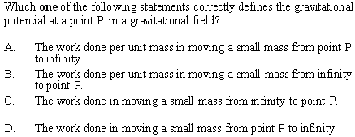
Potential and potential energy – gravitational
•Be sure to know this definition.
•By the way, answer C is the official definition of the gravitational potential energy at a point P.
•Try not to mix up potential and potential energy.

Slide 11
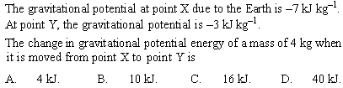
Potential and potential energy – gravitational
•From ∆V_{g} = ∆E_{P} / m we have ∆E_{P} = m∆V_{g}.
•Thus ∆E_{P} = (4)( ⁻3k – ⁻7k) = 16 kJ.

Slide 12
Potential and potential energy – gravitational
•Gravitational potential is derived from gravitational potential energy and is thus a scalar. There is no need to worry about vectors.
EXAMPLE: Find the gravitational potential at the midpoint of the 2750-m radius circle of 125-kg masses shown.
SOLUTION: Potential is a scalar so it doesn’t matter how the masses are arranged on the circle. Only the distance matters.
•For each mass r = 2750 m. Each mass contributes V_{g} = –GM / r so that
V_{g} = –(6.67×10⁻¹¹)(125) / 2750 = -3.03×10⁻¹² J kg⁻¹.
•Thus V_{tot} = 4(-3.03×10⁻¹²) = -1.21×10⁻¹¹ J kg⁻¹.
r

Slide 13
Does it matter what path the mass follows as it is brought in?
NO. Why?
Potential and potential energy – gravitational
•Gravitational potential is derived from gravitational potential energy and is thus a scalar. There is no need to worry about vectors.
EXAMPLE: If a 365-kg mass is brought in from ∞ to the center of the circle of masses, how much potential energy will it have lost?
SOLUTION: ∆V_{g} = ∆E_{P} / m → ∆E_{P} = m ∆V_{g}.
∆E_{P} = m ∆V_{g}
= m (V_{g} – V_{g0})
= mV_{g}
= 365(-1.21×10⁻¹¹)
= -4.42×10⁻⁹ J.
r
0

Slide 14
Potential gradient – gravitational
•The gravitational potential gradient (GPG) is the change in gravitational potential per unit distance. Thus the GPG = ∆V_{g} / ∆r.
EXAMPLE: Find the GPG in moving from Earth’s surface to 5 radii from Earth’s center.
SOLUTION: In a previous slide we showed that ∆V_{g} = ⁺ 5.01×10⁷ J kg⁻¹.
•r₁ = 6.37×10⁶ m.
•r₂ = 5(6.37×10⁶) = 3.19×10⁷ m.
•∆r = r₂ – r₁ = 3.19×10⁷ – 6.37×10⁶ = 2.55×10⁷ m.
GPG = ∆V_{g} / ∆r
= 5.01×10⁷ / 2.55×10⁷ = 1.96 J kg⁻¹ m⁻¹.
r₂
r₁

Slide 15
Potential gradient – gravitational
•The gravitational potential gradient (GPG) is the change in gravitational potential per unit distance. Thus the GPG = ∆V_{g} / ∆r.
PRACTICE: Show that the units for the gravitational potential gradient are the units for acceleration.
SOLUTION:
•The units for ∆V_{g} are J kg⁻¹.
•The units for work are J, but since work is force times distance we have 1 J = 1 N m = 1 kg m s⁻² m.
•Therefore the units of ∆V_{g} are (kg m s⁻² m)kg⁻¹ or
[ ∆V_{g} ] = m² s⁻².
•Then the units of the GPG are
[ GPG ] = [ ∆V_{g} / ∆r ] = m² s⁻² / m = m s⁻².

Slide 16
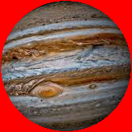
Potential gradient – gravitational
•In Topic 10.1 we found that near Earth, g = –ΔV_{g} / Δy.
•The following potential gradient (which we will not prove) works at the planetary scale:
g = –∆V_{g} / ∆r
gravitational potential gradient
EXAMPLE: The gravitational potential in the vicinity of a planet changes from ⁻6.16×10⁷ J kg⁻¹ to ⁻6.12×10⁷ J kg⁻¹ in moving from 1.80×10⁸ m to 2.85×10⁸ m. What is the gravitational field strength in that region?
SOLUTION:
g = – ∆V_{g} / ∆r
g = –(⁻6.12×10⁷ – ⁻6.16×10⁷) / (2.85×10⁸ – 1.80×10⁸)
g = –4000000 / 105000000 = -0.0381 m s⁻².

Slide 17
Equipotential surfaces revisited – gravitational
•Recall that equipotential surfaces are imaginary surfaces at which the potential is the same.
•Since the gravitational potential for a point mass is given by V_{g} = –GM / r it is clear that the equipotential surfaces are at fixed radii and hence are concentric spheres:
m
equipotential surfaces
FYI
•Generally equipotential surfaces are drawn so that the ∆V_{g}s for consecutive surfaces are equal.
•Because V_{g} is inversely proportional to r, the consecutive rings get farther apart as we get farther from the mass.

Slide 18
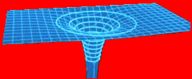
Equipotential surfaces revisited – gravitational
•We know that for a point mass the gravitational field lines point inward.
•Thus the gravitational field lines are perpendicular to the equipotential surfaces.
•A 3D image of the same picture looks like this:
m

Slide 19

Equipotential surfaces and the potential gradient
EXAMPLE: Use the 3D view of the equipotential surface to interpret the gravitational potential gradient g = –∆V_{g} / ∆r.
SOLUTION: We can choose any direction for our r value, say the red line:
•Then g = –∆V_{g} / ∆y.
•This is just the gradient (slope) of the surface.
•Thus g is the (–) gradient of the equipotential surface.
∆r
∆V_{g}

Slide 20
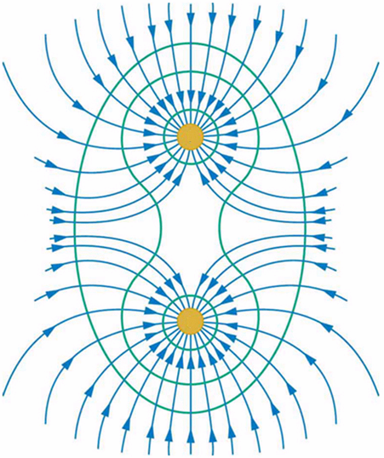
Equipotential surfaces and the potential gradient
EXAMPLE: Sketch the gravitational field lines around two point masses.
SOLUTION: Remember that the gravitational field lines point inward, and that they are perpendicular to the equipotential surfaces.
m
m

Slide 21
Equipotential surfaces and the potential gradient
EXAMPLE: Use a 3D view of the equipotential surface of two point masses to illustrate that the gravitational potential gradient is zero somewhere in between the two masses.
SOLUTION:
•Remember that the gravitational potential gradient g = –∆V_{g} / ∆r is just the slope of the surface.
•The saddle point’s slope is zero. Thus g = 0 there.
saddle point

Slide 22
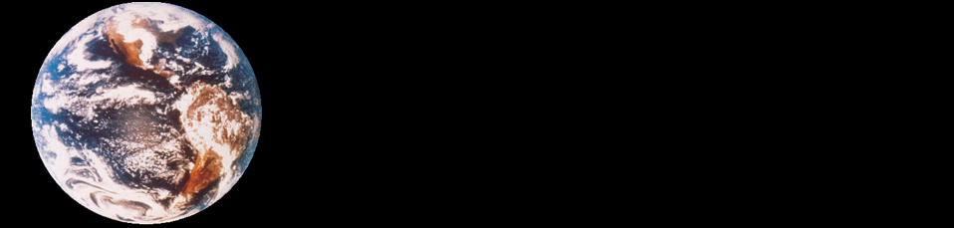
Escape speed
•We define the escape speed to be the minimum speed an object needs to escape a planet’s gravitational pull.
•We can further define escape speed v_{esc} to be that minimum speed which will carry an object to infinity and bring it to rest there.
•Thus we see as r→∞ then v→0.
M
m
R
r = R
r = ∞
u = v_{esc}
v = 0

Slide 23
Note that escape speed is independent of the mass that is actually escaping!
Escape speed
•From the conservation of mechanical energy we have ∆E_{K} + ∆E_{P} = 0. Then
E_{K} – E_{K0} + E_{P} – E_{P0} = 0
(1/2)mv² – (1/2)mu² + ⁻GMm / r – ⁻GMm / r₀ = 0
(1/2)mv_{esc}² = GMm / R
0
0
v_{esc} = 2GM / R
escape speed
PRACTICE: Find the escape speed from Earth.
SOLUTION:
•M = 5.98×10²⁴ kg and R = 6.37×10⁶ m.
v_{esc}² = 2GM / R
= 2(6.67×10⁻¹¹)(5.98×10²⁴) / 6.37×10⁶
v_{esc} = 11200 ms⁻¹ (= 24900 mph!)

Slide 24


Orbital motion, orbital speed and orbital energy •Consider a baseball in circular orbit about Earth.
•Clearly the only force that is causing the ball to move in a circle is the gravitational force.
•Thus the gravitational force is the centripetal force for circular orbital motion.
EXAMPLE: A centripetal force causes a centripetal acceleration a_{c}. What are the two forms for a_{c}?
SOLUTION: Recall from Topic 6 that a_{c} = v² / r.
•Then from the relationship v = 2πr / T we see that
a_{c} = v² / r = (2πr / T)² / r = 4π²r² / (T ²r) = 4π²r / T ².
a_{c} = v² / r = 4π²r / T ²
centripetal acceleration

Slide 25
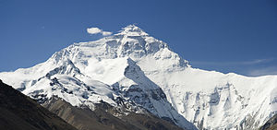

Orbital motion, orbital speed and orbital energy
EXAMPLE: Suppose a 0.500-kg baseball is placed in a circular orbit around the earth at slightly higher than the tallest point, Mount Everest (8850 m). Given that the earth has a radius of R_{E} = 6400000 m, find the speed of the ball.
SOLUTION: r = 6408850 m.
•F_{c} is caused by the weight of the ball so that
F_{c} = mg = (0.5)(9.8) = 4.9 N.
•But F_{c} = mv² / r so that
4.9 = (0.5)v² / 6408850
v = 7925 m s⁻¹!
FYI
•We assumed that g = 9.8 ms⁻² at the top of Everest.

Slide 26
Orbital motion, orbital speed and orbital energy
PRACTICE: Find the period T of one complete orbit of the ball.
SOLUTION:
•r = 6408850 m.
•F_{c} = 4.9 N.
•F_{c} = ma_{c} = 0.5a_{c} so that a_{c} = 9.8.
•But a_{c} = 4π²r / T ² so that
T ² = 4π²r / a_{c}
T ² = 4π²(6408850) / 9.8
T = 5081 s = 84.7 min = 1.4 h.

Slide 27
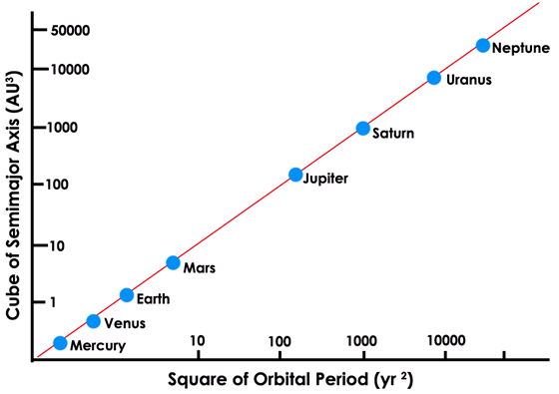
Orbital motion, orbital speed and orbital energy
EXAMPLE: Show that for an object in a circular orbit about a body of mass M that T ² = (4π²/ GM)r³.
SOLUTION:
•In circular orbit F_{c} = ma_{c} and F_{c} = GMm / r².
•But a_{c} = 4π²r / T ². Then
ma_{c} = GMm / r²
4π²r / T ² = GM / r²
4π²r³ = GMT ²
T ² = [4π²/(GM)]r³
FYI
•The IBO expects you to be able to derive this relationship. It is known as Kepler’s 3rd law.

Slide 28
Orbital motion, orbital speed and orbital energy
PRACTICE: Using Kepler’s third law find the period T of one complete orbit of the baseball from the previous example.
SOLUTION: Use T ² = (4π² / GM)r³.
•r = 6408850 m.
•G = 6.67×10⁻¹¹ N m² kg⁻².
•M = 5.98×10²⁴ kg.
T ² = [ 4π² / GM ] r³
= [4π²/ (6.67×10⁻¹¹×5.98×10²⁴)](6408850)³
T = 5104 s = 85.0 min = 1.4 h.
FYI
•Note the slight discrepancy in the period (it was 5081 s before). How do you account for it?

Slide 29
Orbital motion, orbital speed and orbital energy
•An orbiting satellite has both kinetic energy and potential energy.
•The gravitational potential energy of an object of mass m in the gravitational field of Earth is E_{P} = –GMm / r, where M is the mass of the earth.
•As we learned in Topic 2, the kinetic energy of an object of mass m moving at speed v is E_{K} = (1/2)mv².
•Thus the total mechanical energy of an orbiting satellite of mass m is
E = E_{K} + E_{P}
total energy of an orbiting satellite
E = (1/2)mv² – GMm / r

Slide 30
Orbital motion, orbital speed and orbital energy
EXAMPLE: Show that the speed of an orbiting satellite having mass m at a distance r from the center of Earth (mass M) is v_{orbit} = GM / r.
SOLUTION:
•In circular orbit F_{c} = ma_{c} and F_{c} = F_{G} = GMm / r².
•But a_{c} = v² / r. Then
ma_{c} = GMm / r²
mv² / r = GMm / r²
v² = GM / r
v = GM / r
v_{orbit}= GM / r
speed of an orbiting satellite

Slide 31
Orbital motion, orbital speed and orbital energy
EXAMPLE: Show that the kinetic energy of an orbiting satellite having mass m at a distance r from the center of Earth (mass M) is E_{K} = GMm / (2r).
SOLUTION:
•In circular orbit F_{c} = ma_{c} and F_{c} = GMm / r².
•But a_{c} = v² / r. Then
ma_{c} = GMm / r²
mv² / r = GMm / r²
mv² = GMm / r
(1/2)mv² = GMm / (2r)
E_{K} = (1/2)mv² = GMm / (2r)
kinetic energy of an orbiting satellite

Slide 32
Orbital motion, orbital speed and orbital energy
EXAMPLE: Show that the total energy of an orbiting satellite at a distance r from the center of Earth is E = –GMm / (2r).
SOLUTION: From E = E_{K} + E_{P} and the expressions for E_{K} and E_{P} we have
E = E_{K} + E_{P}
E = GMm / (2r) – GMm / r
E = GMm / (2r) – 2GMm / (2r)
E = –GMm / (2r)
E = –GMm / (2r)
total energy of an orbiting satellite
E_{K} = GMm / (2r)
E_{P} = –GMm / r
FYI
•The IBO expects you to derive these relationships.

Slide 33
Orbital motion, orbital speed and orbital energy
E = –GMm / (2r)
total energy of an orbiting satellite
E_{K} = GMm / (2r)
E_{P} = –GMm / r
EXAMPLE: Graph the kinetic energy vs. the radius of orbit for a satellite of mass m about a planet of mass M and radius R.
SOLUTION: Use E_{K} = GMm / (2r). Note that E_{K} decreases with radius. It has a maximum value of E_{K} = GMm / (2R).
E_{K}
GMm
2R
r
R
2R
3R
4R
5R

Slide 34
Orbital motion, orbital speed and orbital energy
E = –GMm / (2r)
total energy of an orbiting satellite
E_{K} = GMm / (2r)
E_{P} = –GMm / r
EXAMPLE: Graph the potential energy vs. the radius of orbit for a satellite of mass m about a planet of mass M and radius R.
SOLUTION: Use E_{P} = –GMm / r. Note that E_{P} increases with radius. It becomes less negative.
R
2R
3R
4R
5R
r
GMm
R
-
E_{P}

Slide 35
Thus a spacecraft must SLOW DOWN in order to reach a higher orbit!
Orbital motion, orbital speed and orbital energy
E = –GMm / (2r)
total energy of an orbiting satellite
E_{K} = GMm / (2r)
E_{P} = –GMm / r
EXAMPLE: Graph the total energy E vs. the radius of orbit and include both E_{K} and E_{P}.
SOLUTION:
+
GMm
2R
R
2R
3R
4R
5R
E_{K}
r
E
GMm
2R
E_{P}
-
-
GMm
R
FYI
•Kinetic energy (thus v) DECREASES with radius.

Slide 36
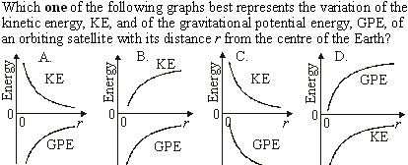
Orbital motion, orbital speed and orbital energy
•KE is POSITIVE and decreasing.
•GPE is NEGATIVE and increasing (becoming less negative).
Notes:
© 2015 By Timothy K. Lund

Slide 37

Orbital motion, orbital speed and orbital energy
•From Kepler’s 3rd law, T ² = [ 4π²/ (GM) ] r³.
•Thus r³ = [ GM / (4π²) ]T ².
•That is to say, r³ ∝ T ².
Notes:
© 2015 By Timothy K. Lund

Slide 38
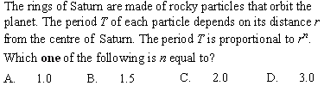
Orbital motion, orbital speed and orbital energy
•From Kepler’s 3rd law T ² = [ 4π² / GM ]r³. Then
•T = { [ 4π²/GM ]r³ }^{1/2}
•T = [ 4π² / GM ]^{1/2}r ^{3/2}
•T ∝ r ^{3/2}.
Notes:
© 2015 By Timothy K. Lund

Slide 39
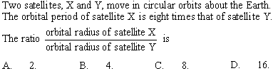
Orbital motion, orbital speed and orbital energy
•From Kepler’s 3rd law T_{X}² = (4π² / GM)r_{X}³.
•From Kepler’s 3rd law T_{Y}² = (4π²/ GM)r_{Y}³.
• T_{X} = 8T_{Y} → T_{X}² = 64T_{Y}².
T_{X}² / T_{Y}² = (4π² / GM)r_{X}³ / [(4π² / GM)r_{Y}³]
64T_{Y}² / T_{Y}² = r_{X}³ / r_{Y}³
64 = (r_{X} / r_{Y})³
r_{X} / r_{Y} = 64^{1/3} = 4
Notes:
© 2015 By Timothy K. Lund

Slide 40

Orbital motion, orbital speed and orbital energy
•Since the satellite is in uniform circular motion at a radius r and a speed v, it must be undergoing a centripetal acceleration.
•Since gravitational field strength g is the acceleration, g = v²/ r.
Notes:
© 2015 By Timothy K. Lund

Slide 41

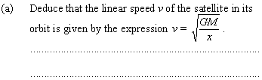
Orbital motion, orbital speed and orbital energy
x
R
•F = mg = GMm / x² = mv²/ x.
•Thus v² = GM / x.
•Finally v = GM / x.
Notes:
© 2015 By Timothy K. Lund

Slide 42
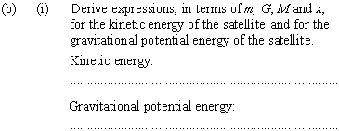
Orbital motion, orbital speed and orbital energy
x
R
•From (a), v² = GM / x.
•But E_{K} = (1/2)mv².
•Thus E_{K} = (1/2)mv² = (1/2)m(GM / x) = GMm / (2x).
•E_{P} = mV and V = –GM / x.
•Then E_{P} = m(–GM / x) = –GMm / x.
Notes:
© 2015 By Timothy K. Lund

Slide 43
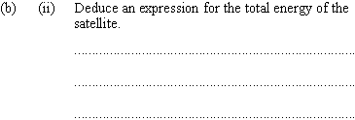
Orbital motion, orbital speed and orbital energy
x
R
•E = E_{K} + E_{P}
•E = GMm / (2x) + –GMm / x [ from (b)(i) ]
•E = 1GMm / (2x) + ⁻2GMm / (2x)
•E = –GMm / (2x).
Notes:
© 2015 By Timothy K. Lund

Slide 44

Orbital motion, orbital speed and orbital energy
x
R
•The satellite will begin to lose some of its mechanical energy in the form of heat.
Notes:
© 2015 By Timothy K. Lund

Slide 45
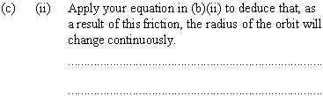
•Refer to E = –GMm / (2x) [ from (b)(ii) ].
Orbital motion, orbital speed and orbital energy
x
R
•If E ↓, then x ↓ (to make E more negative).
•If r ↓ the atmosphere gets thicker and more resistive.
•Clearly the orbit will continue to decay (shrink).
Notes:
© 2015 By Timothy K. Lund

Slide 46


Orbital motion, orbital speed and orbital energy
R₂
R₁
M₁
P
M₂
•It is the gravitational force between the two stars.
Notes:
© 2015 By Timothy K. Lund

Slide 47
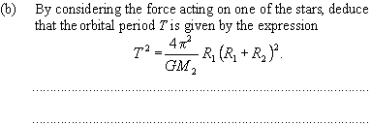
•F_{G} = GM₁M₂ / ( R₁+R₂ )².
•M₁ experiences F_{c} = M₁v₁² / R₁.
•v₁ = 2πR₁ / T, v₁² = 4π²R₁²/ T ².
Orbital motion, orbital speed and orbital energy
R₂
R₁
M₁
P
M₂
•F_{c} = F_{G} →
M₁v₁² / R₁ = GM₁M₂ / ( R₁+R₂ )².
M₁[ 4π²R₁²/ T ² ] / R₁ = GM₁M₂ / ( R₁+R₂ )²
4π²R₁( R₁ + R₂ )² = GM₂T ²
4π²
GM₂
T ² = R₁( R₁+R₂ )².
Notes:
© 2015 By Timothy K. Lund

Slide 48

Orbital motion, orbital speed and orbital energy
R₂
R₁
M₁
P
M₂
•From (b) T ² = [ 4π² / GM₂ ]R₁( R₁+R₂ )².
•From symmetry T ² = [ 4π² / GM₁ ]R₂( R₁+R₂ )². Thus
[ 4π² / GM₂ ]R₁( R₁+R₂ )² = [ 4π² / GM₁ ]R₂( R₁+R₂ )²
(1 / M₂)R₁ = (1 / M₁)R₂
M₁ / M₂ = R₂ / R₁
•Since R₂ > R₁, M₁ > M₂.
Notes:
© 2015 By Timothy K. Lund

Slide 49
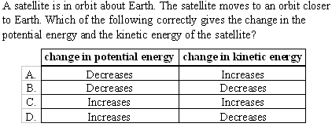
Orbital motion, orbital speed and orbital energy
E = – GMm / (2r)
total energy of an orbiting satellite
E_{K} = GMm / (2r)
E_{P} = – GMm / r
•If r decreases E_{K} gets bigger.
•If r decreases E_{P} gets more negative (smaller).
Notes:
© 2015 By Timothy K. Lund

Slide 50

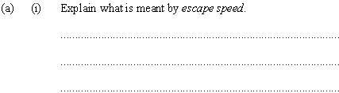
Orbital motion, orbital speed and orbital energy
•Escape speed is the minimum speed needed to travel from the surface of a planet to infinity.
•It has the formula v_{esc}² = 2GM / R.
Notes:
© 2015 By Timothy K. Lund

Slide 51
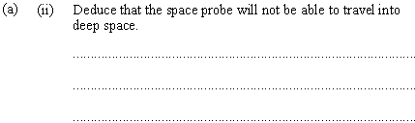
Orbital motion, orbital speed and orbital energy
•To escape we need v_{esc}² = 2GM / R_{e}.
•The kinetic energy alone must then be E = (1/2)mv_{esc}² = (1/2)m(2GM / R_{e}) = GMm / R_{e}.
•This is to say, to escape E = 4GMm / (4R_{e}).
•Since we only have E = 3GMm / (4R_{e}) the probe will not make it into deep space.
Notes:
© 2015 By Timothy K. Lund

Slide 52
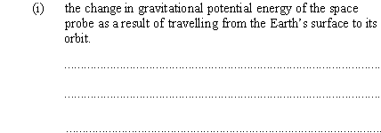
Orbital motion, orbital speed and orbital energy
•Recall that E_{P} = –GMm / r.
•Thus ∆E_{P} = –GMm ( 1 / R – 1 / R_{e} ).
Notes:
© 2015 By Timothy K. Lund

Slide 53

Orbital motion, orbital speed and orbital energy
•The probe is in circular motion so F_{c} = mv²/ R.
•But F_{G} = GMm / R² = F_{c}.
•Thus mv²/ R = GMm / R² or mv² = GMm / R.
•Finally E_{K} = (1/2)mv² = GMm / (2R).
Notes:
© 2015 By Timothy K. Lund

Slide 54

Orbital motion, orbital speed and orbital energy
•The energy given to the probe is stored in potential and kinetic energy. Thus
∆E_{K} + ∆E_{P} = E
GMm / (2R) – GMm(1/ R – 1/ R_{e}) = 3GMm / (4R_{e})
1 / (2R) – 1 / R + 1 / R_{e} = 3 / (4R_{e})
1 / (4R_{e}) = 1 / (2R)
R = 2R_{e}.
Notes:
© 2015 By Timothy K. Lund

Slide 55
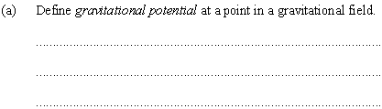
Orbital motion, orbital speed and orbital energy
•It is the work done per unit mass by the gravitational field in bringing a small mass from infinity to that point.
•COMPARE: The work done by the gravitational field in bringing a small mass from infinity to that point is called the gravitational potential energy.
•The phrase only differs by omission of “per unit mass”.
Notes:
© 2015 By Timothy K. Lund

Slide 56
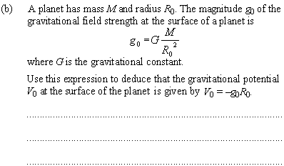
Orbital motion, orbital speed and orbital energy
•V = –GM / r so that V₀ = – GM / R₀.
•But –g₀R₀ = –(GM / R₀²)R₀ = – GM / R₀
= V₀.
•Thus V₀ = – g₀R₀.
Notes:
© 2015 By Timothy K. Lund

Slide 57

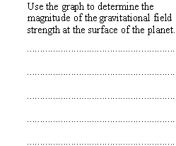
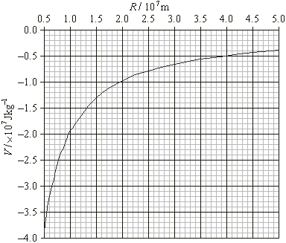
Orbital motion, orbital speed and orbital energy
0.5×10⁷ = 5.0×10⁶ = R₀.
•At R₀ = 0.5×10⁷ clearly V₀ = -4.0×10⁷.
•From previous problem
g₀ = –V₀ / R₀
= – ⁻4.0×10⁷ / 0.5×10⁷
= 8.0 m s⁻².
Notes:
© 2015 By Timothy K. Lund

Slide 58

•This solution assumes probe is not in orbit but merely reaches altitude (and returns).
Orbital motion, orbital speed and orbital energy
ΔV_{g} = (-0.8 - ⁻4.0)×10⁷ = 3.2×10⁷
0
∆E_{K} = – E_{P}
E_{K} – E_{K0} = – E_{P}
(1/2)mv² = ∆E_{P}
v² = 2 ∆E_{P} / m
v² = 2 ∆V_{g}
v² = 2(3.2×10⁷)
v = 8000 ms⁻¹.
Notes:
© 2015 By Timothy K. Lund

