Slide 1
CS x476 Project 0
Aaron Lopes
alopes@gatech.edu
903407727

Slide 2
Instructions
Do not change format or add pages. If you do, you might not receive full score
Images: When placing images or plots, do it at the size of the given box marked in red.
All the red text highlights where you need to fill with an answer.
Submit a pdf to Gradescope, to the assignment “Project 0 – Report”

Slide 3
Part 1: Introduction to Vectors and Matrices

Slide 4
Part 1.b: Tensor multiplication. What happens when you perform matrix multiplication on a 2x3 matrix with a row-vector of size 3?
Torch will return an error. You cannot multiple a 2x3 matrix by a 1x3 matrix.

Slide 5
Part 1.c: After applying the vector transpose, what is the dimension of the resulting vector? (replace the values for ‘a’ and ‘b’)
Size = torch.size([[a],[b]])
Returns (2,1)

Slide 6
Part 2: Working with images

Slide 7
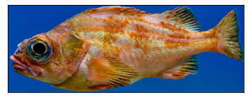
Part 2.a: Cropping images. What special indexing (slicing) values would you have to use to crop a tight bounding box around the fish like the image below?
Cropped_image = im[200:430, 150:780, :]

Slide 8
Part 2.b: Stacking gray images to form colored images. What happens when you try to stack the R,G,B channels in the incorrect order (i.e. G-R-B, B-G-R, R-B-G, etc…)?
The coloring of the image changes, with the fish matching the color of the layer on top and the color of the water a blend of the two bottom images.

Slide 9
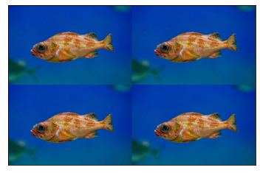
Part 2.c: Concatenation of images. Place the result for the image concatenation.
<Plot here>

Slide 10
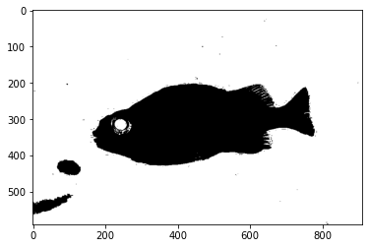
Part 2.d: Point Operations. Place the resulting image after applying the created mask onto the fish image.
<Plot here>

Slide 11
Extra Question: Give a brief description on how easy was for you to setup the environment and start working on the project. Is there something you found difficult during the setup of the project?
Setting up was simple enough, however I was hoping that there would be more guidance on training using GPU

