Slide 1
CS x476 Project 5
Aaron Lopes
alopes@gatech.edu
alopes7
903407727
[Section - 4476/6476]

Slide 2
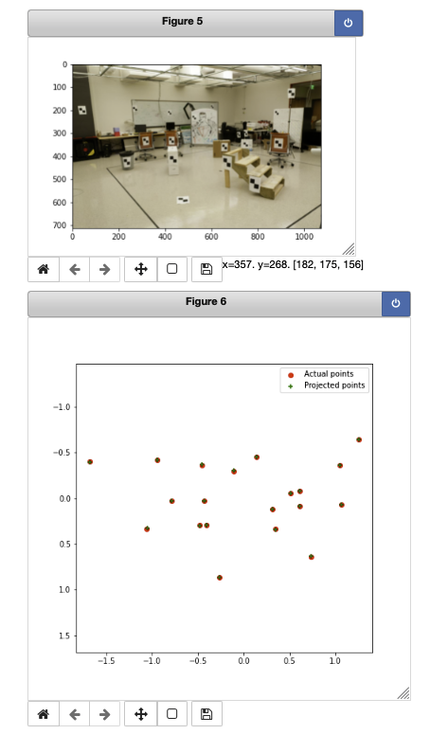
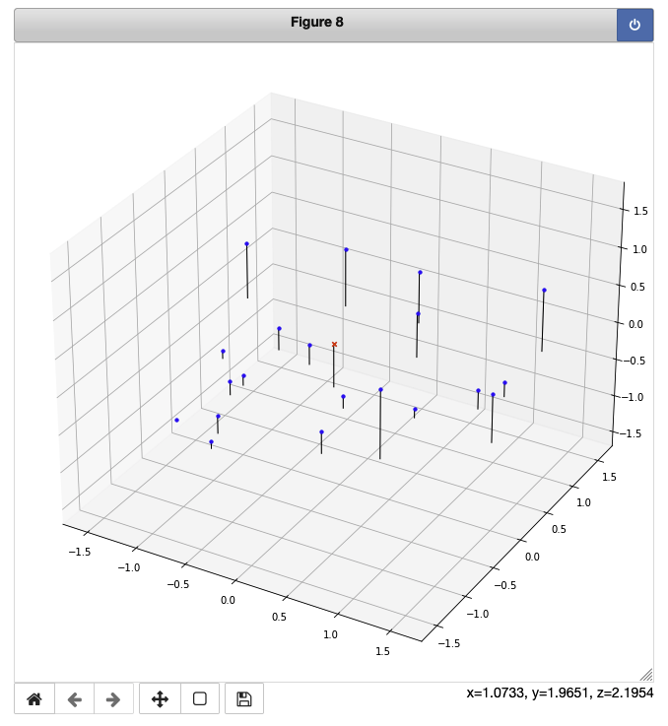
Part 1: Projection matrix
[insert visualization of projected 3D points and actual 2D points for the CCB image we provided here]
[insert visualization of camera center for the CCB image here]

Slide 3
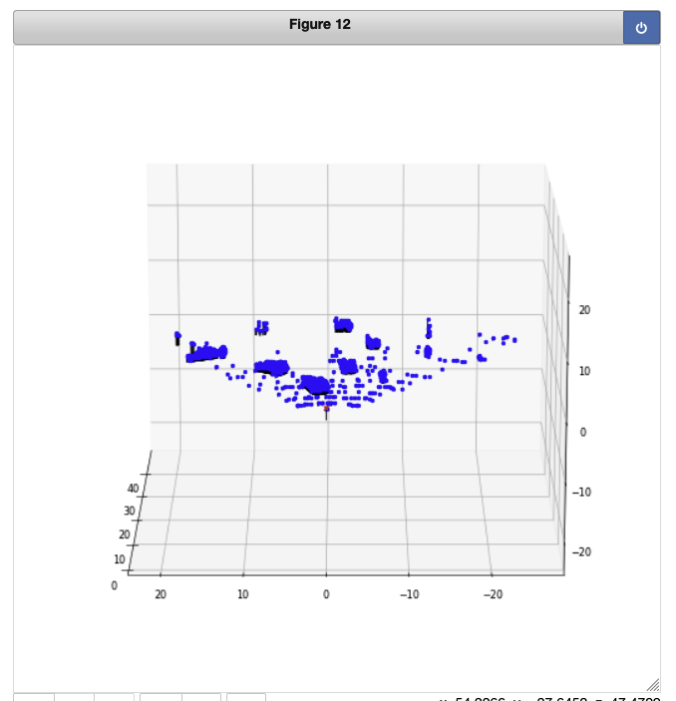
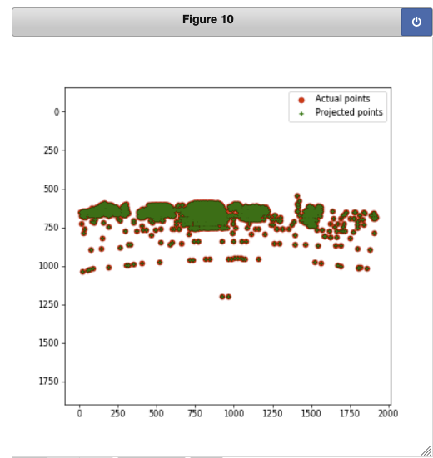
Part 1: Projection matrix
[insert visualization of projected 3D points and actual 2D points for the Argoverse image we provided here]
[insert visualization of camera center for the Argoverse image here]

Slide 4
Part 1: Projection matrix
[What two quantities does the camera matrix relate?]
The camera matrix relates 3D points to 2D image points.
[What quantities can the camera matrix be decomposed into?]
The camera matrix can be decomposed into intrinsic and extrinsic parameters
[List any 3 factors that affect the camera projection matrix.]
Focal legth, principal point offset, and axis skew

Slide 5
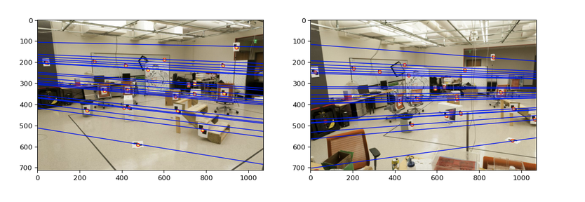
Part 2: Fundamental matrix
[insert visualization of epipolar lines on the CCB image pair]

Slide 6
Part 2: Fundamental matrix
[Why is it that points in one image are projected by the fundamental matrix onto epipolar lines in the other image?]
The fundamental matrix F maps a point in image_a to a corresponding epipolar line connecting a point on image_b.
[How many minimum points do we need to estimate the Fundamental matrix. Explain?]
8 points are needed to compute the fundamental matrix. This is because there are 8 different point pair combinations used to solve for the Fundamental matrix.

Slide 7
Part 2: Fundamental matrix
[What does it mean when your epipolar lines are all horizontal across the two images?]
It means that the points in both images that correspond to each other can be found by looking only along a horizontal line.
[Why is the fundamental matrix defined up to a scale?] (Hint: you can reason using the equation for F)
Since the equation that solves for F (x^T * F * x = 0) can be multiplied by any scalar to solve it. So, a scale is fixed to arrive at a single unique solution.
[Why is the fundamental matrix rank 2?]
F represents a mapping from 2-dimensional space to 1-dimensional projective space. Hence, it must should have rank 2.

Slide 8
Part 4a: Visualize Fundamental Matrices (EC for 4476, required for 6476)
[insert visualization of epipolar lines for Notre Dame]
[insert visualization of epipolar lines for Mount Rushmore]

Slide 9
Part 4a: Visualize Fundamental Matrices (EC for 4476, required for 6476)
[insert visualization of epipolar lines for Gaudi]
[insert visualization of epipolar lines for Woodruff]

Slide 10
Part 4a: Visualize Fundamental Matrices (EC for 4476, required for 6476)
[Explain any one difference you noticed in the feature detection/matching for these 4 pair of images]

Slide 11
Part 4b: Performance comparison (EC for 4476, required for 6476)
[insert visualization of epipolar lines on the Argoverse image pair using the linear method]
[insert visualization of epipolar lines on the Argoverse image pair using RANSAC]

Slide 12
Part 4b: Performance comparison (EC for 4476, required for 6476)
[Describe the different performance of the two methods.]
[Why do these differences appear?]
[Which one should be more robust in real applications? Why?]

Slide 13
Part 5: Visual odometry
[How can we use our code from part 2 and part 3 to determine the “ego-motion” of a camera attached to a robot (i.e., motion of the robot)?]
From calculating the fundamental matrix, the camera center coordinates can be obtained and charted over time to determine the camera’s coordinates.
[How many outputs (poses) does the get_visual_odometry function return?]
The function returns 20 poses.
[How many outputs (poses) does the compute_absolute_poses function return?]
The function returns 20 poses.

Slide 14
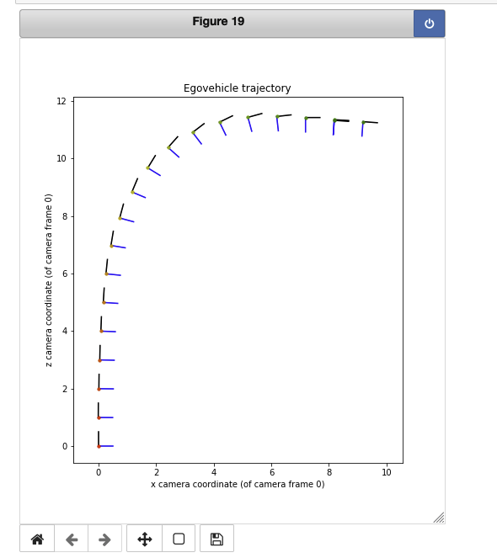
Part 5: Visual odometry
[Attach a plot of the camera’s trajectory through time]

Slide 15
Part 6: gtSAM (EC for Grad Students Only, no credit for UG)
[Attach a plot of the camera’s trajectory through time as computed using gtSAM w/o skip connections]

Slide 16
Part 6: gtSAM (EC for Grad Students Only, no credit for UG)
[Attach a plot of the camera’s trajectory through time as computed using gtSAM with skip connections]

Slide 17
Part 6: gtSAM (EC for Grad Students Only, no credit for UG)
[Explain the differences in the individual factor errors in both the results (optimized_poses1 & optimized_poses2)]
[Of all the factor errors, how many of these correspond to skip connections?]

