Slide 1
CS x476 Project 1
Aaron Lopes
alopes7@gatech.edu
alopes7
903407727

Slide 2
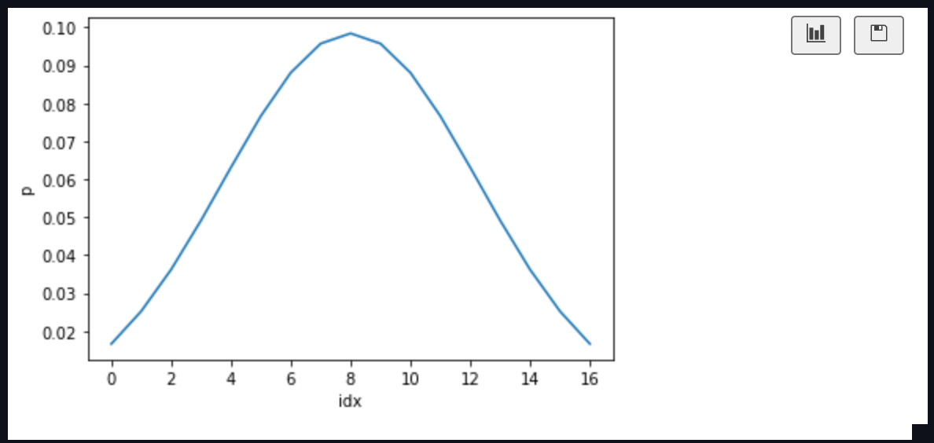
Part 1: 1D Filter

Slide 3
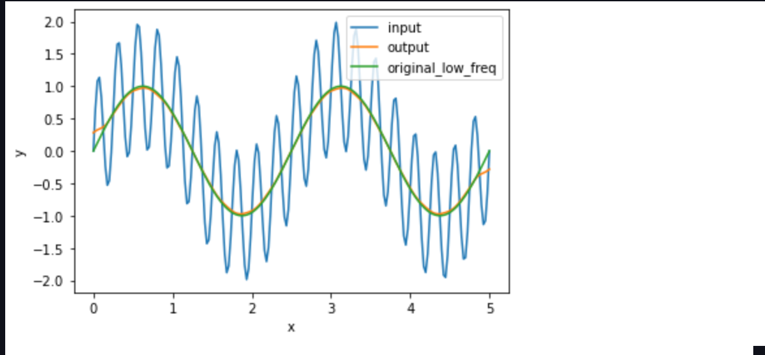
Part 1: 1D Filter
Describe your implementation in words and reflect on the checkpoint questions.

Slide 4
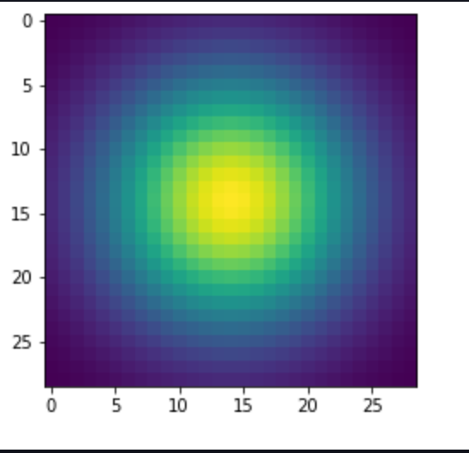
Part 2: Image Filtering
<insert visualization of the 2D Gaussian kernel from proj1.ipynb here>
<Describe your implementation of my_imfilter() in words.>

Slide 5
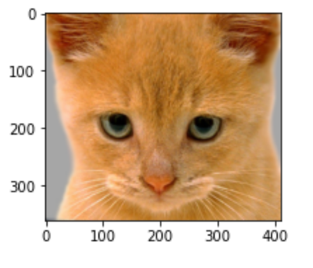
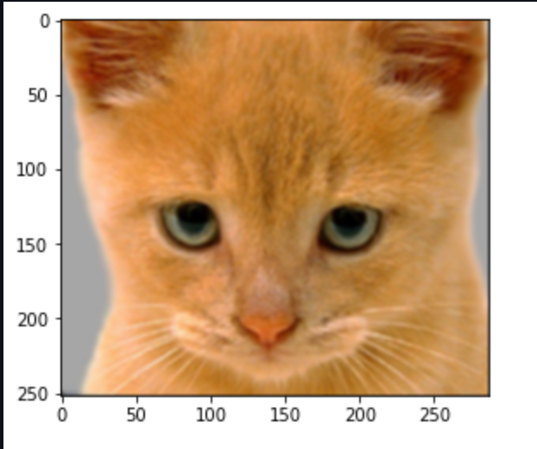
Part 2: Image filtering
Identity filter
Small blur with a box filter

Slide 6
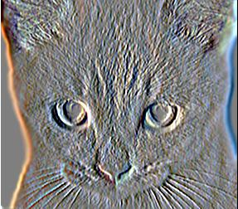
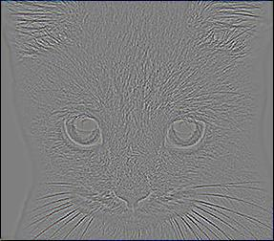
Part 2: Image filtering
Sobel filter
Discrete Laplacian filter

Slide 7
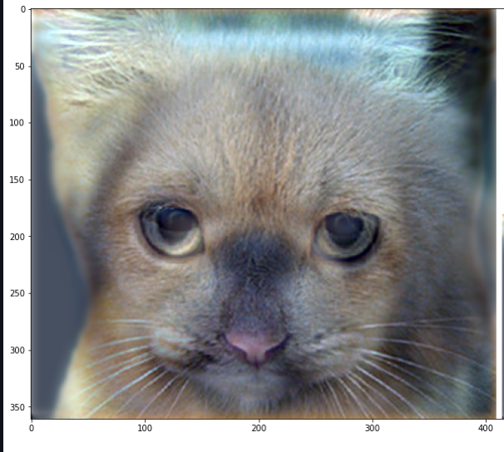
Part 2: Hybrid images manually using Pytorch
Apply the low pass Gaussian kernel to image1 to obtain the low pass image1. Next, apply the low pass Gaussian kernel to image2 then subtract it from image2 to retrieve the high pass image2. Finally, add the two tensors to achieve the hybrid image.
Cat + Dog
Cutoff frequency: 5

Slide 8
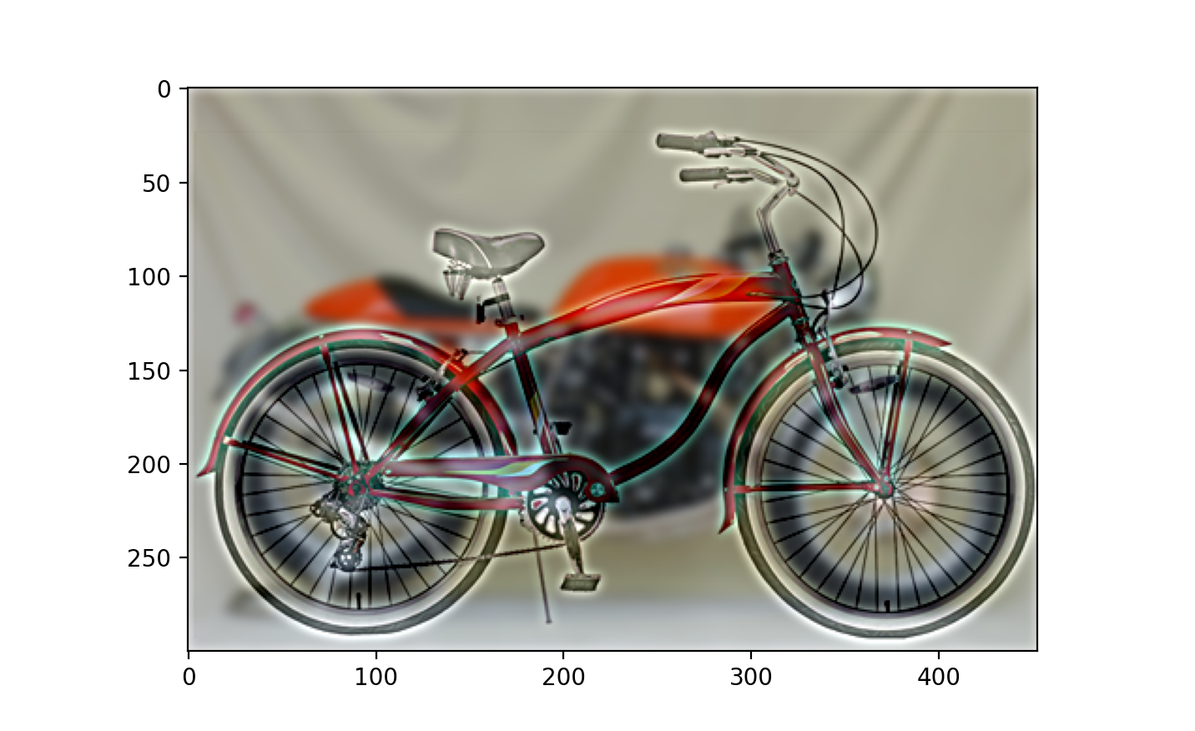
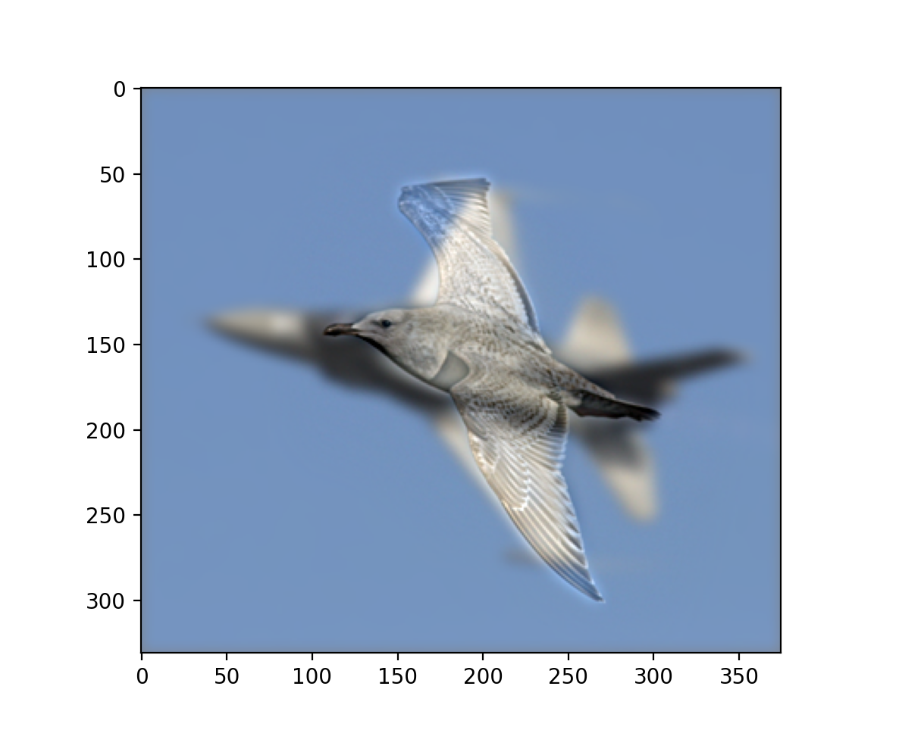
Part 2: Hybrid images manually using Pytorch
Motorcycle + Bicycle
<insert your hybrid image here>
Cutoff frequency: 2
Plane + Bird
Cutoff frequency: 4

Slide 9
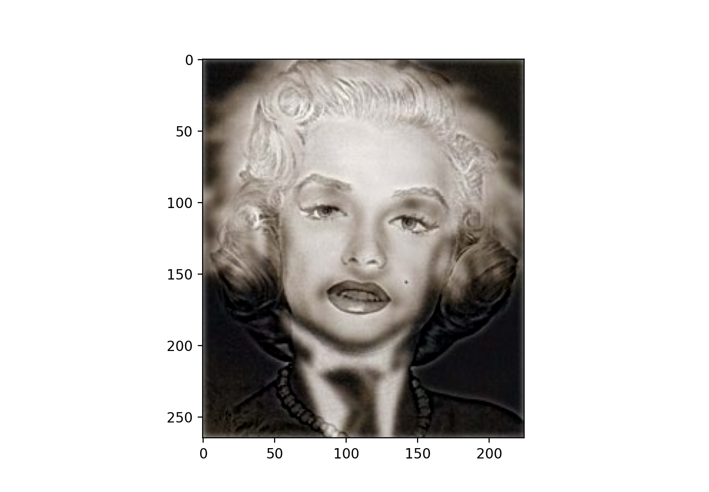
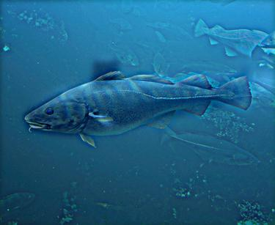
Part 2: Hybrid images manually using Pytorch
Einstein + Marilyn
Cutoff frequency: 2.5
Submarine + Fish
Cutoff frequency: 4

Slide 10
Part 3: Hybrid images with PyTorch operators
Cat + Dog
<insert your hybrid image here>
Motorcycle + Bicycle
<insert your hybrid image here>

Slide 11
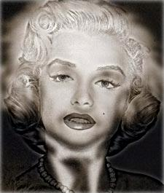
Part 3: Hybrid images with PyTorch operators
Plane + Bird
Einstein + Marilyn

Slide 12
Part 3: Hybrid images with PyTorch operators
Submarine + Fish
<insert your hybrid image here>
Part 1 vs. Part 2
<Compare the run-times of Parts 1 and 2 here, as calculated in proj1.ipynb. What can you say about the two methods?>

Slide 13
Tests
<Provide a screenshot of the results when you run `pytest proj1_unit_tests/` in proj1_code folder on your final code implementation (note: we will re-run these tests).>

Slide 14
Conclusions
<Describe what you have learned in this project. Consider questions like how varying the cutoff standard deviation value or swapping images within a pair influences the resulting hybrid image. Feel free to include any challenges you ran into.>

Slide 15
Note
The following slide is:
REQUIRED for 6476 students
Extra credits for 4476 students.

Slide 16
Image Filtering using DFT
<insert visualization of the DFT filtered 6a_dog.bmp from proj1.ipynb here>
Describe your implementation in words.

Slide 17
Note
The following slide is:
Extra credit for ALL (4476+6476)

Slide 18
Add some cool hybrid images!

