Slide 1
CS x476 Project 3
Aaron Lopes
alopes@gatech.edu
alopes7
903407727
4476

Slide 2
Part 1: Dataloader
Report the classes and the number of instances in the dataset, both train and test. (1pt)
There are 15 classes for both train and test. There are 2985 instances for train and 1500 instances in the dataset for test.
Part 1: Please briefly explain the structure of ImageLoader class and how it works (how to use it to load data)? (2pts)
The ImageLoader class takes in a base filepath for a given dataset, the split folder to parse, and a fundamental transform function to preprocess the dataset before feeding it to the model.

Slide 3
Part 2:
Report the dimensions of the input that is passed to and the output you obtain the SimpleNet you created. Express the answer in variables and clearly mention what each variable specifies. (1pt)
The input dimensions are [N, C, 64, 64] and the obtained output is tensor([[ 0.0757, -0.0358, -0.0265, 0.0288, -0.0046, 0.0410, 0.0711, -0.1041, -0.0040, -0.0742, -0.1032, -0.0071, -0.0169, -0.0947, 0.0376]]), a [1, 15] tensor of which the ith value corresponds to the probability of its belonging to the ith class.

Slide 4
Part 3: Loss function. Why do we need a loss function? (1pt)
A loss function is needed to measure model performance.
Part 3: Explain the reasoning behind the loss function used. (1pt)
Cross entropy is used because we are measuring performance between two probability distribution models. Also, because it is independent of model and activation functions used.

Slide 5
Part4: Optimizer.
Please briefly explain how an optimizer works? (2pts)
An optimizer uses computed gradients of the objective/loss function of a neural network to adjust the output layer weights and obtain better performance.

Slide 6
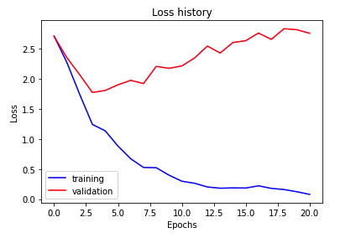
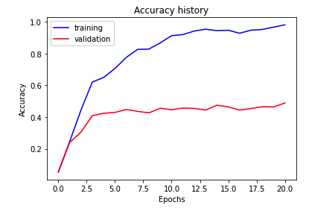
Part 5: Training SimpleNet (5pts) – You need to get >45% validation accuracy as stated in notebook
<Loss plot here> <Accuracy plot here>
Final training accuracy value: 0.9812 (98.12%)
Final validation accuracy value: 0.4887 (48.87%)

Slide 7
Part 5: Training SimpleNet (3pts)
"lr": 5e-4,
"weight_decay": 5e-4

Slide 8
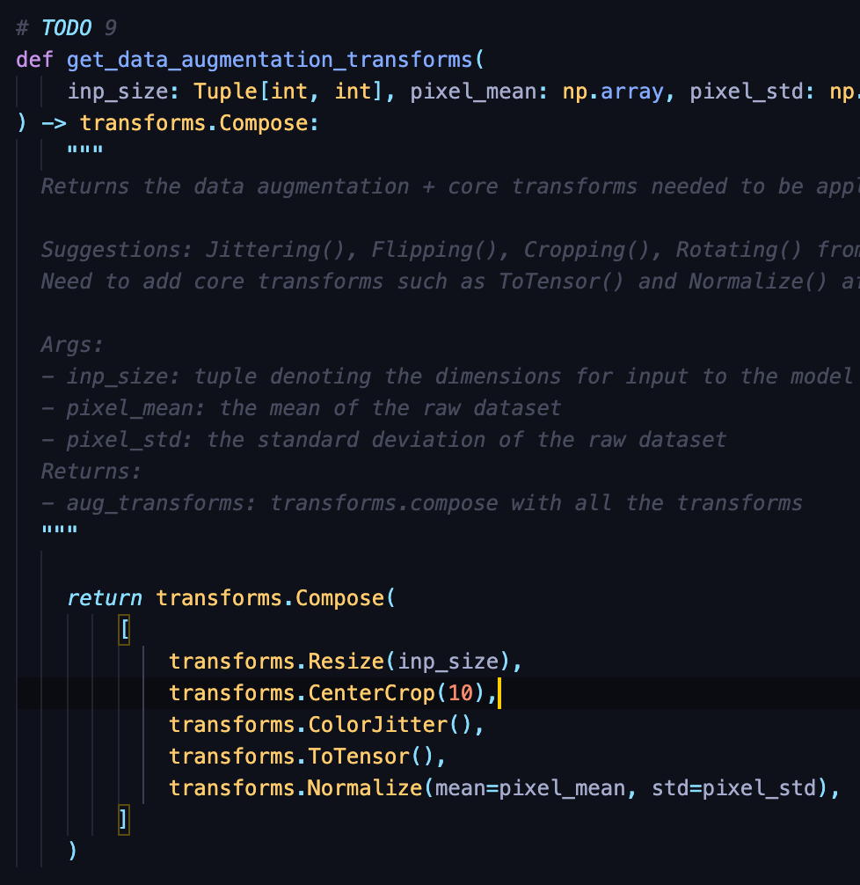
Part 6.1 : Screenshot of the functions you used in get_data_augmentation_transforms() (3pts)
<Screenshot here>

Slide 9
Part 6.2: Building AlexNet: why do we want to “freeze” the conv layers and some of the linear layers in pretrained AlexNet? Why CAN we do this? (0.5pt)
To prevent the weights from being retrained. We can do this because we are using a pretrained network.
Part 6.2: Building AlexNet: Why don’t we have to freeze MaxPool and RELU layers? (0.5pt)
Because those are functions not associated with weights.

Slide 10
Part 6.3: Training AlexNet: what does fine-tuning a network mean? (1pt)
It means adjusting the hyperparameters; in this project’s case those are learning rate and weight decay.

Slide 11
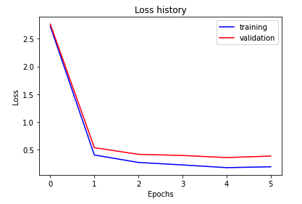
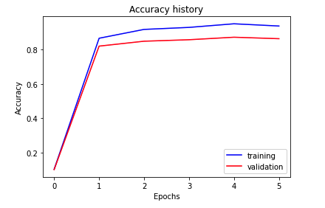
Part 6.3 : Training Alexnet (5pts) – you need to get >85% validation accuracy as stated in the notebook
<Loss plot here> <Accuracy plot here>
Final training accuracy value: 0.9380
Final validation accuracy value: 0.8640

Slide 12
Part 6.3: Training AlexNet (3pts)
"lr": 1e-2,
"weight_decay": 5e-3

Slide 13
Conclusion: briefly discuss what you have learned from this project. (3pts)
How learning rate and weight decay can significantly affect model accuracy. Training neural networks takes a lot of patience. How to align tensor shape as it flows through deeply connected and fully connected layers.

Slide 14
EC1: SimpleNetDropout: How do dropout and data-augmentation help? (1pt)
<Text solution here>

Slide 15
EC1: Training SimpleNetDropout (3pts) – you need to get >52% validation accuracy as stated in the notebook.
<Loss plot here> <Accuracy plot here>
Final training accuracy value:
Final validation accuracy value:

Slide 16
EC1: Training SimpleNetDropout (1pt)
<Paste final hyperparameters here>

Slide 17
EC1: SimpleNetDropout: compare the loss and accuracy for training and testing set, how does the result compare with that of SimpleNet without Dropout? How to interpret this result? (1pt)
<Text solution here>

Slide 18
EC2: Quantization. Paste the code of the quantize function here. (3pts)
<Screenshot here>

Slide 19
EC2: Quantization. Briefly discuss the steps you followed. You cannot use code and should describe the intuition behind each step. (3pts)
<text answer here>

Slide 20
EC2: Quantization. Paste your results here (3pts) – If you satisfy the below limits.
Size comparison: <text answer here> { should be >50% reduction}
Processing Time comparison: <text answer here> { should be >10% reduction}
Accuracy comparison: <text answer here> { should be <5% reduction}

