Slide 1
CS x476 Project 4
[name]
[GT email]
[GT username]
[GTID]

Slide 2
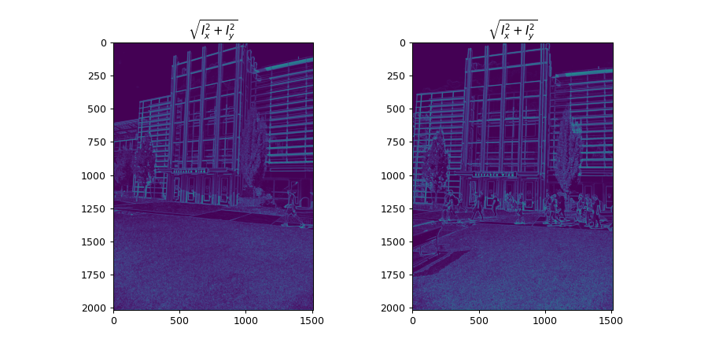
Part 1: Harris corner detector
[insert visualization of \sqrt(I_{x}² + I_{y}²) for Klaus image pair from proj2.ipynb here]
[Which areas have highest magnitude? Why?]

Slide 3
Part 1: Harris corner detector
[insert visualization of I_{x}, I_{y}, s_{x}², s_{y}², s_{x}s_{y} for Notre Dame image pair from proj2.ipynb here]

Slide 4
Part 1: Harris corner detector
[Describe your implementation of generating the Harris cornerness score response map]

Slide 5
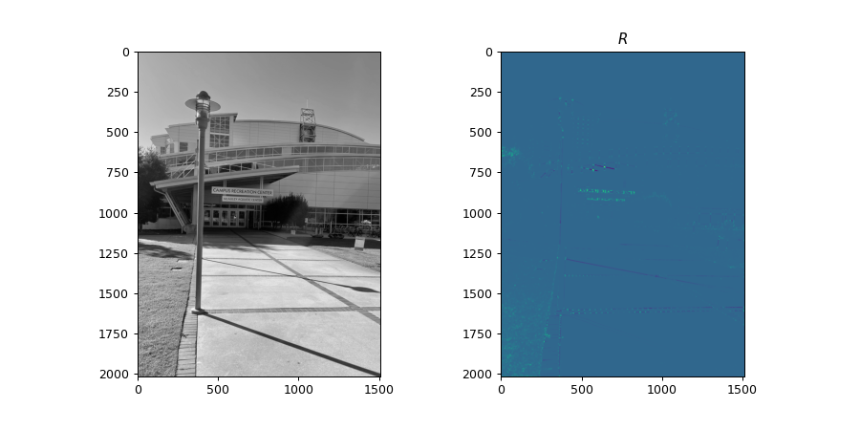
Part 1: Harris corner detector
[insert visualization of corner response map of CRC image from proj2.ipynb here]
[Are gradient features invariant to both additive shifts (brightness) and multiplicative gain (contrast)? Why or why not?]

Slide 6
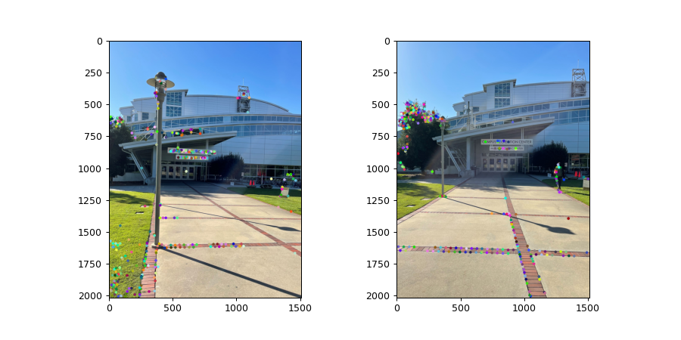
Part 1: Harris corner detector
[insert visualization of CRC interest points from proj2.ipynb here]
[insert visualization of Klaus interest points from proj2.ipynb here]

Slide 7
Part 1: Harris corner detector
[What are the advantages and disadvantages of using maxpooling for non-maximum suppression (NMS)?]

Slide 8
Part 1: Harris corner detector
[What is your intuition behind what makes the Harris corner detector effective?]

Slide 9
Part 2: SIFT feature descriptor
[insert visualization of SIFT feature descriptor from proj2.ipynb here]
[Describe your implementation of SIFT feature descriptors here]

Slide 10
Part 2: SIFT feature descriptor
[Why aren't our version of SIFT features rotation- or scale-invariant? What would you have to do to make them so?]

Slide 11
Part 2: SIFT feature descriptor
[Why are SIFT features better descriptors than simplying normalizing image intensities in a local window?]

Slide 12
Part 3: Feature matching
[insert visualization of matches for Klaus image pair here with num_pts_to_visualize = 30]
[insert visualization of matches for CRC image pair here with num_pts_to_visualize = 30]

Slide 13
Part 3: Feature matching
[Describe your implementation of feature matching here]
[Look at some of the mismatched features in your picture. Why might this have occurred?]

Slide 14
Part 4: SIFT feature descriptor (Extra Credit)
[insert visualization of matches for your own image pair here]
What makes our feature matching pipeline work well or poorly for your image pair?

